Slide 1
Task Based Learning
Артем Морозов
Teacher Trainer, Cambridge Assessment Presenter, сертифицированный преподаватель CELTA и выпускник DELTA, методист, директор года, автор сборника Mishkie Grammar

Slide 2
ЧТО ТАКОЕ PPP?
Even if students appear to produce new language items at the end of the lesson, they might not be able to use them correctly.
Learners might tend to overuse new language structures which can sound unnatural.
Learners do not always produce the target language during the freer practice stage and use already existing language resources to compete the task.
Lewis, 1993; Scrivener, 1994; Prabhu, 1987

Slide 3
TASK BASED LEARNING
Pre-task
Building schemata
Useful language
Instructions
Language Focus
Provide chunks
Practice
Task Cycle
Task
Planning
Report
Willis, J. (1996). A Framework for Task-Based Learning. Pearson Education Ltd.

Slide 4
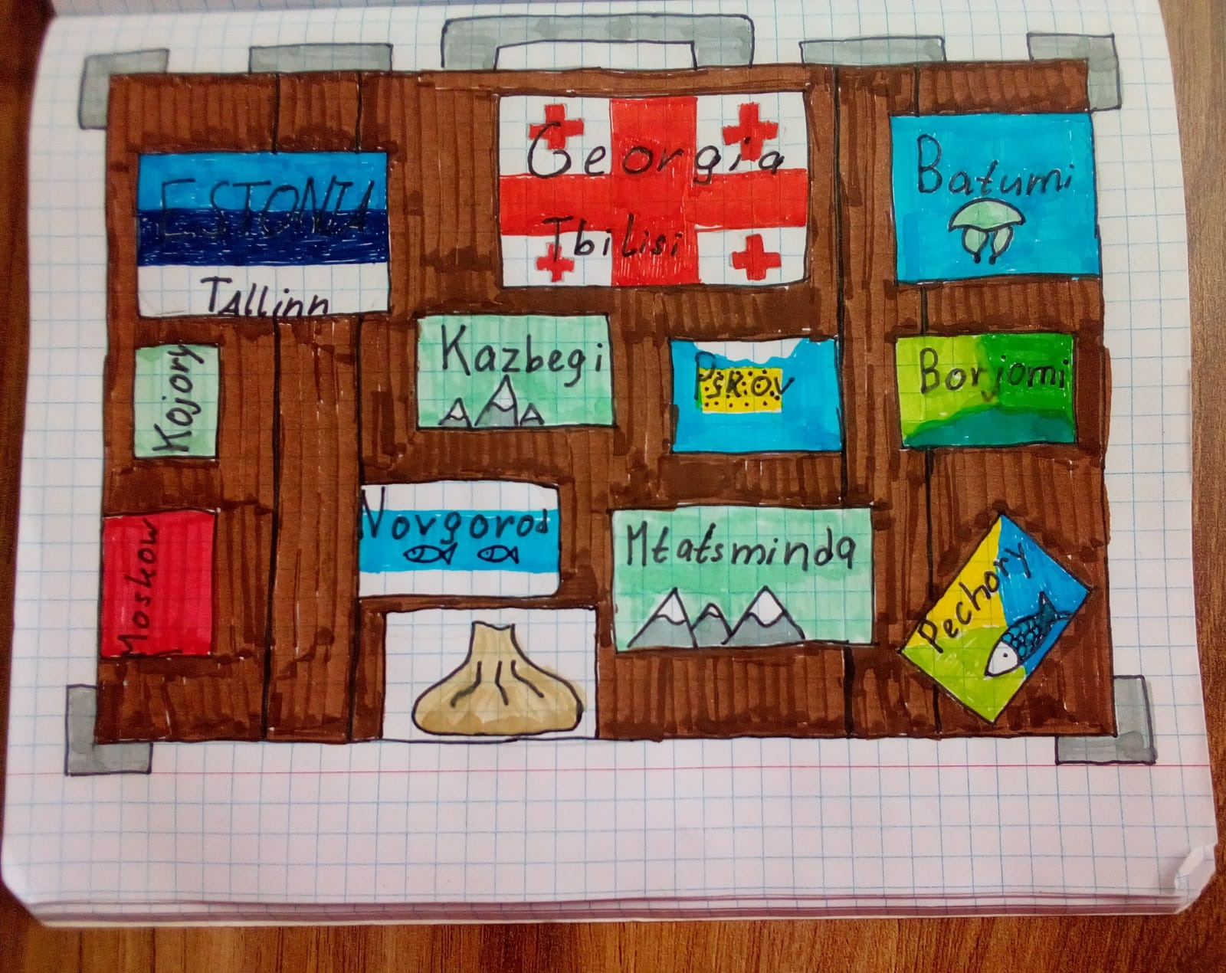
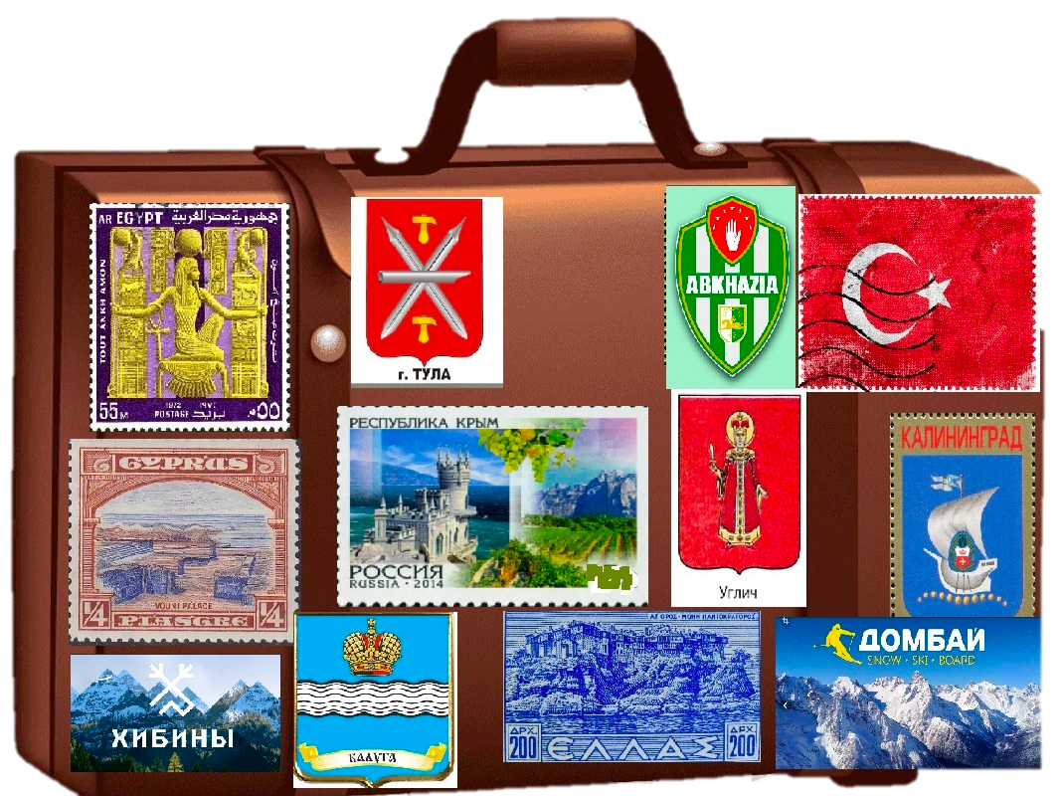
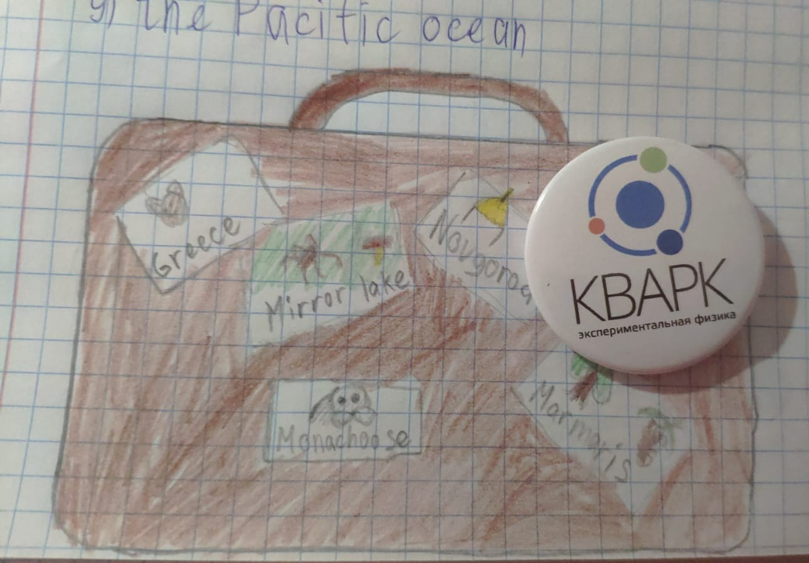
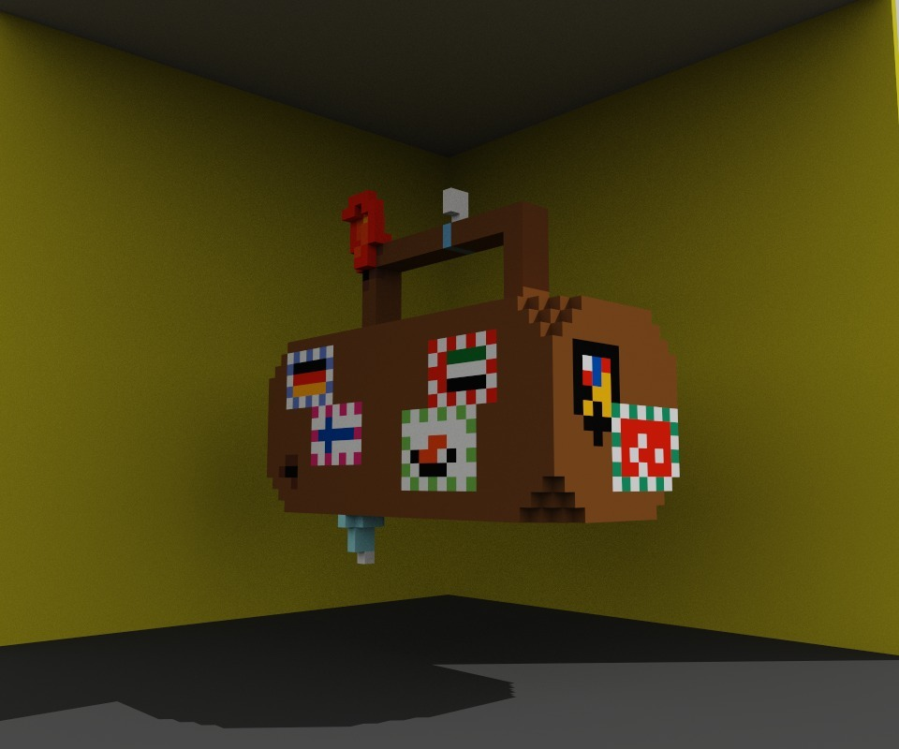
WHAT IS “A TASK”?
Основные критерии:
The activity engages learners' interest
An information / opinion gap
A primary focus on meaning not form
Success judged in terms of outcome
The activity relates to real world activities
Морозов, А. (2024). Mishkie Grammar 2. Titul Publishers.

Slide 5
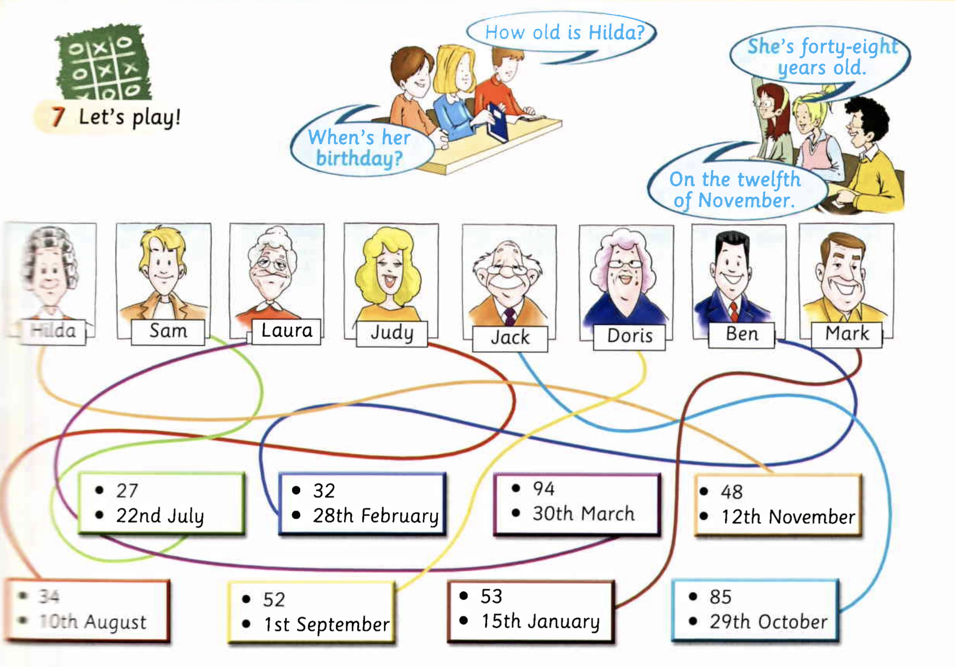
IS THIS A TASK?
Gray, E. (2000). Welcome 2. Express Publishing.

Slide 6

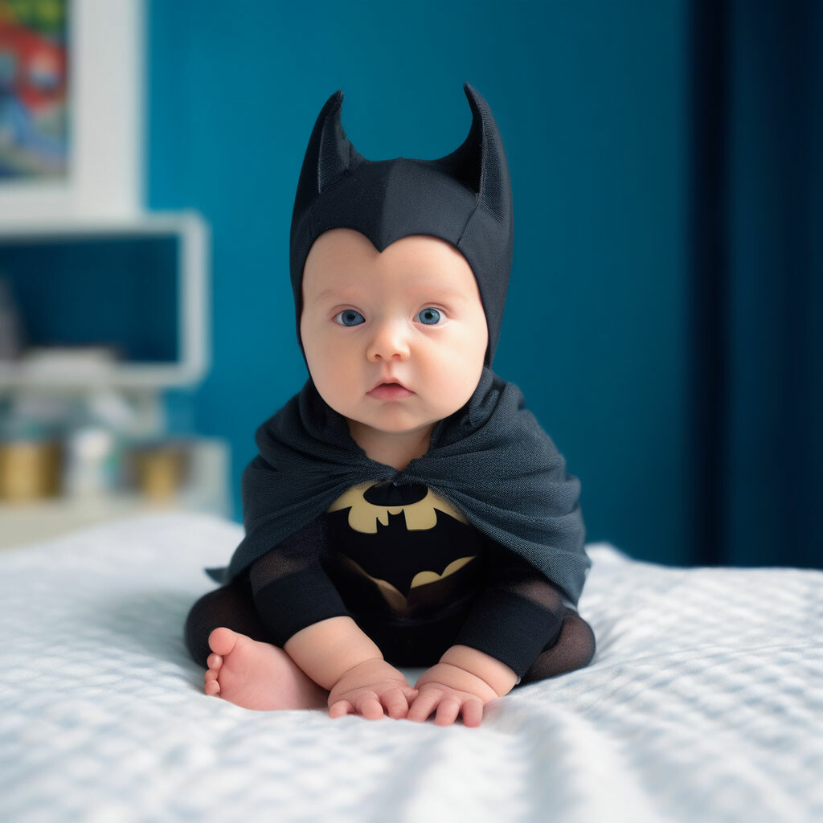
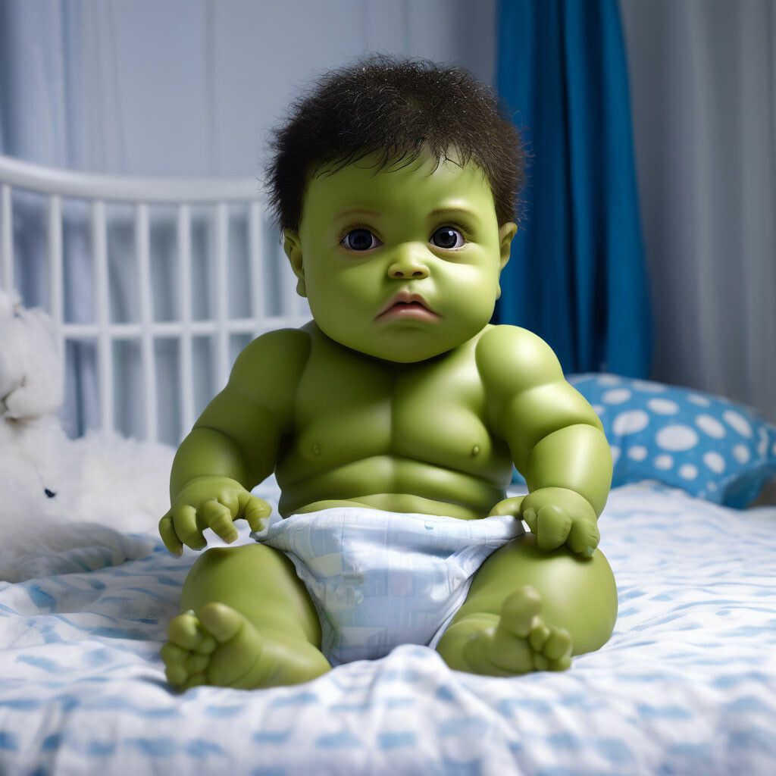
INFORMATION GAP
10 August 1962
19 February 1976
18 December 1969

Slide 7
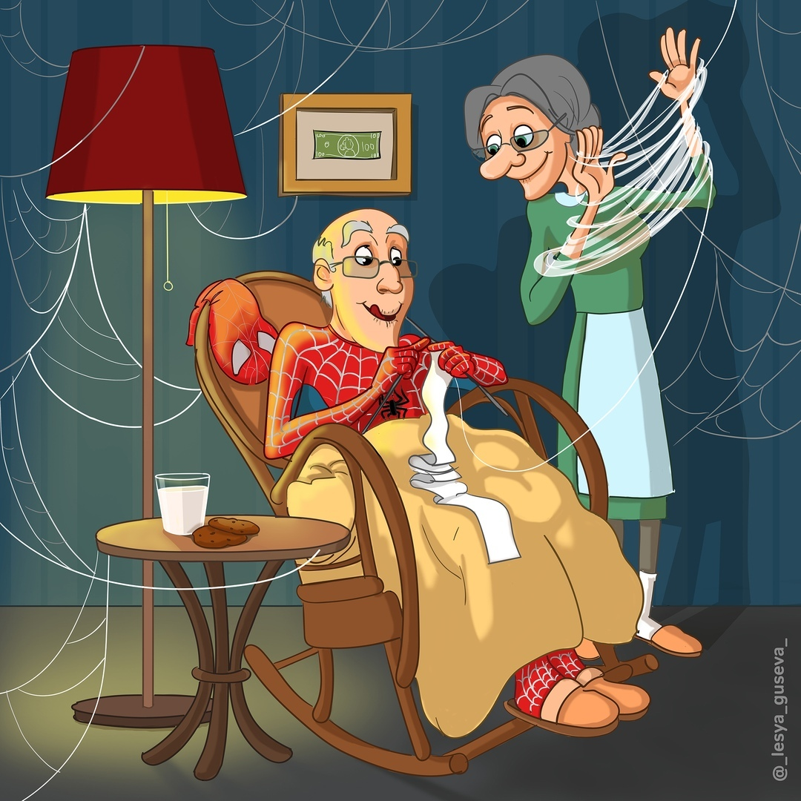
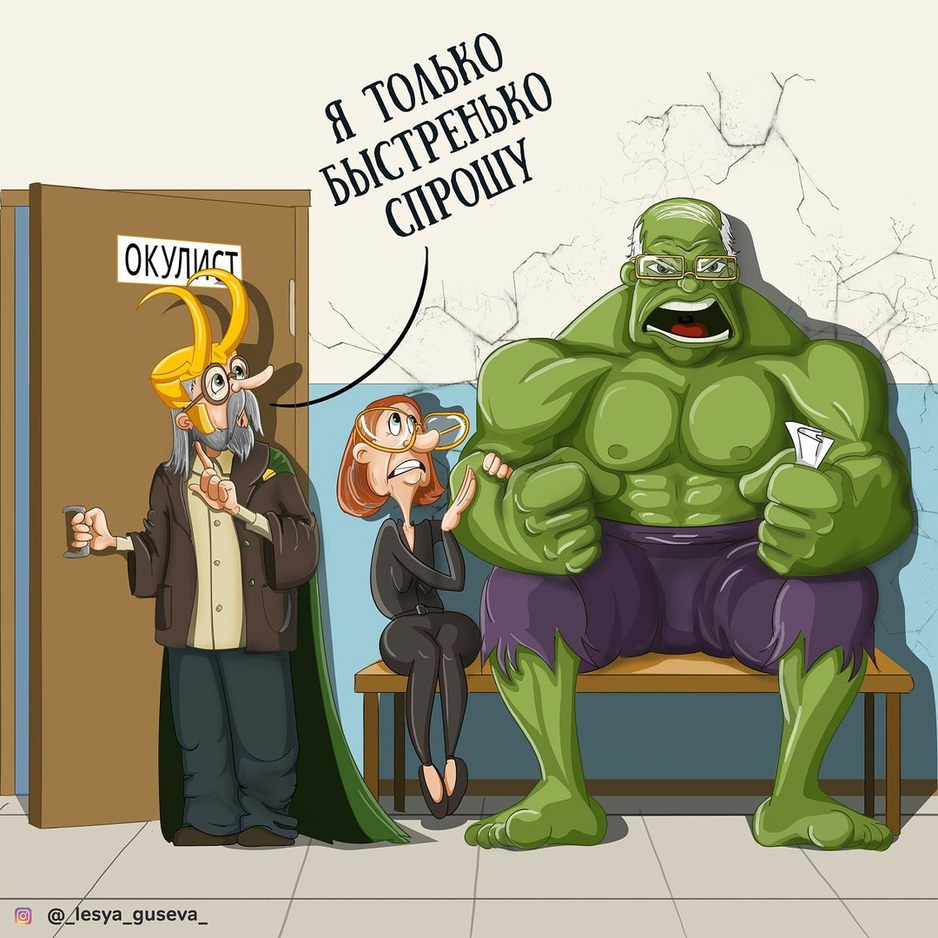
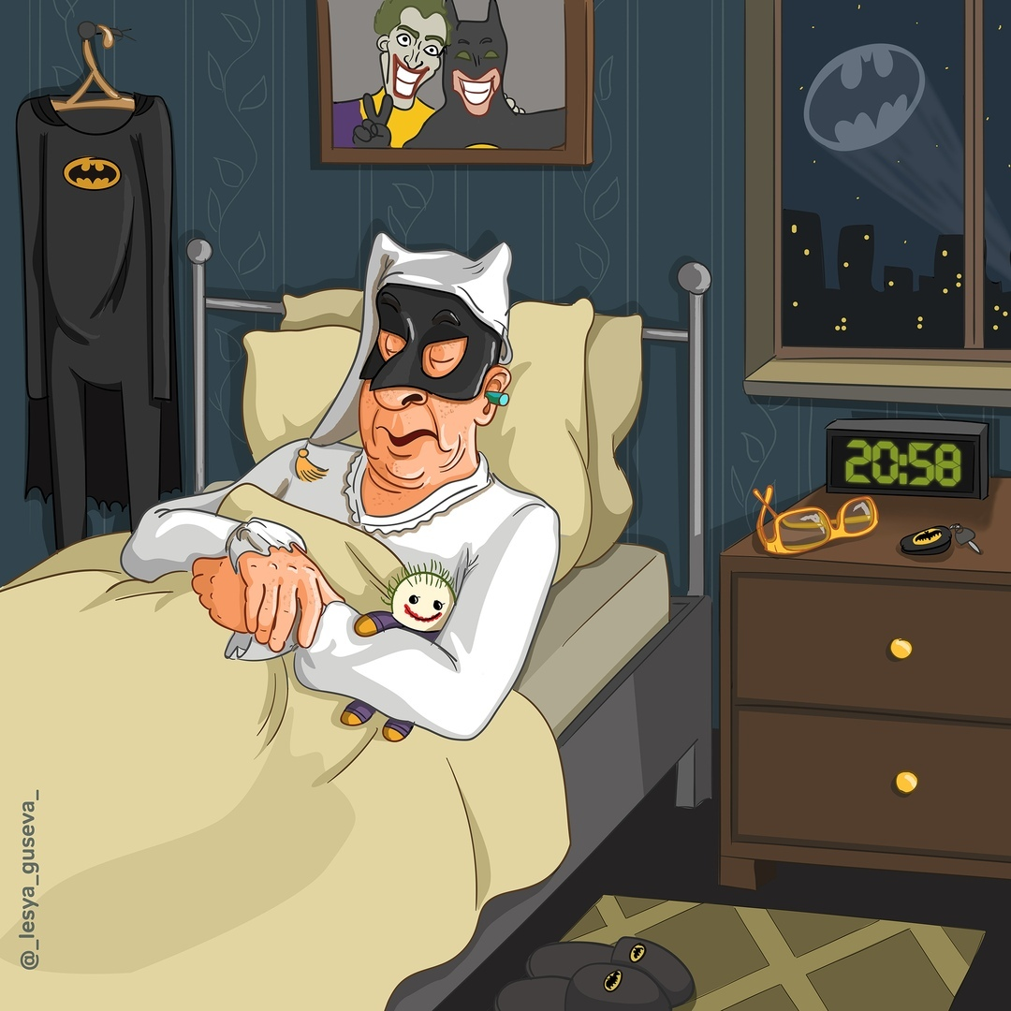
OPINION GAP

Slide 8
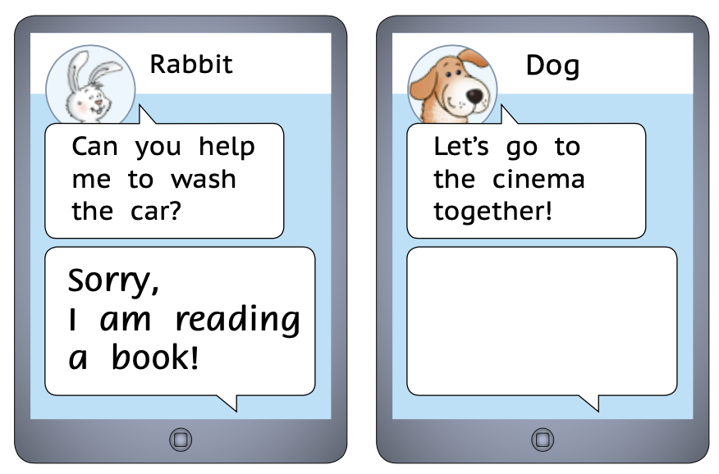
SITUATIONAL AUTHENTICITY
Real-life or academic environment:
Write a message with an excuse
Придумай отговорку, чтобы не ходить в школу
Listen to announcements in the airport
Прочитай параграф из учебника биологии, разложи картинки по порядку (цикл жизни лягушки)
Морозов, А. (2023). Mishkie Grammar 1. Titul Publishers.

Slide 9
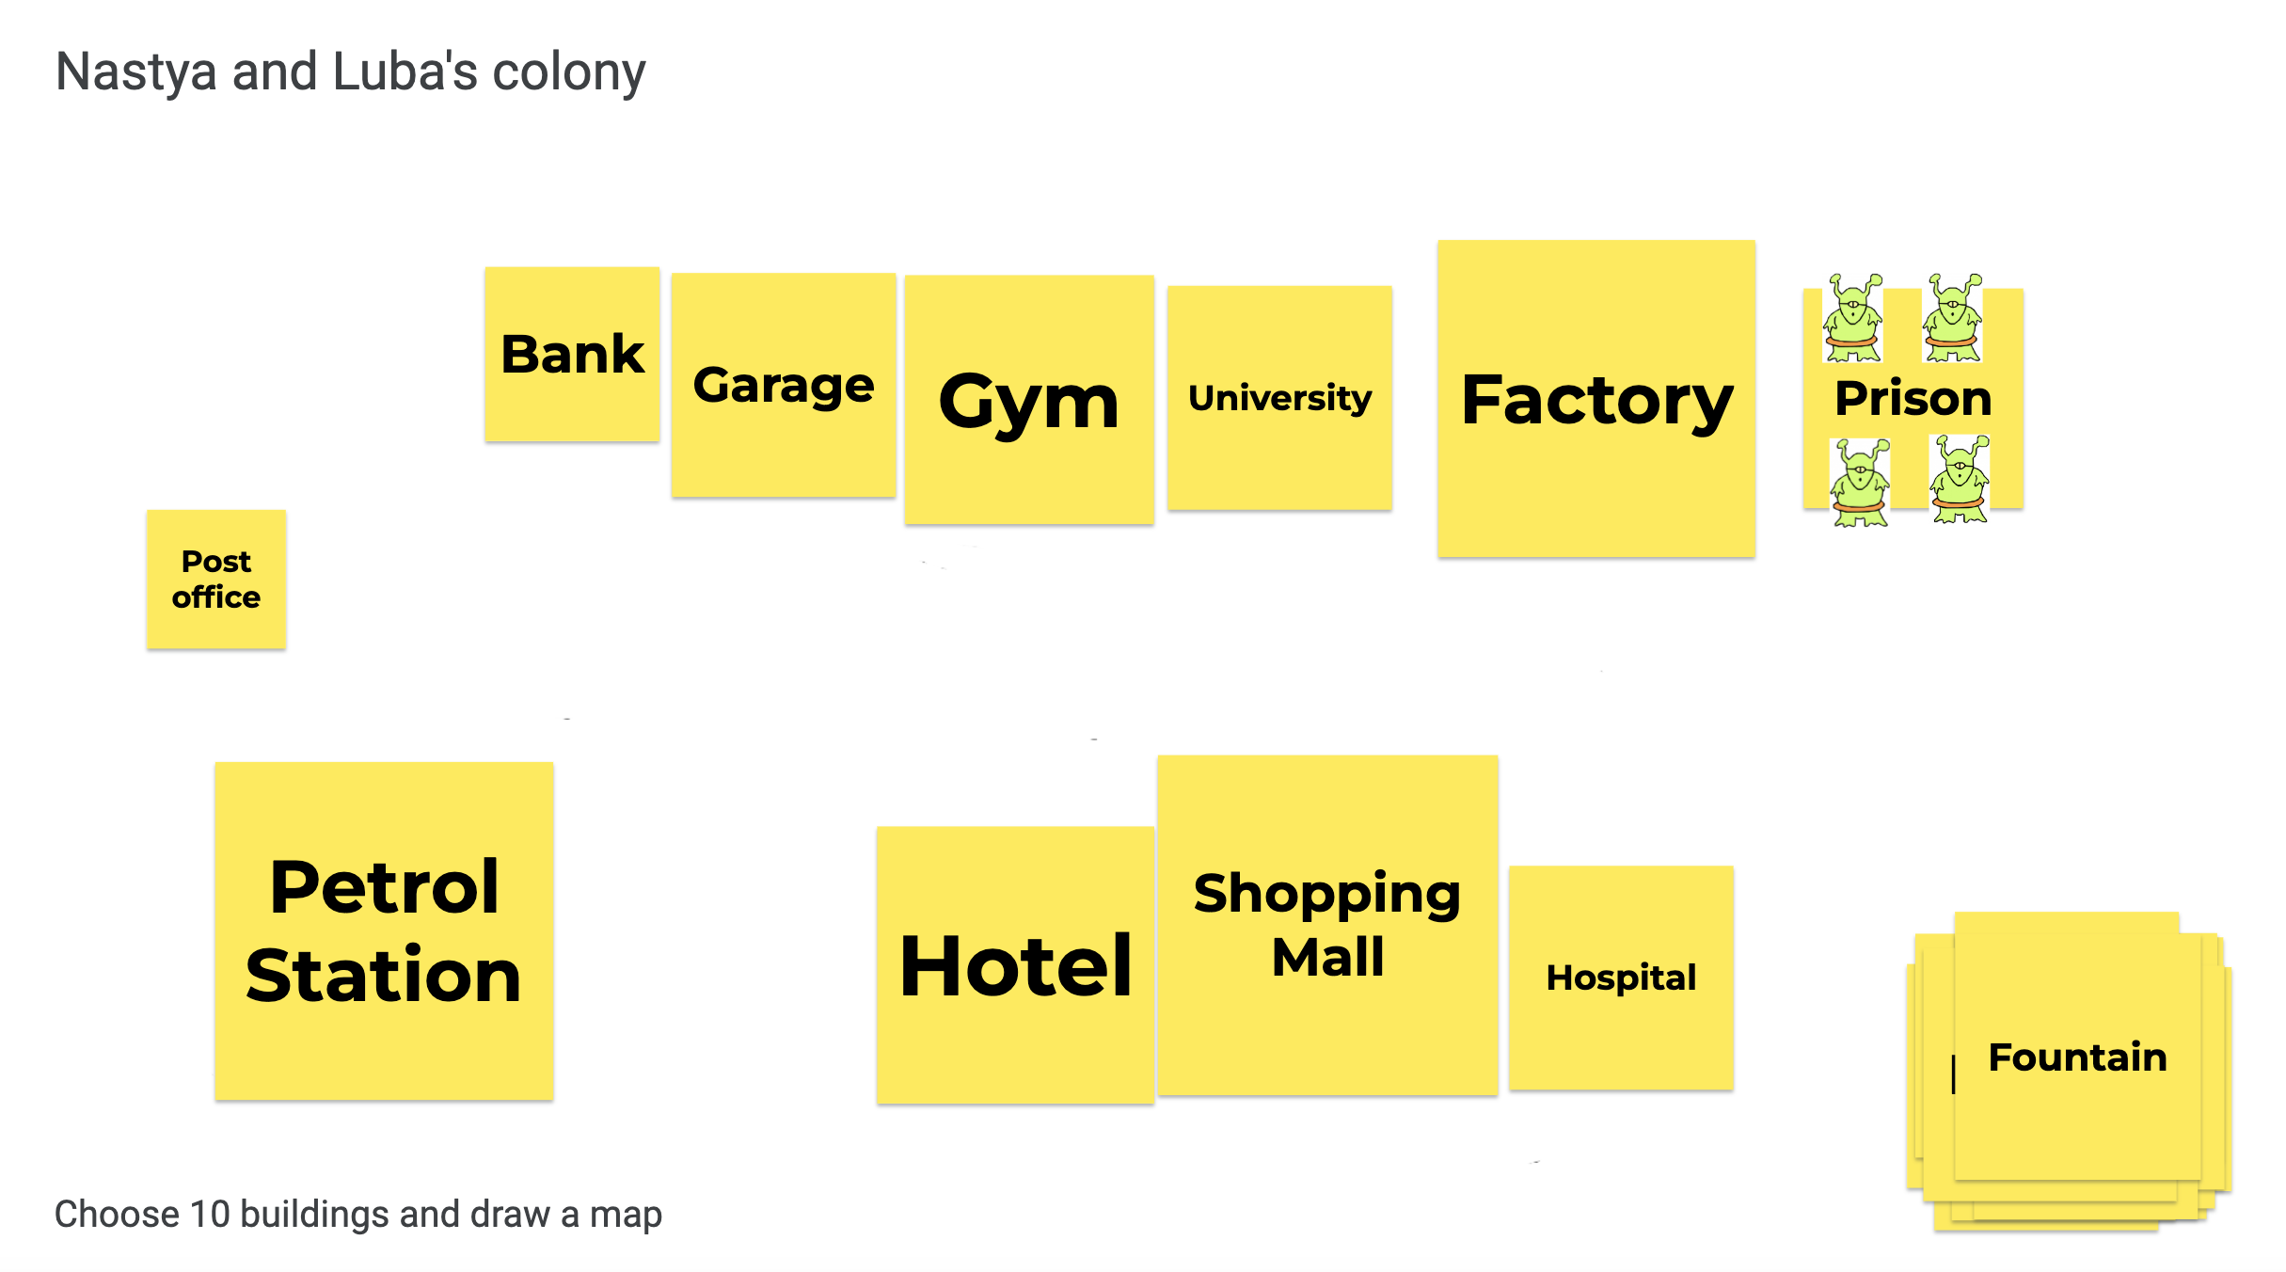
INTERACTIONAL AUTHENTICITY

Slide 10
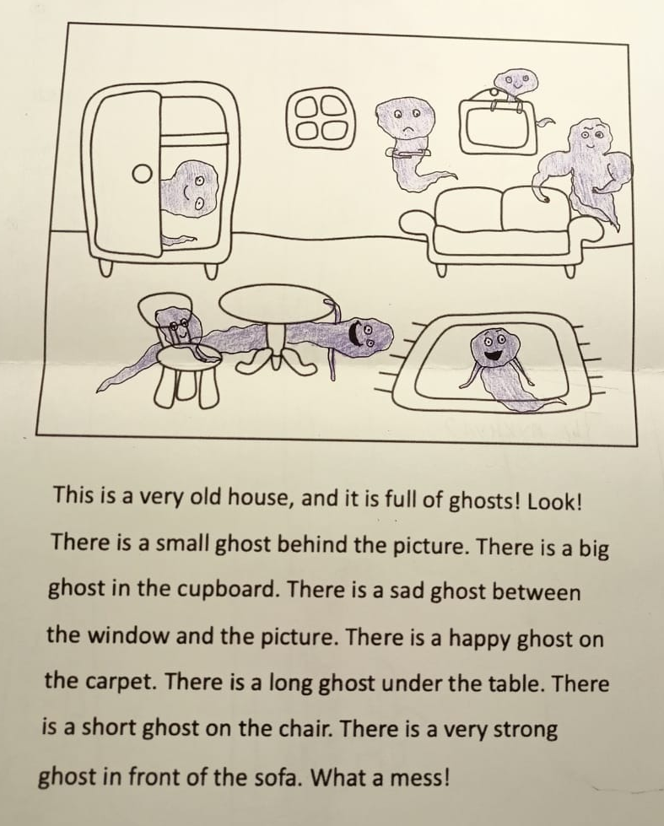
INPUT BASED TASKS
Не требуют говорения и письма:
Нарисуйте маршрут
Составьте карту мира из книги
Нарисуйте блюда на скатерти-самобранке
Придумайте иллюстрации к инструкции для предмета мебели из IKEA
Keyhole book scene
Морозов, А. (2023). Mishkie Grammar 1. Titul Publishers.

Slide 11
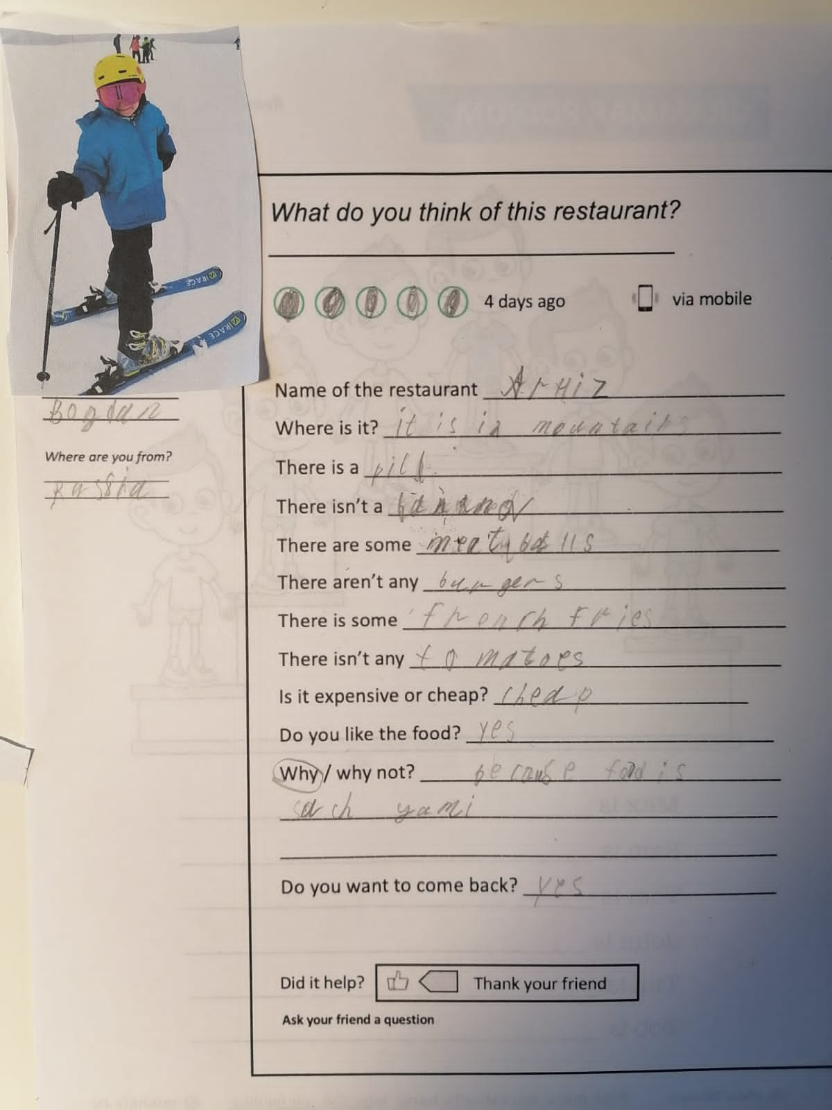
OUTPUT BASED TASKS
Требуют говорения и письма:
Опубликуйте отзыв об отеле
Составьте путеводитель по Нарнии
Старые фото (used to)
Придумайте подарок / наказание герою
История твоего имени

Slide 12
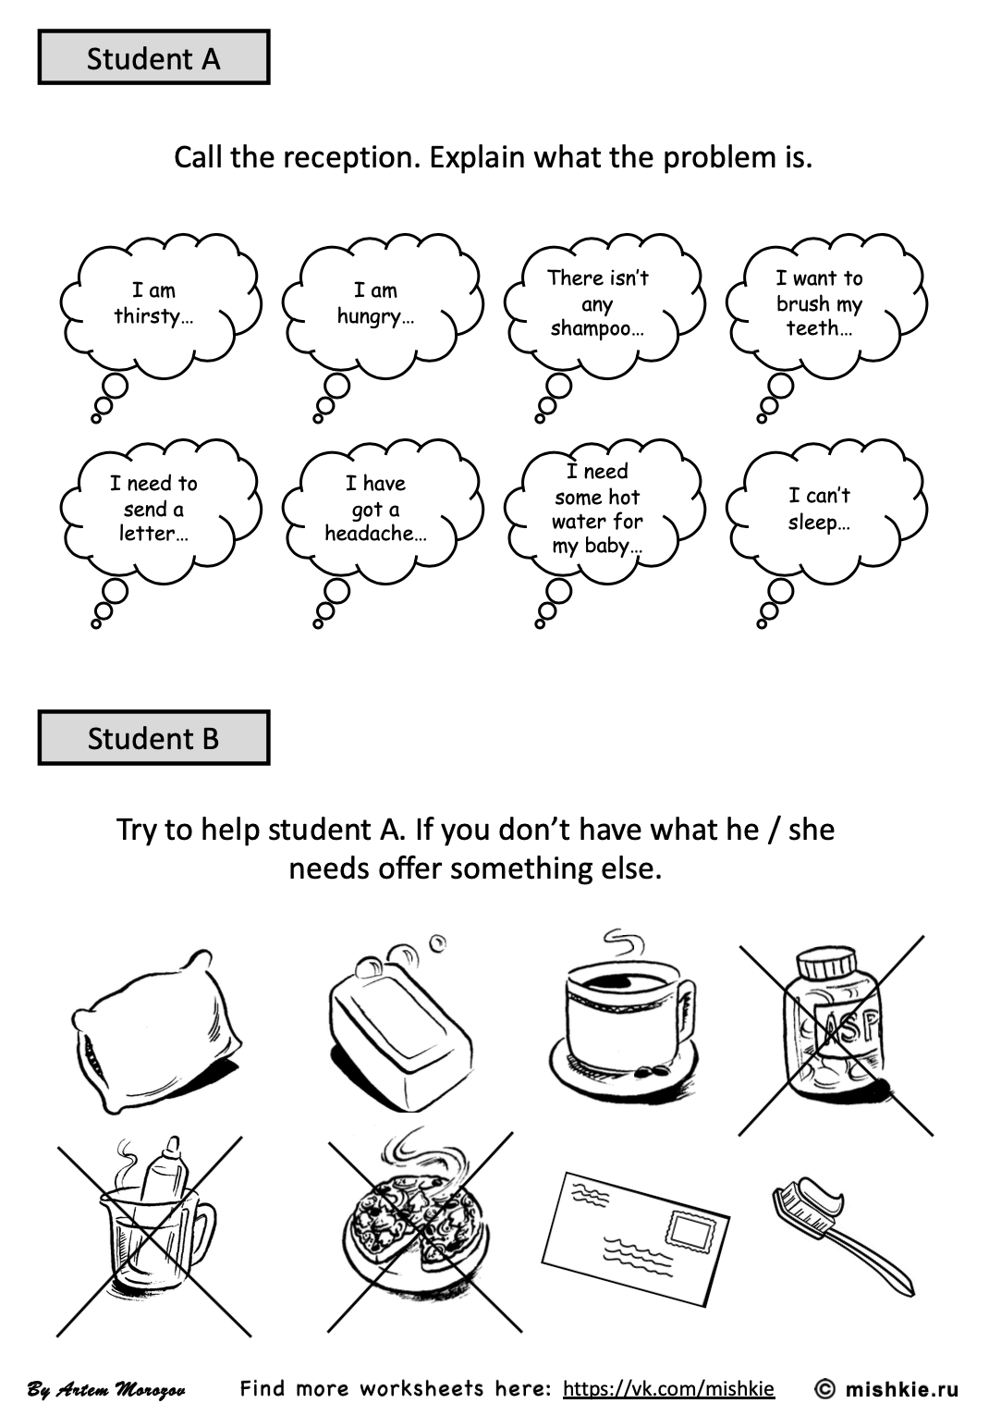
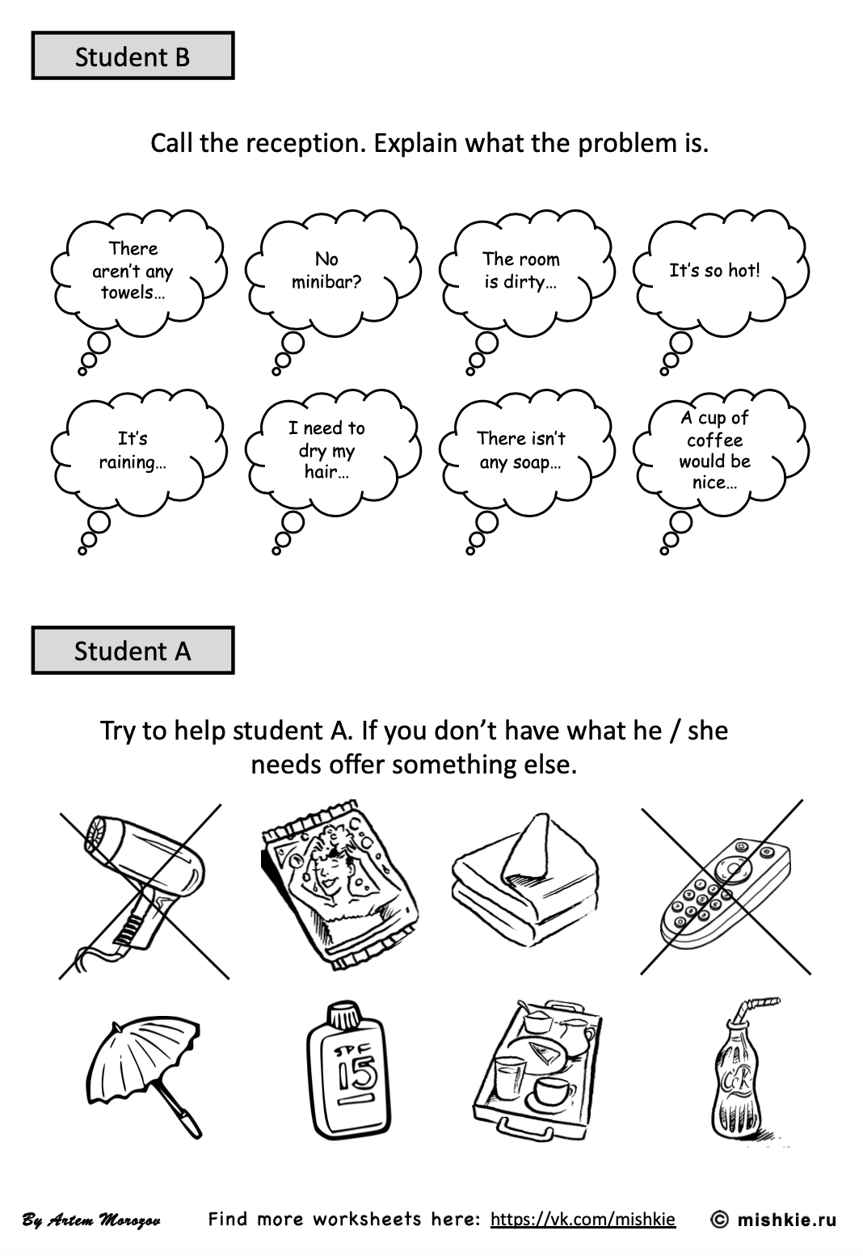
CLOSED TASKS
There is only one clear outcome, one correct answer

Slide 13
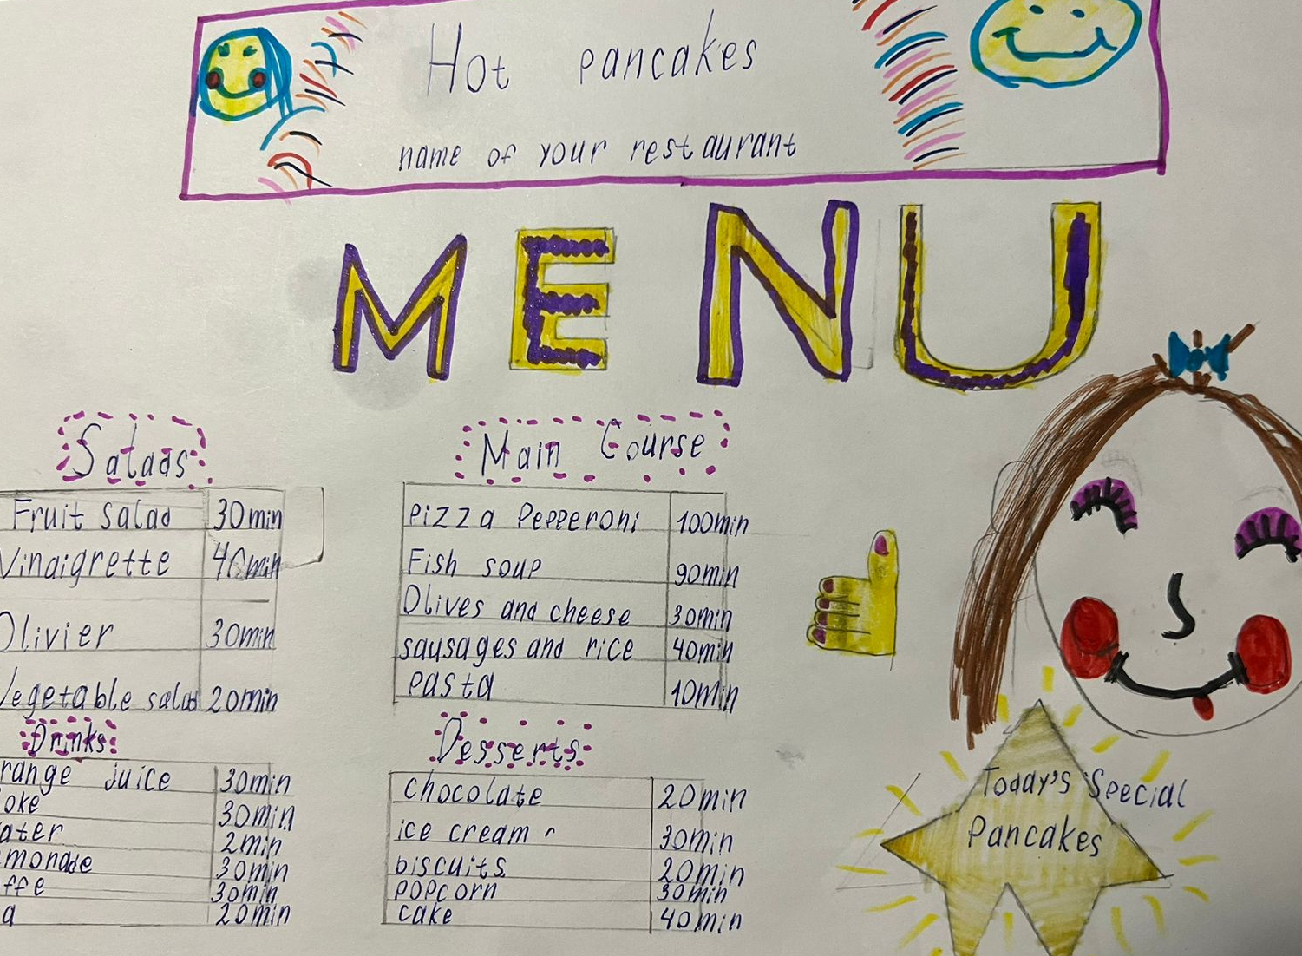
OPEN TASKS
Нет одного правильного ответа:
Разработай меню ресторана (Пирожковая от Красной Шапочки, Фреш-бар от Чебурашки)
Healthier menu for our canteen
Traffic problem
New school uniform
Пропавший питомец
*Information gap = closed, opinion gap = open

Slide 14
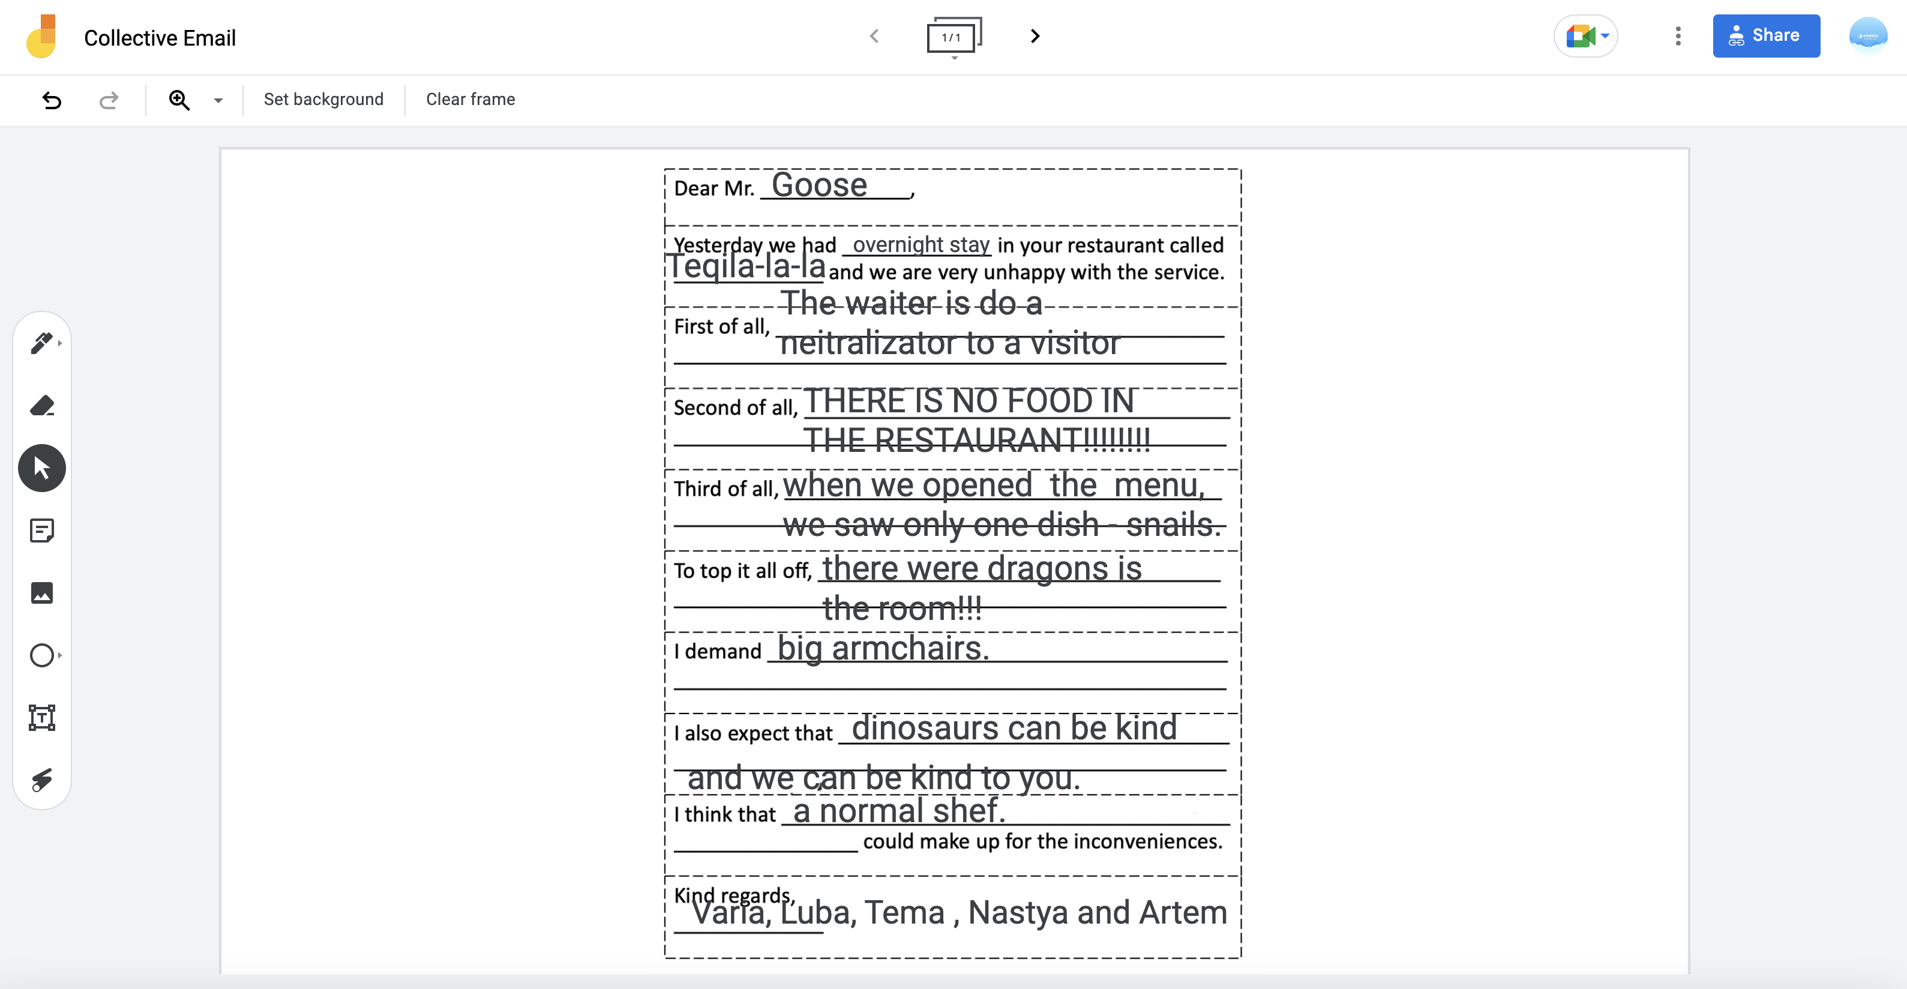
INFORMATION AVAILABILITY

Slide 15
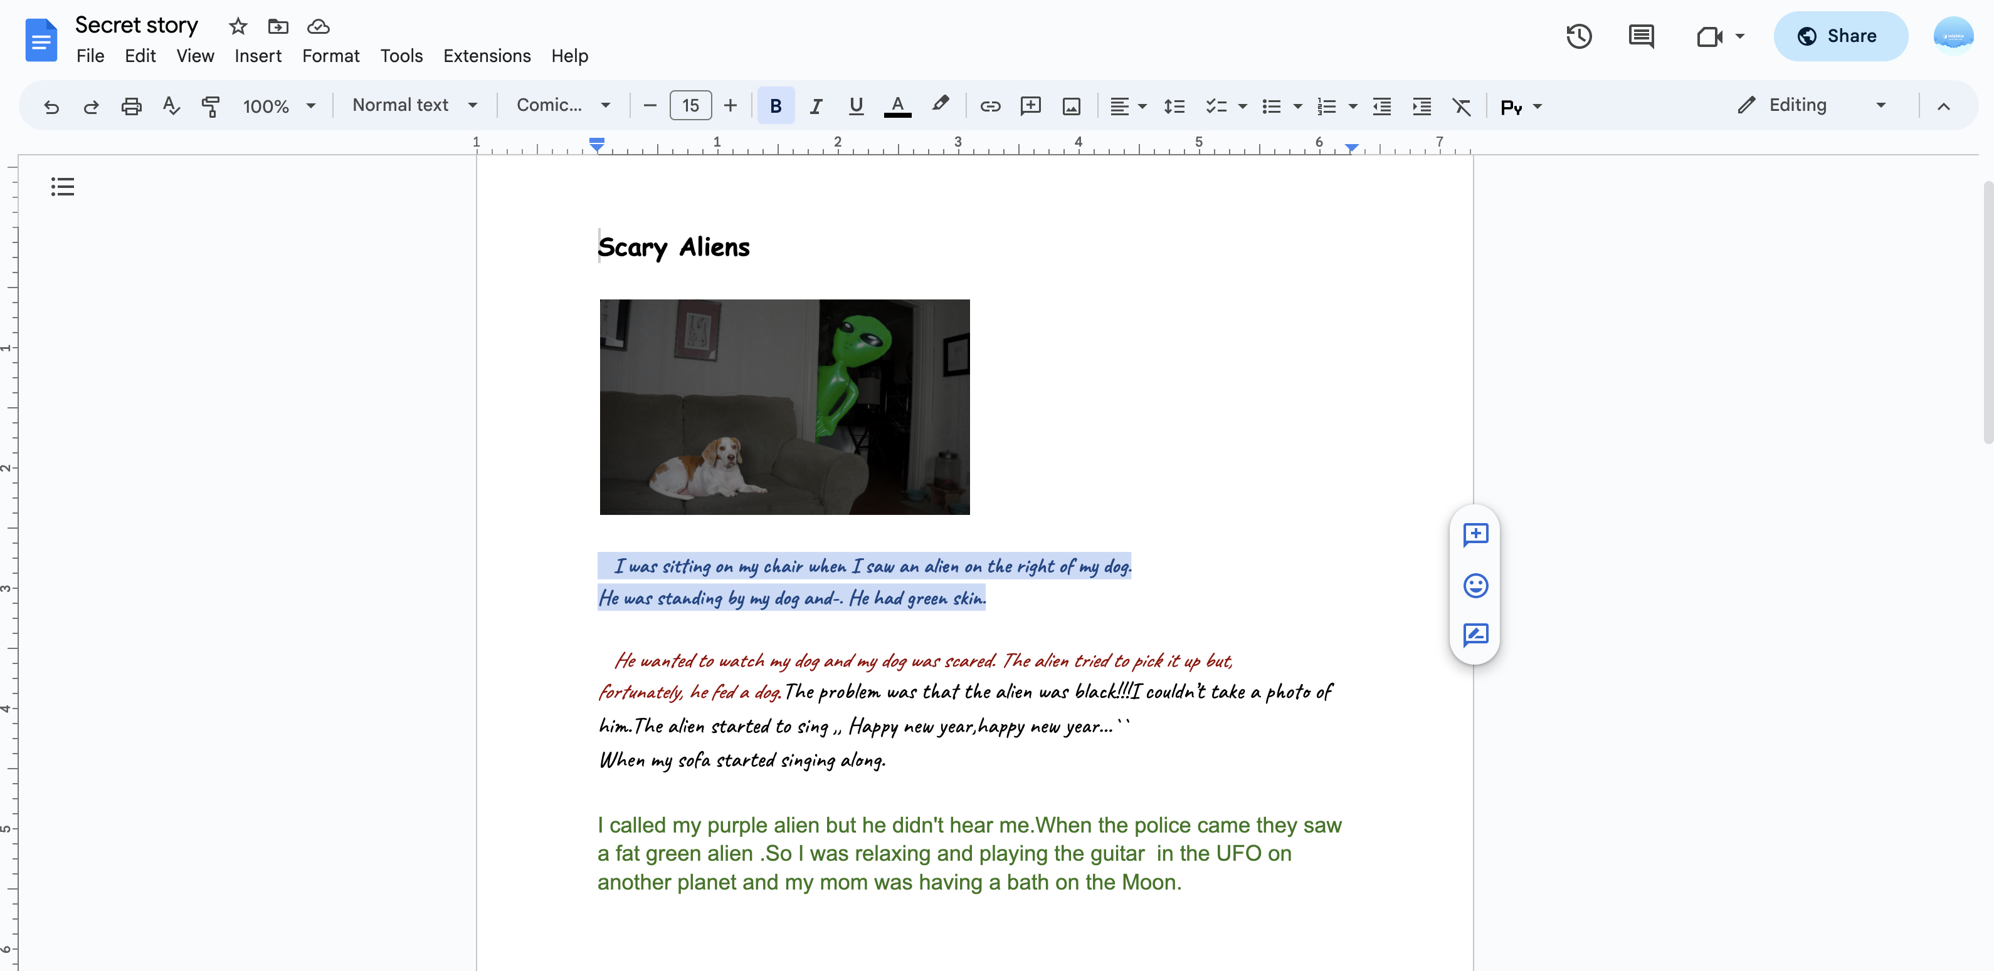
БЕЗ ОПОР

Slide 16
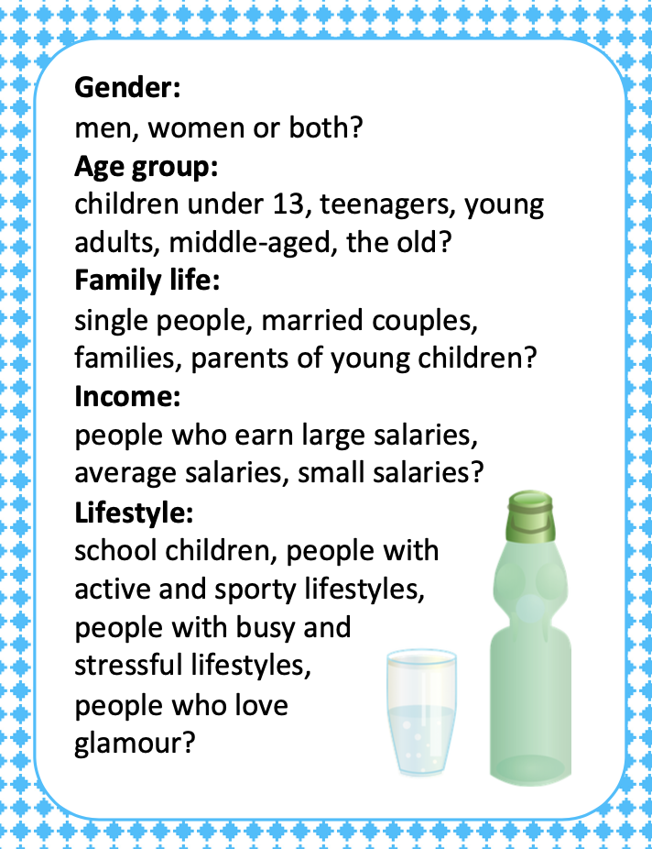
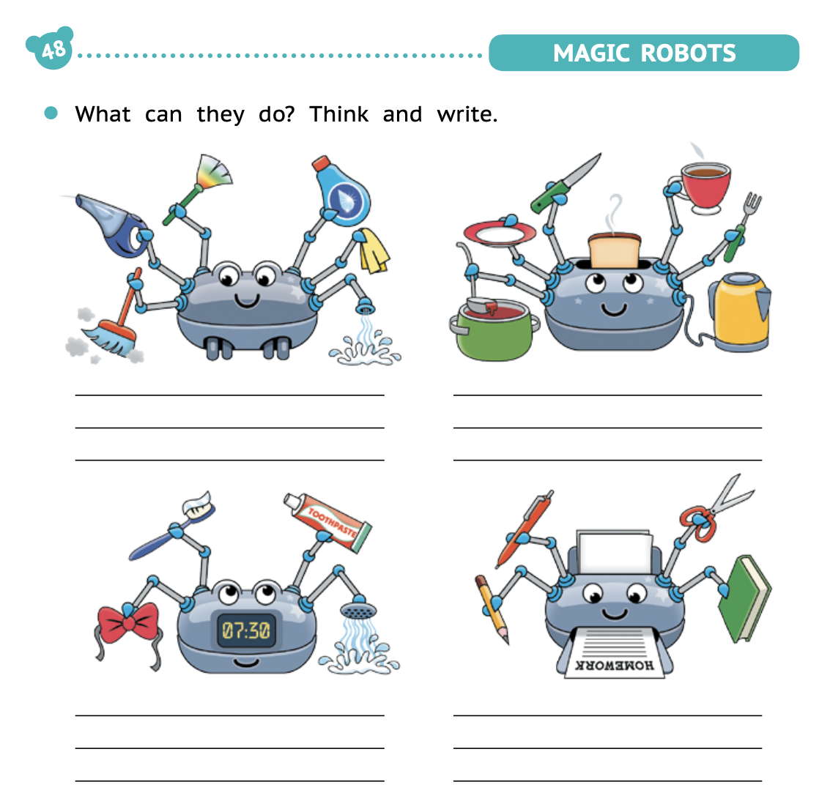
LANGUAGE FOCUS
Focused task
Unfocused task
Морозов, А. (2024). Mishkie Grammar 2. Titul Publishers.

Slide 17
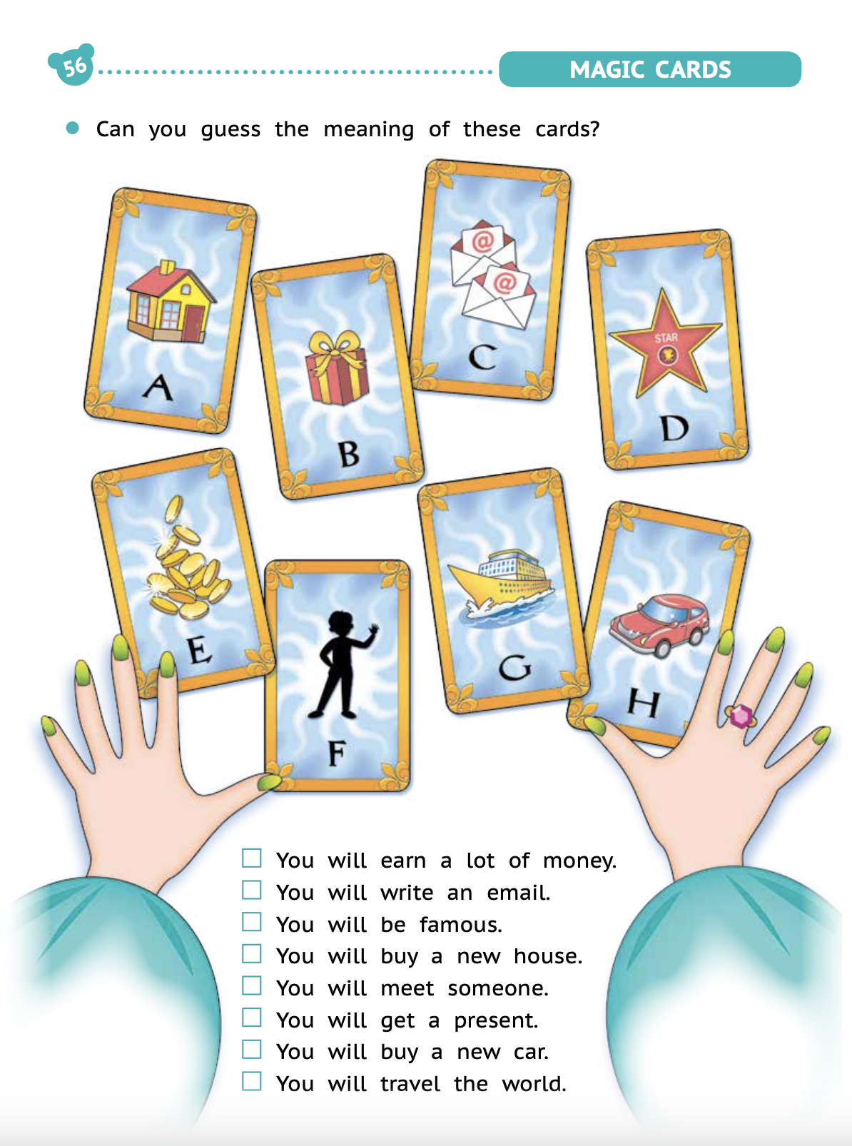
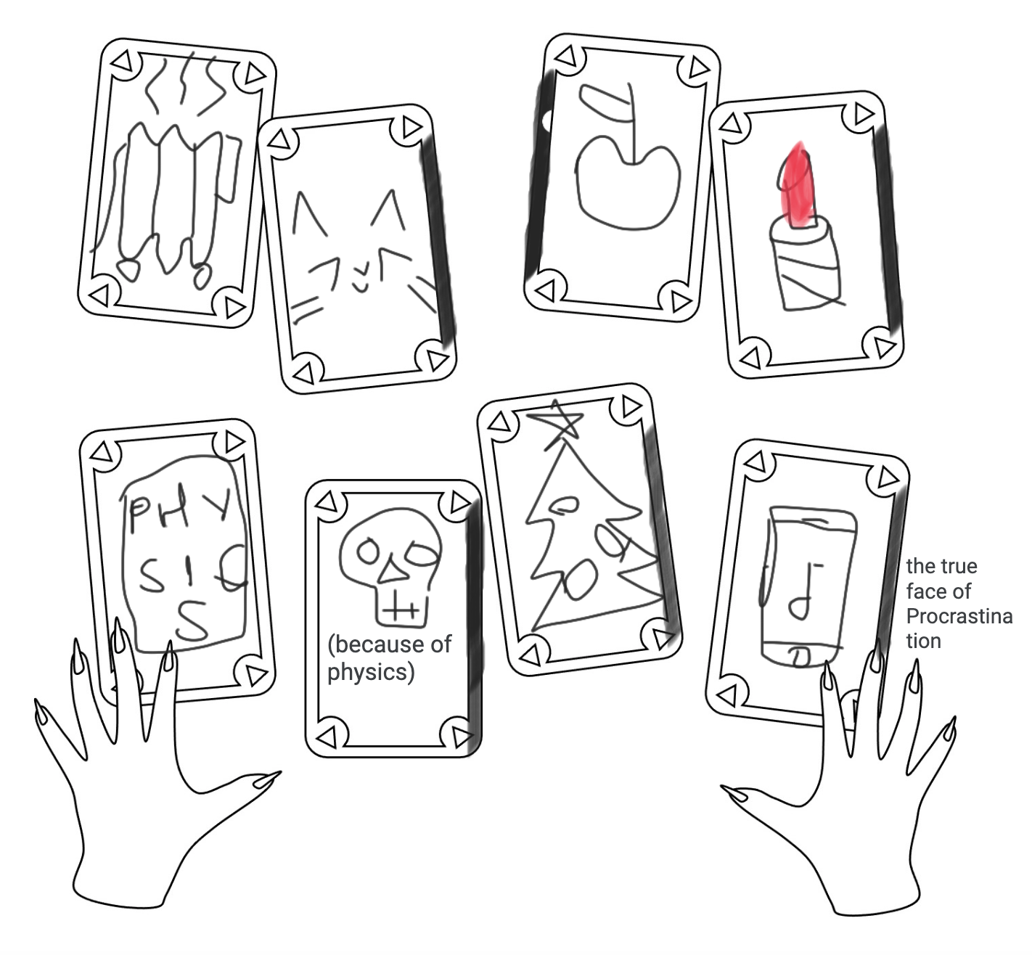
ПОДГОТОВКА К ЗАДАНИЮ
Teacher-generated task
Student-generated task
Морозов, А. (2024). Mishkie Grammar 2. Titul Publishers.

Slide 18
LEVEL-APPROPRIACY
A1-A2
A2-B1
B1-B2
Input-based
Closed
Here-and-now
Focused
Teacher-generated
Input- and output- based
Closed and opened
Here-and-now and there-and-then
Focused and unfocused
Teacher- and learner-generated
Output-based
Open
There-and-then
Unfocused
Learner-generated

Slide 19
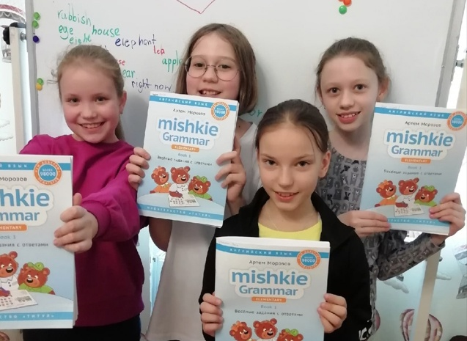
Заглянуть внутрь можно:
На Ozon
https://ozon.ru/t/n4oJqWV
На Wildberries
https://vk.cc/cnrCPi
На сайте «Титул»
https://vk.cc/cm3dsH

