Slide 1
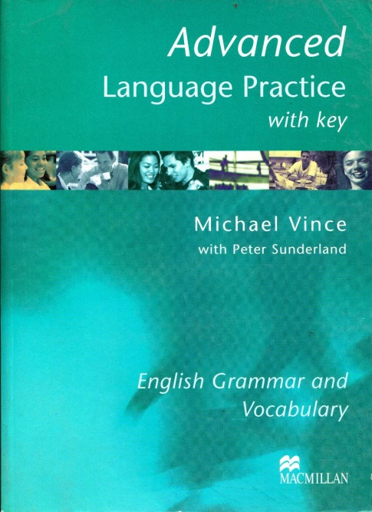
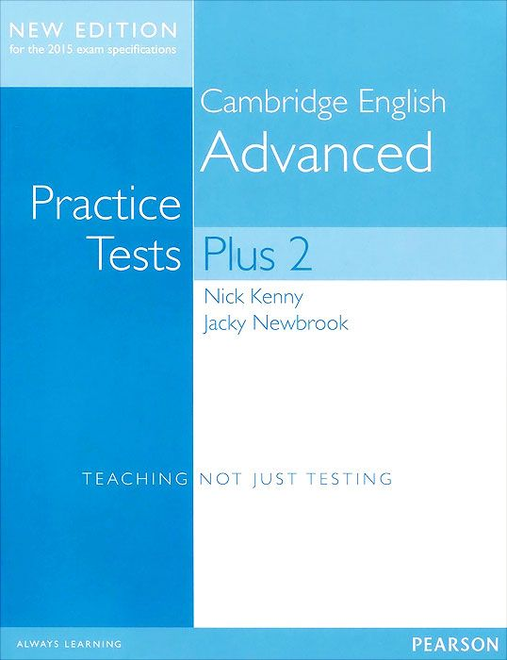
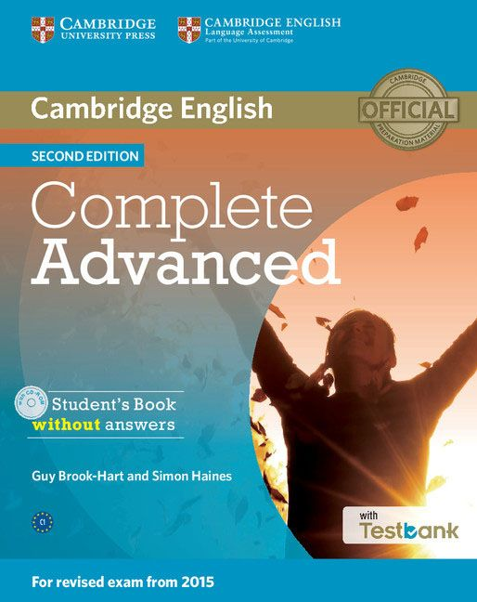
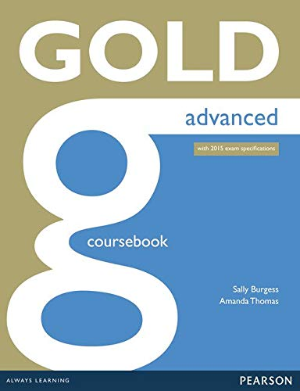
_{CAMBRIDGE ADVANCED}
_{EXAM STRATEGIEs}
VERONIKA BANDURINA
CAMBRIDGE EXAMS EXPERT,
TEACHER TRAINER

Slide 2
CAE FACTFILE
What is the official name of the exam?
The level of English you need to pass this exam is… (choose one in each line)
a) A1 A2 B1 B2 C1 C2
b) Elementary/Pre-intermediate/ Intermediate/Upper-intermediate/Advanced/ Proficiency
How is it graded?
  a) A-B-C
  b) Pass with Merit-Pass-Fail
  c) Good-Good-Satisfactory
How do those grades correspond to the levels?
If you fail one/two/three parts, do you still get a certificate?
Can you retake this exam?
How long is the certificate valid for? (What is the expiry date?)
CAE has 1/2/3/4/5 parts (choose 1).
What are they?
CAMBRIDGE ADVANCED

Slide 3
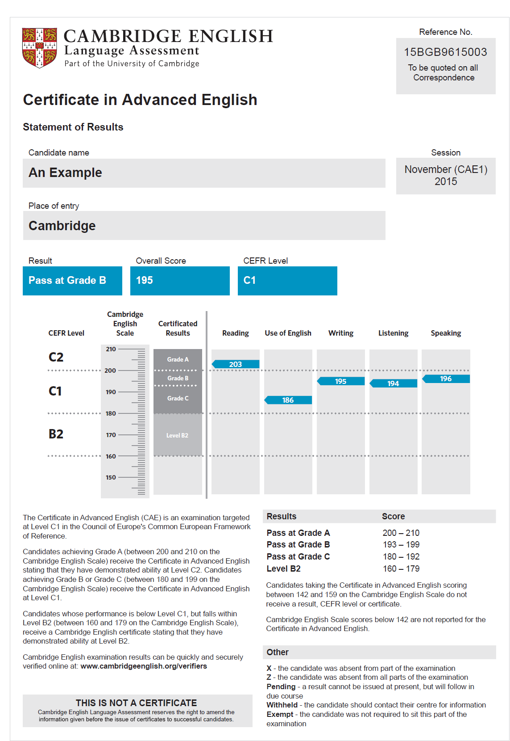

Slide 4
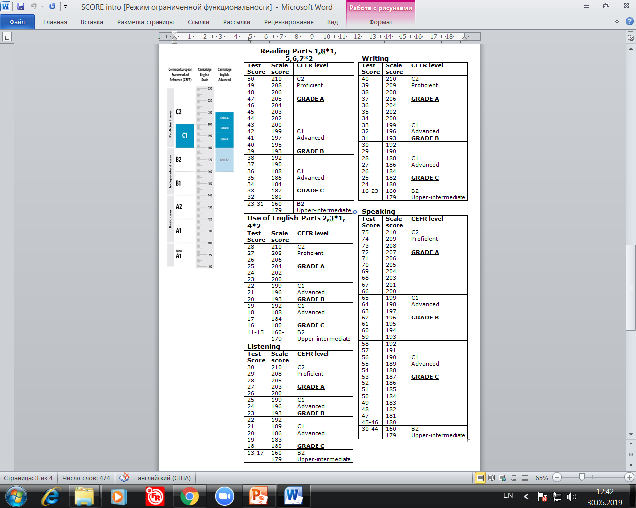

Slide 5
READING & USE OF ENGLISH

Slide 6
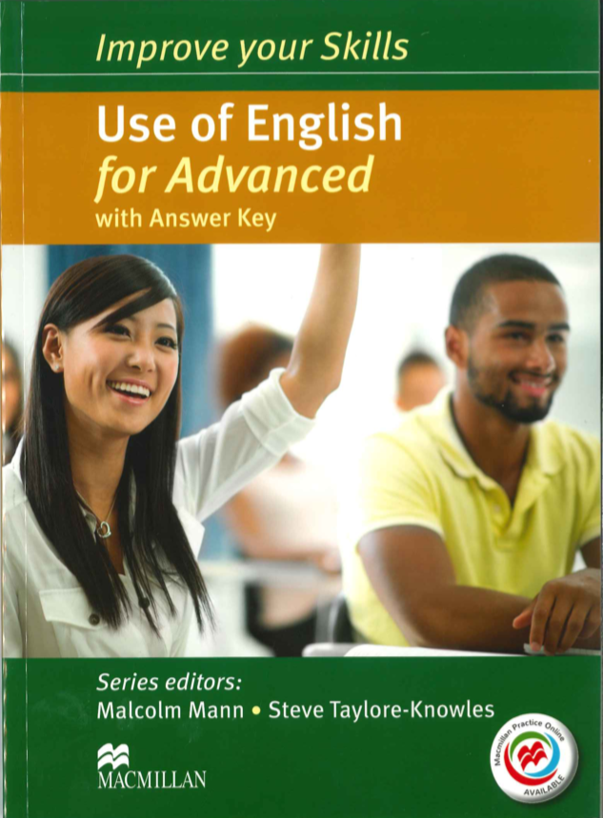
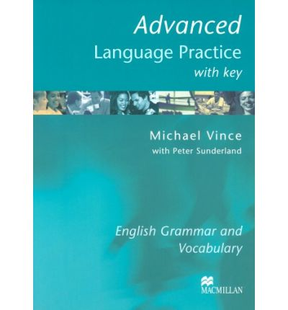
TIME:
1:30 MINUTES
READING
USE OF ENGLISH
5 parts;
Parts 1,8 - 1 point per question, parts 5,6,7 - 2 points per question;
The hardest part;
Do the hard tasks last;
Read texts of various types and registers.
3 parts;
Parts 2,3 - 1 point per question, part 4 - 2 points per question;
Educated guess;
Exploit texts for the language.

Slide 7
Collocations;
Context;
Frequency;
Educated guess.

Slide 8
One word;
Grammar/ vocab;
Functional words

Slide 9
Word formation;
DON’T leave the word unchanged;
Context (the whole text)

Slide 10
Grammar, structures, collocations;
3-6 words;
Contractions – 2 words;
Preserve the meaning;
Use the given word;
DON’T change the word given.

Slide 12




Which reviewer
37 has a different opinion from the others on the confidence with which de Botton discusses architecture?
38 shares reviewer A’s opinion whether architects should take note of de Botton’s ideas?
39 expresses a similar view to reviewer B regarding the extent to which architects share de Botton’s concerns?
40 has a different view to reviewer C on the originality of some of de Botton’s ideas?
Part 6
You are going to read four reviews of a book about how architecture can affect the emotions. For questions 37 – 40, choose from the reviews A – D. The reviews may be chosen more than once.
The Architecture of Happiness
Four reviewers comment on philosopher Alain De Botton’s book
A
Alain de Botton is a brave and highly intelligent writer who writes about complex subjects, clarifying the arcane for the layman. Now, with typical self-assurance, he has turned to the subject of architecture. The essential theme of his book is how architecture influences mood and behaviour. It is not about the specifically architectural characteristics of space and design, but much more about the emotions that architecture inspires in the users of buildings. Yet architects do not normally talk nowadays very much about emotion and beauty. They talk about design and function. De Botton's message, then, is fairly simple but worthwhile precisely because it is simple, readable and timely. His commendable aim is to encourage architects, and society more generally, to pay more attention to the psychological consequences of design in architecture: architecture should be treated as something that affects all our lives, our happiness and well-being.
B
Alain de Botton raises important, previously unasked, questions concerning the quest for beauty in architecture, or its rejection or denial. Yet one is left with the feeling that he needed the help and support of earlier authors on the subject to walk him across the daunting threshold of architecture itself. And he is given to making extraordinary claims: ‘Architecture is perplexing ... in how inconsistent is its capacity to generate the happiness on which its claim to our attention is founded.’ If architecture's capacity to generate happiness is inconsistent, this might be because happiness has rarely been something architects think about. De Botton never once discusses the importance of such dull, yet determining, matters as finance or planning laws, much less inventions such as the lift or reinforced concrete. He appears to believe that architects are still masters of their art, when increasingly they are cogs in a global machine for building in which beauty, and how de Botton feels about it, are increasingly beside the point.
C
In The Architecture of Happiness, Alain de Botton has a great time making bold and amusing judgements about architecture, with lavish and imaginative references, but anyone in search of privileged insights into the substance of building design should be warned that he is not looking at drain schedules or pipe runs. He worries away, as many architects do, at how inert material things can convey meaning and alter consciousness. Although he is a rigorous thinker, most of de Botton’s revelations, such as the contradictions in Le Corbusier's theory and practice, are not particularly new. However, this is an engaging and intelligent book on architecture and something everyone, professionals within the field in particular, should read.
D
Do we want our buildings merely to shelter us, or do we also want them to speak to us? Can the right sort of architecture even improve our character? Music mirrors the dynamics of our emotional lives. Mightn’t architecture work the same way? De Botton thinks so, and in The Architecture of Happiness he makes the most of this theme on his jolly trip through the world of architecture. De Botton certainly writes with conviction and, while focusing on happiness can be a lovely way to make sense of architectural beauty, it probably won’t be of much help in resolving conflicts of taste.

Slide 15
WRITING

Slide 16
WRITING FACTFILE
2 pieces;
1:30 minutes;
You write in PEN;
Task 1: the essay (obligatory);
Task 2: report, proposal, review, letter
(you can choose out of 3);
NO drafts;
Word limit: 220-260 words +- 10%;
Formal (essay, report, proposal, formal letter) and informal (review, informal letter) registers are checked upon.

Slide 19
ESSAY MAP
State the problem+ importance
List two chosen points
Intro
Supporting argument(s) 1
Example(s) 1
Topic sentence
Idea 1
Para 1
content point 1
Idea 2
Supporting argument(s) 2
Example(s) 2
Para 2
content point 2
Topic sentence
Idea 1
Supporting argument(s) 1
Example(s) 1
Conclusion
Choose one idea
Support it by argument, give opinion, explain why

Slide 21
LISTENING

Slide 22
LISTENING FACTFILE
4 parts;
Types of texts:
Monologues: announcements, radio broadcasts, speeches, talks, lectures, anecdotes, etc.
Interacting speakers: radio broadcasts, interviews, discussions, etc.
Subskills: skimming, scanning, listening for detail, inference;
NB: Paraphrasing, synonyms,
reverse order.

Slide 24
Text summary;
Different order;
1-3 words;
Read the context carefully;
Distractors.

Slide 25
The same order;
Underline key words.

Slide 26
Simultaneously;
3 extra options;
Synonyms, inference, gist, scanning.

Slide 27
SPEAKING

Slide 28
SPEAKING FACTFILE
4 parts;
MODE: Two candidates and two examiners. One examiner acts as both interlocutor and assessor and manages the interaction either by asking questions or providing cues for candidates. The other acts as assessor and does not join in the conversation.
TASK TYPES: Short exchanges with the interlocutor and with the other candidate; a 1-minute individual ‘long turn’; a collaborative task involving the two candidates; a discussion.

Slide 30
Warmer;
Intro;
Impress the examiner;
20-30 sec

Slide 31
Compare two pics;
Speculate;
Answer 2 questions;
DON’T describe;
DON’T speak about pic 3;
DON’T spend time on one question.

Slide 32
DIALOGUE:
Talk to your partner;
Use communication strategies;
DON’T speak for a long time;
DON’T use all the options.

Slide 33
TIPS:
1. Don’t panic!
2. Do the hard tasks last;
3. Don’t be afraid of making mistakes;
4. Practise a lot!
5. Read and listen to various authentic resources!
USEFUL RESOURCES:
1. Cambridge English Advanced Handbook for teachers for exams from 2015 Cambridge English Language Assessment.
2. Macmillan Advanced Language Practice With Key 2003 Michael Vince with Peter Sunderland
3. Advanced Practice Tests Plus 2 new edition for the 2015 exam specifications Nick Kenny Jacky Newbrook Longman
4. Gold Advanced for 2015 exam specifications Sally Burgess Amanda Thomas

