Slide 1
Понятие «Уровень Пользователя» как основа современных экзаменов

Slide 2
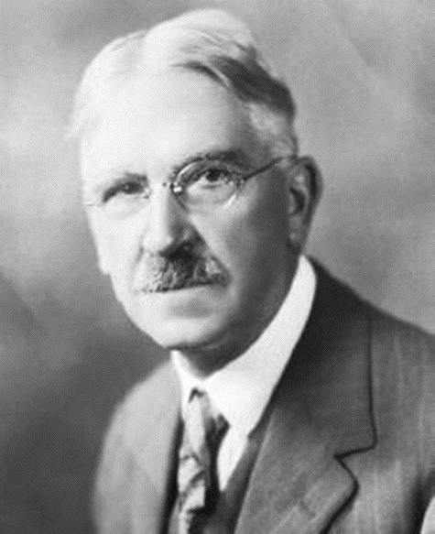
If we teach today’s students as we taught yesterday’s, we rob them of tomorrow.
John Dewey
American philosopher, educator, and writer

Slide 3
Modern approach to language learning and teaching
Based on the notion of communicative proficiency – the increasing ability to communicate and operate effectively in the target language
Skills-based (Can Do statements)
Communicative purpose (what people can do) – rather than on specific linguistic knowledge

Slide 4
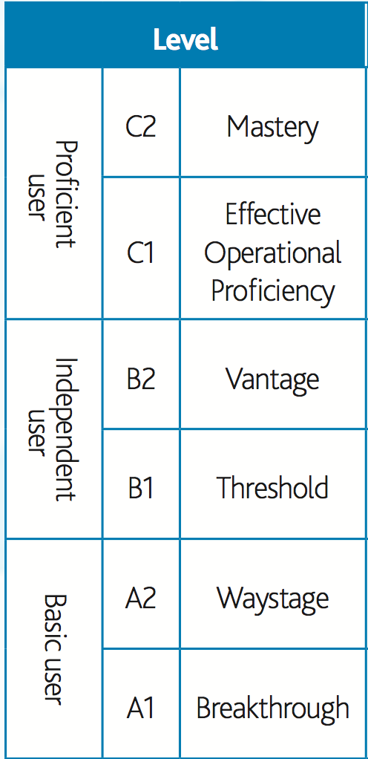
COMMON EUROPEAN FRAMEWORK OF REFERENCE (CEFR)

Slide 5
Global Scale: A:Basic User; B: Independent User; C:Proficient User
Can produce clear, detailed text on a wide range of subjects and explain a viewpoint on a topical issue giving the advantages and disadvantages of various options.
Can interact in a simple way provided the other person talks slowly and clearly and is prepared to help.
Can express him/herself spontaneously, very fluently and precisely, differentiating finer shades of meaning even in more complex situations.

Slide 6
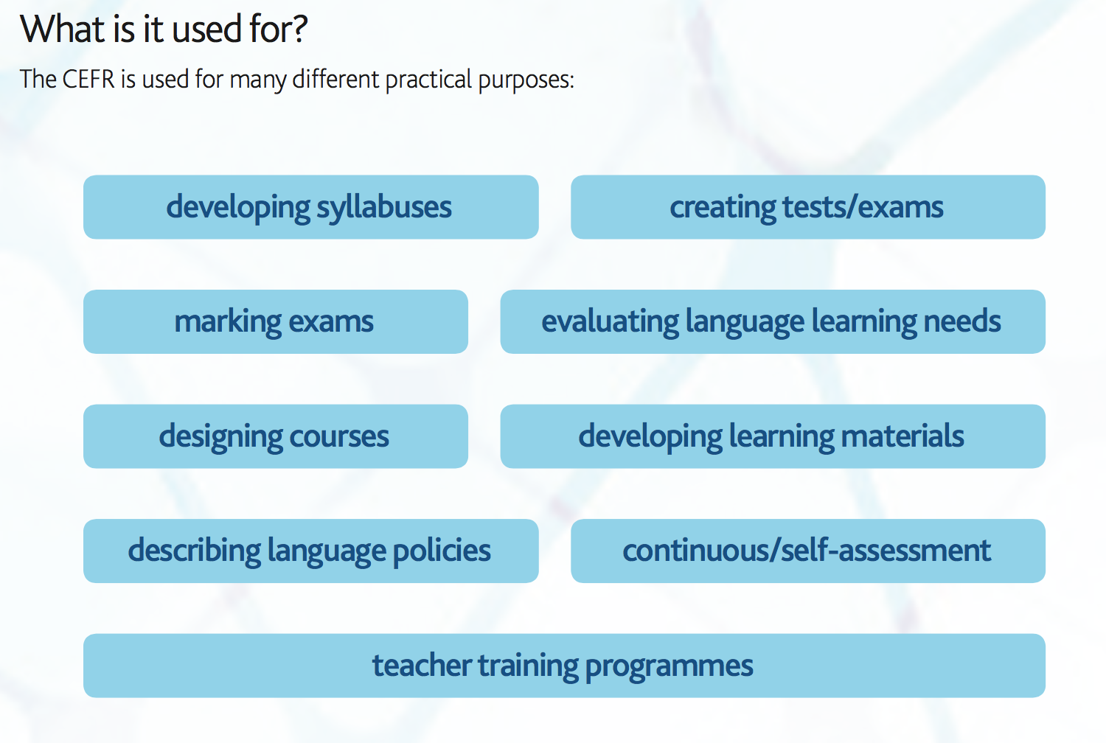
WHAT IS CEFR USED FOR?

Slide 7
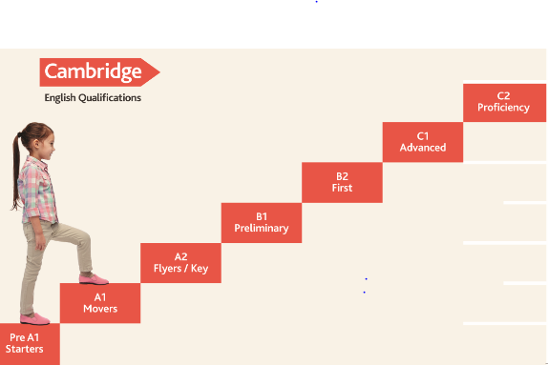
Notes:
The Common European Framework of Reference for Languages (CEFR) is the standard used around the world to benchmark language ability. It makes it easier for teachers, learners and parents to understand the levels of different qualifications. It has a six-point scale, from A1 for beginners, up to C2 for those who have mastered a language. The CEFR describes the things that a language learner can do at each of these six levels. Cambridge Assessment English has been continuously involved in the research and development of the CEFR since the 1970s - B2 First and C2 Proficiency informed the original development of the CEFR.
While the CEFR describes ability at 6 stages, the Cambridge English Scale is designed to provide detailed results so that learners, teachers and parents can see exactly how they have performed within a CEFR level, and from one exam to the next. The Cambridge English Scale is built on years of research and adds granularity to the CEFR. This information enables learners (and their teachers) to take action on problem areas, set new goals, and monitor their progress, which is essential for successful learning. In this way, learners can become more actively involved in their own learning and gain linguistic self-confidence as they move to the next level. Extensive research over many years means that we can be confident that candidates who achieve the same Cambridge English Scale score in different exams show a comparable level of ability.

Slide 8
WHAT DOES ANY LEVEL INCLUDE?
Skills
Language
Grammar
Receptive
R/L
Vocabulary
Pronunciation
Productive
W/S
Functional language

Slide 9

English Profile (Language)
Shows what learners really know at each level of the CEFR (English Vocabulary Profile and English Grammar Profile)
Find word meanings, phrases, phrasal verbs and idioms
A1–C2 levels are available on FREE subscription
www.englishprofile.org
Notes:
Our authors also use English Vocabulary Profile vocabulary to inform their work.
English Vocabulary Profile provides a complete searchable listing of the words and phrases in English that are considered to be within the levels of the CEFR.
Now you can use it too.
Go to English Profile dot org and register for your free subscription.
9

Slide 10
PLACING VOCABULARY ON THE CEFR SCALE
B1
rainforest
B2
psychology
umbrella
A2
A2
grocery store
helicopter
A1
A2
yellow
A1
A1
Mobile phone
to love
teacher
A1
B1
fall in love
indicate (show)
С1

Slide 11
PLACING VOCABULARY ON THE CEFR SCALE (RUN)
A1
run (move fast)
B2
run (use commputer)
C1
run (publish)
C2
B1
run around (be very busy)
run out (use all)
B2
B2
run (travel)
run out (all used)
A 1 11
run around (playing)
C2
run wild (imagination)

Slide 12
USING VOCABULARY ACCORDING TO THE LEVEL
A 2: Uses basic vocabulary reasonably appropriately.
B 1: Uses everyday vocabulary generally appropriately, while occasionally overusing certain lexis.
B 2: Uses a range of everyday vocabulary appropriately, with occasional inappropriate use of less common lexis.
C 1: Uses a range of vocabulary, including less common lexis, appropriately.
C2 : Uses arrange of vocabulary, including less common lexis, effectively and precisely.

Slide 13
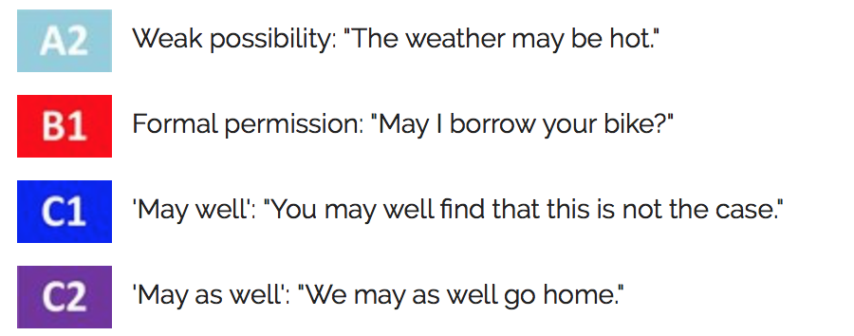
LANGUAGE: GRAMMAR
Moving up the CEFR level (may)

Slide 14
PLACING GRAMMAR ON THE CEFR SCALE
Present Continuous
USE | EXAMPLE
Events in progress (with a limited range of verbs) | We are missing you.
Events in progress (with an increasing range of verbs) | I’m watching a swimming competition.
Events in progress (with a wide range of verbs) | I’m expecting my cousin to visit me.
Politeness | I’m asking permission to be excused from work for at least three days.
Future arrangements (with a wide range of verbs) | We’re throwing a party for fun next Friday
Rhetorical questions | Why is technology taking over our lives?
A1
A2
B1
C2
B2
C1

Slide 15
GRAMMAR AT DIFFERENT LEVELS
A 2: simple grammatical forms (with some degree of control)
B 1: simple grammatical forms (with a good degree of control)
B 2: a range of simple and some complex grammatical forms (with a good degree of control)
C 1: a range of simple and complex grammatical forms (with control and flexibility)
C 2: a wide range of simple and complex grammatical forms (with full control, flexibility and sophistication)

Slide 16
MISTAKES AT DIFFERENT LEVELS
A 2: may impede meaning at times
B 1: are noticeable, but meaning can still be determined
B 2: do not impede communication
C 1: occasionally may be present but do not impede communication
C 2: if present, are related to less common words and structures, or occur as slips

Slide 17




4 skills
Notes:
The exams cover all 4 language skills (Reading, Listening , Writing and Speaking). This has a positive impact on teaching and learning as it ensures that teachers practise all the skills in lessons, including communicative activities, and learners develop the skills needed to use English effectively in the real world. In research projects carried out by Cambridge English, teachers report introducing more communicative activities in class since starting to prepare students for the exams.

Slide 18
Reading. Approaches
learning to read
vs
reading to learn

Slide 19

What reading skills?
Reading for gist
Reading for specific information
Reading for detailed understanding
Reading to infer information not stated
Deducing meaning from context
Predicting
Image used under license from Shutterstock

Slide 20

Skills which can be tested
Understanding gist
Understanding detail
Understanding referencing
Understanding implication
Text organisation features
Image used under license from Shutterstock

Slide 21
Text types included in Cambridge English
Extracts from books (fiction and non-fiction)
Newspaper and magazine articles
Advertisements
Public signs and notices
Informational material: labels, brochures, guides, manuals
Correspondence: text messages, letters or emails

Slide 22
READING. OVERALL READING COMPREHENSION
(A 2) CAN understand short, simple texts containing the highest frequency vocabulary, including a proportion of shared international vocabulary items. / short, simple texts on familiar matters of a concrete type.
(B 1) CAN read straightforward factual texts on subjects related to his/her field and interest with a satisfactory level of comprehension.
(B 2) CAN read with a large degree of independence, adapting style and speed of reading to different texts and purposes, and using appropriate reference sources selectively. Has a broad active reading vocabulary, but may experience some difficulty with low frequency idioms.
(C 1) CAN understand in detail lengthy, complex
texts, whether or not they relate to his/her own
area of specialty, provided he/she can reread
difficult sections.

Slide 23

Image used under license from Shutterstock
Listening skills
listening for gist
listening for specific details or main points
listening to understand opinion
listening to follow an argument
listening to infer something not directly stated

Slide 24

Text types (Listening)
formal/informal conversations
answerphone messages/recorded messages
news broadcasts/podcasts
radio discussions
speeches
interviews
announcements on television or in a public place
anecdotes
lectures/talks
Image used under license from Shutterstock

Slide 25
LISTENING. OVERALL GENERAL ABILITY
A 2: CAN understand simple questions and instructions.
B 1: CAN understand straightforward instructions or public announcements.
B 2: CAN follow a talk on a familiar topic.
C 1: CAN follow discussion and argument with only occasional need for clarification, employing compensation strategies to overcome inadequacies.

Slide 26
WRITING SUBSKILLS
Accuracy – spelling, writing legibly, punctuating, layouts, choosing the right vocabulary, using grammar correctly and correctly using paragraphs.
Communicating ideas – appropriate style and register, organizing ideas in a helpful way, using the features typical of the text type we are writing, joining or words and sentences clearly and using appropriate functions to express our meaning

Slide 27
WRITING. OVERALL GENERAL ABILITY
A 2: CAN complete forms and write short, simple letters or postcards related to personal
information / write a very short, simple narrative or description.
B 1: CAN write letters or make notes on familiar or predictable matters / take basic notes
in a lecture.
B 2: CAN write clear, detailed text on a wide range of subjects related to his/her interests.
C 1: CAN produce clear, well-structured, detailed text on complex subjects, showing
controlled use of organizational patterns, connectors and cohesive devices.

Slide 28
SPEAKING
Speaking subskills
making use of grammar, vocabulary and functions
making use of register to speak appropriately
using features of connected speech
using body language
producing different text types
oral fluency (normal speed; little hesitation, repetition or self-correction and smooth use of connected speech)
using interactive strategies

Slide 29
Oral fluency (hesitation)
CEFR level | Descriptors
A2 | Can make him/herself understood in very short utterances, even though pauses, false starts and reformulations are very evident.
B1 | Can keep going comprehensibly, even though pausing for grammatical and lexical planning and repair is very evident, especially in longer stretches of free production.
B2 | … There are few noticeably long pauses.
C1 | … Only a conceptually difficult subject can hinder a natural, smooth flow of language.

Slide 30
SPEAKING. OVERALL GENERAL ABLITIES
A 2: CAN express simple opinions or requirements in a familiar context / express likes and dislikes in a familiar context.
B 1: CAN express simple opinions on abstract/cultural matters in a limited way or offer advice within a known area / ask for information about accommodation and travel / take part in a seminar or tutorial using simple language.
B 2: CAN keep up a conversation on a fairly wide range of topics / ask for clarification and further explanation / express own opinion and present arguments
to a limited extent / answer predictable or factual questions.
C 1: CAN keep up a conversation of a casual nature for an extended period of time /
discuss abstract/cultural topics with a good degree of fluency and range of expressions /
deal with unpredictable questions / follow up questions
by probing for more detail / make critical
remarks/express disagreement without causing offence.

Slide 31
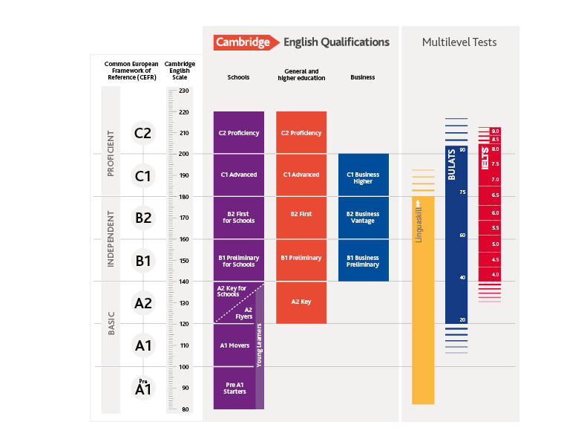

Notes:
Cambridge Assessment English offers a wide range of qualifications and tests to meet the needs of learners at different stages of their learning journey and in different contexts – e.g. at school, applying for, studying at and graduating from university, and applying for jobs or in the workplace. Our exams for schools (click to highlight the exams in purple on the diagram) are designed to reflect the type of learning that goes on in schools. There are 8 exams, each targeted at a specific level of the Common European Framework of Reference for Language (CEFR). The exams act as milestones as learners progress through school. The content of each exam is designed to reflect the target age and ability, with each exam gradually building on the one before, so that taking C1 Advanced, for example, builds on what has been covered in B2 First for Schools. High achievers, who want to show they have achieved the highest level in English, may choose to go on to do C2 Proficiency.
(Click to show the box around A2 Key for Schools/A2 Key, B1 Preliminary for Schools/B1 Preliminary, B2 First for Schools/B2 First.) As you can see from this table, there are different versions of A2 Key, B1 Preliminary and B2 First – one with content aimed specifically at school-aged learners and one for older learners. We are sometimes asked why there is no C1 Advanced for Schools (click to show box around C1 Advanced and C2 Proficiency). C1 Advanced is designed to support the transition from school into higher education and the workplace and to demonstrate that learners have the language skills required to succeed in these contexts. Universities and employers around the world recognise C1 Advanced on this basis and, for this reason, there is no C1 Advanced for Schools, but the topics and tasks in the exam are designed to be of interest and relevance both to students in upper-secondary school as well as older learners.

Slide 32
Questions?
Notes:
Do you have questions?

Slide 33
Благодарим за внимание!
Наши социальные сети

