Slide 1
MAKING LEARNING FUN AND EFFECTIVE,
TEACHING EASIER.
DEVELOPING RECEPTIVE SKILLS.

Slide 2
NEW TEACHER GUIDES FOR DEVELOPING RECEPTIVE SKILLS
Can be used as training and teaching resource
Designed with attention to teaching, learning and assessment
Insights into subskills of listening/reading
Teaching receptive skills with exam in mind
Practical teaching activities (listening – with integrated audio)

Slide 3
STEP-BY-STEP APPROACH
to build learner confidence
to develop reading/listening skills
to develop exam strategies

Slide 4



LISTENING

Slide 5
THE CHALLENGES OF LISTENING IN A SECOND LANGUAGE
For the learner:
Language level (enough vocabulary, grammar or idioms?)
Awareness of pronunciation (understanding connected speech?)
Experience and exposure to the language(speaker’s accent?)
Knowledge of the topic (schematic knowledge?)
Learner motivation (interested? confident? aware of own strengths and weaknesses?)

Slide 6
THE CHALLENGES OF LISTENING IN A SECOND LANGUAGE
For the teacher:
Time and space in the syllabus (How much time do you have?)
Access to resources (Are the materials compatible for exam preparation?)
Giving feedback (Checking answers and understanding. Learners reflection?)
Technology (Equipment available in class? Distant learning? Blended?)

Slide 7
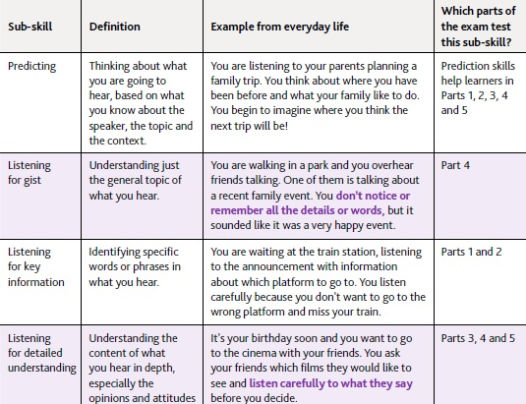
KEY TERMINOLOGY - INSIGHTS INTO SUBSKILLS OF LISTENING

Slide 8
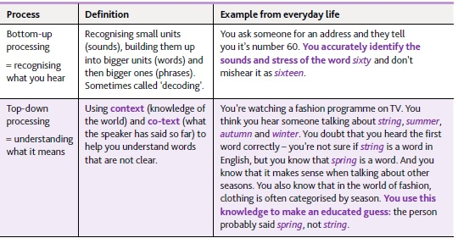
KEY TERMINOLOGY - INSIGHTS INTO SUBSKILLS OF LISTENING

Slide 9
Bottom-up processing skills.
Activity idea: Connected speech. How many words?
Example from Part 1 (with weak forms)
Audioscript: ‘Yeah, with my sister. She loves it but I’m not as keen as she is.’
Stressed words:
not, keen, she
(Here: negative words,
adjectives and subject pronouns)
Unstressed words:
I’m, as x 2, is

Slide 10
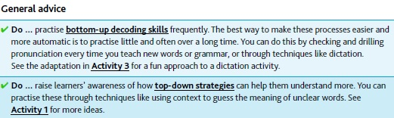
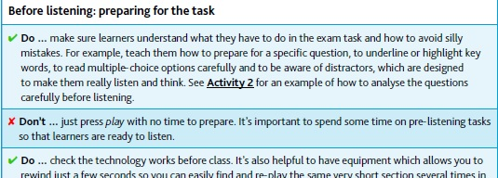
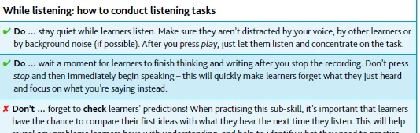
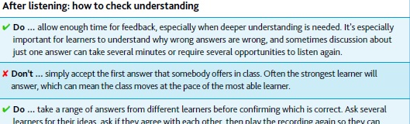
TOP TIPS

Slide 11
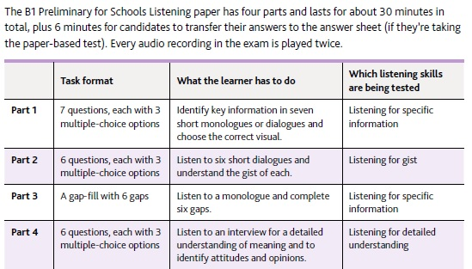
exam procedure
exam format

Slide 12
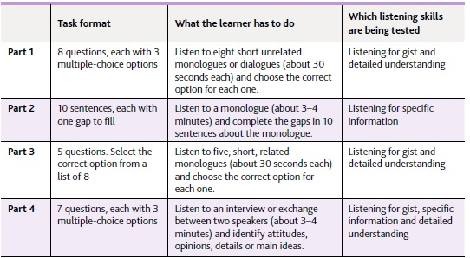
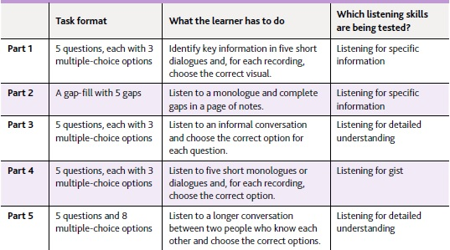
B 2 First for
schools
A 2 Key for Schools

Slide 13
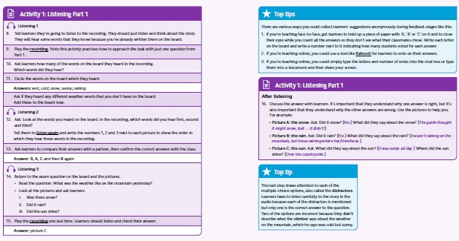
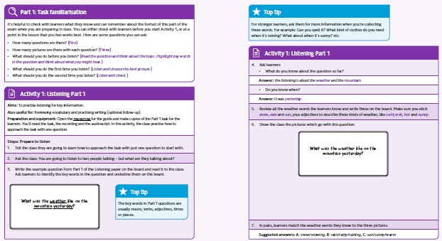

Slide 14
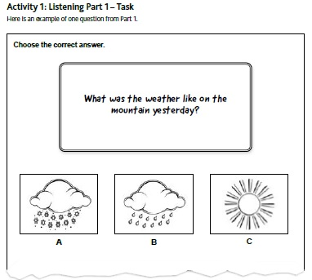
RESOURCE PACK

Slide 15
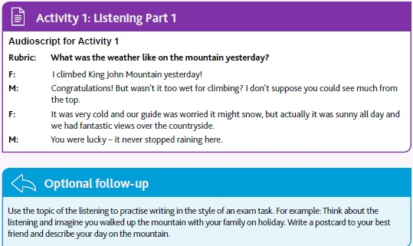
Where you went
Who you were with
What the weather was like
Ask about your friend’s holiday

Slide 16
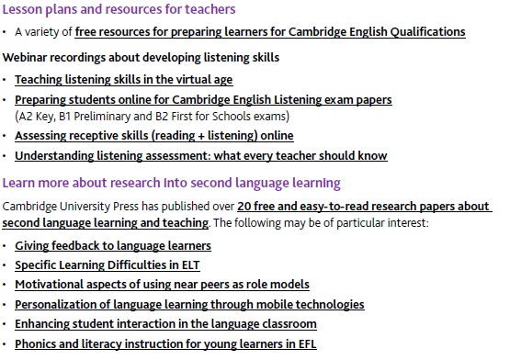
EXTRA RESOURCES

Slide 17
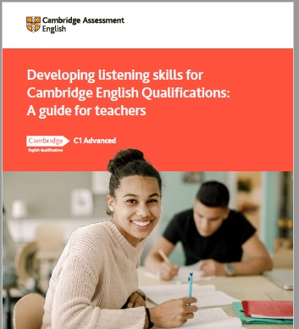
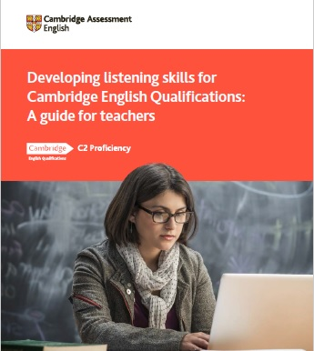

Slide 18



READING

Slide 19
reads a wide range of things and reads regularly
guesses the meaning of
words they don’t know
A good reader
uses different skills such as
skimming and scanning
reflects on what they have read

Slide 20
REFLECTION
What reading skills did you use?
When do we skim? Why?
How do you skim?
When do we scan? Why?
How do you scan?

Slide 21
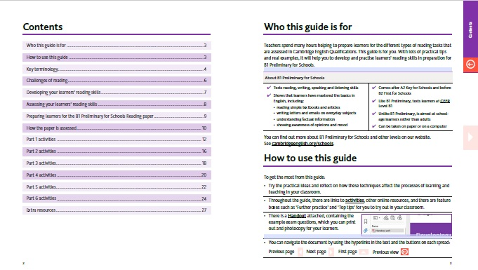

Slide 22
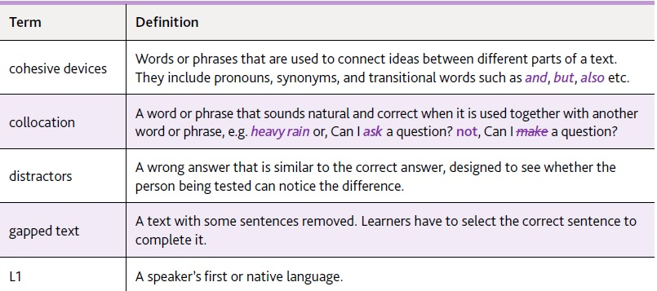
KEY TERMINOLOGY

Slide 23
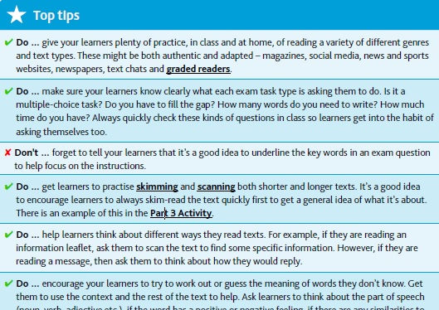
Developing your learners reading skills

Slide 24
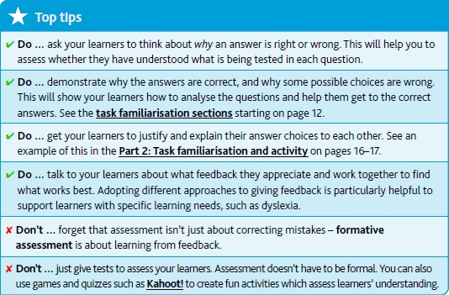
Assessing your learners reading skills

Slide 25
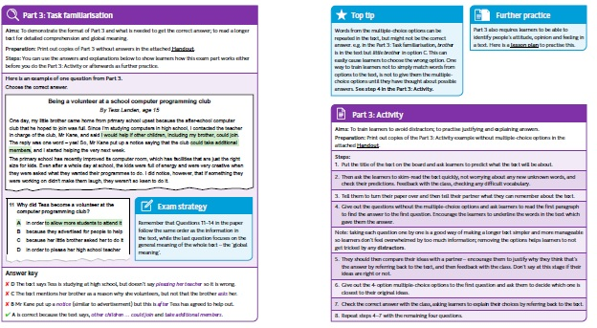

Slide 26
SKIMMING
Read the text quickly and answer the questions
What text type is this?
Who was it written for?
Who wrote it?
Why?

Slide 27
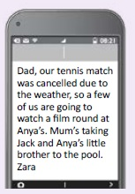

Slide 28
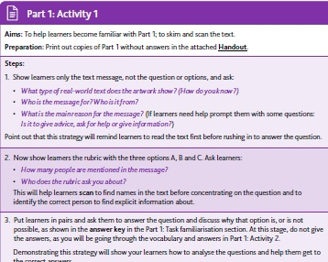
skimming
scanning

Slide 29
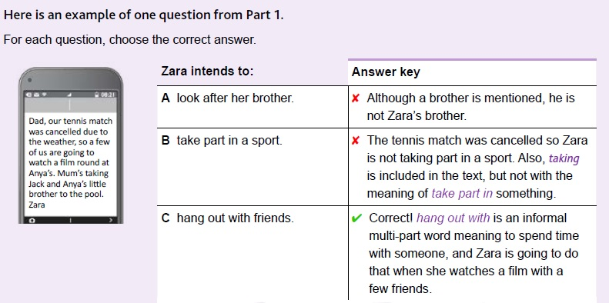

Slide 30
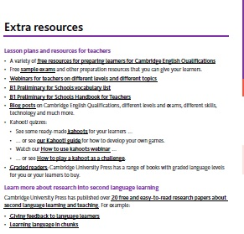

Slide 31



Slide 32
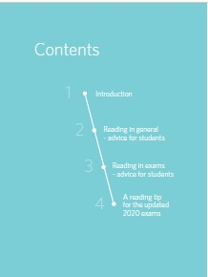


Slide 33
SUMMING UP
Guides for teachers + resource pack / handouts
Activities in the guides (for each exam)
Integrate teaching and learning with an assessment focus
One activity for each part of the exam
Part of a task or a complete task + audio (listening)
Link to Mock Test Toolkit

Slide 34
QUESTIONS?

Slide 35
Наши социальные сети

