Slide 1
Уроки - мотиваторы
Марианна Юрьевна Кауфман автор курса
«Happy English.ru» Master of Arts in Sociolinguistics

Slide 2
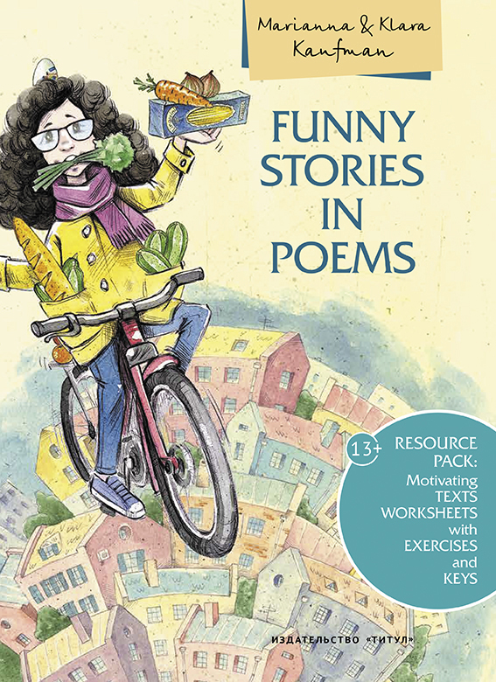
ПОСОБИЯ

Slide 3
УЧЕБНИКИ

Slide 5
Понятие мотивации
Мотивация — общее название для процессов, методов, средств побуждения учащихся к продуктивной познавательной деятельности.
Мотивация (от лат. "movere") – побуждение к действию, динамический процесс физиологического и психологического плана, управляющий поведением человека.
И. А. Зимняя называет мотивацию "запускным механизмом" всякой человеческой деятельности: будь то труд, общение или познание.

Slide 6
Виды мотивации
Мотивация обучения может определяться внешними или внтуренними мотивами.
Внешние мотивы не связаны с содержанием учебного материала: мотив долга, обязанности, оценки, личного благополучия , отсутствие желания учиться (отрицательные мотивы).
An extrinsically motivated student studies and learns for other reasons. Such a student performs in order to receive a reward, like graduating or passing a test or getting a new shirt from mom, or to avoid a penalty like a failing grade (Lumsden).
Внутренние мотивы, напротив, связаны с содержанием учебного материала: мотивы познавательной деятельности, интереса к содержанию обучения, мотивы овладения общими способами действий, выявление причинно-следственных связей в изучаемом учебном материале .
Intrinsic motivation is motivation from within the student (Lumsden). An intrinsically motivated student studies because he/she wants to study. The material is interesting, challenging and rewarding, and the student receives some kind of satisfaction from learning.
Г. В. Рогова и З. Н. Никитенко “…интерес к процессу обучения по иностранному языку, держится на внутренних мотивах, которые исходят из самой иноязычной деятельности"

Slide 7
GEN Z Characteristics
1. Technology Integration
Early Exposure: Gen Z has grown up with technology from a very young age. Many were using computers before the age of five, leading to a fundamental shift in how they process information and engage with learning (Seemiller & Grace, 2016).
Instant Gratification: They are accustomed to rapid access to information and immediate responses, which affects their patience and focus. This contrasts with previous generations who acquired technology later in life (O’Connor, 2016).
2. Attention Span
Shorter Attention Span: Research indicates that Gen Z has a significantly shorter attention span, often only able to concentrate for about eight seconds. This is partly due to frequent multitasking and rapid information consumption online (Rich, 2012; Carr, 2010).
3. Learning Preferences
Preference for Active Learning: Gen Z learners prefer active, hands-on learning experiences rather than passive lecture-based instruction. They engage more with teaching methods that involve discussions, activities, and practical applications (Lieberg, 2008; Seemiller & Grace, 2016).
Desire for Relevance: They seek information that is immediately relevant to their lives rather than abstract or future-oriented content. They want to see the direct applicability of what they are learning (M. Johnson & L. Johnson, 2010).
4. Technological Dependence
Integrated Technology: For Gen Z, technology is an integral part of their identity. They are used to interacting with digital content and social media, which can sometimes lead to distractions in traditional learning environments (Elmore, 2016; Pandit, 2015).
5. Motivation and Engagement
Motivation for Instant Results: Gen Z learners are motivated by immediate rewards and results. They may struggle with traditional educational approaches that require long-term commitment and delayed gratification (McCrindle, 2014).
6. Social and Emotional Characteristics
Influence of Peer Opinion: Gen Z places high value on peer opinions and may feel insecure about participating if they fear negative judgment. They often prefer open-ended questions and discussions that minimize the risk of incorrect answers (Pandit, 2015).
In summary, Generation Z differs from previous learners in their reliance on technology, shorter attention spans, preference for active and relevant learning, and immediate gratification. Educators need to adapt their methods to engage this generation effectively.

Slide 8
Effective Strategies for Engaging Generation Z
Adopt Active Teaching Methods: Use storytelling, discussions, and hands-on activities.
Focus on Relevance: Ensure content is immediately useful and relatable to students.
Encourage Participation: Use open-ended questions and allow students to choose topics.
Leverage Passion: Demonstrate enthusiasm and authenticity in teaching.
Conclusion: Active, relevant, and engaging teaching methods are crucial for capturing and maintaining Generation Z students' attention.

Slide 9
Factors Influencing Student Engagement Findings
Passionate Teaching: Professors who are energetic and use stories maintain 80% more student attention.
Active Learning: Engaging activities, discussions, and illustrations improve student participation.
Relevance: Students prefer content that is immediately applicable to their lives.
Handwritten Notes: Students are more engaged when given physical notes versus using laptops for non-class activities.
Engaging Generation Z: A Case Study on Motivating the Post-Millennial Traditional College Student in the Classroom Kimberlee R. Mendoza San Diego Christian College, California, United States

Slide 10
PART
2

Slide 11
PART
2

Slide 13
L
istening and matching
2
The Camp Pineland friends, who are from different parts of the world, didn’t understand some facts about each other. The abbreviations were especially difficult to understand, so the friends posted some comments and explanations on the website.
Listen to this information and match the abbreviations with their meanings.
University of California, Los Angeles (UCLA)
Scholastic Assessment Test (SAT)
General Certificate of Secondary Education course (GCSE)
General Certificate of Secondary Education exams (GCSEs)
Advanced level course
Advanced level exams (A-levels)
A compulsory British school course which runs for two years.
An optional British school course which is required to get into a college or a university.
An American test required for getting into a college or a university.
British exams required for getting into a college or a university.
British exams which students take before leaving school.
An American university in California.
Reading for specific information
3 Read the text about Charlie Rose and answer the questions. Support your answers with the information from the text.
When did Charlie start his GCSE course?
What subjects can you do at GCSE level?
Will Charlie have to take exams in all his GCSE subjects?
Is it optional to go to school until you are sixteen?
Why are GCSE grades so important?
How many GCSEs can one sit? Give the minimum and the maximum numbers.
What options does Charlie have after sitting GCSEs?
What does Charlie want to do after finishing the GCSE course?
Are A-levels compulsory?
Can A-level students choose their subjects?
Does Charlie want to get into a university? Why?/ Why not?
Has Charlie decided what he wants to be?
What is Charlie going to do after finishing the A-level course?
Unit 1 Lessons 3, 4, 5
11

Slide 14
Сamp Pineland
www.camppineland.uk
Charlie Rose
Last year when I was fourteen, I started my GCSE course. GCSE is short for General Certificate of Secondary Education. The course runs for two years. All of us study English, Maths, Science, Information Technology and Religious Education. We also have optional subjects to choose from like Languages,
Business Studies, Design and Technology, Music, Geography, History and many more. At the end of this two-year course when I’m sixteen, my teachers will give me grades in some of the subjects based on the standard of my coursework over the year. In the other subjects I have to take GCSE exams to get my grades. We can take a minimum of five exams in optional and compulsory subjects, but most of us are going to sit about seven to nine GCSEs. It seems a lot, but one can do even more. I heard that in public schools they take up to twelve GCSEs. Just imagine doing that! However, there’s a good reason for this. These exams are extremely important for one’s education and career. If you decide to leave school after doing your GCSEs, your employers will always want to see your results before giving you a job.
GCSEs are graded from A (excellent), the highest, to E (satisfactory), the lowest. If someone fails GCSEs, it’s not the end of the world: one can resit GCSEs later, but it’s not an option for me. At sixteen, after finishing their GCSEs, some of my classmates, who are not academically minded, will leave school and start looking for jobs. I don’t think it’s a great choice. Nowadays you can’t succeed in life without having a good education. I’m planning to go on to the sixth form. This is a traditional name for the last two years of school, which are optional. During these two years students do their Advanced Level course and get ready for their Advanced Level exams, which are usually called A-levels. These exams are taken at the end of the school year and the results don’t come through until August.
12
Unit 1 Lessons 3, 4, 5

Slide 15
They are absolutely necessary for those who want to get into a university. A-level students choose their subjects according to what they’re planning to study at university. Most universities will accept applicants with two or three A-levels, but for some top ones students may need to have more. And they may need to get straight As to win a place. To be honest, I haven’t chosen a university yet. I haven’t even chosen what I want to do. I think I still have a bit of time for that. Anyway, after doing my A-levels, I’m going to take a gap year before university. During that year I will have a chance to see the world, try some different jobs and decide what I want to be.
Ordering
4 What is Charlie going to do in the next few years? Order the events and speak about his plans.
1. sit A-levels
2. take a gap year
3. sit GCSEs
4. start an A-level course
5. get into a university
Reading for specific information
5 Read the text about Belle and answer the questions. Support your answers with the information from the text.
Is Belle still at school?
Why did Belle have to give up all her favourite pastimes?
Are only the grades which Belle will get during her next year important? Why?/ Why not?
What test is Belle going to take this year? What is it for?
Do you have to finish the school course to do well in the SAT test?
Why does Belle have to sit the SAT test?
What will happen if Belle doesn’t get a high score in the SAT test?
How much does the SAT test cost?
What university has Belle chosen to apply to?
What factors influenced her choice?
Unit 1 Lessons 3, 4, 5 13

Slide 16
Сamp Pineland
www.camppineland.uk
Belle Lawrence
I’m in the third year of high school. It’s not the last year, because there is one more, but I still have to study day and night instead of going partying. I even had to give up watching TV and reading
ANSWER FORMAT:
A B C D
A B C D
A B C D
A B C
A B C D
for pleasure in the evening. Everything we do in high
school is important, as all our grades get into our official records. Sometimes future employers and universities want to see more than just final exam results: they also want to see how students have worked and improved over the years. Although our
D
end-of-school exams are only next year, all of us are feeling the pressure. We keep working all the time. We’ll finish our secondary education at the age of eighteen. Some of us will say “goodbye” to studying forever, but a lot of my schoolmates want to go on studying at colleges and universities.
This year I’m going to take a SAT reasoning test. It’s a standard test required by most American colleges. The SAT shows not only what you have learned at school, but also how well you can use your knowledge to analyse and solve problems. It consists of three major sections: Critical Reading, Mathematics, and Writing. The SAT results are believed to predict whether a student will do well at college. The test is carried out by Educational Testing Service nearly every month and costs $45. Although you can sit the SAT as many times as you want, normally it’s taken once or twice. I keep putting it off, but in March I’ll have to go for my first try. I hope I’ll do well and won’t have to resit it.
I’ve decided to apply to UCLA, the University of California, Los Angeles, so I’ll
need a high score in my test. UCLA is one of the most popular universities in the States. I know that in the last few years they have received more applications than any other university and have admitted only about ten per cent of those who applied. Students are attracted to UCLA by both its excellent educational and social-life opportunities.
University of California, Los Angeles
14 Unit 1 Lessons 3, 4, 5

Slide 17
Multiple choice
6 Choose all the right answers to complete each statement. Refer to Charlie’s and Belle’s texts.
British schoolchildren can leave school at the age of
sixteen.
eighteen.
fourteen.
British schoolchildren can take a minimum of … GCSEs.
a) 5 b) 12 c) 7
British schoolchildren usually take a minimum of … A-levels.
a) 2 b) 3 c) 4
A-levels are graded
from 1 to 5.
from A to E. с) from A to B.
GCSEs are graded
from 1 to 5.
from A to E. с) from A to B.
A-levels are required
to finish school.
to get into a university.
to find a job.
The sixth form is a name for
the sixth year of education at school.
the two years when students study for their A-levels.
the last two years at school when children study for their GCSEs.
American high school runs for
… years.
a) 2 b) 3 c) 4
The SAT is
a compulsory exam.
an optional exam.
an end-of-year test.
The SAT is designed to test
a student’s subject knowledge.
a student’s personal qualities.
a student’s ability to think.
The SAT can be taken
only once every year.
every month.
one or two times during high school.
Collocations
7 Find the verb that does not go with the noun.
to do, to sit, to resit, to take, to fail, to test
to get into, to fail, to apply to, to graduate from
to get, to receive, to apply, to require
to leave, to start, to study at, to require
to receive, to send, to fail, to get, to fill in, to complete
to require, to get, to fail, to expect, to give
an exam
a university / a college
a grade / a score
school
an application
top grades
Unit 1 Lessons 3, 4, 5
15

Slide 18
Kate sold her house in Suffolk so fund the business. Although she had to move back into her parents’ place and do her work from a computer in the tiny bedroom where she used to live as a teenager. Kate doesn’t mind talking about that time, “While my whole future was on hold, I became even more determined — it meant that I had to believe in my vision, and I’m convinced it was a huge driving force in the success of my company.” Kate’s healthy snacks are now stocked nationwide and her profit last year was estimated at more than 100,000 GBP. Despite that, Kate has since then opened a couple of her own shops and bought herself a new house in London. The lesson to be learnt from this story is quite simple — never give up — if you have a dream, just go for it.
9 Замените неправильно употребленные слова и выражения (упр. 8), используя приведенные ниже.
moreover, in order to, on the one hand, on the other hand, however, needless to say, on top of that
Чтение и аудирование
10 Прочитайте вопросы и подчеркните ключевые слова, на которые вы будете ориентироваться в поисках информации.
What joke do taxi and delivery companies play on their new colleagues?
What do the houses at 23–24 Leinster Gardens look like?
Where was the first underground line in the world?
What kind of trains were in use at the end of the 19th century?
What did the trains need some open air spots for?
How did the company deal with the problem of venting off?
Who most often becomes the victim of cruel jokes nowadays?
When a new driver joins a taxi company or a pizza delivery service, his colleagues and future friends often test the newcomer with practical jokes. The list is endless and there are no limits to the jokers’ imagination. Only those working in London don’t have to invent anything, their best joke is about 150 years old and still there to use. Send the new guy to 23–24 Leinster Gardens and the job is done for you. What is so special about this address? Is it inhabited by a vampire family, reckless hooligans or is it haunted by ghosts?
Nothing like that. In fact, 23–24 Leinster Gardens are situated in a very upmarket area of the city. The facades of the five-storey Victorian houses are decorated with balconies and columns, so there is absolutely nothing suspicious about these buildings at first sight. It is only when you get close up and see
44 Unit 1 Lessons 12, 13

Slide 19
there is no letter box and that the windows are painted on concrete that you realise that these houses are nothing but a fake.
In fact, this fake facade is hiding an interesting story. On 10th January 1863, the first underground train line in the world, the Metropolitan Line, was opened after three years of construction. At that time trains were steam trains and needed ventilation. Even though they were fitted with condensers to reduce smoke and steam in the tunnels, they had to vent off in the open air. (Venting off was when the trains vented their steam and smoke. It was best done outside of the underground sections.) The railway company, therefore, needed to make sure that there were open stretches of railway at regular intervals. One of the solutions the rail company found was to buy two houses, 23–24 at Leinster Gardens, and demolish them. Naturally, the wealthy residents of the area complained so the company suggested a compromise — a five-storey false facade (5ft thick) was built fitted with fake door and painted windows, to fill in the gap and hide the blast of fumes caused by trains passing underneath.
The fake facade has been a hotspot for practical jokers ever since. A famous one dates back to the 1930s when a young man sold very expensive tickets for a charity ball at one of these houses and made a small fortune out of this fraud. It was only when the excited guests turned up in evening dress and knocked on the fake door that they realised they’d been taken in. The old joke is still very much in use nowadays. This address is a real pain in the neck for food delivery companies and taxi drivers. They do know about it, but when it gets busy, they don’t really have the time to
check every address, so they get caught again and again.
Расскажите, что имеется в виду в данных утверждениях, своими словами.
This address is still a real pain in the neck for food delivery companies and taxi drivers.
The fake facade has been a hotspot for practical jokers ever since.
It was only when the excited guests turned up in evening dress and knocked on the fake door that they realised they’d been taken in.
A young man made a small fortune out of this fraud.
In fact, 23–24 Leinster Gardens are situated in a very upmarket area of the city.
12 Выберите наиболее подходящий заголовок для этого текста. Объясните свой выбор.
London underground history An old joke is as good as new
Fake houses make real money
11
Unit 1 Lessons 12, 13
45

Slide 20
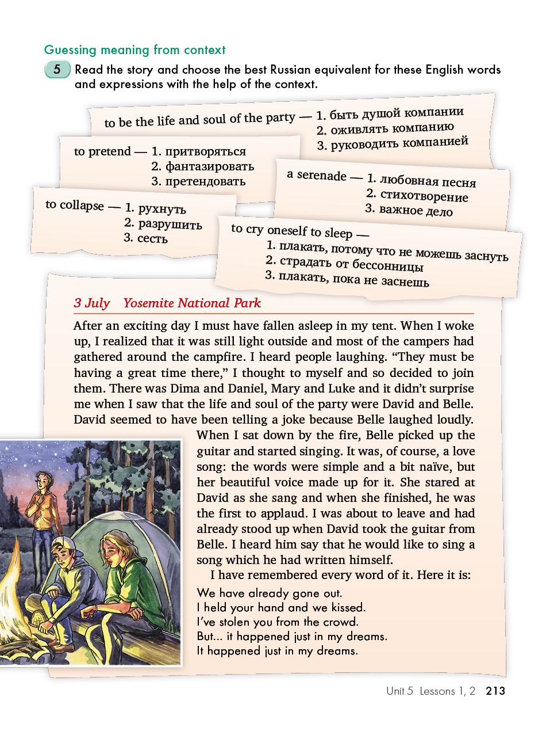
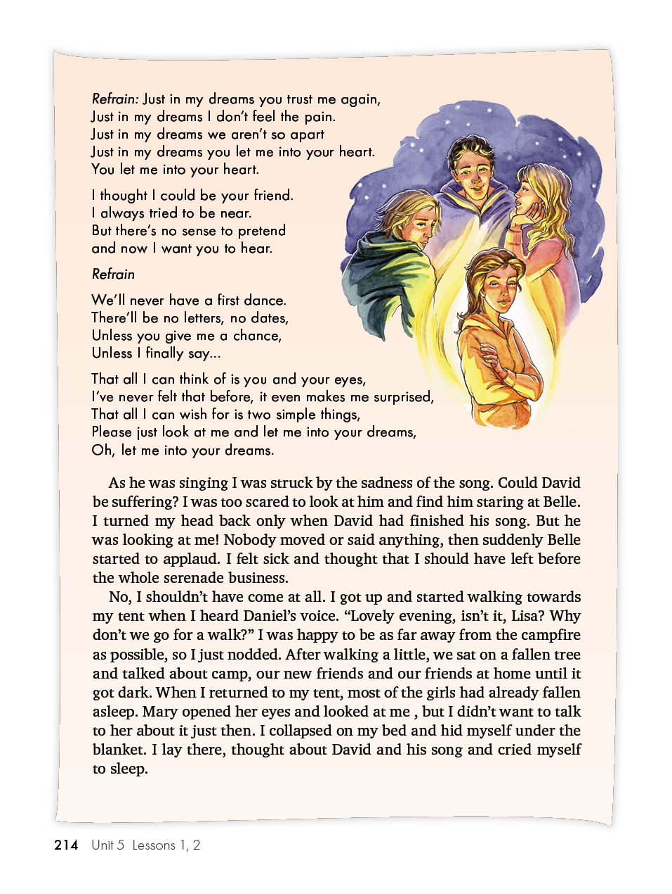

Slide 22
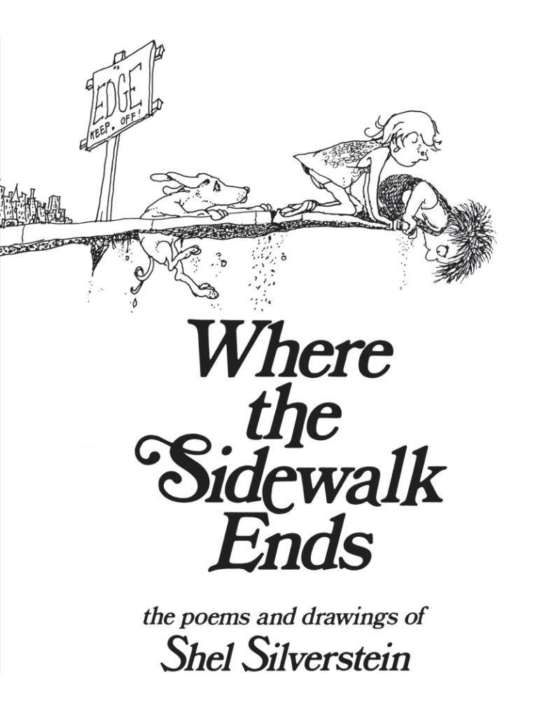
“Ma and God God gave us fingers--Ma says, "Use your fork." God gave us voices--Ma says, "Don't scream." Ma says eat broccoli, cereal and carrots. But God gave us tasteys for maple ice cream. God gave us fingers--Ma says, "Use your hanky." God gave us puddles--Ma says, "Don't splash." Ma says, "Be quiet, your father is sleeping." But God gave us garbage can covers to crash. God gave us fingers--Ma says, "Put your gloves on." God gave us raindrops--Ma says, "Don't get wet." Ma says be careful, and don't get too near to Thoses strange lovely dogs that God gave us to pet. God gave us fingers--Ma says, "Go wash 'em." But God gave us coal bins and nice dirty bodies. And I ain't too smart, but there's one thing for certain-- Either Ma's wrong or else God is.”

Slide 23
Ма и Бог
Бог дал нам пальцы – Ма просит есть вилкой и ложкой.
Бог дал нам голос – но Ма запрещает кричать.
Ма заставляет есть брокколи, суп и картошку.
А Бог посылает конфеты нам прямо в кровать.
Бог дал нам пальцы – сморкаться в них Ма запрещает.
Бог дал нам лужи, но прыгать в них Ма не велит.
Ма говорит: «Не шуми, твой отец отдыхает».
Но Бог дал нам крышки от баков и все, что гремит.
Бог дал нам пальцы – но Ма надевает перчатки.
Бог дал нам дождь , с Ма попасть под него нелегко .
Ма подходить запрещает к собачьей площадке,
А Бог посылает забавных пушистых щенков.
Бог дал нам пальцы, Ма просит их мыть ежечасно.
Бог дал нам грязные пятки от пыльных дорог.
Сам я не гений, но тут уж и мне стало ясно.
Кто-то здесь точно неправ – то ли Ма, то ли Бог.

