Slide 1

Как написать задание 38 на высший балл: рекомендации экспертов.
Хитрова Ирина Викторовна
Зверева Наталья Сергеевна

Slide 2
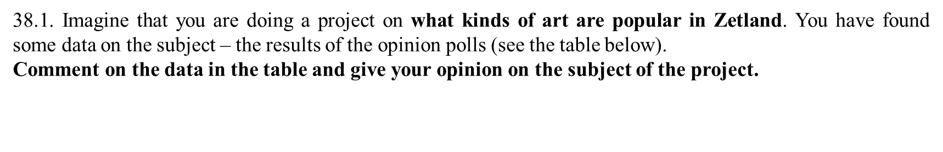
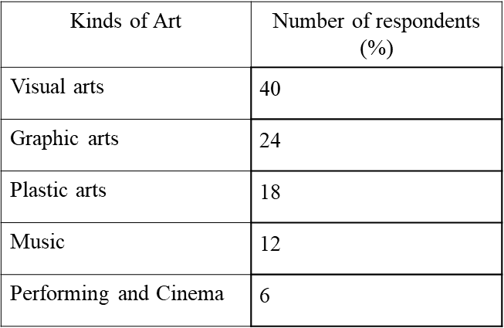
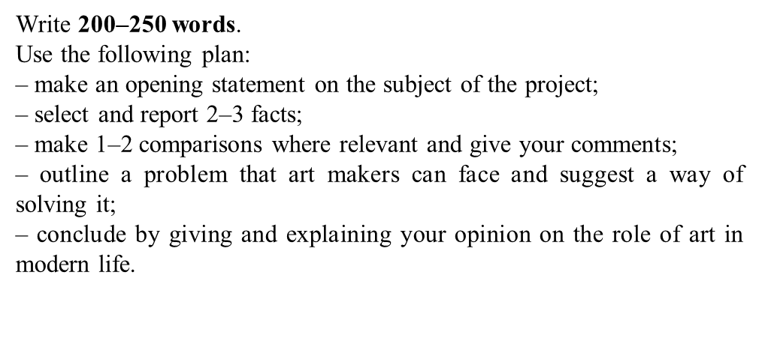

Slide 3
Рекомендации по выполнению задания 38.
Внимательно прочитайте инструкцию к заданию.
Изучите план к заданию.
Пишите каждый абзац из пяти, представленных в плане, опираясь на следующие пункты:

Slide 4
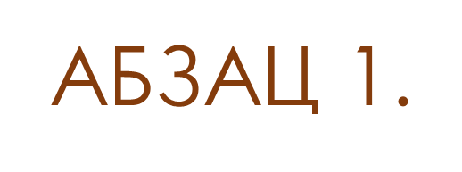
напишите, что выполняете проектную работу,
укажите ее тему и/или цель,
уточните, что проектная работа выполняется по данным опроса, результаты которого представлены в таблице или диаграмме,
укажите где был проведен опрос,
подчеркните, что вы нашли статистические данные по теме проекта и собираетесь их описать в данной работе.
Задани 2

Slide 5
Different types of art are popular all over the world now. I am working on the project about kinds of art that are popular in Zetland. I have found the results of relevant opinion polls presented in the table. I am going to analyse the statistics and I express my opinion on the subject of the project.
Задани 2

Slide 6

сделайте ссылку на используемую таблицу/диаграмму, чтобы было понятно, откуда берутся приводимые факты и цифры,
опишите 2–3 факта из данных, приведенных в таблице/диаграмме (не перепутайте таблицу и круговую диаграмму),
укажите цифровые показатели, приведенные в таблице или диаграмме,
пишите числительные цифрами, а не словами,
в описании результатов социологического опроса используйте глаголы в одном времени.

Slide 7
According to the data in the table , there are five most popular kinds of art . 40% of the respondents choose visual art. Almost a fifth of the polled (18%) prefer plastic arts. Another 12% mention music as the most popular kind of art.

Slide 8

сравните данные, представленные в таблице / диаграмме, используя
сравнительную и превосходную степени прилагательных и слов, обозначающих количество (many/much, more, the most; few, fewer, the fewest; little, less, the least),
конструкции с while и whereas,
конструкции с уточнением во сколько раз или на сколько процентов один показатель больше или меньше другого: twice / three times / four times… as many (исчисляемые существительные)/as much as (неисчисляемые существительные), by 3 % more/less/higher/lower than и иные сравнительные конструкции

Slide 9
пишите числительные цифрами, а не словами,
дайте комментарий к приведенному сравнению (объясните, почему так происходит или поясните возможные причины разницы/ сходства между фактами).

Slide 10
It is evident that the percentage of the respondents who choose graphic arts is four times as much as the percentage of those who mention performing and cinema (24% and 6% respectively). I find such a difference rather predictable as graphic arts are more traditional and widely-spread.

Slide 11

обозначьте возможную проблему, связанную с темой проектной работы, указанную в пункте задания,
предложите способ ее решения.

Slide 12
Obviously, there is a problem that art makers can face. It is a possible loss of public interest in their works of art. The solution to the problem is to apply new approaches and improve artistic skills to attract public attention.

Slide 13

четко выразите свое мнение касательно важности, роли, необходимости и пр. (строго по пункту 5 плана задания 38),
обоснуйте свою точку зрения,
напишите как минимум два предложения в абзаце 5: всегда должны присутствовать 3 обязательных компонента –
эксплицитность ( указание на авторство),
соответствие заданию,
обоснование своего мнения.

Slide 14
To conclude, I am convinced that art plays a really significant role in modern life. It makes people’s lives more meaningful and exciting.

Slide 15
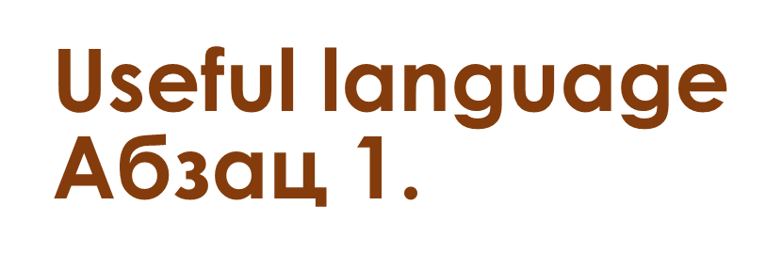

Slide 16
It is impossible to imagine …. (our lives) without … .
It is well known that …
Nowadays more and more people …
Over the last few decades there has been a significant increase in the number of people who …
… plays an important role in our life.
Nowadays the issue of ... causes great arguments and controversy.

Slide 17
The aim of my project is to examine / to find out …
My aim is to analyse …. and comment on ... .
The project I am working on is aimed at finding out…
My project, which I am still working on, is aimed at finding out …
The issue of ... has been widely discussed in society recently.
It is no exaggeration to say that our society could not function without ….
There is no doubt that ... is becoming a relevant issue nowadays.
Undoubtedly, … play(s) an important role in everyone’s life.
The current project focuses on …
The topic of the project I am working on is …
I am doing a project on…

Slide 18
I am going to comment on the data I have found…
I am going to give my opinion on the subject of the project.
I am doing a project ... I have found some data on the subject of the project. I am going to comment on it and give my opinion on the topic of the project.
… I have found the results of relevant opinion polls … .
I have found data on …
I have found some data on this issue.
I have found some data on the subject of the project
I have found a table (diagram/pie chart) with some data illustrating …
I have found some results of relevant opinion polls …
I have found relevant information presented in the table / pie chart and I am going to analyse it.
I am going to describe / to present my findings and express my opinion on ... .

Slide 19
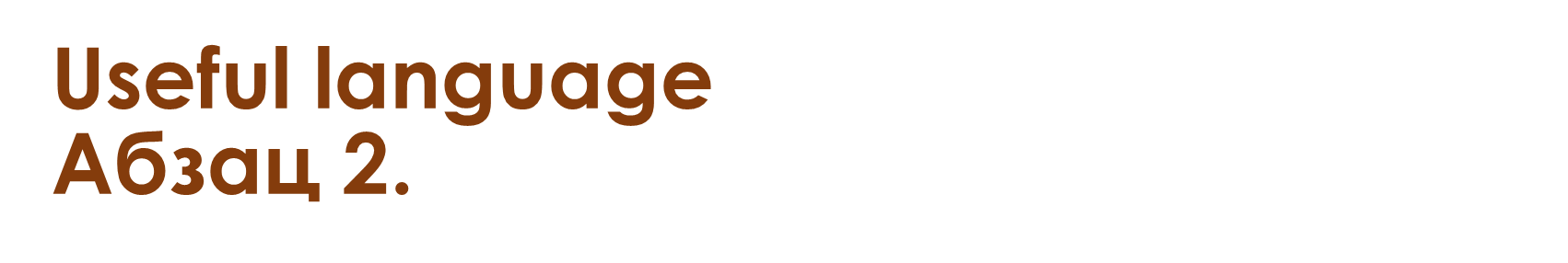

Slide 20
According to the data given in the table, ..
According to the results of the opinion poll, …
To begin with, I would like to say that…
As it can be seen from the table / the pie chart, …
According to the table/ diagram, ….
One can see from the table/diagram that...
The results show that the largest percentage of participants express a preference for …, whereas … appeared to be ….
The table / diagram demonstrates …

Slide 21


Slide 22
… % of the respondents … , while only … % of the questioned ... .
… by 3 % more/less/higher/lower than
According to the found data, …
The statistics allow me to make some comparisons.
In comparison with … , … .
In contrast, ... .
... , whereas/while/although ... .
It is evident that the percentage of the respondents who…
Further analysis reveals that …
The data analysis reveals that…
The results of the opinion poll allow me to make some comparisons…
Studying the table / pie chart in detail, one can see that ... .
According to the data, ....
… is twice as … as … .
… is much more … than … .
… is less … than ... .
… is the least … of all the ... .
… the difference between … is … %.

Slide 23
It is worth mentioning that …, whereas the number of … who … is nearly … times the number of those who … and about … times the number of participants who are interested in …
In terms of …, … percent of the interviewees … which is comparable with … but noticeably more than …, which accounts for … percent.
However, there is a difference of … % among the people who … and …
It may show that …% of those who … whereas …% represents that …
According to the data given in the table/diagram, … appear to be more popular than …

Slide 24
Another important thing to mention is that … are almost as popular as … - the difference between them is … %.
There is such a difference in the percentages since ... .
The percentages are predictably almost identical as ... .
It is quite surprising that …
Such a slight difference in the number of voters can be caused by…
It/This distribution demonstrates/shows that…

Slide 25
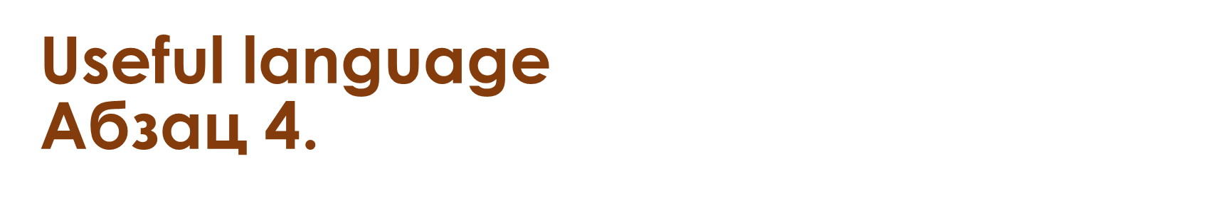

Slide 26
The best way to deal with this problem is to ... .
Another method is to…
It will lead to…
For example,…
Undoubtedly, …
It is important /significant /crucial to note that…
There is a problem that…
One problem that can be connected with … .
There is a problem connected to the subject of the project which is … .
There is a problem that is often faced/experienced by … .
One issue that is associated with ... .
The biggest problem with ... is that … .
One solution to this problem is to … .
The best way to solve this problem is to ...

Slide 27


Slide 28
In conclusion, …
To sum up, …
All in all, ..
To summarise, …
Personally, I believe that … because …
As far as I am concerned, …
I am convinced that…
To my mind, …
From my point of view, …
In my opinion, …
I would like to express my opinion on …

Slide 29

Наши пособия

Slide 30

Наши пособия

Slide 31

Exam-SIMULATOR.ru
Преимущества нашего тренажёра:
Сертифицирован ФИПИ
Авторские варианты
Хранение аудиозаписи
Отправка записи любым удобным способом
И многие другие!

Slide 32



EXAM-SIMULATOR ВСЕГДА НА СВЯЗИ!
https://vk.com/club213103444
https://exam-simulator.ru/
https://t.me/exam_simulator

Slide 33









Наши
социальные сети

