Slide 1
Уроки, на которых говорят по-английски. Как мотивировать учеников?
Марианна Юрьевна Кауфман автор курса «Happy English.ru»
Master of Arts in Sociolinguistics

Slide 2
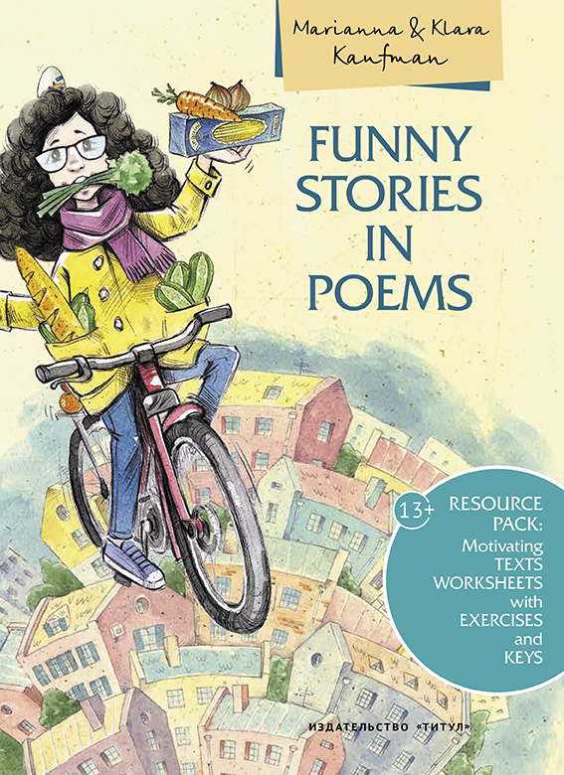




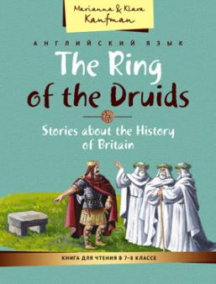
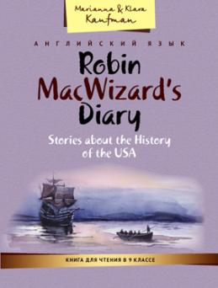





ПОСОБИЯ

Slide 3




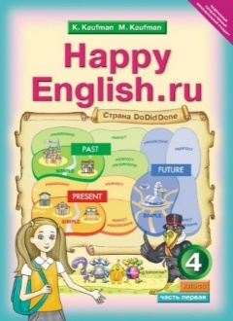








УЧЕБНИКИ

Slide 4
Единицей деятельности говорения является речевое действие, входящее в структуру говорения. Если продуктом деятельности говорения является целое высказывание (текст), то речевыми действиями, создающими этот продукт, являются фразы как относительно законченные коммуникативные смысловые образования.

Slide 5
В плане содержания говорение можно разбить на следующие иерархические единицы
: 1) логико-синтаксические структуры; 2) лексические «функции» (или семантические связи слов); 3) грамматические структуры (или модели); 4) лексические единицы – значимые слова.

Slide 6
При овладении родным языком ребенок интуитивно овладевает всеми четырьмя уровнями единиц в процессе общения. Л. С. Выготский : «Ребенок идет «снизу вверх»: от речевых реализаций и отдельных слов к грамматическим структурам (моделям), к операциональному выявлению лексических функций и к уяснению (интуитивному) основных логико-синтаксических структур.» Школьное обучение помогает ему осознать то, чем он уже владеет.
Овладевая иностранным языком, человек, как отметил Л. С. Выготский, идет «сверху вниз». Этот путь –путь осознания иерархии самих единиц.
Таким образом становится очевидно, что овладение единицей деятельности говорения – речевым поступком – предполагает отработку многих единиц логического, семантического, грамматического и фонационного уровней.

Slide 7
Возможные проблемы
Стимулировать у учащегося возникновение мысли – предмета высказывания.
Создать мотивирующую обстановку.
Обеспечить учащихся инструментами для организации и соподчинения всех единиц говорения для обучения выражению мысли, реализующей речевой поступок на иностранном языке.

Slide 8
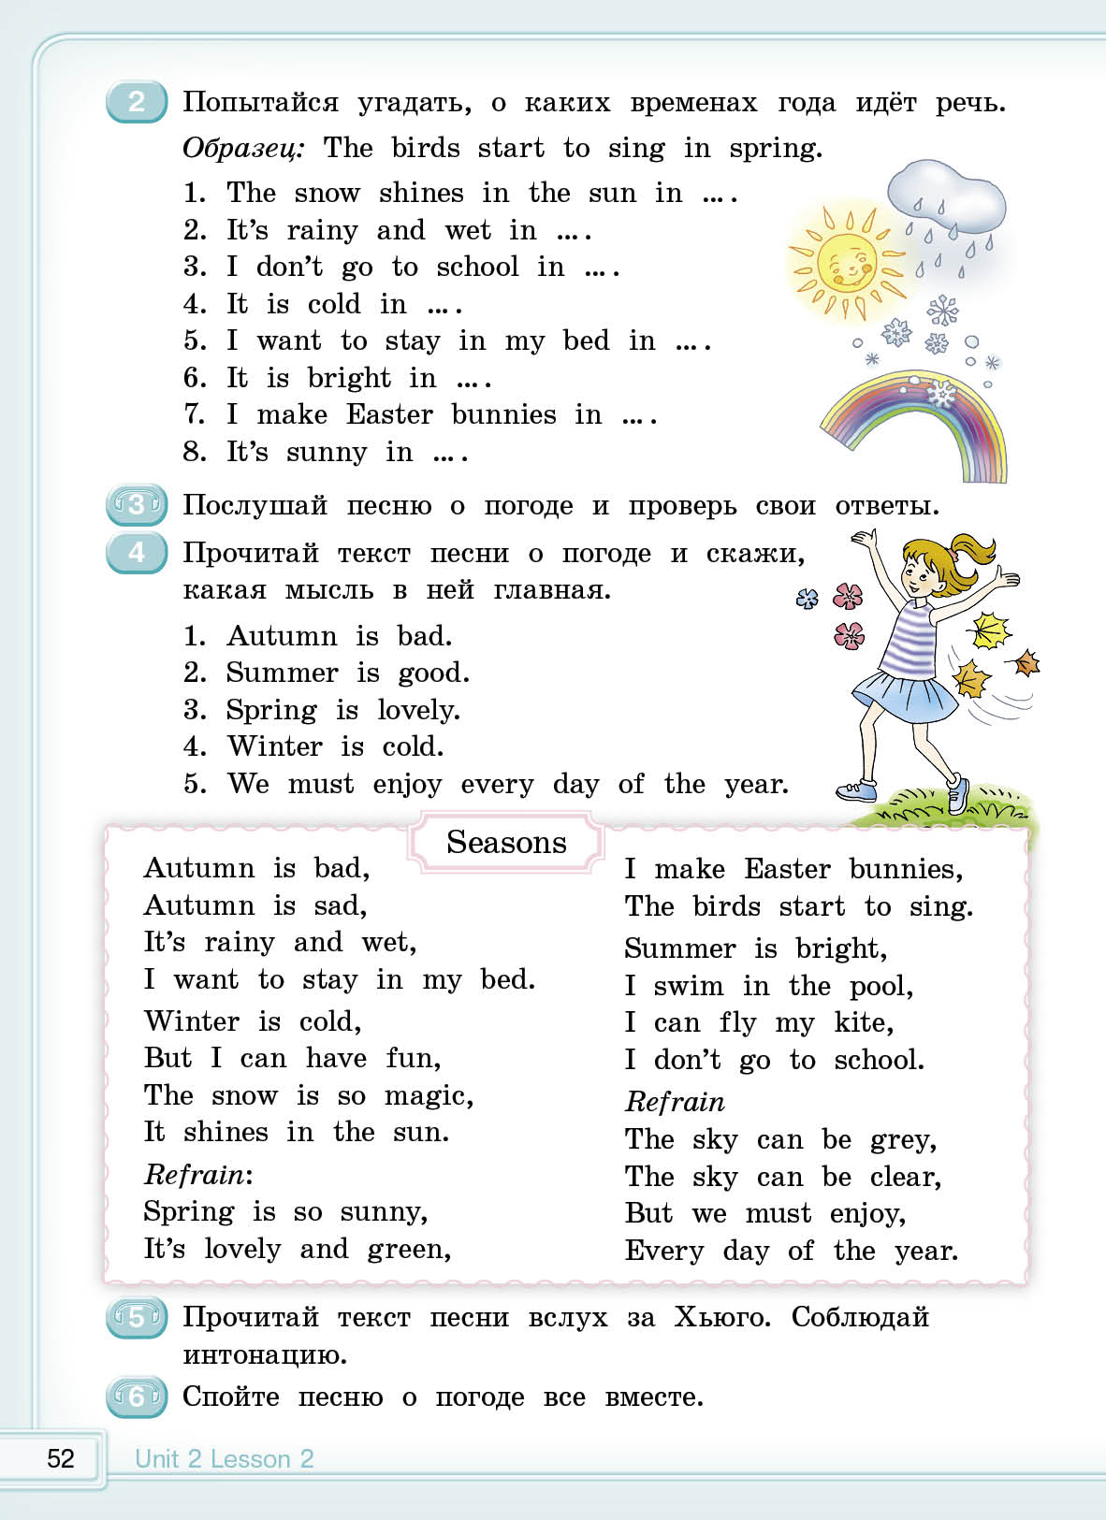


Slide 9



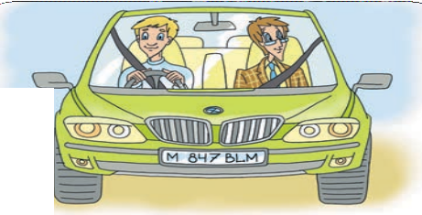















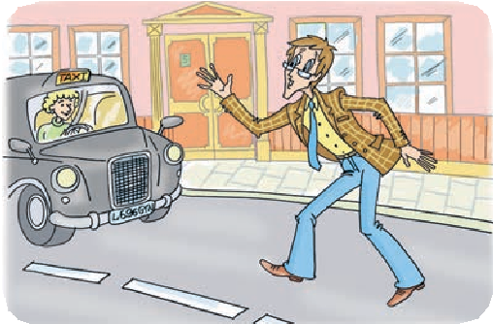


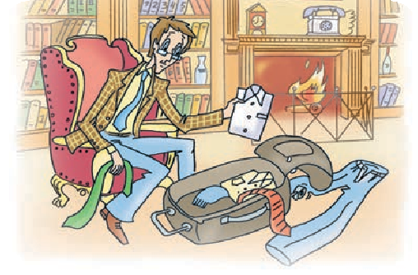
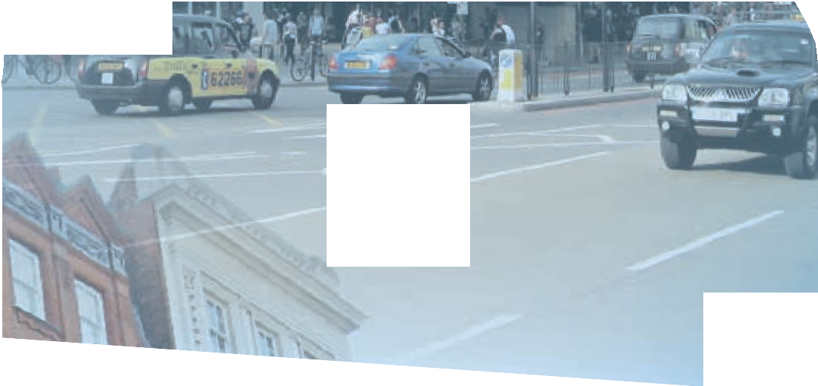


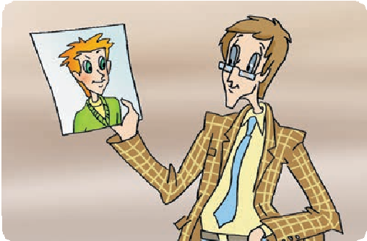




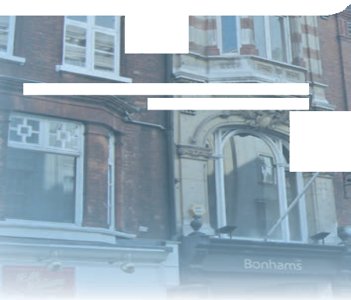








5. 6. Описание иллюстрации: Кьют едет в
машине за рулем мужчина
6
An old friend wants to drive Cute to the airport. Go to the
n h
Start
airport. (Square 13)
e
t
C
g
u
A
t
e
i
n
s
w
s
o
a
i
y
5. 5. Описание иллюстрации: Кьют пытается
ловить такси.
5
Agent Cute can’t get a taxi.
Miss a turn. (Пропустите ход.)
5. 1. Описание иллюстрации: Кьют пакует
рюкзак у себя дома в Оксворде
1
Agent Cute is at home.
Help agent Cute pack his suitcase.
Agent Cute doesn’t know a lot of things
4
about Rob MacWizard. Help him write some questions about Rob for his boss.
5.2. Описание иллюстрации: кьют покупает фут-
болки в сувенирном магаизне
Agent Cute wants to take some souvenirs to his new Russian friends.
What can he take with him?
5. 3. Описание иллюстрации: Кьют рассматривает
Мишину фотографию
2
3
Agent Cute doesn’t know a lot of things about Misha Inin. Help him write some questions about Misha for his boss.
138 Unit 5 Lesson 8

Slide 10




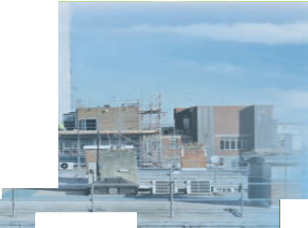



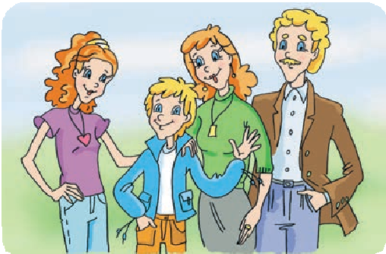

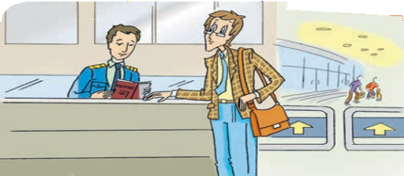









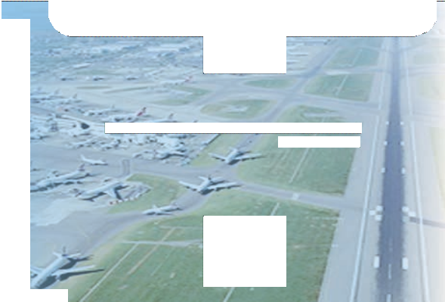




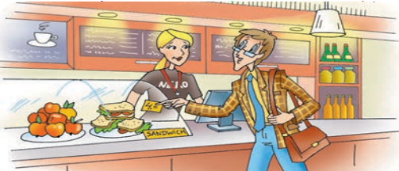
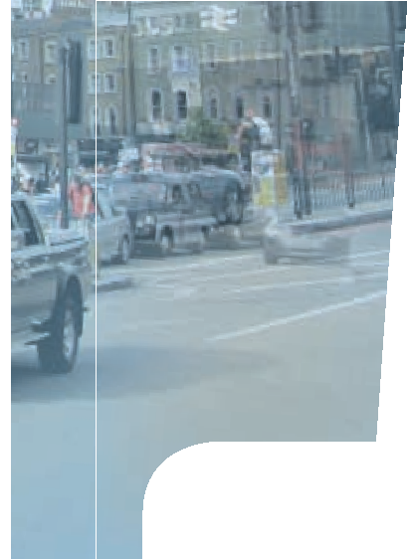
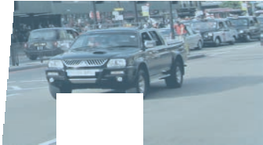


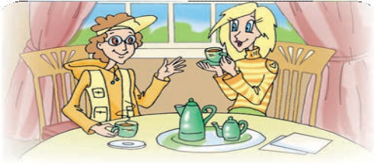

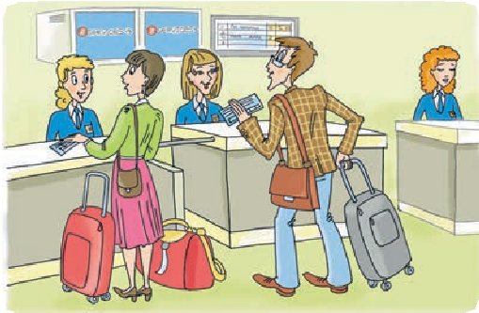











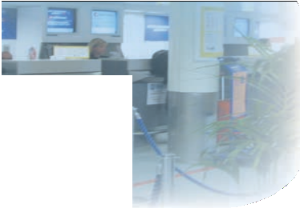
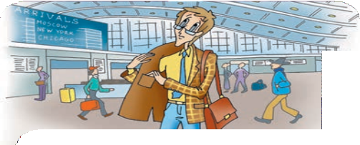







7
Tell agent Cute about Misha Inin.
13
He’s at passport control.
Give him instructions.
ние иллюстрации:
Ро
5. 8. Описа
б
р
каф .
5. 12. Описание иллюстрации: Кьют покупает
сэндвич в кафе
8
Tell agent Cute about Rob MacWizard.
12
He’s hungry. Give him instructions.
5. 9. Описание иллюстрации: Марк и Рози
9
Tell agent Cute about Rob’s
brother and sister.
11
Agent Cute is at Heathrow Airport. He wants to check in. Give him instructions.
5. 10. Описание иллюстрации: изображение в Хи-
троу кьют ищет билет
Agent Cute is at Heathrow Airport
Agent Cute is at Heathrow Airport. He hasn’t got a ticket. Go back ho e. (Square 4)
10
.
me.
Unit 5 Lesson 8
139

Slide 11

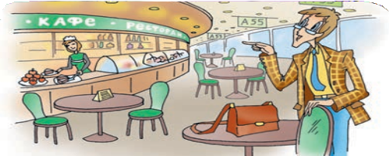




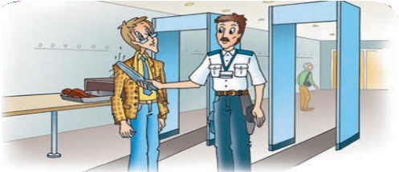











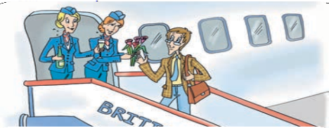











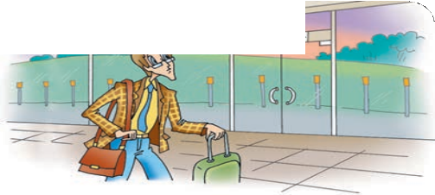






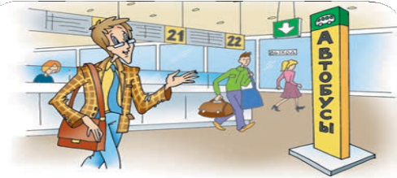

Agent Cute is at Domodedovo Airport.
₂₀ Help him translate the words
“ресторан, кафе”.
5. 14. Описание иллюстрации: Агента кьюта про-
веряет охранник.
14
Agent Cute is at security control.
Give him instructions.
19. Agent Cute is at Sheremetyevo Airport.
Help
him translate the word “стойка информац
.
info
n
ии”
(information d
esk)
5. 15. Описание иллюстрации: Агента кьюта встречают цветами и шампанским при входе в
самолет.
19
Agent Cute is at Domodedovo
Airport. Help him translate the word
“информация”.
15
Agent Cute is the first passenger on a new British Airways plane.
Go to square 21.
Agent Cu at
e Airpo p
а бус
18. Agent Cute is at Sheremetyevo Airport.
Help him
Agent Cute is at
translate the word “автобусы”.
(buses)
Domodedovo
5. 22_{A}. Оп_{i}и_{r}са_{p}ни_{o}е и_{r}лл_{t}юстрации: оформить пункты 18-
16. Agent Cute is at Shere2m3 eсtоyоeтvoвеAтirсpтoвrtу.юHщelиpмhиimзнtаrкaаnмslиate
the word “выход” (exit)
Agent Cute is at Domodedovo Airport.
18
Help him translate the word “такси”.
s at Sh
ety Airport. Help him e h ord “т и”. (t )
16
Agent Cute is at Domodedovo Airport. Help him translate the word “выход”.
17. Agent Cute is at Sheremetyevo Airport. Help him
translate the word “такси”.
(taxi)
17
Agent Cute is at Domodedovo Airport. Help him translate the word “автобусы”.
140 Unit 5 Lesson 8

Slide 12
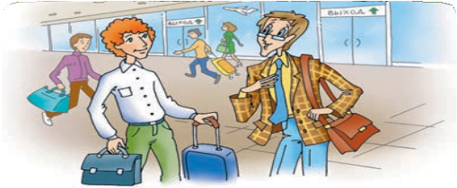





















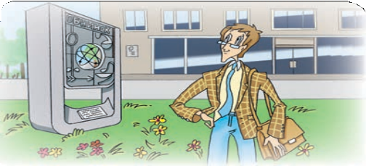
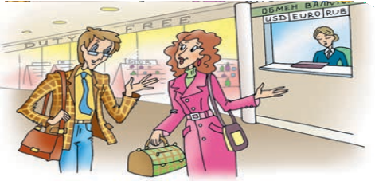













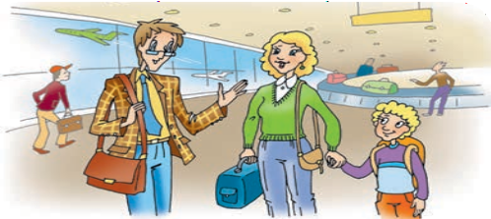
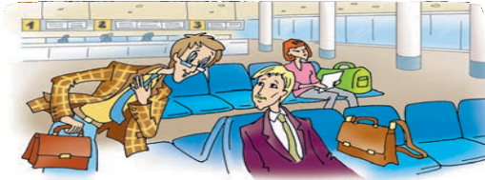
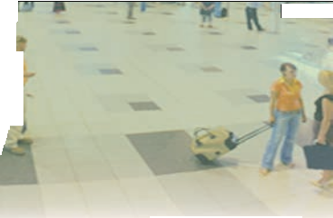










21. Agent Cute is at Sheremetyevo Airpor
rt. Help him translate
. rency exchange)
the word “обмен валюты”
(cur
21
Agent Cute is at Domodedovo
Airport. Help him translate the words
“обмен валюты”.
Finish
22
Help agent Cute. Translate into Russian “Where can I get a taxi?”.
23. Help aageent Cute
. Tra
nslate into
Russian “Whhere can I exchange ssome money?”
5. 26. Описание иллюстрации: Нарисовать Кьюта в Обнинске
₂₃ Help agent Cute. Translate into Russian “Where can I exchange some money?”.
26 Agent Cute is in Obninsk.
25.. Help agent Cute. T
ranslate into Rus
sian “Where can I get
24. Help agent Cute. Translate into Russian “I donn’t speeak
Russian. Can you heellpp me?”
my baggage?”
Help agent Cute. Translate into Russian “I don’t speak Russian.
Can you help me?”.
25
Help agent Cute. Translate into Russian “Where can I get my baggage?”.
24
Unit 5 Lesson 8
141

Slide 13


Slide 14


Slide 15
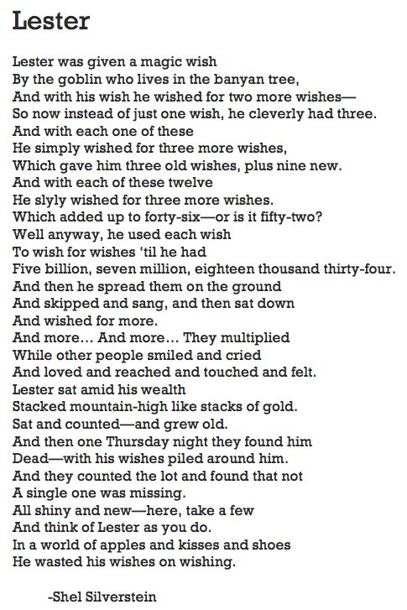

Slide 16
ЛЕСТЕР
Лестер гоблина нашёл в баньяне,
Тот исполнить обещал желанье.
Лестер смекнул, как использовать приз.
Желаю: «Пусть станет желаний три».
Потом с каждым новым желаньем опять
Желал он желанья на три умножать.
Три старых желанья плюс новеньких девять.
В итоге двенадцать — извольте проверить.
Потом он истратил все эти двенадцать,
Чтоб дальше желанья могли умножаться.
Но Лестер на этом не бросил желать —
Их стал триллион двадцать тысяч и пять.
Он стопками их на земле разложил,
Он хлопал в ладоши, кричал и вопил,
Он прыгал и пел, но потом вдруг опять
Он сел и продолжил желать и желать.
Желал и желал, и они умножались,
А люди в то время грустили, смеялись,
Влюблялись, гуляли под первым дождём,
А Лестер сидел на богатстве своём.
Желанья сверкали, росли, словно ком,
А он всё считал их и стал стариком.
Лестер был найден в пещере у скал.
Он мёртвым на куче желаний лежал.
Их вновь посчитали, и кто‑то заметил,
Что все до единого были на месте.
Теперь раздают их — бери же скорей,
Подумай о Лестере и пожалей.
Ведь в яблочном мире цветов и мечтаний
Он всё разменял на желанье желаний.

Slide 17
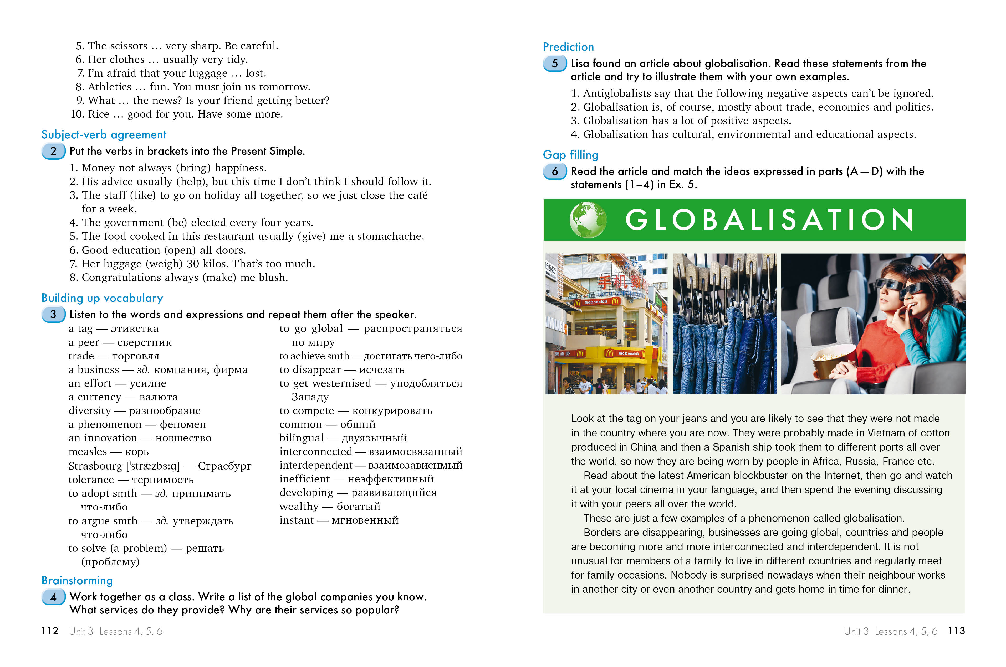

11 класс стр 112-117

Slide 18
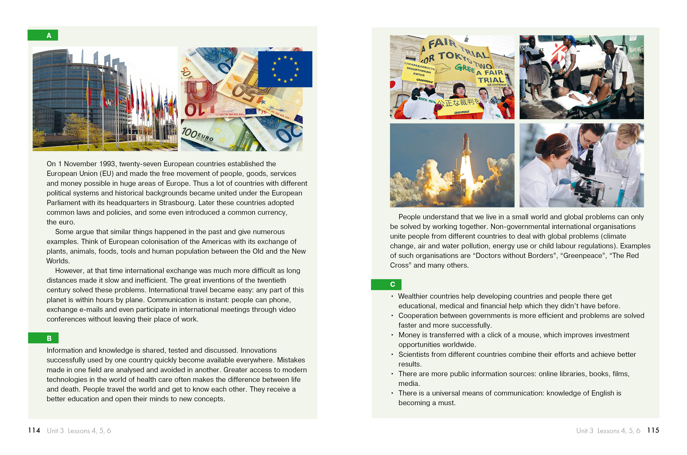
11 класс стр 112-117

Slide 19
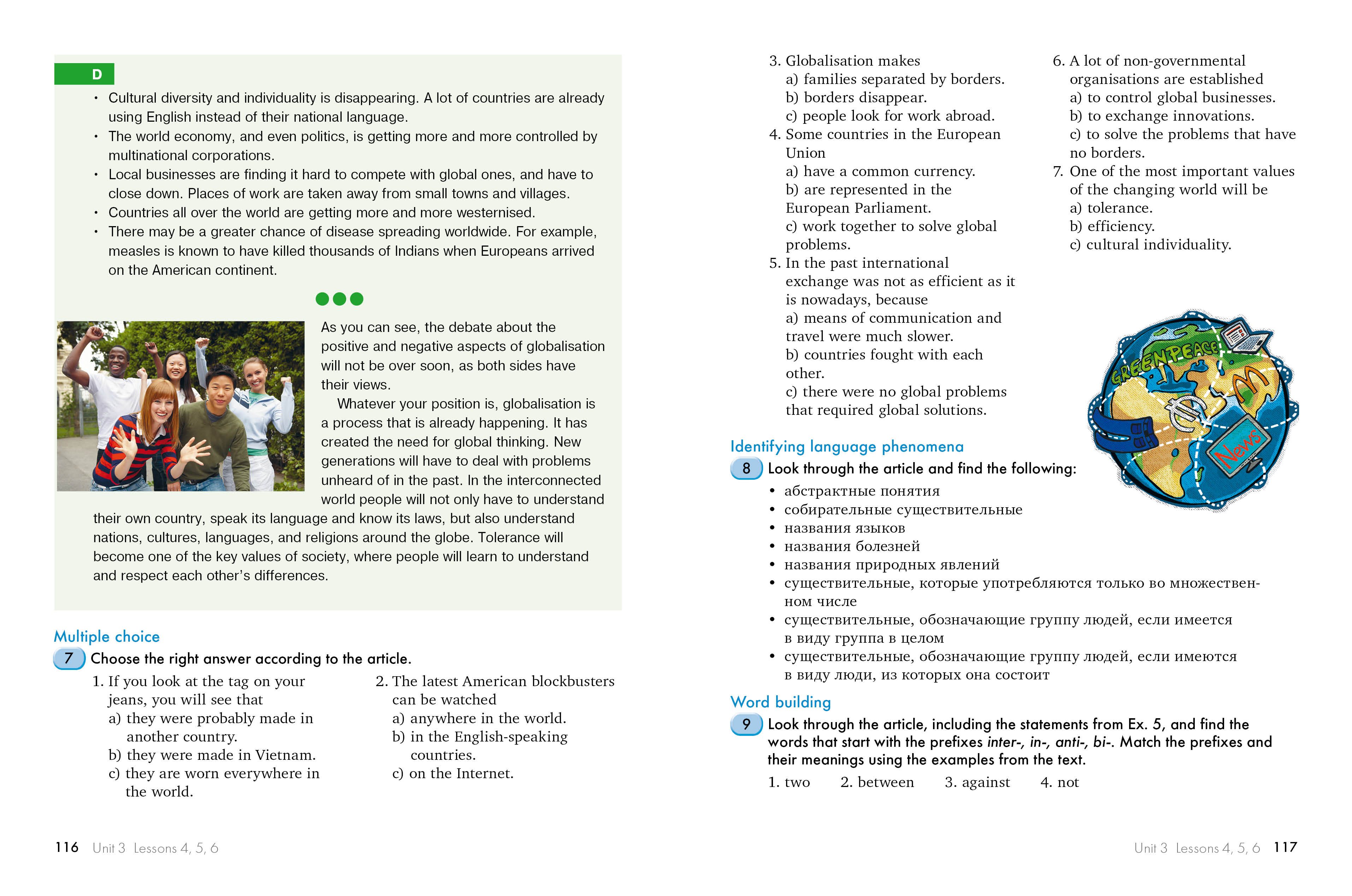
11 класс стр 112-117

Slide 20

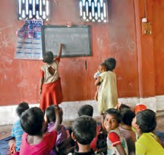
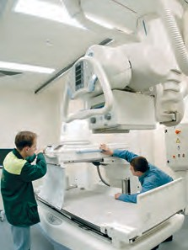

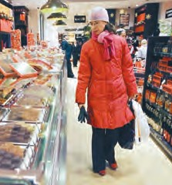
Choose between the noun and the verb in brackets and change the form if necessary.
  Western countries open schools (education / to educate) children from developing countries.
  This organisation will help improve (communication / to communicate) between the two countries.
  The scientists (achievement / to achieve) more than they could ever hope for.
  Our village shop couldn’t (competition / to compete) with the big supermarket which opened last year.
  A lot of people believe that (knowledge / to know) should be shared and exchanged.
  It’s important (information / to inform) people about the opportunities they have.
  There is still no (solution / to solve) to a lot of global problems.
Statement transformation
Write sentences with similar meanings using the words in brackets.
Model: I think we need to solve this problem immediately. (deal with) — I think we need to deal with this problem immediately.
  The technology you invented should be tested in our laboratory. (innovation)
  Let’s send our results to our colleagues and they will send their results to us. (exchange)
  I sometimes find it boring to spend time with people of my age. (peers)
  We need to be patient and understanding with him. He is very tired. (tolerant)
  Communication is very quick nowadays. (instant)
  A lot of animal species are very difficult to find nowadays. (disappear)
  I think I should take part in this meeting. (participate)
  They gave us access to secret information on their space programme. (make available)
  A new corporation was founded yesterday. (establish)
  This means of transportation is slow and expensive. (inefficient)
  Have you got any local money on you? (currency)
118
Unit 3 Lessons 4, 5, 6

Slide 21





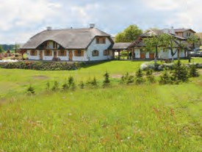
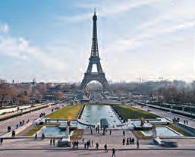
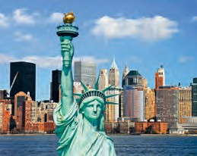
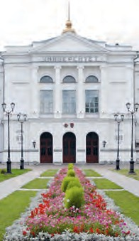
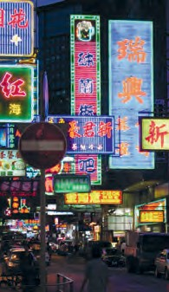
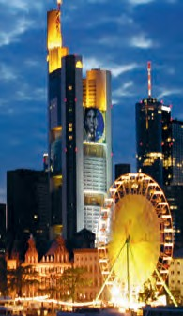
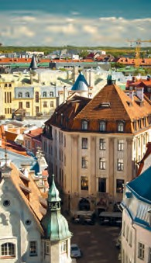




Listening and matching
14 Six teenagers from different countries were asked the following questions:
Can you say that you already live in the global village? What makes you think so?
What does living in the global village mean for you?
How would people and countries have to change to become part of the global village?
Is globalisation a good or a bad thing?
Listening and matching
15
Listen to the teenagers answering the questions and match their answers (1–6) with where they come from (A– G). There is one extra place with no match.
Mark which of them think they already live in the global village and which of them don’t.
A Poland
B France
С The USA
D Tomsk, Russia
E China
F Frankfurt, Germany
G Estonia
120
Unit 3 Lessons 4, 5, 6

Slide 22




Listen to the teenagers again and match their answers (1–6) with the following statements (A— G). There is one extra statement with no match.
A I live in the global village, because people from all over the world live in my city.
B People just can’t live in peace, because they are so different and racism exists.
C Globalisation may change my country forever and all our customs and traditions will be lost.
D Globalisation allows me to learn about different cultures without leaving my home town.
  The most important part of living in the global village is understanding the world’s problems and working to solve them.
  Living in the global village means countries helping each other and exchanging goods and services.
G The population of my city doesn’t include a lot of foreigners.
Listening for specific information
Listen to the teenagers once more and mark these statements True or False. Do you agree with the opinions expressed in the statements? Why?/
Why not?
A girl from Poland thinks that some international corporations are wealthier than some countries.
A boy from China argues that people holding different beliefs will soon learn to respect each other’s points of view.
A Russian girl thinks that it is necessary to speak English to be a part of the global village.
A boy from France believes that if you watch foreign films and eat foreign food, you don’t need to travel the world.
A girl from Frankfurt believes that her city has lost its identity, because there are so many different cultures represented there.
A boy from Estonia thinks that many countries live in peace with each other because they are interdependent.
Unit 3 Lessons 4, 5, 6
121

Slide 23
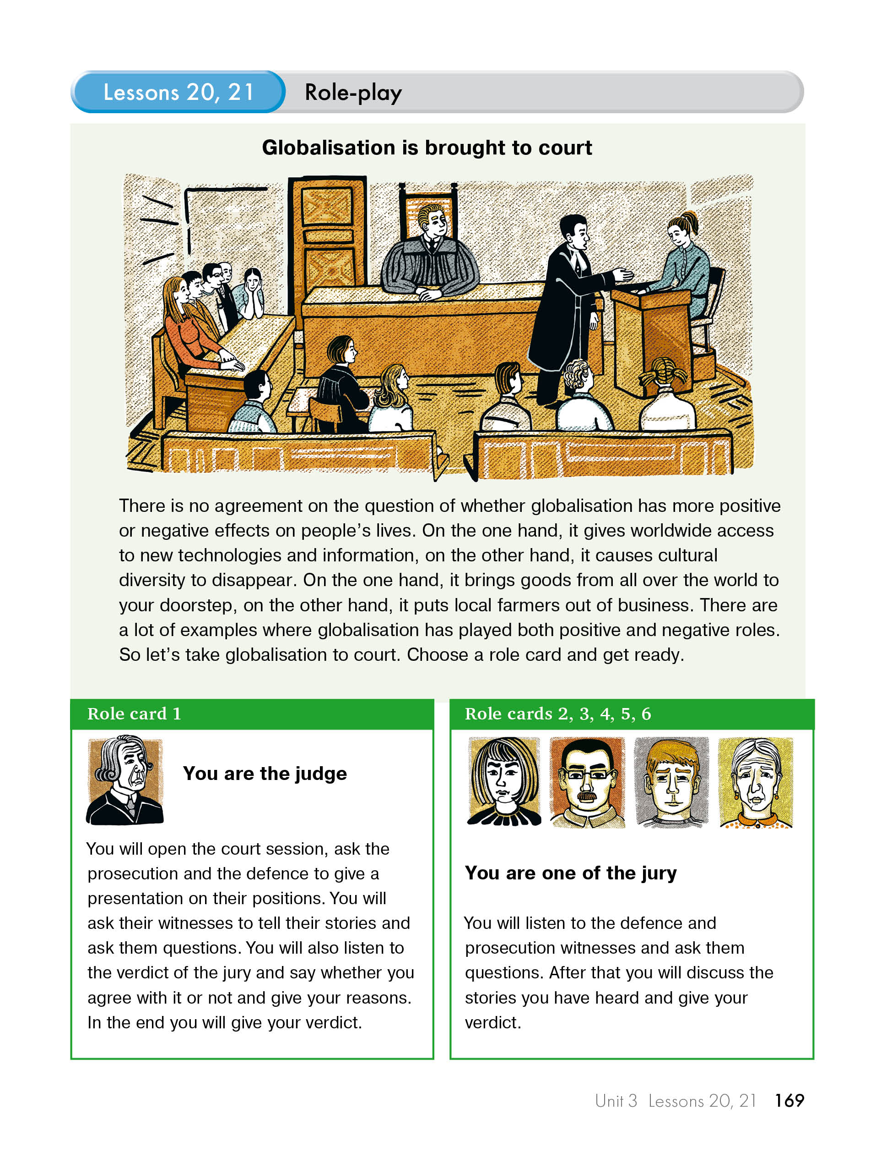
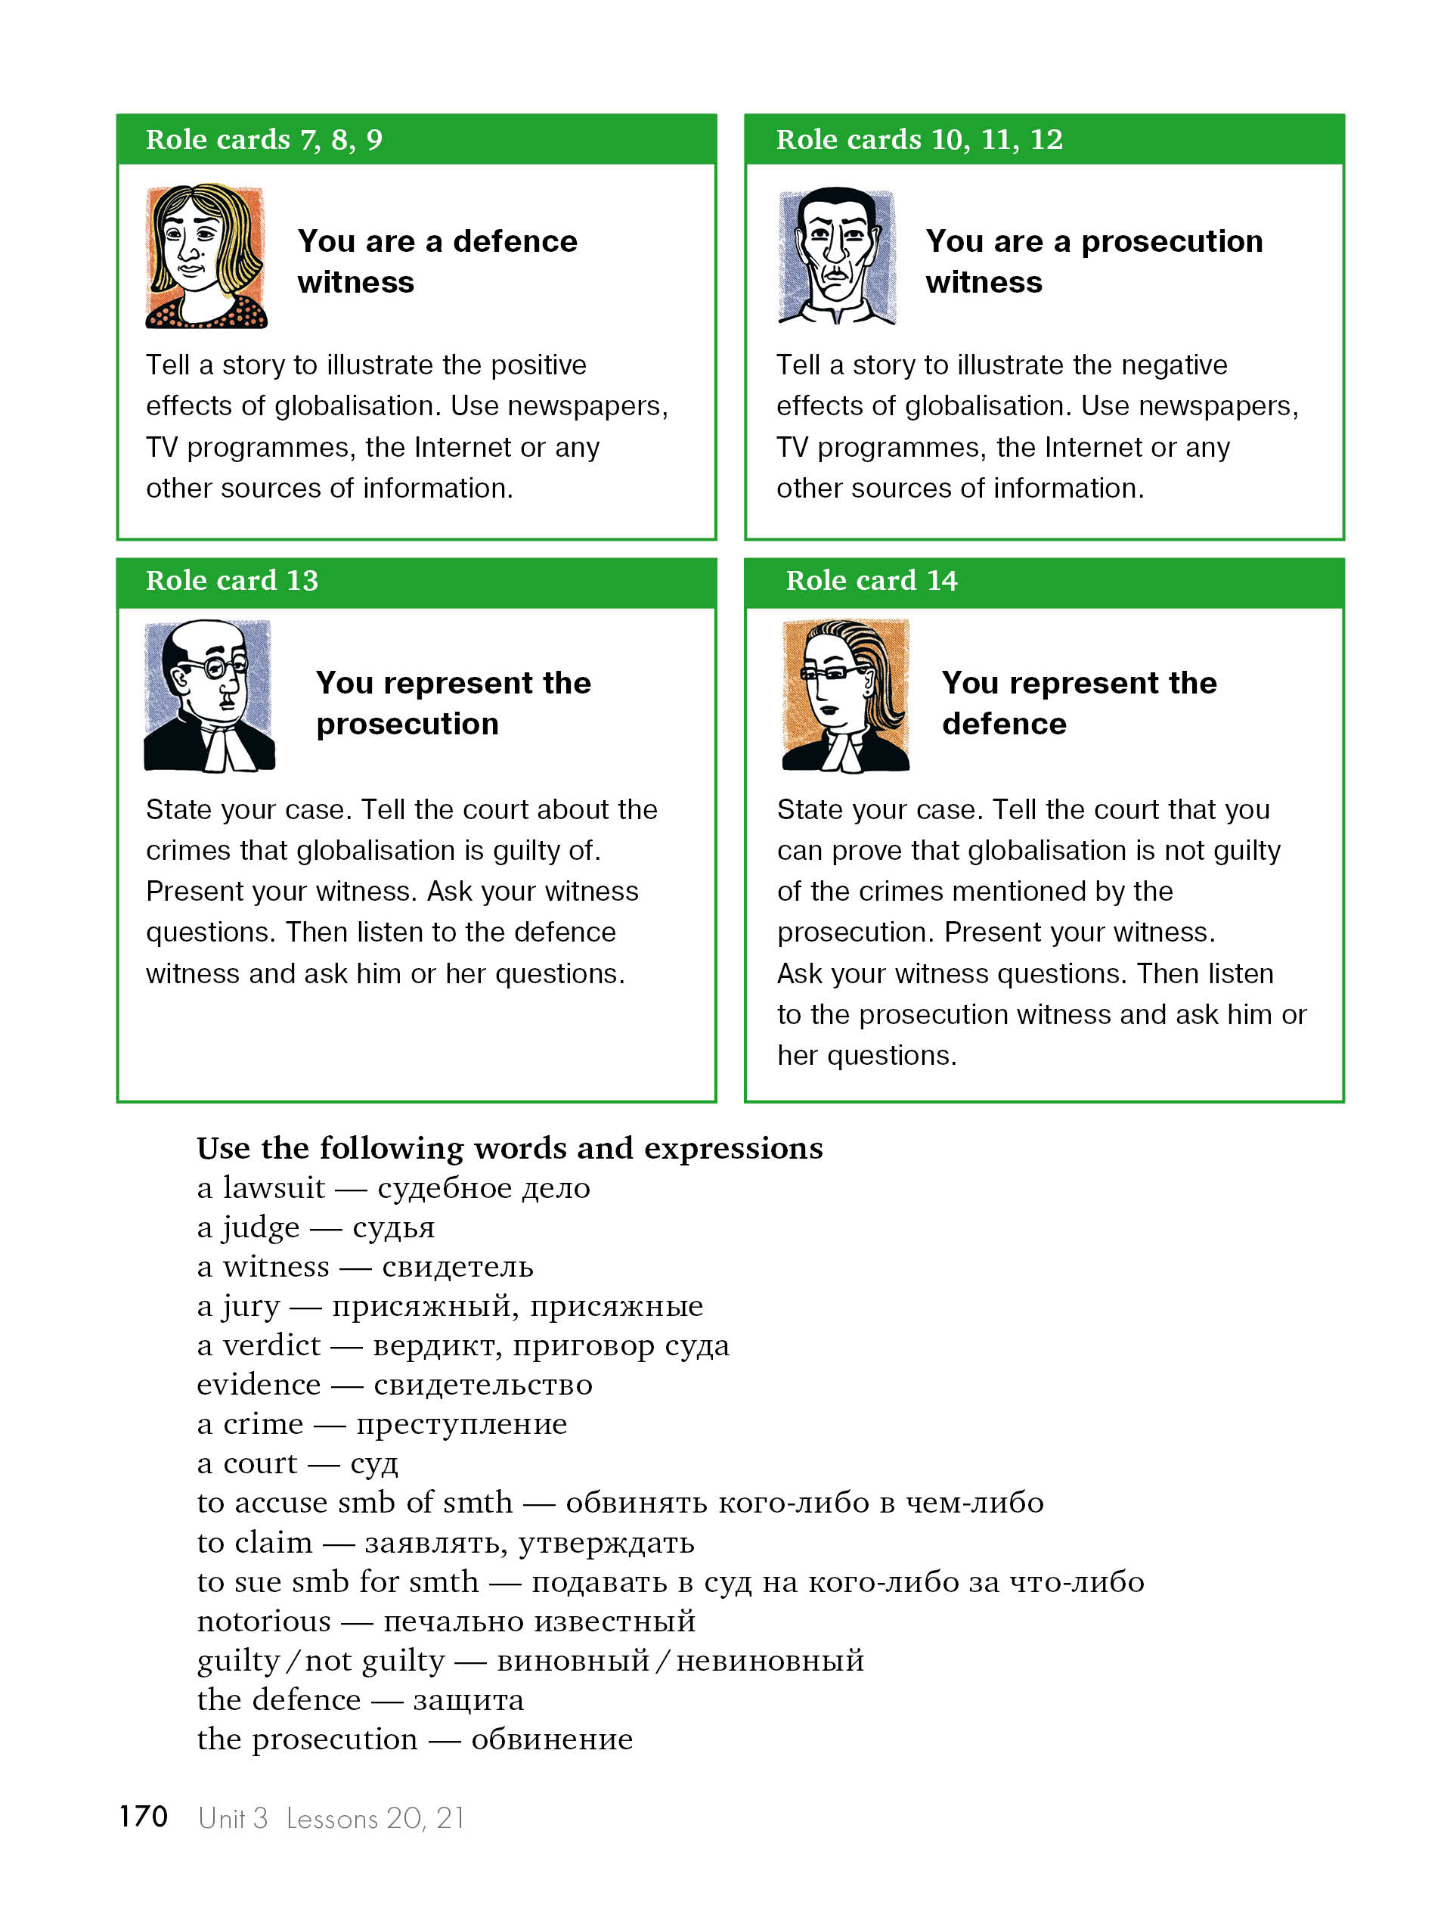

Slide 24







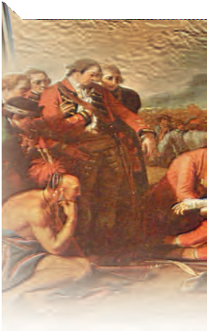
The Maple Leaf Forever
In Days of yore, from Britain’s shore, Wolfe, the dauntless hero came, And planted firm Britannia’s flag, On Canada’s fair domain.
Here may it wave, our boast, our pride, And joined in love together,
The thistle, shamrock, rose entwine, The Maple Leaf forever!
Chorus:
The Maple Leaf, our emblem dear, The Maple Leaf forever!
God save our King (Queen), and Heaven bless, The Maple Leaf forever!
At Queenston Heights and Lundy’s Lane, Our brave fathers, side by side,
For freedom, homes, and loved ones dear, Firmly stood and nobly died;
And those dear rights which they maintained, We swear to yield them never!
Our watchword evermore shall be, The Maple Leaf forever!
Our fair Dominion now extends From Cape Race to Nootka Sound; May peace forever be our lot,
And plenteous store abound:
And may those ties of love be ours Which discord cannot sever,
And flourish green o’er freedom’s home The Maple Leaf forever!
On merry England’s far-famed land, May kind Heaven sweetly smile; God bless Old Scotland evermore, And Ireland’s Emer’ld Isle!
Then swell the song, both loud and long, Till rocks and forest quiver,
God save our King (Queen), and Heaven bless The Maple Leaf forever!
122 Unit 3 Lessons 5, 6, 7

Slide 25
















Self-assessment
5 Read the Russian translation of the song and check some of your answers.
Кленовый лист навеки
Мы славу Вольфу пропоем — Отважному герою.
Он водрузил британский флаг Над нашею землею.
Трилистник и чертополох на нем в любви сердечной, И розы стебли оплели Кленовый лист навечно!
Припев:
Кленовый лист — наш добрый знак, Кленовый лист — вперед!
Пусть вечно царствует монарх и клена лист цветет!
В боях при Лунди, Квинстон Хайтс Отцы наши стояли,
За дом, свободу и любовь Дрались и умирали.
И то, за что лилась их кровь, Хранить клянемся вечно;
И тот же все у нас пароль: Кленовый лист навечно!
С пролива Нутка к мысу Рейс Раскинулась Канада,
Пусть будет мирным наш удел, Нам большего не надо.
И пусть мы будем жить в любви, В спокойствии беспечном;
Наш дом свободы осени Кленовый лист навечно!
Господь, храни наш дальний дом, Его солдат, матросов,
Шотландию благослови и Изумрудный остров.
Мы вместе песню пропоем, Пусть слышат горы, реки… Пусть вечно царствует монарх, Кленовый лист навеки!
Перевод Марианны Кауфман
Unit 3 Lessons 5, 6, 7 123

Slide 26









A competition.
Look closely at the words of the song and think about why this song never became Canada’s official national anthem? Be the first to write your answer and pass it to your teacher.
Information gap completion
Fill in the gaps with the right facts.
Sergey Mikhalkov, Sergey Mikhalkov and G. El-Registan, Stalin,
2000, The Russian People’s Prayer, after the October Socialist Revolution, until 1944.
It was … who wrote the modern State Anthem of the Russian Federation.
It was in … that the modern anthem was adopted.
It is … that was used as the national anthem before the October Socialist Revolution. This song was known by everybody as “God Save the Tsar!”.
It was … that “The Internationale” was chosen as a new anthem.
It was not … that “The Internationale” was replaced by a new anthem.
It was … who approved the new anthem in 1944.
It was … who wrote the lyrics for the anthem in 1944.
Presenting and discussing information
8 Group work. Talk about Russia. What is our national anthem? Who wrote it? Did our country use to have any other national anthems in the last 100 years? What is your favourite Russian patriotic song? Why? Is there a song which could be called an unofficial national anthem of Russia? Give reasons for
and against it.
124 Unit 3 Lessons 5, 6, 7

Slide 27


Discuss your answers to Ex. 6. Your teacher will tell you whose answers are politically correct. Then read this piece on political correctness.
For your information
The term “political correctness” or PC is not new to Western and particularly American society. To be politically correct means to behave and speak in such way that you don’t offend anyone. For example, as a man you wouldn’t tell a dirty joke about women in front of a woman or you wouldn’t make fun of a particular ethnic group to a person who was part of that ethnicity. In the past we called this politeness but nowadays it’s called “political correctness”. The idea to show respect to everybody is good, but as it so often happens, people soon started to overdo it. Many American men never open a door for a woman, or offer to pay for her in a restaurant anymore because they don’t want to offend her. You may ask: How can opening a door offend anybody? Some women think that if a man opens a door for a woman, he demonstrates to her that he thinks she is weak and can’t take care of herself.
Political correctness has changed the language too. Older people are not called “old” anymore because it may offend them, so they are officially called “senior citizens”. But a lot of people think political correctness is nonsense. In fact, the term is sometimes used ironically, especially when somebody uses awkward language instead of more traditional words to describe someone.
Guessing meaning
This is a list of politically correct expressions which are generally used in modern English. Try to match these expressions with their more traditional equivalents.
Model: an old person — a senior citizen
a peacekeeper
a rainforest
an African American
a law enforcement officer
a differently abled person
a Native American (US)
a differently sized person
a mentally challenged person
an intellectually challenged person
a letter carrier
a newcomer
a soldier on a mission abroad
a postman
an invalid
a slow learner
a mad person
a Negro
a jungle
a fat person
an Indian
an immigrant
a policeman / a policewoman
Unit 3 Lessons 5, 6, 7 125

Slide 28
Наши социальные сети

