Slide 1
MAKING LEARNING FUN AND EFFECTIVE,
TEACHING EASIER.
DEVELOPING PRODUCTIVE SKILLS.

Slide 2
CAMBRIDGE ENGLISH TEACHER COMPETITION
CAMBRIDGE ASSESSMENT ENGLISH & CAMBRIDGE UNIVERSITY PRESS
Отборочный тур: 13 сентября 2021 г. – 1 декабря 2021 г.
Финальный тур: 13-20 декабря 2021 г.
https://urok.1sept.ru/contests/cambridge-english-teacher

Slide 3
What is writing?
The teaching of writing has assumed much greater importance in recent years with the arrival of new forms of rapid written communication. This means that we need to pay more attention to helping students learn how to write well than previous generations of teachers did.
… writing cannot normally be ‘picked up’ but has to be systematically taught. This means that we actually need to devote a lot of attention to teaching it, even though it is actually used by most people far less than the other skills.
Penny Ur. A Course in English Language Teaching

Slide 4
WRITING PROCESS
Pre-writing
Writing/Revising
Proofreading
Getting feedback
from the teacher
Exchanging drafts
with peers
Reorganising ideas
Adding, changing or
removing parts of the
text
Changing words and
expressions
Checking punctuation
and spelling
Checking grammatical
inaccuracies
Brainstorming
ideas
Selecting ideas
Planning
Organising
Final
version

Slide 5
Motivating students before writing (levels B1-B2)
Get them interested in the topic before they do a writing task
Discuss the topic
Ask and answer questions about the topic
Brainstorm ideas around the topic
Elicit relevant vocabulary
Notes:
Elicit ideas about how to motivate students before doing a writing task, then show the points on the slide.

Slide 6
Writing problems
Learners don’t include all of the points in the question when they are writing their answers.
Learners produce writing that is not well organised. They move from one point to another and then back again.
Learners give in work that has a lot of mistakes that they could correct themselves.

Slide 7




Slide 8
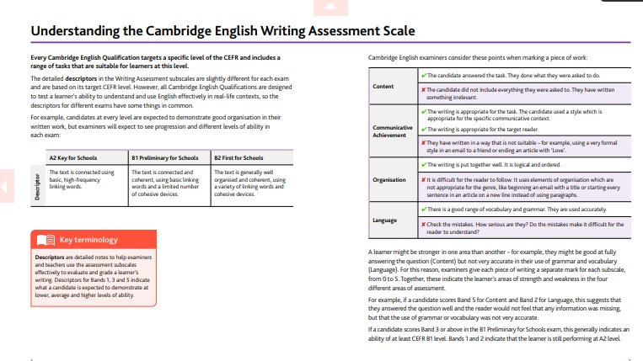
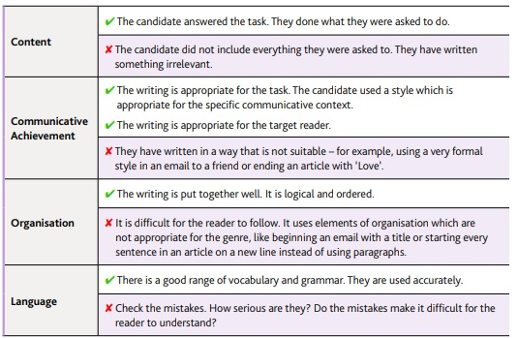
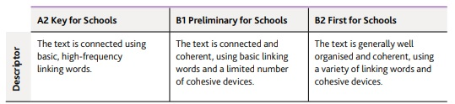
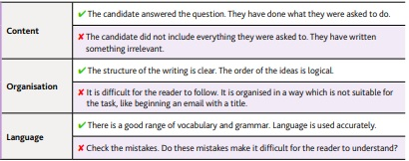

Slide 9
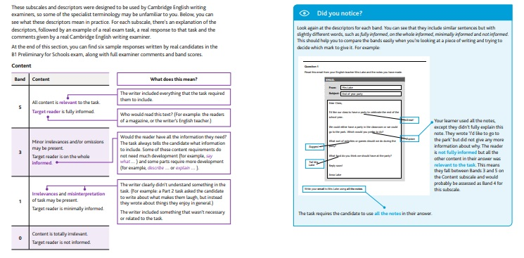

Slide 10
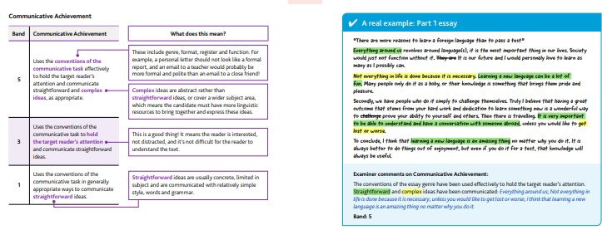
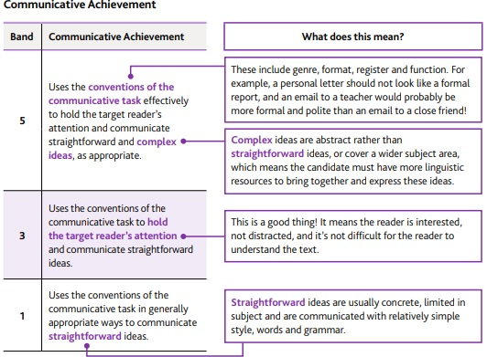
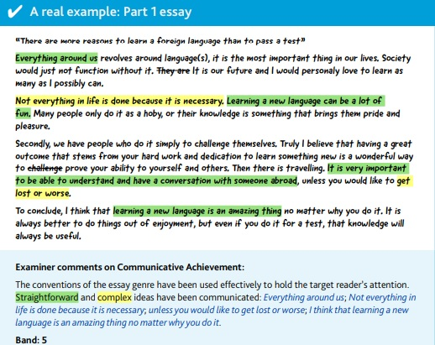

Slide 11
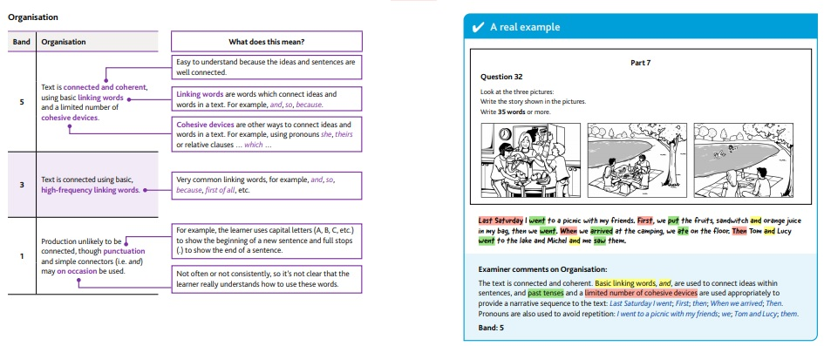

Slide 12
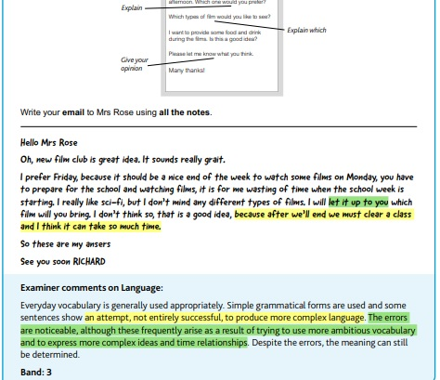
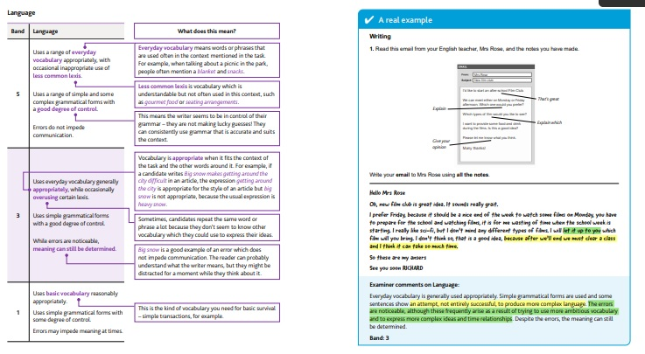
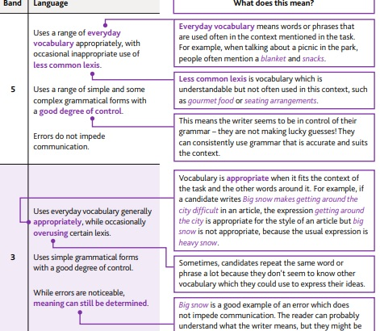

Slide 13
writeandimprove.com
Notes:
Write&Improve is an online tool from Cambridge Assessment English. It evaluates a piece of writing and provides instant feedback. You need to register, but it's free. There's a video on the home page, which goes through all of the functionality, so you can see exactly how it works.

Slide 14
Notes:
Once you've registered, choose your task from those on offer. There are options for both Beginner and Intermediate. Both have suitable tasks for Key and Preliminary.

Slide 15
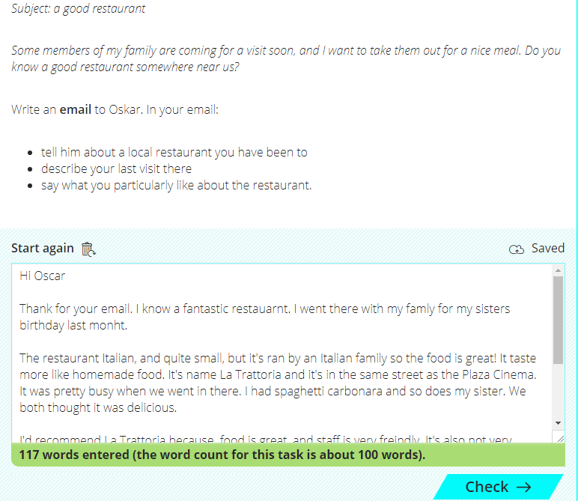
Notes:
Once you’ve chosen a task, your students write or upload their text, and submit their writing for feedback. This one is an email from a friend asking for information about a good restaurant. It is similar to the email writing tasks in both Key and Preliminary. The writer must write an email including 3 pieces of information. It tells you how many words you’ve written.

Slide 16
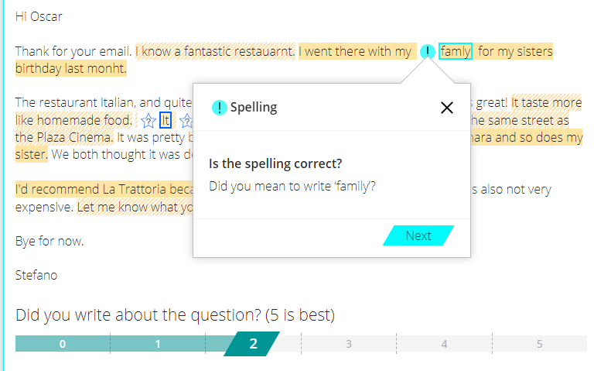
Notes:
The Write&Improve tool then gives feedback on your students’ writing. Using the suggestions from the system, students can gradually improve their writing. Here spelling is highlighted, and a suggestion given.

Slide 17
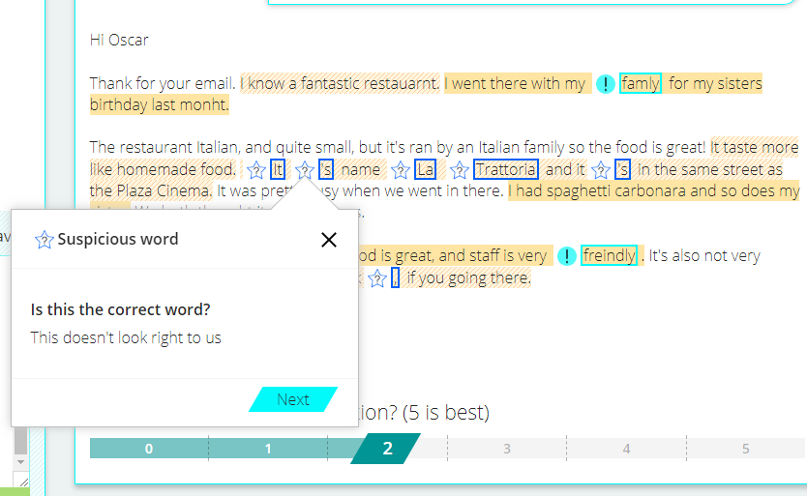
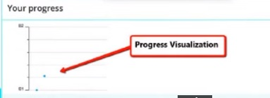
Notes:
This time it focuses on a word that looks wrong. Once a student has made some changes they can submit their writing again.
Your students can also use Microsoft Word to help identify basic spelling, punctuation and grammar errors (shown with red and blue wavy lines) and to self-correct, if they set the language to English.

Slide 18
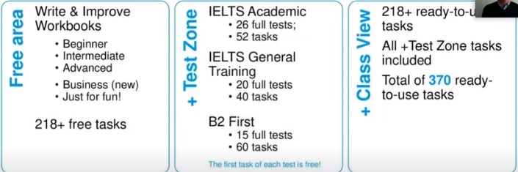
Write&Improve
Webinar Help your students improve their writing skills with Write&Impove on
YouTube Cambridge Assessment English channel

Slide 19
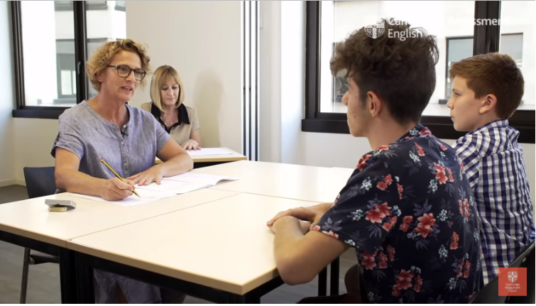
SPEAKING

Slide 20
What constitutes an A2 level speaker?
The kind of situations the speaker is in (predictable / familiar / unfamiliar / unexpected) | Very familiar or highly predictable situations
Length of utterances | Tend to be very short – words or phrases
Accuracy/range | Some control of simple grammatical forms and appropriate vocabulary
Hesitation | Frequent hesitation and pauses
Pronunciation | May at times be difficult to understand
Command of the spoken language | Basic command
Notes:
Summarise what is expected in the Speaking Test at this level. Remind participants that the test is based on a vocabulary list which can be found on cambridgeenglish.org, and a set of language specifications (including grammar, functional language and topics) which can be found in the A2 Key/A2 Key for Schools Handbook for Teachers.
(Note that this is from the Cambridge English Common Scale for Speaking)

Slide 21

ASSESSING SPEAKING (A2)
Grammar and Vocabulary (control, range, appropriacy)
Pronunciation (intonation, stress, individual sounds)
Interactive Communication (initiating, responding, development)
Global achievement (overall effectiveness)
Notes:
How is Speaking assessed? We’re going to use A2 Key for Schools as the example. Do you know the criteria that examiners use to assess Speaking at A2 level?
Click to show the first three criteria, which are used at A2 level: Grammar and Vocabulary, Pronunciation and Interactive Communication. Interactive communication at this level refers to the candidate’s ability to maintain a conversation.
Click to show Discourse Management which is used at B1 level and above: this refers to assessing the student’s ability to produce extended stretches of language.
Click to show Global Achievement. There are two examiners in the room when the Speaking exam is taking place: the assessor, who is just listening, and assessing, and gives a mark for each criterion; the interlocutor, who manages the test, gives a global achievement mark.

Slide 22
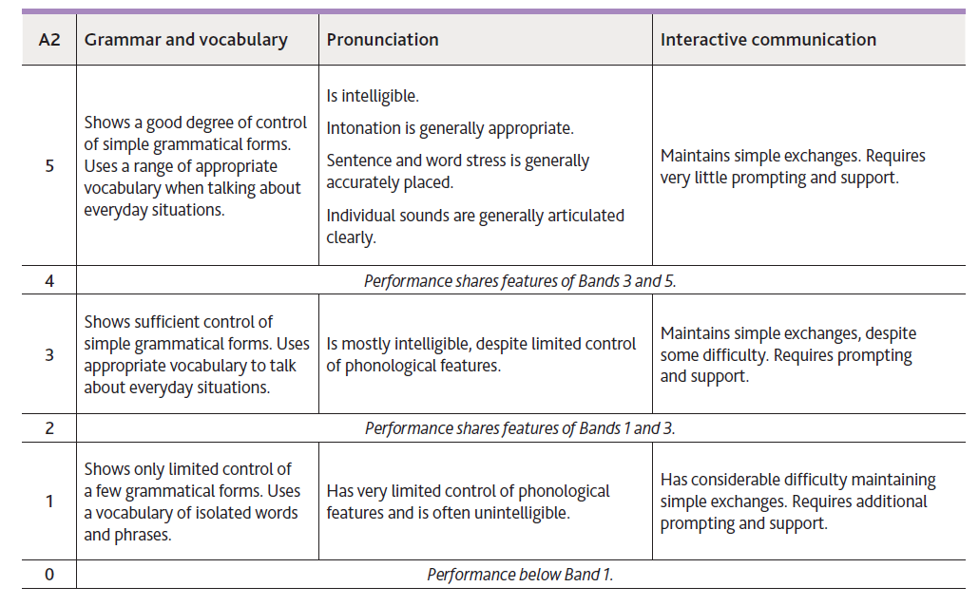
Assessing Speaking (A2)
Notes:
The Assessor uses a more detailed assessment criteria.
You can see the differences between what is expected at Band 5, Band 3 and Band 1. For example, in relation to grammar and vocabulary, a Band 5 candidate shows a good deal of control of simple grammatical forms, a Band 3 candidate shows sufficient control and Band 1 shows only limited control.
The assessor does not count errors or deduct marks for every mistake. They are focusing instead on how well the candidate communicates, so, in class, try not to worry about the mistakes your learners make, and think about whether their message is clear.

Slide 23
Assessing Speaking (A2)
BAND | A2 GLOBAL ACHIEVEMENT
5 | Handles communication in everyday situations, despite hesitation. Constructs longer utterances but is not able to use complex language except in well-rehearsed utterances.
4 | Performance shares features of Bands 3 and 5.
3 | Conveys basic meaning in very familiar everyday situations. Produces utterances which tend to be very short – words or phrases – with frequent hesitation and pauses.
2 | Performance shares features of Bands 1 and 3.
1 | Has difficulty conveying basic meaning even in very familiar everyday situations. Responses are limited to short phrases or isolated words with frequent hesitation and pauses.
0 | Performance below Band 1.
Notes:
This table shows the global achievement criterion at A2 level.
As you can see, even at Band 5, candidates are not expected to be perfect speakers of English. They are being assessed in relation to A2 level, so they are being assessed in the context of everyday situations, hesitation is expected and they are not expected to use complex language.
Notice the differences between Bands 5, 3 and 1: the types of situation, the amount of hesitation and the length of utterances vary.

Slide 24
What constitutes a B1 level speaker?
А2
The kind of situations the speaker is in (predictable / familiar / unfamiliar / unexpected) | Very familiar or highly predictable situations
Length of utterances | Tend to be very short – words or phrases
Accuracy/range | Some control of simple grammatical forms and appropriate vocabulary
Hesitation | Frequent hesitation and pauses
Pronunciation | May at times be difficult to understand
Command of the spoken language | Basic command
The kind of situations the speaker is in (predictable / familiar / unfamiliar / unexpected) | Familiar situations
Accuracy/range | Good degree of control of simple grammatical forms, range of appropriate vocabulary
Ability to organise discourse | Some extended discourse, mostly relevant, basic cohesive devices
Hesitation | Some hesitation and pauses while searching for language to express ideas
Pronunciation | Generally intelligible, but may at times put a strain on the listener
Command of the spoken language | Limited but effective command
Notes:
Summarise what is expected in the Speaking Test at this level. Remind participants that the test is based on a vocabulary list which can be found on cambridgeenglish.org, and a set of language specifications (including grammar, functional language and topics) which can be found in the B1 Preliminary/B1 Preliminary for Schools Handbook for Teachers.
(Note that this is from the Cambridge English Common Scale for Speaking)

Slide 25
What constitutes a B2 level speaker?
В1
The kind of situations the speaker is in (predictable / familiar / unfamiliar / unexpected) | Familiar situations
Accuracy/range | Good degree of control of simple grammatical forms, range of appropriate vocabulary
Ability to organise discourse | Some extended discourse, mostly relevant, basic cohesive devices
Hesitation | Some hesitation and pauses while searching for language to express ideas
Pronunciation | Generally intelligible, but may at times put a strain on the listener
Command of the spoken language | Limited but effective command
The kind of situations the speaker is in (predictable / familiar / unfamiliar / unexpected) | Able to handle communication in familiar situations
Grammatical accuracy | Generally accurate but some inaccuracies and inappropriate usage occur
Ability to organise discourse | Able to organise extended discourse but occasionally produces utterances that lack coherence
Hesitation | Maintains a flow of language, although hesitation may occur when searching for language
Pronunciation | Although pronunciation is easily understood, L1 features may be intrusive
Command of the spoken language | Generally effective command of the spoken language
Notes:
Elicit ideas and the talk through the slide to summarise what is expected in the Speaking Test at this level. We’ll be looking at this in more detail when we come on to Assessment, but first we’re going to move on to look at the format and tasks in the Speaking test.

Slide 26
ASSESSING SPEAKING CRITERIA (B1-B2)
Grammar and Vocabulary (control, range, appropriacy)
Pronunciation (intonation, (sentence)stress, individual sounds)
Interactive Communication (initiating, responding, development)
Discourse Management (extent, relevance, coherence, cohesion)
Global achievement (overall effectiveness)
Notes:
How is Speaking assessed? We’re going to use A2 Key for Schools as the example. Do you know the criteria that examiners use to assess Speaking at A2 level?
Click to show the first three criteria, which are used at A2 level: Grammar and Vocabulary, Pronunciation and Interactive Communication. Interactive communication at this level refers to the candidate’s ability to maintain a conversation.
Click to show Discourse Management which is used at B1 level and above: this refers to assessing the student’s ability to produce extended stretches of language.
Click to show Global Achievement. There are two examiners in the room when the Speaking exam is taking place: the assessor, who is just listening, and assessing, and gives a mark for each criterion; the interlocutor, who manages the test, gives a global achievement mark.

Slide 27
ASSESSING SPEAKING
Can be done informally or more formally
Use descriptors to asses rather than intuition
For informal assessment, it’s better to focus on one aspect at a time

Slide 28
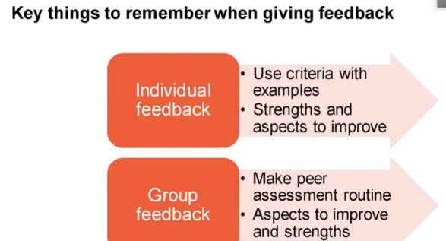

Slide 29
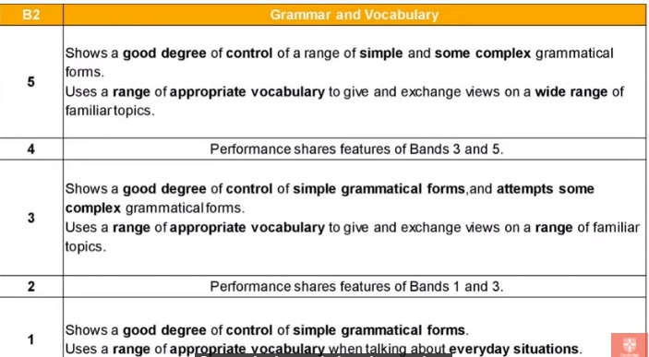
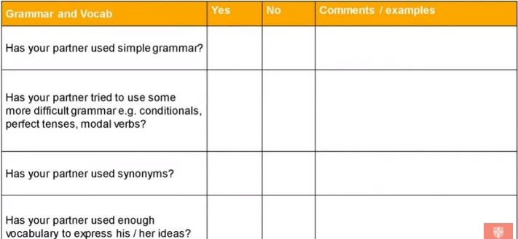

Slide 30
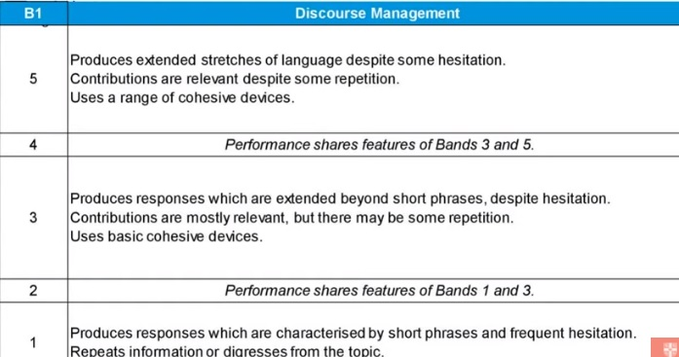
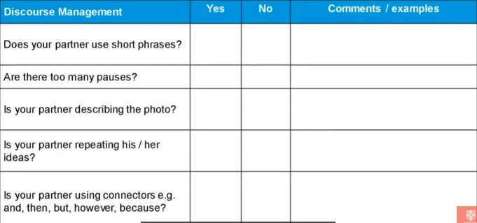

Slide 31
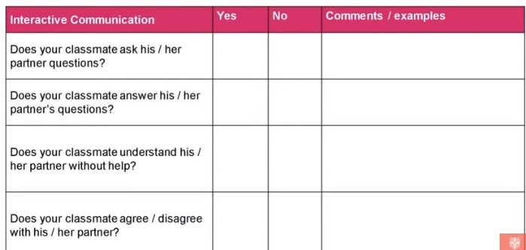
A2 | Interactive communication
5 | Maintains simple exchanges. Requires very little prompting and support.
4 | Performance shares features of Bands 3 and 5.
3 | Maintains simple exchanges, despite some difficulty. Requires prompting and support.
2 | Performance shares features of Bands 1 and 3.
1 | Has considerable difficulty maintaining simple exchanges. Requires additional prompting and support.

Slide 32
Self/Peer assessment
B1 Preliminary for Schools, Part 1 (interview)
Can anything be improved? In what way?
 | Yes | No
Did he/she give full answers (reasons, examples)?
Was their pronunciation clear enough?
 | Yes | No

Slide 33
B1 Preliminary for Schools, Part 2 (a 1-minute long turn)
Can anything be improved? In what way?
 | Yes | No
Did they manage to talk for a minute?
Did they talk about the people, the activities, the objects and the background?
Did they progress in their description (not repeating the same information)?
Did they use the vocabulary that is in the picture?
Did they give reasons for what they say?
Was their pronunciation clear enough?

Slide 34
B1 Preliminary for Schools, Part 3 (collaborative task)
 | Yes | No
Did they talk about all the pictures?
Did they talk about the people in the pictures (not themselves)?
Did they talk about themselves/their own experience?
Did they give reasons for what they say?
Did they make a decision?
Did they talk without letting their partner speak?
Can anything be improved? In what way?

Slide 35
B1 Preliminary for Schools, Part 4 (discussion)
Can anything be improved? In what way?
 | Yes | No
Did they look at each other?
Did they ask each other questions?
Did they agree/disagree with their partner?
Did they show interest in what their partner said?
Did they give examples and reasons for what they said?
Did they give their partner a chance to speak?

Slide 36


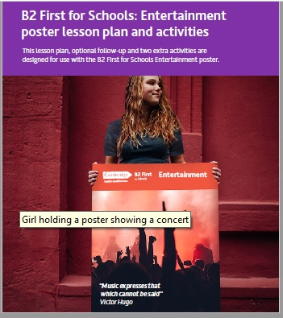
FREE RESOURCES

Slide 37

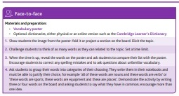
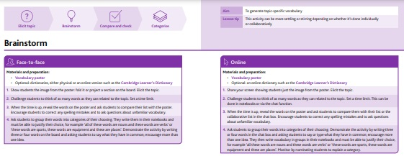


Slide 38
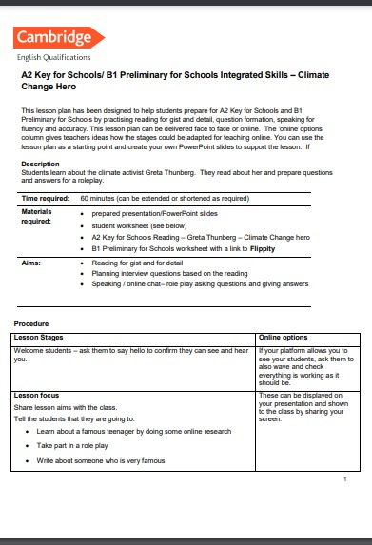
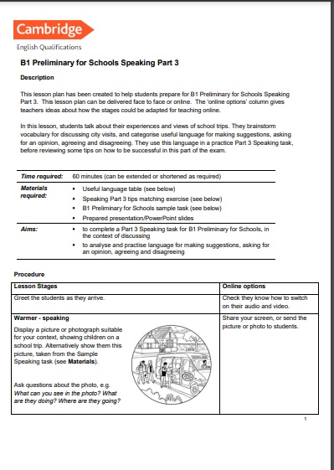
LESSON PLANS FOR EACH PART OF THE TEST / INTEGRATED SKILLS

Slide 39
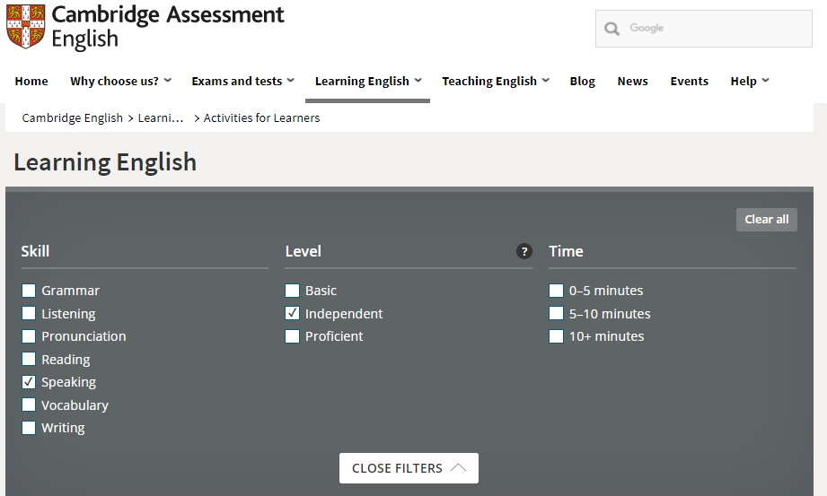
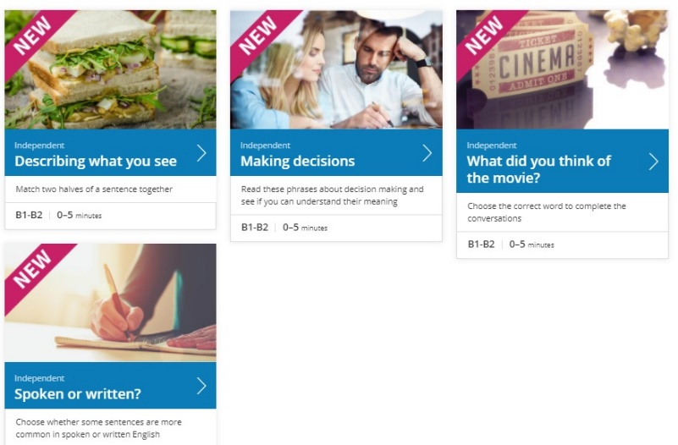
SELF-STUDY

Slide 40


Slide 41
QUESTIONS?

Slide 42
Наши социальные сети

