Slide 1
Запускаем грамматические структуры в речь
Marianna Kaufman MA in Sociolinguistics University of Essex

Slide 2













УЧЕБНИКИ

Slide 3





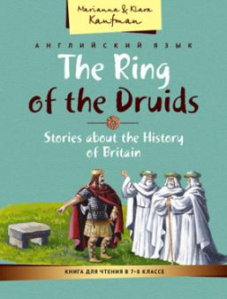
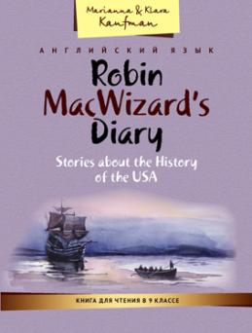





ПОСОБИЯ

Slide 4
Навык
Использование
Погружение
Понимание
Сравнение
Ознакомление

Slide 5
Принципы работы с грамматическим материалом
Объяснение грамматического материала на родном языке на знакомом лексическом материале, иллюстрирующем реальные ситуации использования этого материала носителями языка.
Соблюдение методически обоснованной последовательности предъявления грамматических явлений. Поэтапная, дозированная и посильная презентация сложных грамматических явлений.
Достаточный объем чисто языковых упражнений для первоначальной отработки грамматики.
Адекватная и полноценная иллюстрация использования грамматических явлений в тексте.
Коммуникативная направленность даже чисто тренировочных упражнений, с тем , чтобы в конечном итоге, использовать новый материал в речи.
Наличие и доступность полноценных и развернутых справочных материалов.
Постоянное повторение пройденного грамматического материала.

Slide 6


Сборники учебных стихов и песен для начальной и основной школы

Slide 7

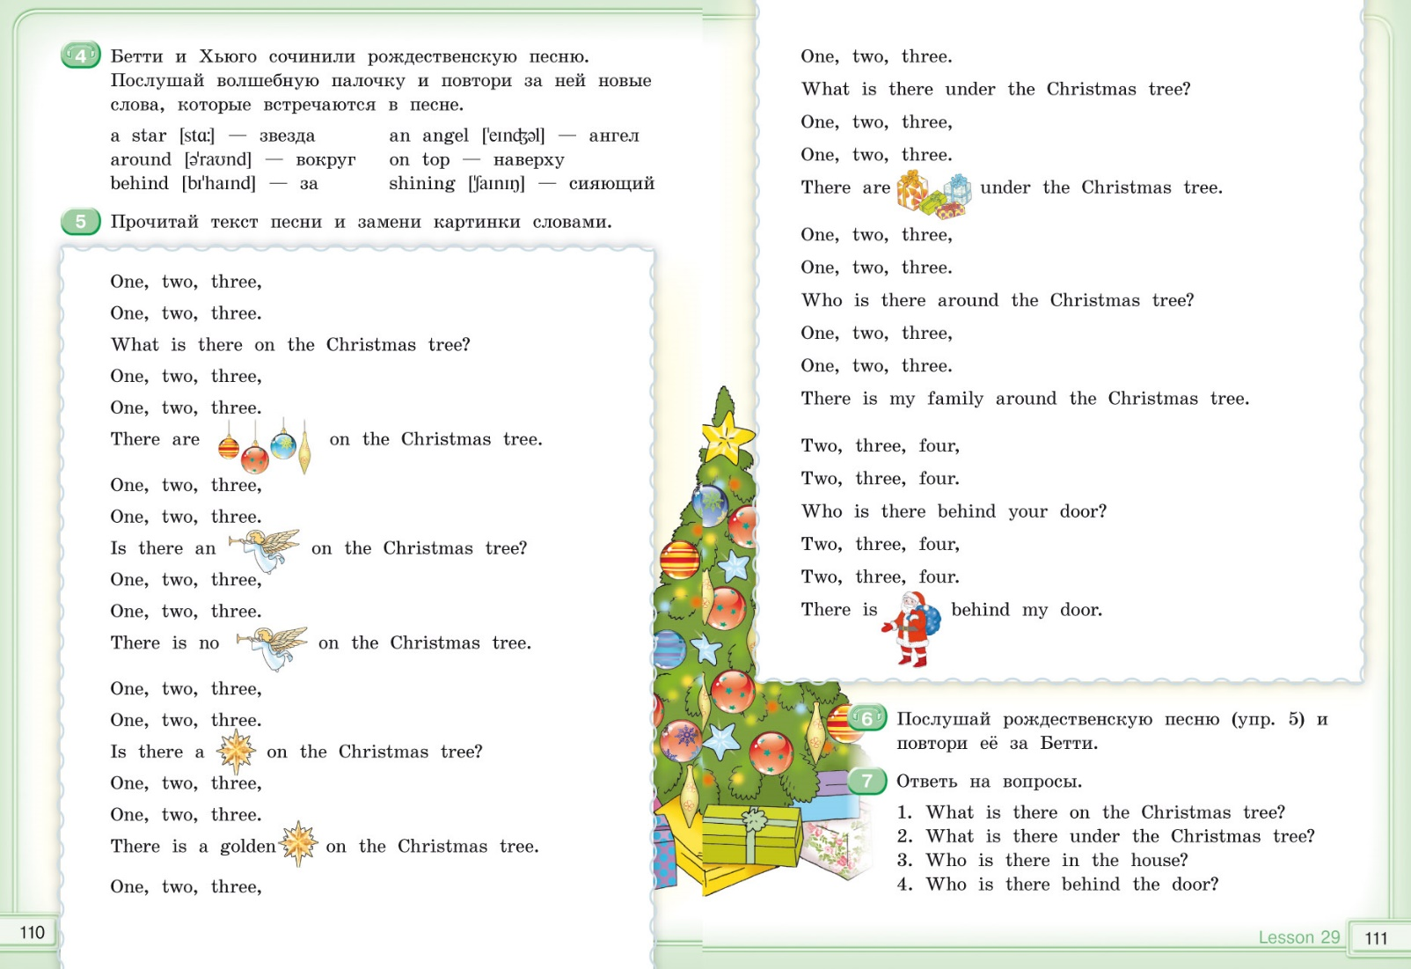

Slide 8
Сборники учебных песен для начальной и основной школы
2 сборника включают 57 песен и стихотворений.
Учебные песни и стихи органично сочетают учебный и развлекательный характер деятельности.
Учебные песни и стихи предлагаются не изолированно, а сопровождаются серией упражнений, что позволяет использовать сборники как на уроке, так и во внеурочной деятельности.
Учебные песни и стихи сопровождаются аудиозаписями и караоке версиями, которые можно скачать бесплатно с помощью QR кода.
В каждом сборнике приводится таблица с указанием названия песни, темы, лексического и грамматического наполнения, социокультурной информации

Slide 9
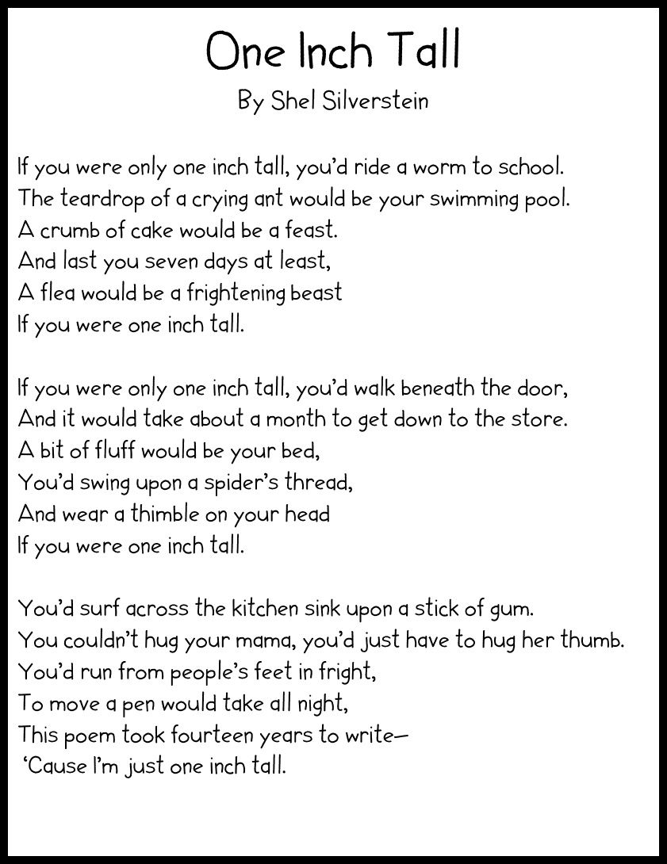



Slide 10






What are you going to do in summer?
Lessons 1, 2 What does a ranger do?
Употребление the Present Simple Tense вместо the Future Simple Tense в английских придаточных предложениях времени и условия
В английских придаточных предложениях времени и условия для выражения будущих действий употребляется the Present Simple, а не the Future Simple.
Английские придаточные предложения времени присоединяются к главному предложению с помощью союзов when (когда), till / until (до тех пор пока), as soon as (как только), after (после того как).
Не will send an e-mail as soon as he gets the parcel.— Он отправит сообще- ние (когда?), как только получит посылку.
When they arrive, I’ll phone you.— Когда они приедут, я вам позвоню. I’ll wait till he comes back.— Я подожду до тех пор, пока он не вернется. We’ll watch TV after we do our homework.— Мы будем смотреть телеви- зор после того, как сделаем уроки.
Английские придаточные предложения условия присоединяются к главному предложению с помощью союзов if (если), unless (если не). If he asks, she’ll tell him the truth.— Если он спросит, она скажет ему правду. I won’t be able to do anything unless he agrees to help.— Я не смогу ничего сделать, если он не согласится помочь.
Обратите внимани е, что союз unless имеет отрицательное значение, поэтому в сложноподчиненном предложении больше не нужно отрицания. Придаточное предложение может стоять как после главного предложения, так и перед ним. Если придаточное предложение стоит перед главным предложением, оно отделяется запятой.
We’ll go to the theatre if my friend phones me. If my friend phones me, we’ll go to the theatre.
1
Translate the sentences into Russian. Explain the use of tenses.
I’ll explain everything after he leaves the room.
She’ll buy a new dress as soon as she loses some weight.
If your mother treats you like a child, you’ll never learn how to make your own decisions.
182 Unit 6 Lessons 1, 2

Slide 11

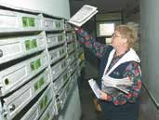
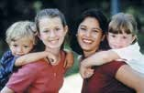
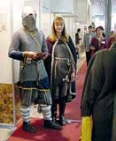
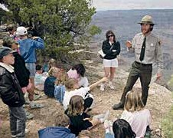
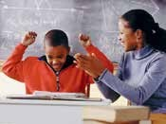

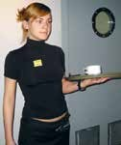
I’ll wait till he comes back.
He won’t achieve anything unless he learns to work harder.
Alice will study English until she is able to understand her pen friend’s letters.
They won’t be able to help Jane unless she asks them to.
He won’t stop until he finds out the truth.
Match the parts of the sentences.
2
They’ll have a picnic
He’ll phone us
I’ll wait
Even if he complains,
unless it rains.
nobody will listen to him.
с) if we don’t answer his letter.
d) till my friend tells me what to do.
Write the verbs in brackets in the correct tense.
If I (find out) something about him, I (phone) you.
She (not know) anything unless you (tell) her yourself.
He (pass the test) if you (help) him.
They (be) at home when the match (start).
Granny (be happy) if I (go) to the country with her tomorrow.
4 Listen to the words and expressions and repeat them after the speaker. Match
3
the words with the pictures of jobs. Which of the expressions doesn’t describe a job? Guess the meaning of the expression or translate it using a dictionary.
3
1
• to give out advert
2
6
4
5
ising fliers
to deliver the post
to help children catch up with their studies
to be a babysitter
to work as a waiter
to be a ranger
7
to make website home pages
to be green with envy
Unit 6 Lessons 1, 2 183

Slide 12


Misha: Hmmm, you don’t really think you’ll be that lucky, do you? Is it dangerous to work in a national park then?
Emily: Now I can see that you don’t know anything about the national parks in California. Working there is a real adventure. I’m just not sure if they take teenagers. Let me tell you what rangers do. You’ll be green with envy.
Найдите в диалоге предложения, где союз if используется для введения придаточных изъяснительных предложений. Переведите эти предложения на русский язык.
Complete the sentences with the facts from the dialogue. Pay attention to the way the Present Simple and the Future Simple are used.
Model: When the friends find the treasure, their adventure will be over.
The friends will find the treasure if…
When Misha goes back to Russia,…
Misha will visit his friends if…
Misha will try to get a summer job if…
It will take Misha a lot of time if…
If someone wants to find a good job,…
Emily won’t tell anybody about her summer job until…
Emily and Misha only have time to talk about everything until…
Emily could save somebody’s life if…
If California national parks give jobs to teenagers,…
When Emily tells Misha about California national parks,…
Tell the class about your plans for next summer in two or three sentences. Use these ideas for help if you have to.
Model: If I have enough time, I’ll catch up with my school work. I hope it’s not too late. My best friend promised to help me.
to go to a summer camp, to catch up with school work, to go to the country, to find a summer job, to make a bit of pocket money, to work to help the family, to go hiking, to go to the seaside, to do nothing, to watch TV all day, to do sports, to read books, to find time for one’s hobby
7
8
9
Homework
A
Put the verbs in the correct tense form.
If he (have) a toothache, he (go) to the dentist.
He (not go) to university unless he (work) hard.
They (wait) until he (come back).
She (not go) to the park if it (rain).
I (give) you the book if I (find) it.
You (have to) take a taxi if you (miss) the bus.
Unit 6 Lessons 1, 2 185

Slide 13



B Write questions about the underlined words.
They’ll go to the disco if it rains.
She’ll find out a lot about the subject when she reads this book.
She’ll lose weight when she goes on a diet.
If she has time, she’ll work as a babysitter.
You’ll burn calories if you do sports.
Translate the sentences into English.
Если вы будете знать английский язык хорошо, вы сможете найти хорошую работу.
Если мальчики найдут сокровище, их приключение закончится.
Что будет делать Миша, когда вернется в Россию?
Если в моем городе откроется ресторан, я попробую найти там работу.
Ты умрешь от зависти, когда я расскажу тебе о своих планах на лето.
Летом он будет работать официантом, если его возьмут.
Если Эмили не поедет в летний лагерь, она будет помогать лесникам.
Ты будешь раздавать рекламные объявления, пока не найдешь работу лучше.
C
Lessons 3, 4 It would be nice to have a summer job
Сослагательное наклонение / The Subjunctive mood
В английском языке существует три типа сложноподчиненных предложе-
ний с придаточными условия. Вы уже знакомы с придаточными услов- ными предложениями I типа. В них содержится указание на реальное, выполнимое условие.
She’ll go to the party if Mike invites her.— Она пойдет на вечеринку, если Майк пригласит ее.
Сослагательное наклонение (The Subjunctive mood) используется в условных предложениях II типа (Conditionals type 2). В этих пред- ложениях содержится указание на нереальное условие, по причине которого осуществление действия главного предложения проблематично или невозможно. В таких предложениях действия могли бы произойти в настоящем или будущем, но это маловероятно. В главном предложе- нии употребляется the Future-in-the Past, в придаточном the Past Simple.
She would go to the party if Mike invited her.— Она пошла бы на вече- ринку, если бы Майк пригласил ее. (Это все еще возможно, поскольку вечеринка еще не состоялась, но это маловероятно.)
186 Unit 6 Lessons 1, 2 and 3, 4

Slide 14

О бр ати те вн и ман и е! Сокращенная форма would = ’d
I’d help you today if I had time.
Глагол to be в условных предложениях II типа имеет форму were.
If I were older, I would work as a ranger.— Если бы я был старше, я бы ра- ботал лесником.
If I were you, I’d spend this money on books.— На твоем месте я потратил
бы эти деньги на книги.
Наклонение | Тип условного предложения | Время, к которому относится высказывание | Главное предложение | Союз | Придаточное предложение
Изъявительное | I тип Придаточное предложение содержит реаль- ное, выполнимое условие | настоящее, будущее | I will give her the document Я отдам ей документ, | if если | she comes at 5 p.m. tomorrow. она придет завтра в 5 часов.
Сослагательное | II тип Придаточное предложение содержит не- | настоящее, будущее | I would give her the document Я отдал | if если | she came at 5 p.m. today. она пришла
 | реальное или трудновыполни- мое условие |  | бы ей документ, | бы | сегодня в 5 часов.
1 Translate the sentences into Russian.
She’d pass her exams next month if she worked hard.
She’d be happy if her friend phoned her tomorrow.
If we were in America, we’d go to see Washington.
He’d work as a waiter next summer if they hired him.
If I knew his e-mail, I’d send him a birthday greeting.
If I were you, I’d apologise.
If I were able to swim, we could go canoeing.
Answer the questions.
What would you do if you won the lottery?
What famous person would you like to meet if you had the chance?
Would you go to America if you had a friend there?
Would you lend money to your friend if you had some?
What country would you visit if you could choose any country?
What questions would you ask if you met a real fortune teller?
What would you be able to do if you lived in 2150?
Unit 6 Lessons 3, 4 187
2

Slide 15
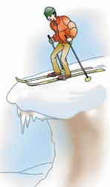

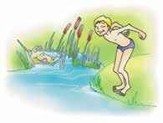
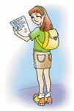
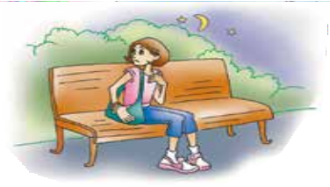
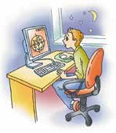
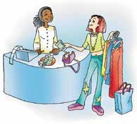
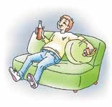
3
Look at the people in the pictures and give them some advice. Start with: If I were you…
Model: If I were you, I’d have a break.— На твоем месте я бы передохнул.
2
not swim here
¹ have a break
4
not go down this slope
3
do some revision
5
go home now
6
⁷ not spend too much
8
lose some weight money on clothes not stay up so long
4
Listen to the words and expressions and repeat them after the speaker.
to apply for a job — подавать заявление о приеме на работу to offer smb smth — предложить кому-либо что-либо
to charge smb for smth — взимать плату с кого-либо за что-либо to require smth — требовать что-либо
to hire smb — нанимать кого-либо на работу a requirement — требование
a skill — умение patience — терпение
a strong point — зд. сильная сторона
an amusement park — парк с аттракционами to mind — возражать
yard work — работа во дворе / в саду an attitude — отношение
188 Unit 6 Lessons 3, 4

Slide 16

When in Rome
Choose the phrase which best describes the idea.
Does this ring a bell? — Does it wake you up? Does it sound familiar?
Does it sound exciting?
To have green fingers — to be beautiful / to be lazy / to be good at gardening I don’t have a clue. — I don’t know. / I have no key. / I’m not interested.
5
Read the list of possible questions about summer jobs. Rate them according to their importance for you. Explain the first five positions in your rating.
Explain the last position in your rating.
How should I look for a job?
Where can I find information about the job?
Should I advertise my services?
What kind of jobs are there for me to do?
Will the job be interesting?
How much will I earn?
How much should I charge?
When should I apply for the job?
Is there a minimum age requirement?
Does this job require any special skills?
Will I learn anything new at this job?
Will I be able to meet new people?
Will I be able to travel?
Will I still have any free time?
What are the working hours?
Will I need permission from my parents?
Look through the text and find out which of your questions about summer jobs it answers.
7 Emily showed Misha an article with some advice on summer jobs for American teenagers. Listen to the text and read it for detail.
6
“It would be nice to have a job this summer.”
“If I had more time, I’d definitely look for a job.”
“If only they could give me something interesting to do, I’d be happy to try a job out.” “If I were older…”
Does this ring a bell? If you want to find a summer job, don’t just sit around and dream. If you want to get results, get up and get moving. You’ll
Unit 6 Lessons 3, 4 189

Slide 17

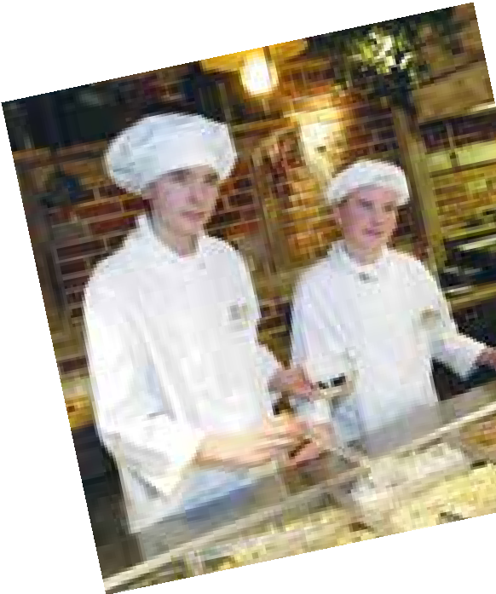

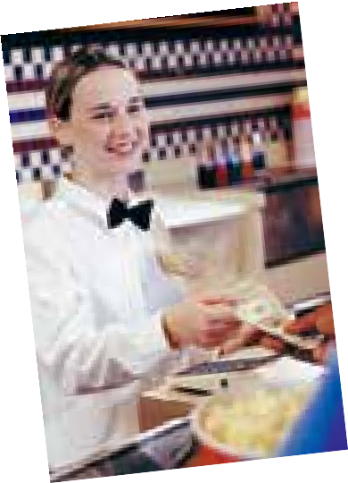
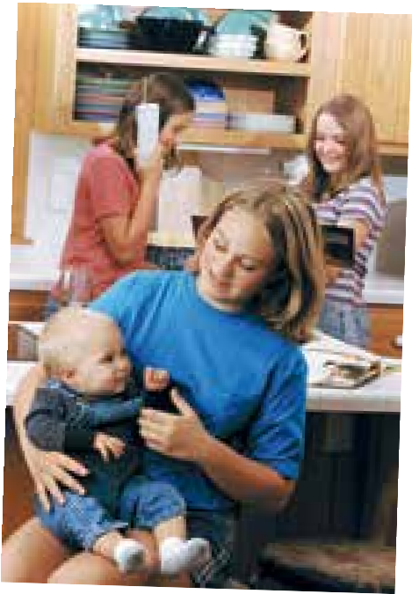

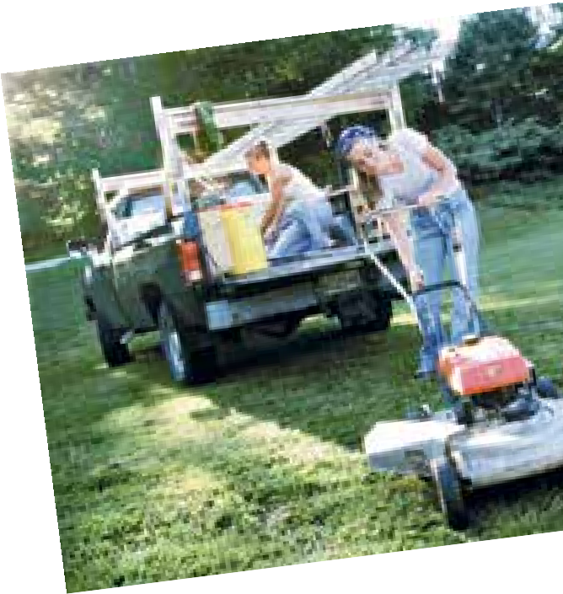
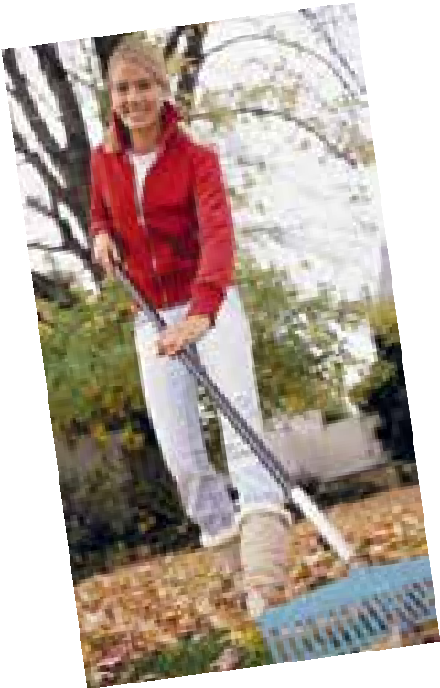
be surprised how many options there are. But you won’t know about them if you don’t make the effort.
Your first step should be to look for adverts in the local papers. Then try to talk to your neighbours, relatives anybody else who will listen to you.
So what are the options you can try?
Working at a café or a restaurant. This will suit someone who wants to earn as much money as possible. Hot summer days are usually a very time for cafés and bistros, so they’ll probably
all the help they can get. But you have to bear in mind that it’s not an easy job. You have to be physically fit and work well under stress if you think a job like this is for you. Your attitude is
a factor. If you think to yourself “I hate this job” as you wash the dishes or clear the tables, you won’t get much from it. But if you think positively, you could learn a lot about the restaurant business and later this knowledge could be useful when you start a business of your own.
Babysitting. This is a traditional job for teenagers to do. If you are responsible and love kids, then this is the job for you. There will always be a family with busy working parents who’ll be more than
happy to give you a job to help out over the summer.
Your help will be even more welcome if you can do something useful with the children: teach them music or languages or do sports with them.
Yard work or cutting the grass. There will always be people who’ll be glad to pay you for looking after their yard. A lot of things in the garden need attention in summer, and not everybody who has a garden is born with green fingers. Fresh air and lots of physical activity is an extra advantage.
Dog walking. “I’d have a dog, if I weren’t so busy.” You sometimes hear people say that, but not everybody is so responsible. A lot of people who have pets don’t have enough time to walk them properly and often feel guilty about it. You can get
190 Unit 6 Lessons 3, 4
or
busy want
also

Slide 18

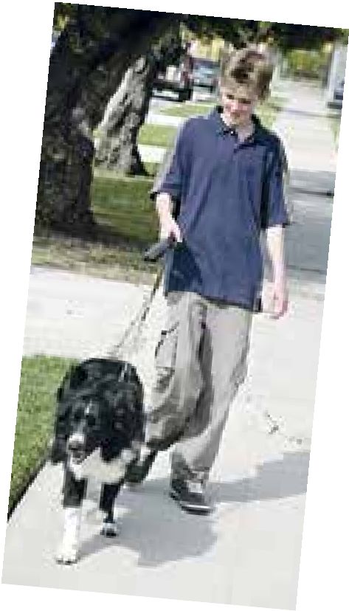


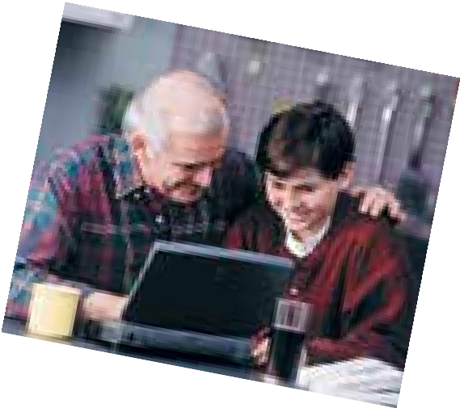
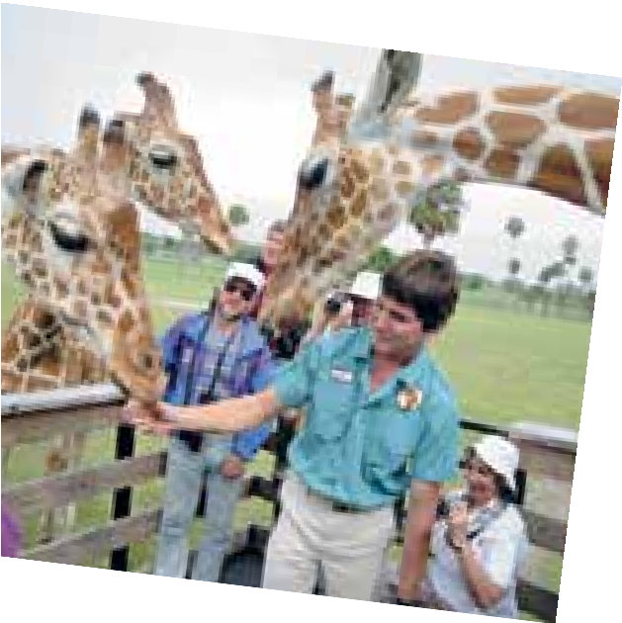


quite a lot of clients if you just stick an advert up on the bus stop near your house. Summer is the time when people want to go on holiday. If your parents don’t mind, you can also offer to look after a dog or a cat for a couple of weeks until the owners come back from holiday.
Teaching people how to use computers or the Internet. It’s probably hard for you to imagine what it is like to live without a computer. You’d feel
completely cut off if you switched off your computer even for a day. Well, you’ll probably be surprised to know that there are a lot of people who don’t have
a clue about how to use one. They’d like to be able to, but they’re scared. You may be able to help those people if you’re very good at using a computer, and patience is your strong point.
Working at an amusement park. Most of these places are only open in the summer, but they hire hundreds of people. Going on free rides, having a lot of fun and getting to know lots of new people are all guaranteed.
Working at a summer camp, national park or a holiday resort. If you have a friendly and outgoing personality and if you like to travel, this is the job for you. The only problem is that jobs like this are really popular, so you’ll need to apply early and hope that you’ll be selected.
•
•
8
Find in the text the sentences that contain
real conditions unreal conditions
Which advice given in the text can be used in your city (town, village)? Why? / Why not?
Which of the jobs mentioned in the text would you not charge for but do them as a favour instead?
Imagine that you want to find a job. What special skills do you have? What are your strong points?
What special skills do you not have now but you would have if you were older?
Model: I can play the piano. If I were older, I’d be able to drive a car.
Unit 6 Lessons 3, 4 191
9
10

Slide 19





Someone who is good-looking.
Someone who wants to be more successful than other people.
Someone who is good at thinking of new, interesting ideas.
C What is your ideal summer job? What would you like to do and why?
Write 5–7 sentences.
Lesson 7 An accident in Death Valley
III тип условных предложений / Conditionals type 3
Сослагательное наклонение также используется в условных предложениях
III типа. В условных предложениях III типа действия могли бы произойти в прошлом, но не произошли. В главном предложении употребляется the Future Perfect-in-the Past (would + have + глагол в III форме), в при- даточном the Past Perfect:
Jim would have finished his work yesterday if he had got this information in time.— Джим закончил бы свою работу вчера, если бы он вовремя получил эту информацию.
Как вы видите, перевод на русский язык условных предложений II и III ти- па отличается лишь тем, что действия, описываемые в них, произошли бы в предложениях II типа в настоящем или в будущем, а в предложениях III типа — в прошлом. Однако английский вариант условных предложений II и III типа существенно отличается глагольными формами.
1 a) Join the two sentences to rewrite the main events from Robin MacWizard’s diary.
b) Translate the sentences into Russian.
Model: The boys didn’t read Robin’s diary. The boys didn’t meet Emily.—
If the boys hadn’t met Emily, they wouldn’t have read Robin’s diary.
Robin didn’t sail with the Pilgrims. Robin didn’t meet Squanto.
Squanto didn’t see the ring that Robin wore on a chain round his neck. Squanto didn’t tell Robin about the treasure.
The future of the world wasn’t in Robin’s hands. Robin didn’t become the guard of the treasure.
Robin didn’t know about the treasure. He didn’t go into the future.
The people in his time were better. Robin gave them the treasure.
Unit 6 Lessons 5, 6 and 7 199

Slide 20


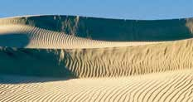

2
Match the phrases with suitable reactions.
That’s good to know. Actually, I need 20 roubles.
I’m afraid there’s no chance of that. They’re always late.
So you were hungry all day! I’m so sorry to hear that!
I’m glad you liked it. What was it about?
Good idea. I hate boring films.
Why didn’t I think of you? Yesterday I phoned all my friends, but none of them was able to help.
I’d lend you some money if you asked me.
If the film is boring, we won’t stay until the end.
If the train arrived on time, we’d have enough time to have breakfast before our meeting.
If the train had arrived on time, we would have had enough time to have lunch before our meeting.
I’d have lent you some money if you had asked me yesterday.
If the film had been boring, we wouldn’t have stayed until the end.
3
Match the words and expressions with the definitions.
a path through the countryside
lack of water in the body
to go for a long walk
illness or collapse caused by doing too much physical activity in hot weather
heatstroke
2. a trail
1. dehydration
3.
4. to hike
4 Emily keeps her promise to tell Misha about some of California’s national
parks. Listen to the story, read it and answer the questions.
1. What’s the name of the national park described in the story?
What is it famous for?
What’s dangerous about it?
T
his happened in one of the hottest places
on Earth: Death Valley National Park.
Three friends from France, Martin, Paul and
Christian were only a couple of days into their tour of the USA when they decided to visit
this world-famous place. They arrived there in the evening and started to plan their adventure. They had bought a guidebook that described the most interesting trails and decided to try some of them. They soon found out, though, that most of the trails were either closed or you had to go with a ranger. If they had come to Death Valley in winter, they’d have been able to
200 Unit 6 Lesson 7

Slide 21
Наши социальные сети

