Slide 1
МЕЖДУНАРОДНЫЕ СТАНДАРТЫ ПРИ ОБУЧЕНИИ
И ТЕСТИРОВАНИИ ДЕТЕЙ В НАЧАЛЬНОЙ ШКОЛЕ
(УРОВНИ PRE-A1 – A2)

Slide 2
Successful language learning requires…
Motivation
Confidence
Fun
Clear objectives
Right level and content
Practice
Notes:
[Before showing the slide, ask the audience what they think are the important factors for successful language learning. Note that the themes on this slide are repeated throughout the presentation – shown in capitals in the notes – to demonstrate how Starters, Movers and Flyers are designed to reflect best practice.]
MOTIVATION - this is crucial to learners developing their English skills. Motivated teachers and parental involvement both also play an important role in motivating students.
CONFIDENCE – using a foreign language requires having confidence in all 4 skills (reading, writing, listening, speaking). It is particularly important for young learners that confidence is built up gradually and maintained over time.
FUN – children are more likely to stay motivated if they are enjoying themselves
CLEAR OBJECTIVES – having clear and attainable goals helps schools and teachers to structure their course, which increases learners’ motivation as they have a better understanding of how they are progressing.
RIGHT LEVEL and CONTENT – at this age, children are still developing their first language skills, they have limited world knowledge and reasoning skills. Children will perform better if the materials they use take these factors into account and are appropriate to their age and level. To be successful in learning a language, you also need to learn all the different skills and not just grammar and vocabulary, or the passive skills of reading and listening.
PRACTICE – learning any new skill requires practice and getting to a good level takes time. Starting young will help to give learners a head start on their lifelong language learning journey.

Slide 3
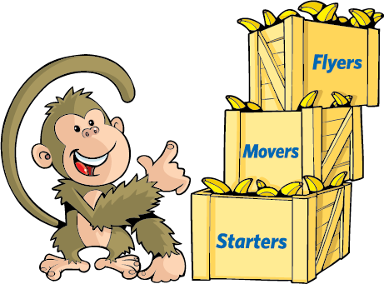
Step-by-step progression
A2
Flyers
A1
Movers
Pre-A1
Starters
Notes:
Starters, Movers and Flyers are the first three levels of Cambridge English Qualifications for learners in primary and lower secondary. Each of the three levels is designed to build on the one before, gradually developing learners’ CONFIDENCE in English.
The exams are aligned to the Common European Framework of Reference (CEFR). This is an international framework which describes language ability at six levels from A1 for beginners to C2 for mastery. The CEFR describes what learners can typically do at each level using a series of ‘Can Do Statements’.

Slide 4
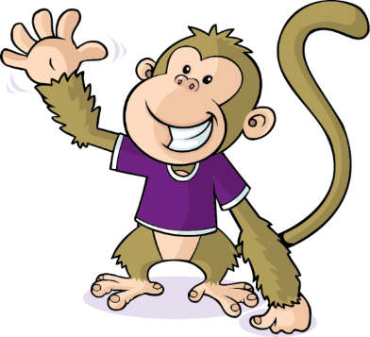
Starters, Movers and Flyers
What makes Starters, Movers and Flyers different from exams for teens and adults?:
Designed to be fun and motivating
Vocabulary and topic areas – relevant to age
Speaking 1-to-1 to take account of limited interactional skills and cognitive development
Designed to reward achievement – no pass or fail
Use a lot of pictures
Notes:
[Show the question and elicit answers from participants before showing the differences.]

Slide 5




4 skills
Notes:
The exams cover all 4 language skills (Reading, Listening , Writing and Speaking). This has a positive impact on teaching and learning as it ensures that teachers practise all the skills in lessons, including communicative activities, and learners develop the skills needed to use English effectively in the real world. In research projects carried out by Cambridge English, teachers report introducing more communicative activities in class since starting to prepare students for the exams.

Slide 6
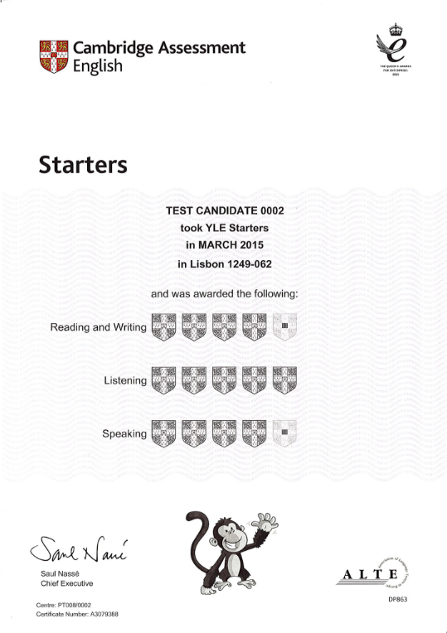
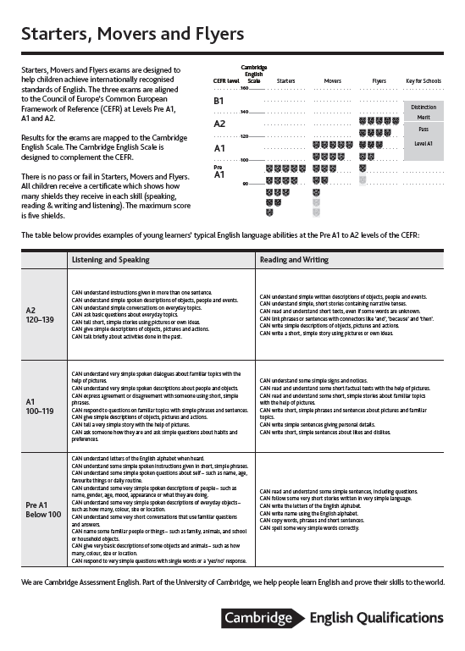
Results designed to motivate
All learners receive a certificate…
To celebrate achievement ✓
✓ To build confidence
To inform future learning and teaching ✓
Notes:
Taking an international exam can be highly MOTIVATING for learners as they receive a certificate linked to international standards to celebrate their achievements. All children taking Starters, Movers and Flyers get a certificate – no child fails the exam. This helps to build their CONFIDENCE in English.
They receive between 1 and 5 shields on each paper - Listening, Speaking, Reading and Writing – to demonstrate what they’ve achieved and show where they are stronger or weaker. A result of one shield means the child can improve a lot in that skill; four or five shields mean that the child did well in that skill and answered most questions correctly and is ready for the next level.
The back of the certificate describes in more detail what the shields mean, how they relate to the CEFR and what a child can typically do at that level. Let’s look at it in more detail.

Slide 7
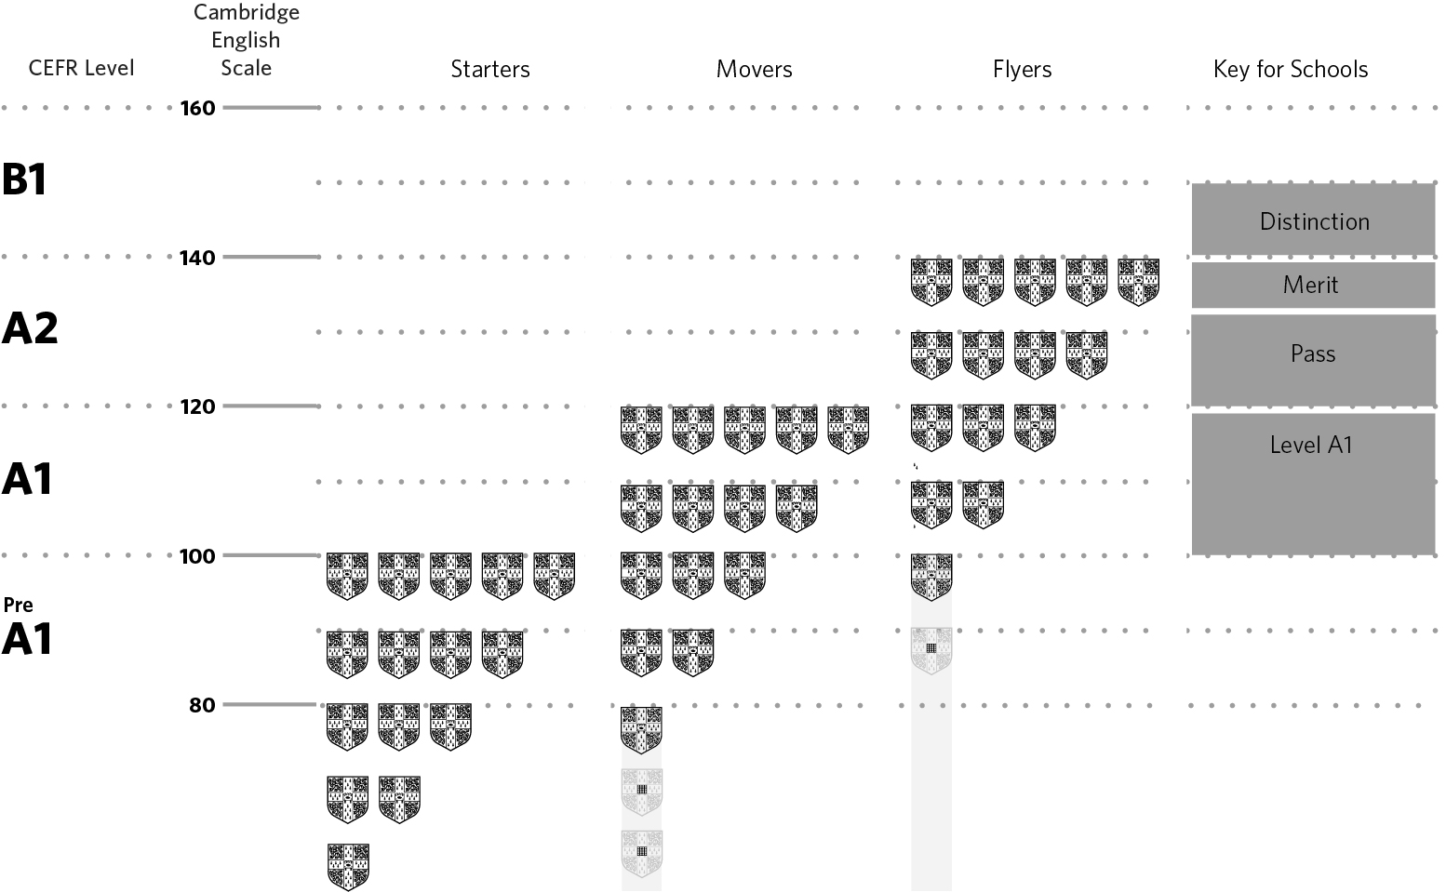
Notes:
The table on the back of the certificate shows how the tests build on each other, including the progression from Flyers to Key for Schools. It also shows how to interpret shields against the CEFR and gives a broad alignment to the Cambridge English Scale, which helps learners to measure their progress as they move up the levels.
The CEFR provides milestones for learning and shows the child and their parent where they stand against international standards and what that means in practice. The teacher can use the results to inform conversations with parents and to reflect on their teaching (e.g. does more time need to be spent on a particular skill?).

Slide 8
Skills | Starters 45 min. | Movers 60 min. | Flyers 75 min.
Listening | 20 mins | 25 mins | 25 mins
Speaking | 3-5 mins | 5-7 mins | 7-9 mins
Reading & Writing | 20 mins | 30 mins | 40 mins
Notes:
This table shows how long each part is at each level. As the levels progress, the tests get a little longer. This reflects the fact that the learners are building and being assessed on more language skills.

Slide 9
LISTENING
Pre-A1:
CAN understand very short conversations that use familiar questions and answers.
A1:
CAN understand very simple spoken dialogues about familiar topics with the help of pictures.
A2:
CAN understand simple conversations on everyday topics.

Slide 10
Progression up the levels, Listening
number of objects
increased detail in pictures
tasks more complex

Slide 11
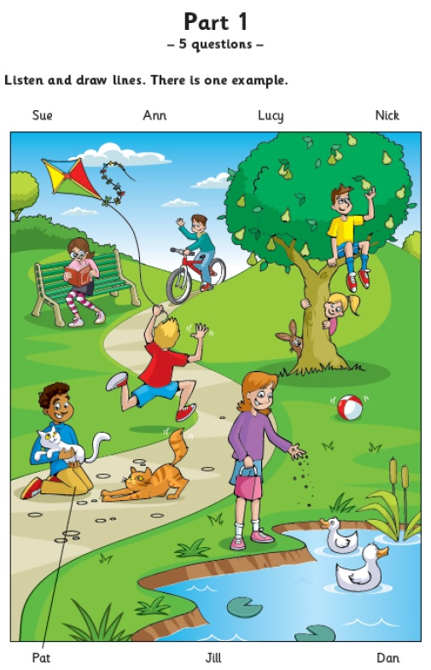
Pre-A1 Starters, Listening Part 1
Tapescript
M Here’s a photo of me and
my friends in the park, Miss Box.
F Oh yes! Who’s that?
The boy with the cats?
M His name’s Pat.
He’s holding one cat in his arms!
Pat loves animals.
F That’s good.
Notes:
Let’s look firstly at Listening.
Songs are a great way for children to develop not only their listening skills, but also to build vocabulary and to help pronunciation by singing along. Parents could ask their child to teach them a song they are learning at school. If time is an issue, they could do this on the journey to or from school. Sing and Learn on the Cambridge English website is designed to support learning English through songs, using words found in the YLE tests. (click on At the zoo image to go to the relevant bit of the website)
Also on the Cambridge English website, you’ll find a series of short activities, some of which have a listening focus. (click on the image with the monkey climbing the palm tree to go to the relevant bit of the website)
There is a wide range of materials on the internet that can help children practise listening in an enjoyable way, such as audio stories and cartoon videos. Parents who speak English can read story books to their child and ask them questions about the story. Apart from the Cambridge English website, another useful site is the British Council’s Learn English kids site
http://learnenglishkids.britishcouncil.org/en/

Slide 12
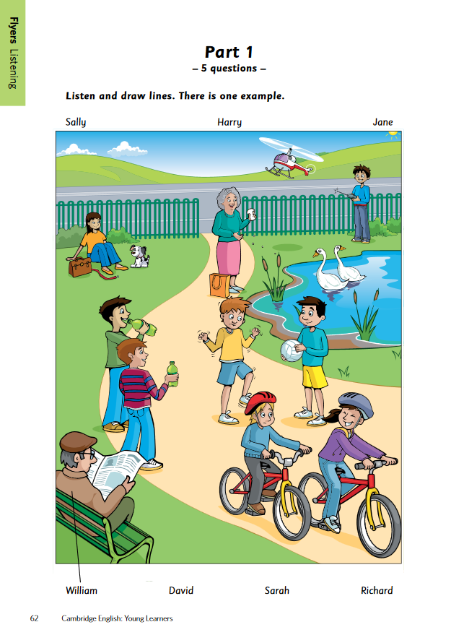
A2 Flyers: Listening Part 1
Fch I took this photo by the lake last Saturday,
Grandma.
F It looks lovely. Do you know any of these
people?
Fch Yes, I do. The man who’s reading the
newspaper is William.
F He’s wearing a nice hat.
Fch He’s, isn’t he? Grandpa knows him, I think!

Slide 13
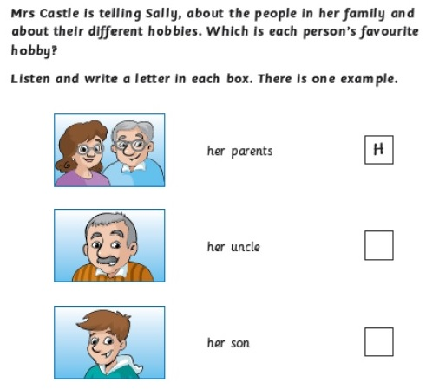
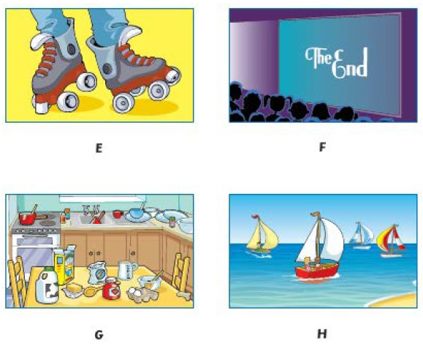
Movers: Listening Part 3
Two-way dialogue – answers from one speaker.

Slide 14
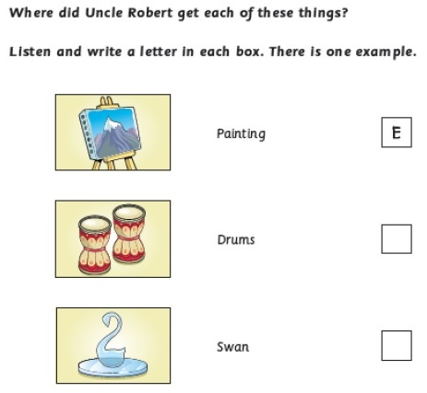
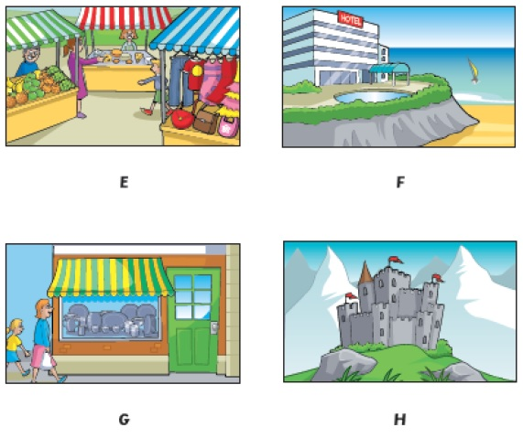
Flyers: Listening Part 3
Two-way dialogue – answers from both speakers.

Slide 15
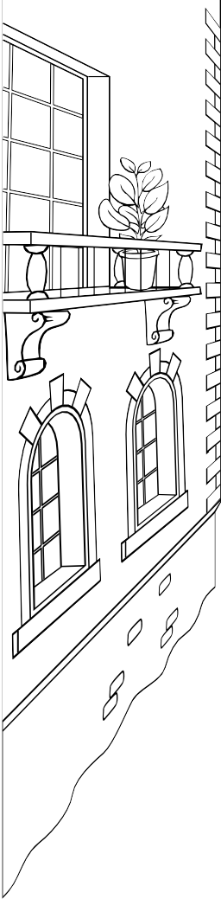
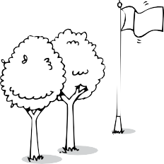
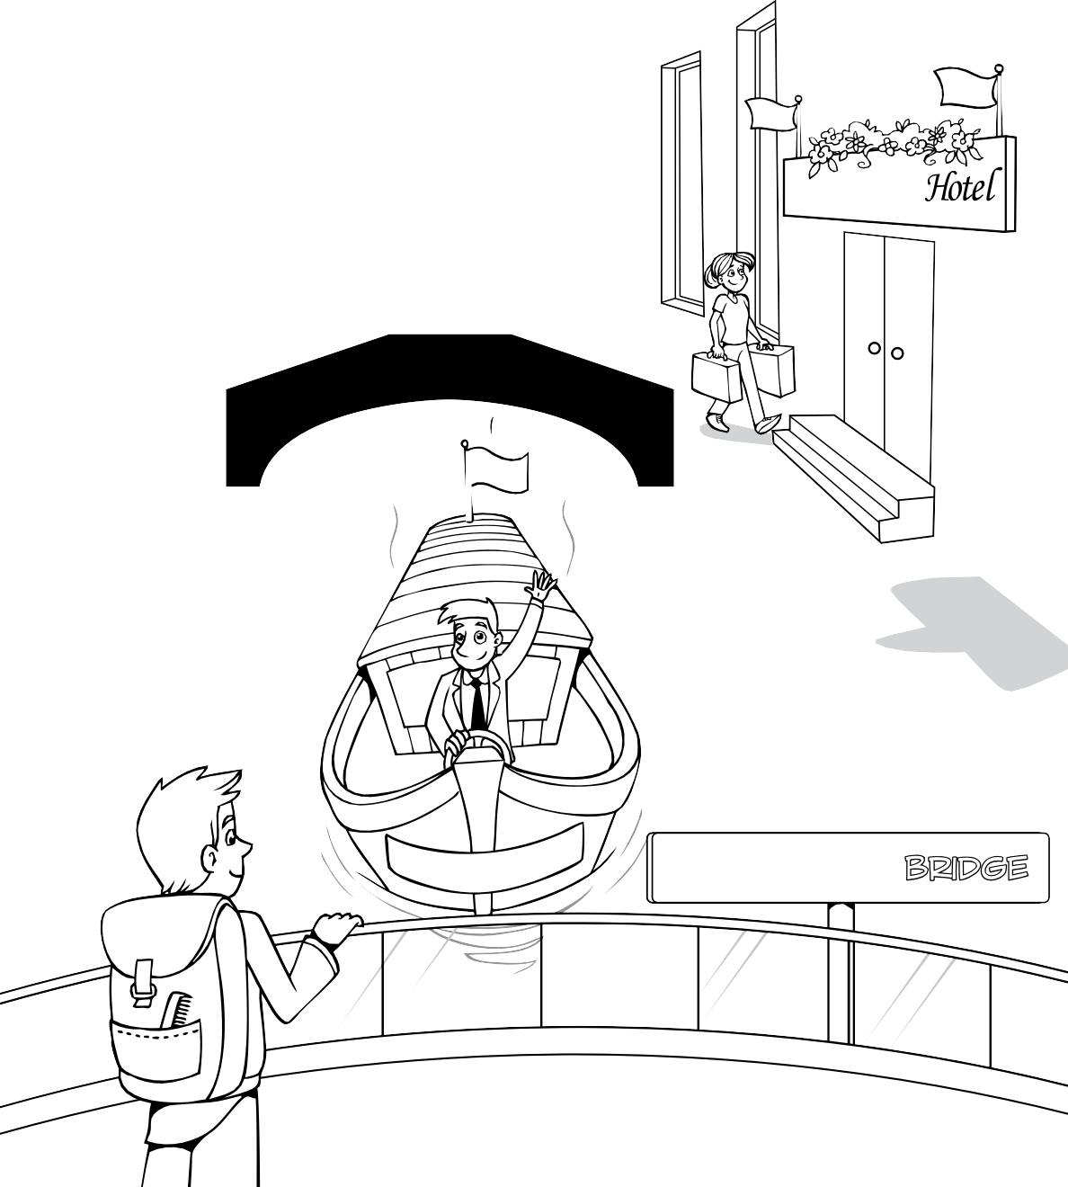






Flyers Listening
Part 5
– 5 questions –
Listen and colour and write. There is one example.
M …Write a name on
the front of the
boat for me.
Fch OK. What do you
want me to call it?
M ‘Sunny’ … like the
weather!
68
Cambridge English: Young Learners

Slide 16
READING
Pre-A1:
CAN follow some very short stories written in very simple language.
A1:
CAN read and understand some short, simple stories about familiar topics with the help of pictures.
A2:
CAN read and understand short texts, even if some words are unknown.

Slide 17
Progression up the levels, Reading and Writing
length of text
language in text
sentence length
number of distractors
picture support
language needed for answers
productive writing (Movers, Flyers)

Slide 18
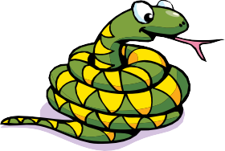

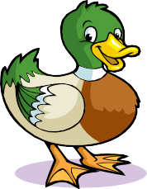


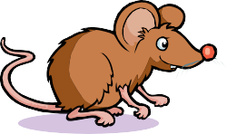



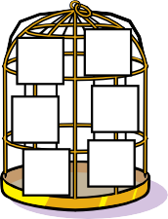
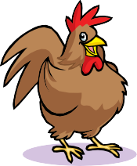

Starters Reading & Writing
Part 3
– 5 questions –
Look at the pictures. Look at the letters. Write the words. Example
All levels – copying words
and checking spelling
e
a s
s n a k e
n
k
Questions
1
k
u
c d
Pre-A1
e m
o
2
u s
--------------
3
h _{p} i
_{o} p
4
o m k
h
e
n y e
n c
i
k
5
c
Starters
19

Slide 19


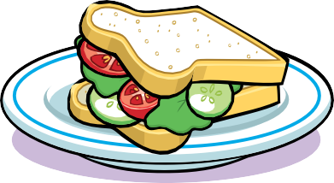



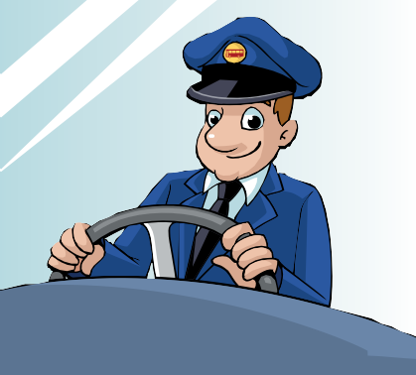
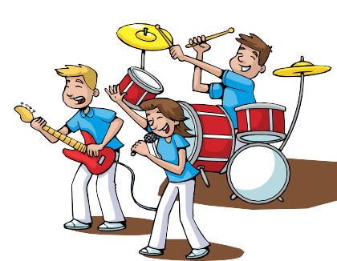








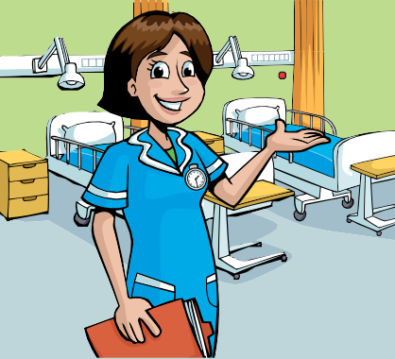
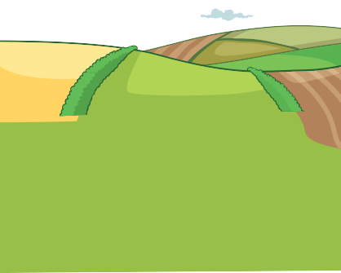
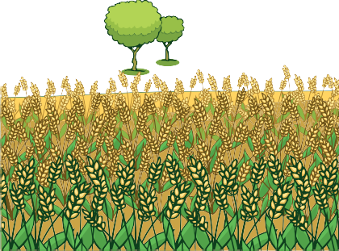
Movers Reading & Writing
Part 1
– 5 questions –
Look and read. Choose the correct words and write them on the lines. There is one example.
an island
a sandwich
This person helps people who
aren’t well in hospital.
…………………………………
2. Some people put milk or lemon
in this drink.
……………………………………..
3. There are lots of cars, buses and
people in this busy place.
………………………………………….
4. You can put cheese or meat
between bread to make this.
………………………………………..
5. This is a part of a farm where
you often see vegetables
plants.
…………………………………………..
A1
a band
a driver
tea
a city
a field
a nurse
42
Cambridge English: Young Learners

Slide 20
Flyers Reading & Writing
Part 1
– 10 questions –
Look and read. Choose the correct words and write them on the lines. There is one example.
an astronaut a pilot golf sugar This person can fly to the moon in a rocket. ..a..n...a..s..t.r..o..n..a..u.t..
A2
This is made from fruit and you can put it on your bread with a knife.
Players in this game throw, catch and hit the ball on a sports field.
These have pictures on them and you can write on the back and send them to friends when you’re on holiday.
It is this person’s job to write about news in a newspaper.
You buy these and put them on your envelopes before you post them.
This person flies a plane and usually wears a uniform.
People like reading these because they have stories with pictures or photos on their pages.
You can play this game inside on ice or outside on a field.
Some people like this in their tea or coffee and they put it in with a spoon.
People don’t usually play this game in teams. They use a small, hard white ball.
.......................
basketball
.......................
hockey
.......................
.......................
salt
magazines
.......................
.......................
jam
.......................
baseball
.......................
.......................
stamps
postcards
.......................
a journalist
letters
a photographer
Flyers
77

Slide 21
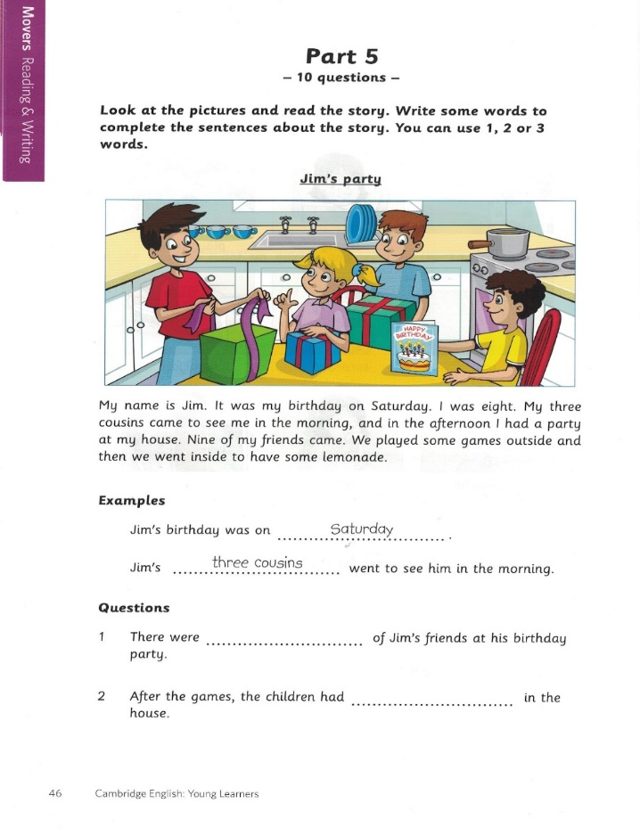
Reading and Writing
Movers and Flyers (Part 5)
SS should not write more words than needed (1 to 3, Movers/ 1 to 4, Flyers)
All the words they need for the answer are in the story, and these words must not be changed.

Slide 22
Reading aloud - ?
Traditional reading aloud round the class one by one:
little pleasure, of little interest to the listeners
encouraging stumbling and mistakes in tone, emphasis
and expression
harmful to the silent reading techniques
inefficient way to use your lesson time

Slide 23
Reading aloud as a useful technique
Choral reading as a means of training and checking rhythm and pronunciation (after the teacher/ recording, together with the recording).
Reading dialogues in pairs /groups (checking work, peer teaching).
Reading aloud from a book in small groups.

Slide 24
Silent reading
Reading aloud can be a useful skill in the classroom, but
silent reading remains with people to the rest of their lives.
Textbooks – conscious language development (intensive reading).
Books – for understanding and pleasure (extensive reading).

Slide 25
CRAMMAR AMD VOCABULARY (HANDBOOK FOR TEACHERS)
For each level (Pre-A1 – A2)
Grammar and structures list
Alphabetical vocabulary list
www.cambridgeenglish.org/teaching-english

Slide 26
Fun with words
Bingo
Seven lives/Hangman
Group or order the words (from longest to shortest; from smallest
to biggest; in alphabetical order;
in colour group; in sound group)
‘Letter’ each learner from A to Z and spell out a word (e.g.
elephant). Learners with those letters line up, then say out their
letter loudly and clearly.
Miming vocabulary

Slide 27
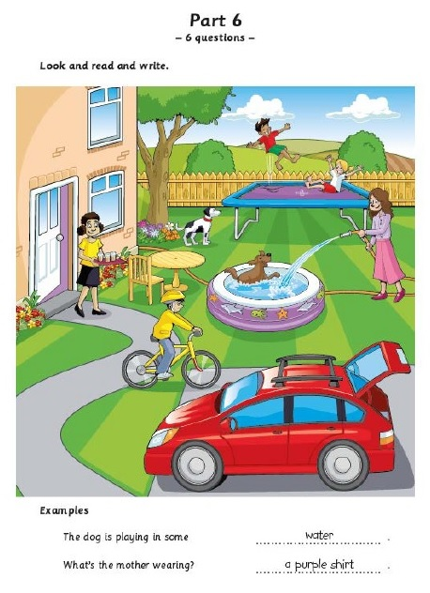
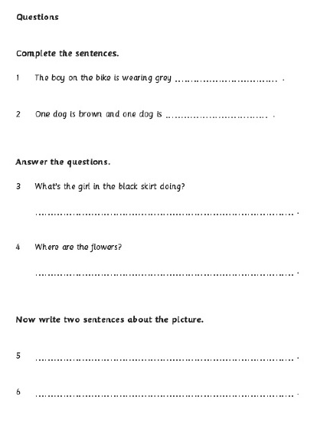
A1 level (Movers): Can write short, simple, isolated phrases about everyday topics and communicative situations
Answers for questions
3 and 4 should be full
sentences.
All the answers should
refer to the picture.
Sentences should be
comprehensible, not
necessarily
grammatically correct.
It’s better to avoid
ready made sentences.

Slide 28
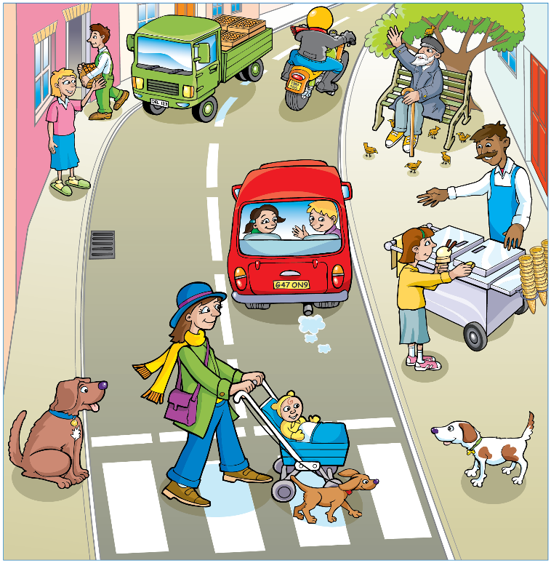
Assessing Writing: Movers Part 6 (scores 1-2 per each answer)
3. What’s the man with the
white beard doing?
It’s a white.
4. Who is in the red car?
There are some childs.
5. It’s a three dog.
6. I like the picture.

Slide 29
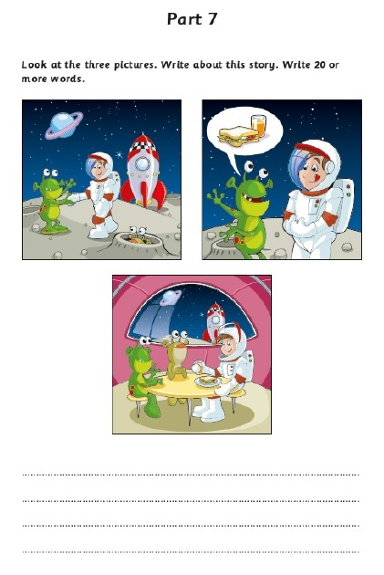
A2 level (Flyers): Can write a short, simple message in an email [here, a story]
Three linked picture prompts
Write 20 or more words

Slide 30
Flyers: Reading & Writing Part 7 (scores 0-5)
The candidate’s response
… describes a progression of events which are clearly connected (Does it tell
a story?)
… is based on all
three pictures (Does it connect all the pictures in a story?)
… makes sense to the reader (Is it easy to read and understand?)

Slide 31
Example answer 1
Once upon a time, Two friends went circus. Then a girl rode one bikes and wore clown’s hat.

Slide 32
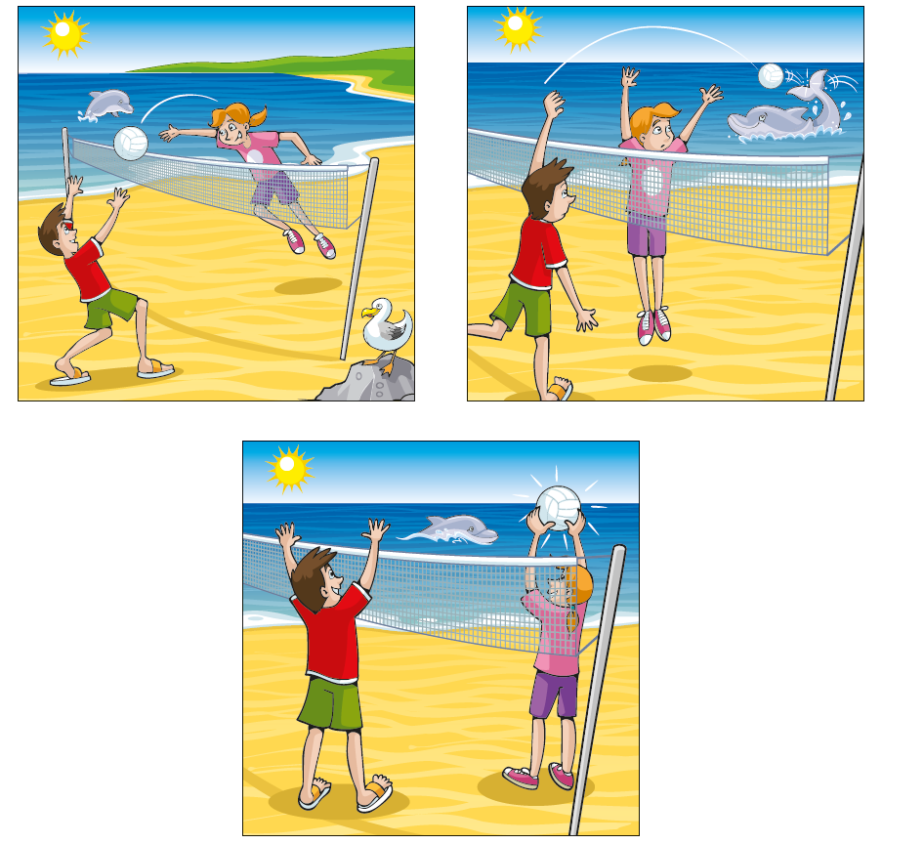
Example answer 2
First Sasha and Ariana play volleyball. Then ball fly in the sea, friendly dolphin gives ball their. Finally, they are laugh and smile dolphin. Dolphin sing for present love song.

Slide 33
 | Example 1 | Example 2
Progression? | Yes, evidence of progression of events | Yes, progression of events which are explicitly connected to each other
Use of pictures? | Addresses two of the pictures | All three pictures are addressed
Comprehensible? | Yes, despite mistakes – no significant strain on reader | Minimal to no effort is required by reader. Story is clear from first reading
Final score | 3 | 5

Slide 34
Agree or disagree?
It’s a good idea to give students a score based on the exam assessment criteria every time, so they can see how much progress they are making.
It’s wrong to correct students’ grammar mistakes.
Teachers should give balanced feedback, starting with strengths and giving ideas for what to improve.
Teachers should always comment on the content of the writing.
We can give students models of writing to learn so
they can use them in this kind of task.
Notes:
In order to help students do their best in the exams, it’s a good idea to raise their awareness of the areas assessed. This can be done by focusing on these areas when assessing students’ writing informally, in the classroom, on everyday classroom tasks.
Task:
Read the five statements on the slide – do you agree or disagree with them? Discuss in pairs/small groups. [Elicit ideas from the participants. You could mention the following during the discussions, though there are of course no right and wrong answers:]
1. Not everything needs to be scored and graded. It is more important to look at the strengths and areas to work on. Scores and grades can be useful to show students and parents exactly how well they are doing, and might be useful for reports, but people tend to focus more on the score than on the feedback, so it’s a good idea to just give comments more often.
2. As we have seen, criteria for assessing the Movers and Flyers writing tasks focus on communicative achievement, and not grammatical accuracy. However, spelling and grammatical accuracy is still tested elsewhere on the paper, and Cambridge English certainly does not advocate ignoring grammatical accuracy altogether. It’s a question of balance. It can be very demotivating to see the teacher’s scribbles all over your work. If an individual student often makes the same mistake, highlight it and ask them to correct it. It is also a good idea to note some common mistakes while looking at students’ writing, and work on them later with the whole class.
3. Teachers should give balanced feedback, starting with strengths and giving ideas for what to improve. It is as important that students know what they do well, as it is that they know where they can improve. Always think of something positive to write! When possible, make comments related to the areas assessed as this will raise their awareness and help them see where they can improve these skills.
4. Always try to write a content-related comment if it’s appropriate – Did you enjoy the story? Was it funny? What about the characters?
5. This is strongly discouraged. There is little benefit in this sort of rote-learning in a child’s language development, and it would not prepare them for Movers and Flyers as each paper is different and the writing needs to be relevant to the specific picture prompts provided.
Self-assessment is where we ask students to reflect on the quality of their own work. There are lots of ways to do this, but let’s look at a self-assessment tool you could use in your classroom. [Distribute Handout 3.] This tool can easily be adapted for different writing tasks by changing the criteria on the left. The bottom two criteria are more general. Notice that the self-assessment uses positive language, thinking about what students can do, not what they can’t. If they feel they have not done well, then they don’t mark a cross or an unhappy face but are asked to think about what they can do to improve next time.
Similar to self-assessment is peer assessment. This is when students read and evaluate another student’s work. In fact you can use a very similar tool for peer assessment, just changing the wording.

Slide 35

Stuck for a classroom writing activity?
Writing activities for young learners
Notes:
With the help of an internet search engine you need never be stuck for a writing activity. A phrase such as ‘writing activities for young learners’ will lead you to a wealth of practical suggestions from which you can select something to adapt to your classroom. The provided handout in the Participant Booklet shows some ideas that a search will bring up.
Sharing ideas with other professionals is also an excellent way to develop great writing activities, as we shall now demonstrate.

Slide 36
SPEAKING. ASSESSMENT CRITERIA
Vocabulary and grammar | Pronunciation | Interaction
Range Control Extent Cohesion | Individual sounds Words stress/ Stress Intonation | Reception/Responding Support required Fluency/Promptness
www.cambridgeenglish.org/teaching-english

Slide 37
Starters, Movers and Flyers:
designed for successful language learning
Motivation
Confidence
Fun
Clear objectives
Right level and content
Practice
Notes:
At the start, we considered the key factors for successful language learning. We have now seen how Starters, Movers and Flyers have been designed to reflect best practice in primary teaching, learning and assessment.
Motivation – the exams build motivation by being child-friendly and non-threatening while providing a certificate that recognises the child’s achievements against international standards. Preparing learners for the tests can also motivate teachers to reflect on their teaching and build in communicative activities into their lesson.
Confidence – receiving their certificate will give your students confidence that they are progressing step by step. The tests are designed to be non-threatening.
Fun – children are more likely to stay motivated if they are enjoying themselves and children find the varied and colourful activities in the exams fun.
Clear objectives – the CEFR gives clear and attainable goals, with the exams acting as milestones that show that the goals have been met. This is a powerful way to sustain motivation
Right level and content – Starters, Movers and Flyers take children’s age, abilities and interests into account and build gradually on each other.
Practice – Cambridge English provides extensive support to help teachers ensure that learners get plenty of practice in all the skills they will need for the real world.

Slide 38
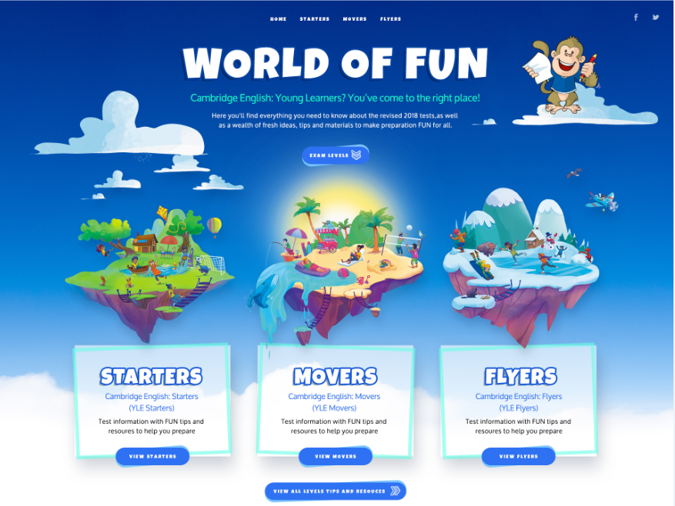
worldoffun.cambridge.org
Information, resources, teaching tips and more
Notes:
Another source of resources is the World of FUN website. This is an online hub for resources and teaching tips, such as videos, to help learners prepare forStarters, Movers and Flyers.

Slide 39
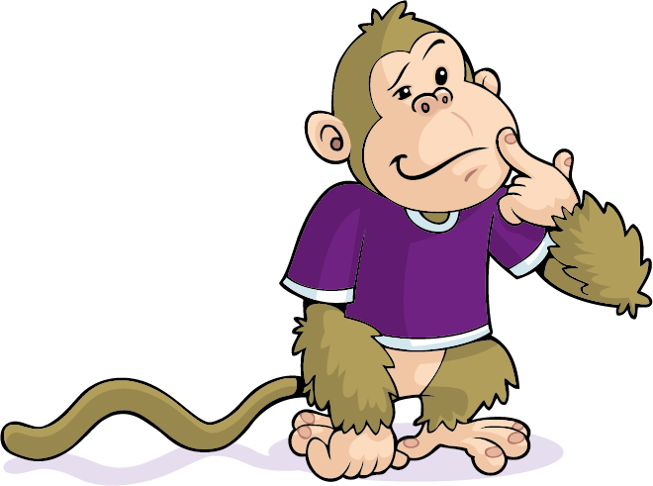
Questions ?
Notes:
Questions

Slide 40
Благодарим за внимание!
Наши социальные сети

