Slide 1
Что такое страноведение для старшеклассников?
Уроки, на которых говорят. США, Австралия, Канада
Марианна Юрьевна Кауфман
автор курса «Happy English. ru» Master of Arts in Sociolinguistics University of Essex

Slide 2




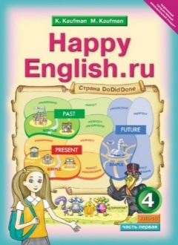
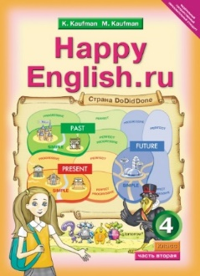







УЧЕБНИКИ

Slide 3





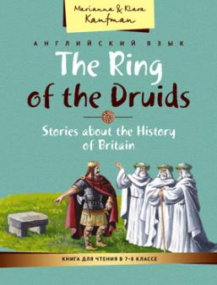
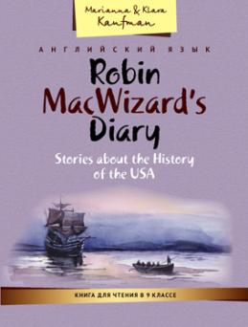
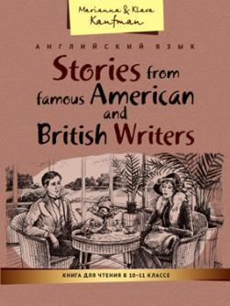

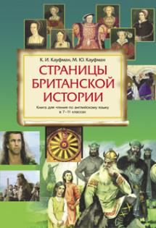


ПОСОБИЯ

Slide 4

Когнитивный треугольник
Знания
ПРЕДСТАВЛЕНИЯ
Ощущения

Slide 5
Использование художественных текстов
Важнейшим средством приобщения учащихся к культуре страны изучаемого языка являются адаптированные тексты художественных произведений. Читая литературные тексты учащиеся становятся виртуальными, эмоциональными свидетелями и участниками происходящих событий, связанных с историей или традициями, знакомятся со специфической стороной культуры другого народа и поэтому являются наиболее значимым средством усвоения лингвострановедческой информации.
Чтение специально отобранных художественных произведений способствует более прочному усвоению культурологических сведений.

Slide 6
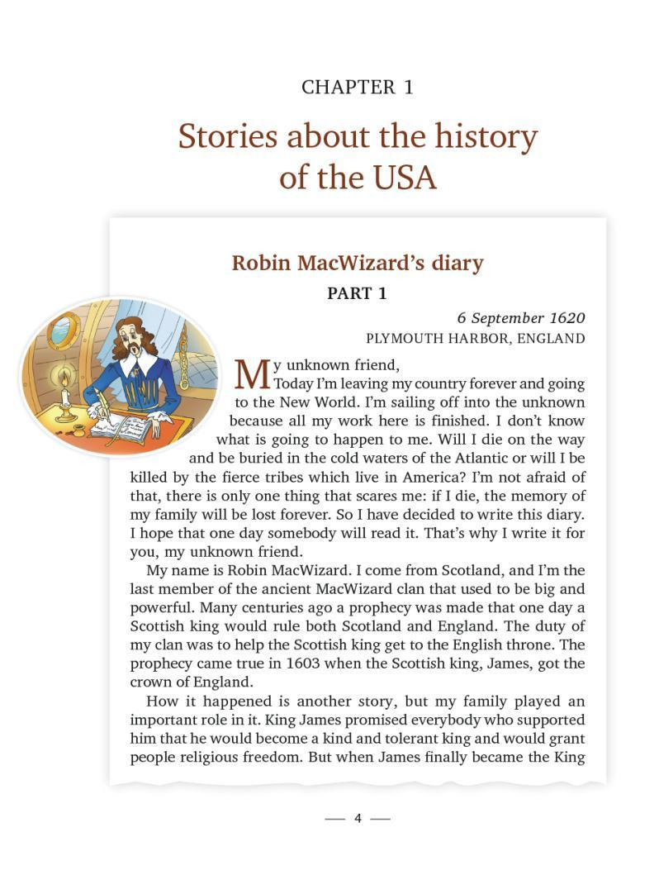
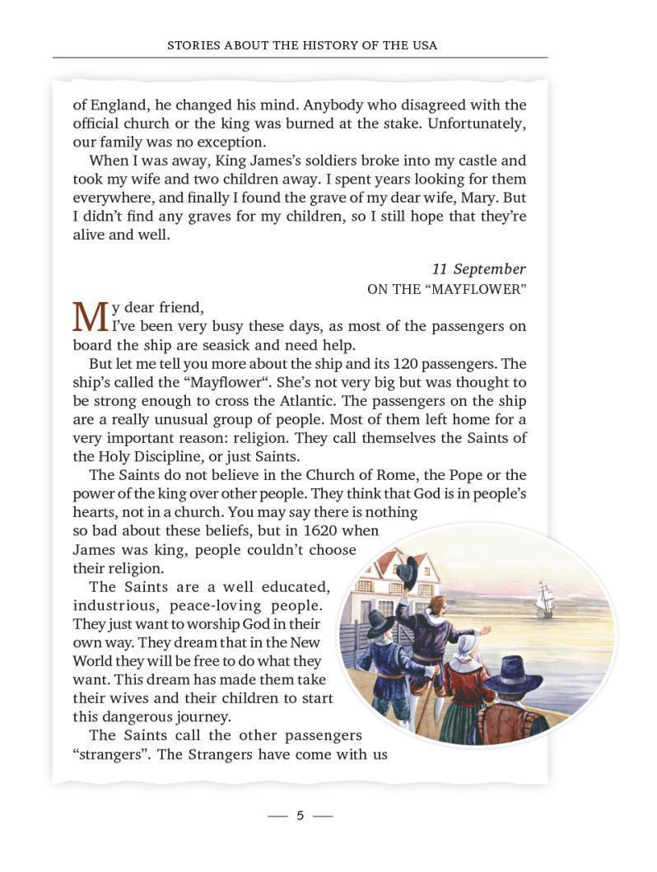
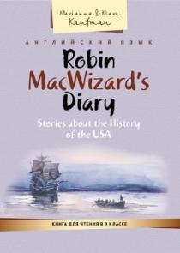

Slide 7
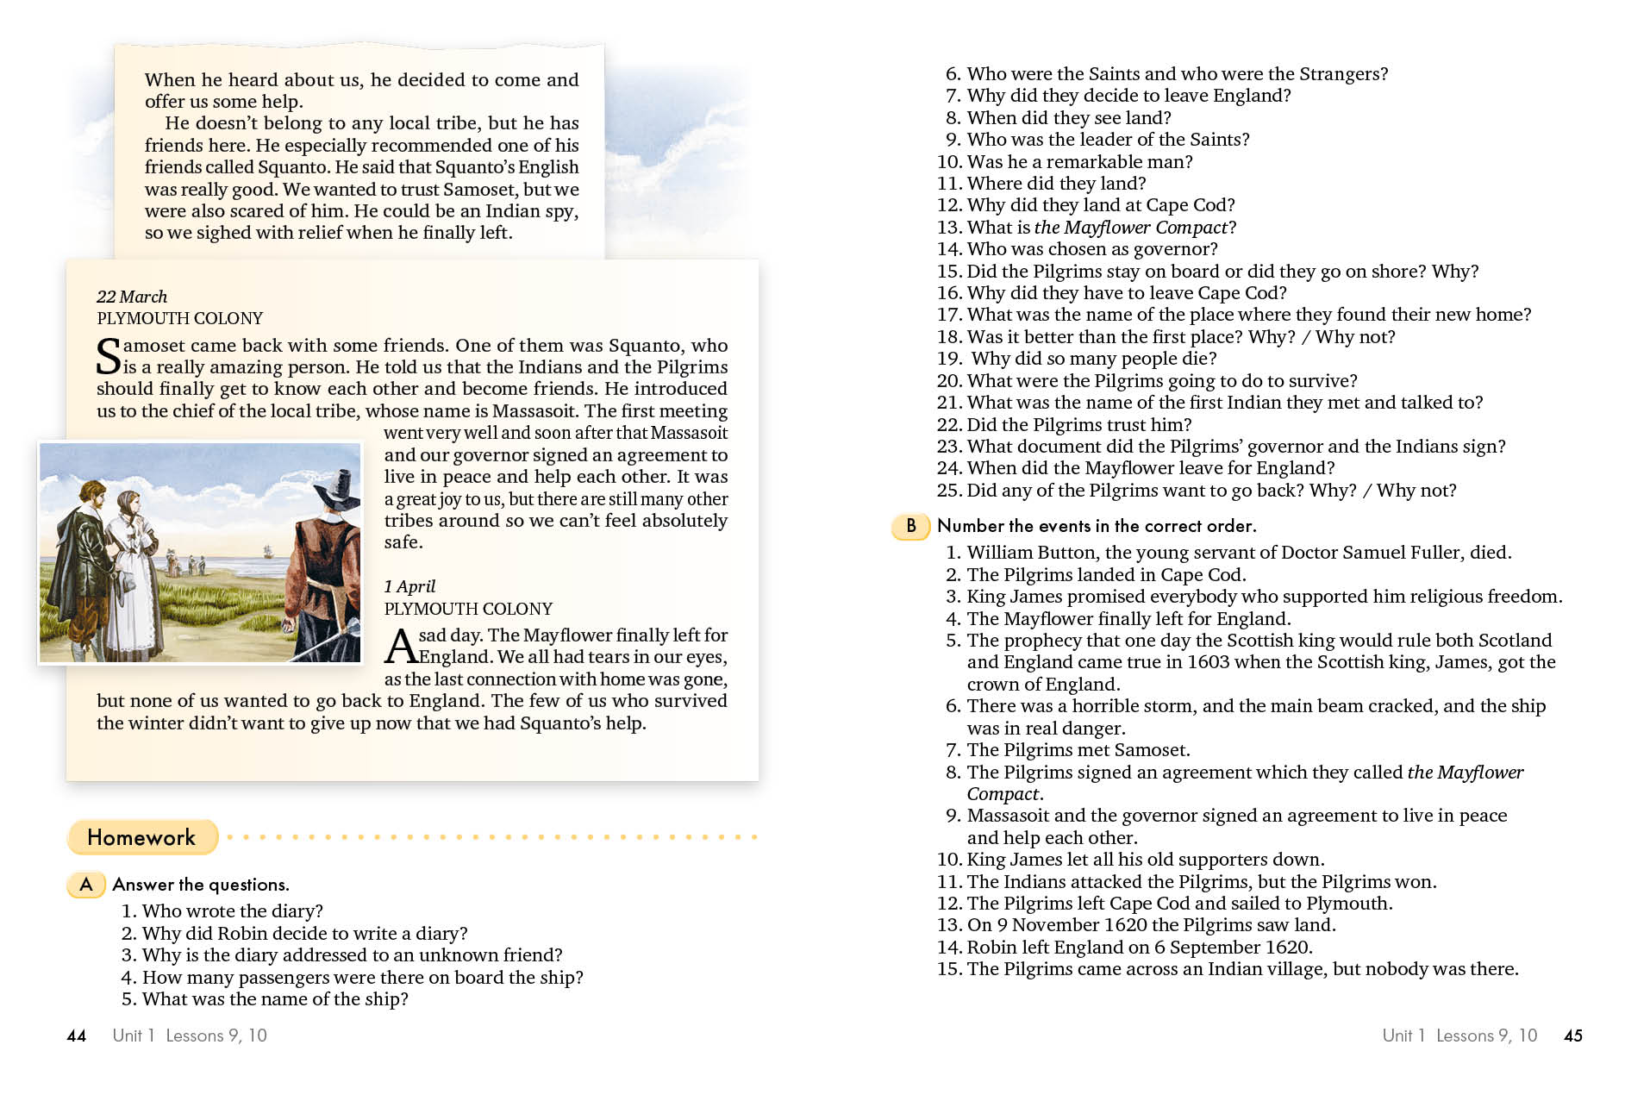

Slide 8
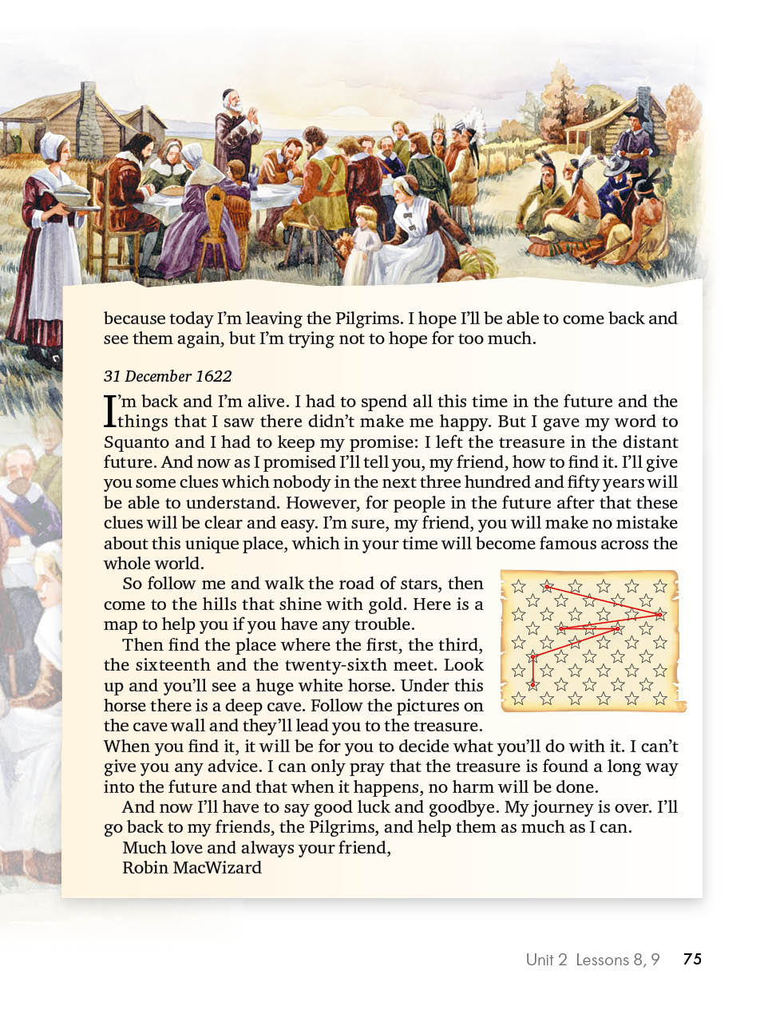

Slide 9
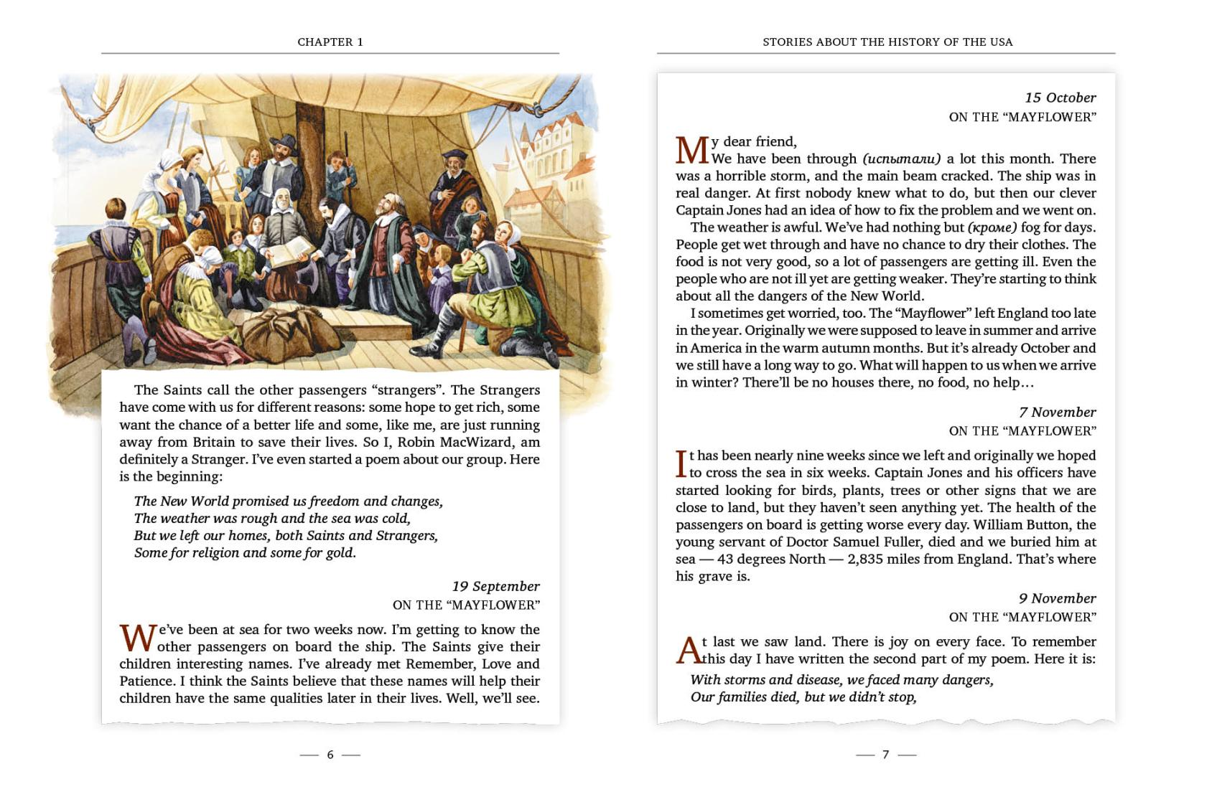

Slide 10
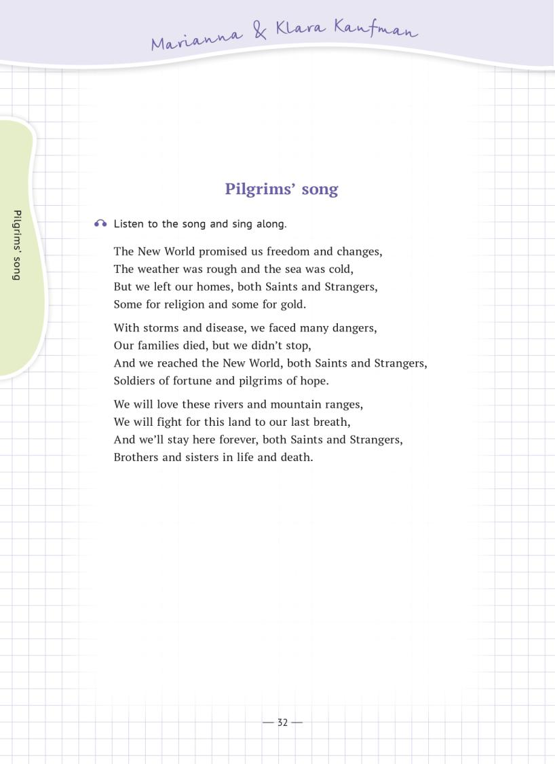


Slide 11




The name of the country was given
  by First Nations.
  by the French.
  by the Vikings.
First Nations are
  the French people who came to Canada in 1603.
  the Americans who came after the American Revolution.
  the aboriginal people of Canada.
The thirteen colonies later became
  the first states of the USA.
  the biggest part of Canada.
  the English part of Canada.
Canada is world known for its
  warm climate.
  rich natural resources.
  ties with Great Britain.
The official language(s) of Canada
  is French.
  is English.
  are both English and French.
French is mostly spoken in
  Quebec.
  Toronto.
  all of Canada.
Loyalists are
  the English who came to Canada after the American Revolution.
  the French who came to Canada after the French Revolution.
  First Nations who were loyal to the Europeans during various wars.
Canada is
  a British dominion.
  an American colony.
  an independent state.
The official head of state in Canada is
  the president.
  the prime minister.
  the British king or queen.
Nowadays one of the biggest problems is that
  Canada wants to gain independence from Great Britain.
  Quebec wants to gain independence from the rest of Canada.
  Canada wants to gain independence from the USA.
The symbol of Canada is
  the pine tree.
  the maple leaf.
  the polar bear.
Using adverbs and conjunctions
Exam tip
Неправильное понимание и употребление наречий и союзов может привести к боль- шому количеству ошибок в любом разделе экзамена. Запишите изученные наречия и союзы и проиллюстрируйте их собственными примерами.
11 Choose the suitable conjunction or adverb to complete the sentences. Sometimes both answers are possible.
(In spite of / However) a very nice climate, this country doesn’t grow much wheat.
(Both / Since) Kate and Jeremy like tomatoes. (However / So) Kate eats them only in a salad.
Unit 3 Lessons 3, 4 115

Slide 12

Her parents didn’t welcome her friends (although / in spite of) the fact that Jenny asked them to.
Neither Jane (nor / or) her husband is a good swimmer.
(So / Therefore) when the waves got higher, they got out of the water.
(Since/ So) Monday was a public holiday, all the shops were closed.
First Nations lived in Canada for thousands of years. (So/ Both) a lot of Canadian towns have got aboriginal names.
His friend was (so / as) brave (that/ and) he didn’t run away when they were attacked by the dog.
He was happy to see us (as if / in spite of) we were his best friends.
(Either / Both) Granny (or / and) mother has taken the key. It was on the table when I left.
Alex is very good at Mathematics. (Besides / So) he speaks English and German.
Mary is my best friend (since / unless) she’s never let me down.
The population of Moscow is more than 11 million people. (Thus / Moreover) it is the largest city in Russia.
(Although / Since) this city is very big and old, it is not the country’s capital.
Transforming statements
12 Change the sentences to the Passive Voice using the verbs in brackets. Model: In our country you can speak either English or French.
Both languages are official. (speak) — In our country both English and French are spoken as official languages.
A lot of the names of our cities and lakes came from the language of First Nations. (give)
Besides, we produce 15% of the world’s diamonds. (produce)
In spite of the fact that the climate is so cold, the aboriginal people, or First Nations, had lived there for thousands of years before the Europeans came. (populate)
In 1603 the French explorer Samuel de Champlain started the colonization of the country. (start)
The French established some of our major cities: Quebec City and Montreal. (establish)
In 1787 the English settlers founded Toronto. (found)
The choice surprised the people so much that they made a lot of jokes about it. (surprise)
Each Canadian province also has its own government which makes all the important decisions. (make)
In Quebec they made French the only official language. (make)
116 Unit 3 Lessons 3, 4

Slide 13


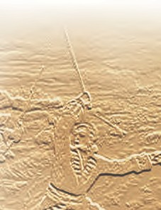




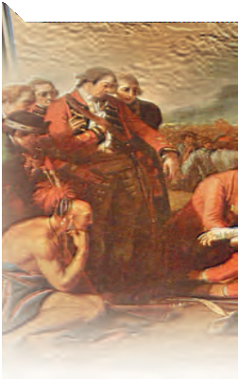
The Maple Leaf Forever
In Days of yore, from Britain’s shore, Wolfe, the dauntless hero came, And planted firm Britannia’s flag, On Canada’s fair domain.
Here may it wave, our boast, our pride, And joined in love together,
The thistle, shamrock, rose entwine, The Maple Leaf forever!
Chorus:
The Maple Leaf, our emblem dear, The Maple Leaf forever!
God save our King (Queen), and Heaven bless, The Maple Leaf forever!
At Queenston Heights and Lundy’s Lane, Our brave fathers, side by side,
For freedom, homes, and loved ones dear, Firmly stood and nobly died;
And those dear rights which they maintained, We swear to yield them never!
Our watchword evermore shall be, The Maple Leaf forever!
Our fair Dominion now extends From Cape Race to Nootka Sound; May peace forever be our lot,
And plenteous store abound:
And may those ties of love be ours Which discord cannot sever,
And flourish green o’er freedom’s home The Maple Leaf forever!
On merry England’s far-famed land, May kind Heaven sweetly smile; God bless Old Scotland evermore, And Ireland’s Emer’ld Isle!
Then swell the song, both loud and long, Till rocks and forest quiver,
God save our King (Queen), and Heaven bless The Maple Leaf forever!
122 Unit 3 Lessons 5, 6, 7

Slide 14














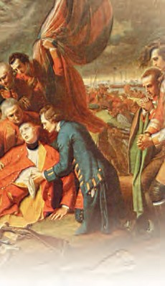

Self-assessment
5 Read the Russian translation of the song and check some of your answers.
Кленовый лист навеки
Мы славу Вольфу пропоем — Отважному герою.
Он водрузил британский флаг Над нашею землею.
Трилистник и чертополох на нем в любви сердечной, И розы стебли оплели Кленовый лист навечно!
Припев:
Кленовый лист — наш добрый знак, Кленовый лист — вперед!
Пусть вечно царствует монарх и клена лист цветет!
В боях при Лунди, Квинстон Хайтс Отцы наши стояли,
За дом, свободу и любовь Дрались и умирали.
И то, за что лилась их кровь, Хранить клянемся вечно;
И тот же все у нас пароль: Кленовый лист навечно!
С пролива Нутка к мысу Рейс Раскинулась Канада,
Пусть будет мирным наш удел, Нам большего не надо.
И пусть мы будем жить в любви, В спокойствии беспечном;
Наш дом свободы осени Кленовый лист навечно!
Господь, храни наш дальний дом, Его солдат, матросов,
Шотландию благослови и Изумрудный остров.
Мы вместе песню пропоем, Пусть слышат горы, реки… Пусть вечно царствует монарх, Кленовый лист навеки!
Перевод Марианны Кауфман
Unit 3 Lessons 5, 6, 7 123

Slide 15
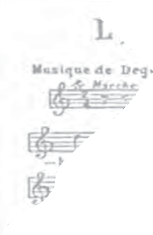
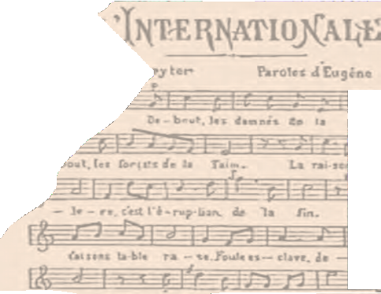
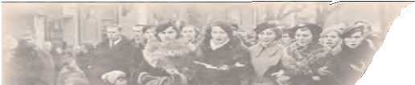
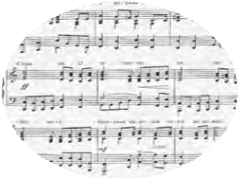


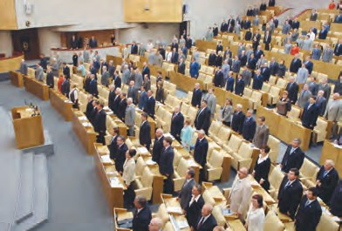
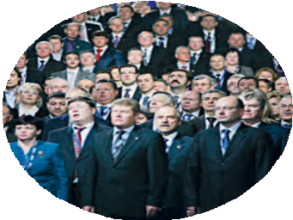
Critical text analysis
A competition.
Look closely at the words of the song and think about why this song never became Canada’s official national anthem? Be the first to write your answer and pass it to your teacher.
Information gap completion
Fill in the gaps with the right facts.
Sergey Mikhalkov, Sergey Mikhalkov and G. El-Registan, Stalin,
2000, The Russian People’s Prayer, after the October Socialist Revolution, until 1944.
It was … who wrote the modern State Anthem of the Russian Federation.
It was in … that the modern anthem was adopted.
It is … that was used as the national anthem before the October Socialist Revolution. This song was known by everybody as “God Save the Tsar!”.
It was … that “The Internationale” was chosen as a new anthem.
It was not … that “The Internationale” was replaced by a new anthem.
It was … who approved the new anthem in 1944.
It was … who wrote the lyrics for the anthem in 1944.
Presenting and discussing information
8 Group work. Talk about Russia. What is our national anthem? Who wrote it? Did our country use to have any other national anthems in the last 100 years? What is your favourite Russian patriotic song? Why? Is there a song which could be called an unofficial national anthem of Russia? Give reasons for
and against it.
124 Unit 3 Lessons 5, 6, 7

Slide 16

Extensive reading
Discuss your answers to Ex. 6. Your teacher will tell you whose answers are politically correct. Then read this piece on political correctness.
For your information
The term “political correctness” or PC is not new to Western and particularly American society. To be politically correct means to behave and speak in such way that you don’t offend anyone. For example, as a man you wouldn’t tell a dirty joke about women in front of a woman or you wouldn’t make fun of a particular ethnic group to a person who was part of that ethnicity. In the past we called this politeness but nowadays it’s called “political correctness”. The idea to show respect to everybody is good, but as it so often happens, people soon started to overdo it. Many American men never open a door for a woman, or offer to pay for her in a restaurant anymore because they don’t want to offend her. You may ask: How can opening a door offend anybody? Some women think that if a man opens a door for a woman, he demonstrates to her that he thinks she is weak and can’t take care of herself.
Political correctness has changed the language too. Older people are not called “old” anymore because it may offend them, so they are officially called “senior citizens”. But a lot of people think political correctness is nonsense. In fact, the term is sometimes used ironically, especially when somebody uses awkward language instead of more traditional words to describe someone.
Guessing meaning
This is a list of politically correct expressions which are generally used in modern English. Try to match these expressions with their more traditional equivalents.
Model: an old person — a senior citizen
a peacekeeper
a rainforest
an African American
a law enforcement officer
a differently abled person
a Native American (US)
a differently sized person
a mentally challenged person
an intellectually challenged person
a letter carrier
a newcomer
a soldier on a mission abroad
a postman
an invalid
a slow learner
a mad person
a Negro
a jungle
a fat person
an Indian
an immigrant
a policeman / a policewoman
Unit 3 Lessons 5, 6, 7 125

Slide 17




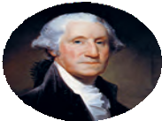






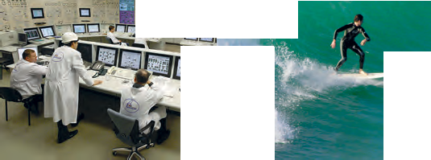





Presenting and justifying opinions
What achievements of their countries would you suggest for Lisa, Belle, David, Mary and Daniel?
Matching
Match the countries with the things that make the players proud. Sometimes more than one match is possi l
  the UK
  the USA
  Russia
  Canada
  Australia
ble.
This country has one of the oldest parliaments in the world. It is also sometimes called the Mother of Parliaments.
A citizen of this country invented the telephone.
This country has never had a Civil War.
This country has never had a revolution.
The first nuclear power station in the world was opened in this country.
This country has more inland waters and lakes than any other country in the world.
The Internet was invented in this country.
It was in this country that the first president was elected.
This country sent the first sputnik to orbit.
This country is home to one of the oldest universities in the world.
Basketball was invented in this country.
This country is home to a lot of unique animals which don’t live anywhere else.
This country has the highest quality of life in the world.
This country’s hockey team has always been one of the best in the world.
140 Unit 3 Lessons 10, 11

Slide 18

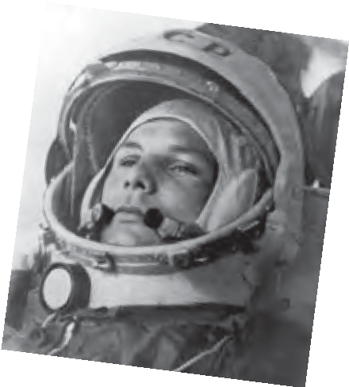
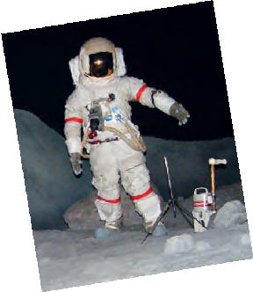

Reading for specific information
5 Read the conversation and say what Mary, David, Belle and Lisa are proud of. Who is ashamed of some of the events in his / her country? What are they ashamed of?
Counsellor: Let’s start with you, Lisa.
Lisa: Russia has got a lot of achievements which are recognised all over the world, but I think the most wonderful thing we have done was to build the first spaceship and to send a man to space.
Belle: You were the first, of course, but the USA has done it too. So I’m keeping my stone.
David: My country hasn’t done it yet. But I don’t think we need so many spaceships anyway. It is much wiser to spend money on health and education. Here is my stone.
Mary: We haven’t done it either. Here is my stone.
Daniel: Take mine too. Australia hasn’t built a spaceship yet either. And I think we should. You’ll be surprised, but the Russian scientist Sergey Korolyov is my role model. He had a dream to fly to space and he fulfilled it, although
nobody believed it was possible. His story is fascinating.
Belle: OK. My turn. A citizen of my country first landed on the moon. Lisa: Here is my stone. We haven’t done it yet.
David: Nobody else has done it, right? So each of us should put in a stone.
Now it’s my turn. Although my country is an island, we, together with France, have made a tunnel connecting Britain to the continent. The Channel Tunnel which was opened in
1994 is the second-longest tunnel in the world. Amazing, isn’t it?
Lisa: I couldn’t agree more. This is a real wonder. We haven’t got a tunnel like that. Here is my stone.
Belle: We haven’t done anything like that either, and I agree it was an awesome project.
Mary: Neither has Canada, but not everybody needs a tunnel like that.
Daniel: That’s exactly what I think. I don’t think we need a tunnel like this. Here’s my stone.
Unit 3 Lessons 10, 11 141

Slide 19
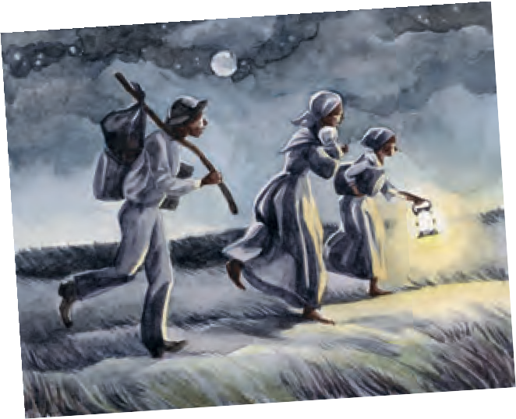
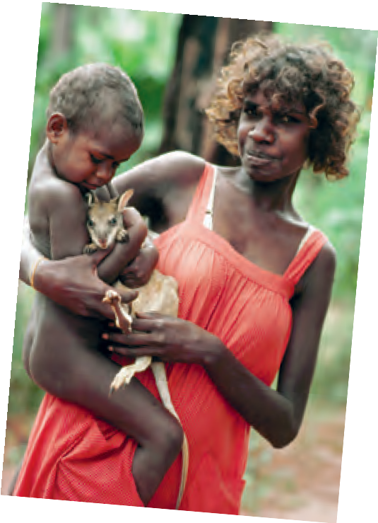
Mary: All the achievements that have been mentioned are great. I’d like to speak about something which is less impressive, but not less important. I think the greatness of a country is also in how it treats the old, the poor and the weak. I’m proud that my country didn’t only free its slaves but also gave them equal rights. Moreover, it helped the slaves from the USA in times when slavery there was still legal. To me this shows that Canada is a real democracy which has true respect for everybody’s rights and freedoms.
Belle: The USA also freed its slaves, but it didn’t happen until after
the Civil War. I come from South Carolina, one of the Southern states. My great-grandfather used to have slaves. He was not
a very good master and his slaves often tried to run away to Canada. I think this is a very shameful part of our family history. Here is my stone.
Lisa: We didn’t have many slaves from Africa in Russia, but a lot of Russian people themselves used to be slaves until 1861. Although slavery was abolished in Russia, in my opinion, it happened too late. Here is my stone.
David: I believe there wasn’t any real slavery in modern England.
However, I’m sure there’s also some law which makes slavery illegal. So I think I can keep my stone.
Counsellor: May I interrupt here? I’m not sure I agree with you. What about the British colonies? Those colonies had slavery and they were part of Great
Britain. I think you need to give us your stone, David. Now what about you, Daniel? There weren’t any real slaves in Australia, were there?
Daniel: We didn’t have real slavery, it’s true. But what we had was probably in some ways worse. Have you ever heard about the stolen generations?
David: Yeah, I’ve read something about aboriginal children who were brought up by church missionaries, but that was ages ago, right?
142 Unit 3 Lessons 10, 11

Slide 20
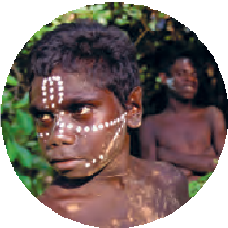
Daniel: The truth, that not everybody knows, is that a large number of aboriginal children were taken from their own parents until 1970. By that time about 100,000 aboriginal children
had been either taken away by government officials, or simply stolen from their own families. When the children were removed
from their homes, they were usually very young,
so they didn’t remember their parents. They were told that they had been orphans. Later those children were raised by foster families or church missionaries.
Mary: But how could the government explain these actions?
Daniel: The Australian government said that it was trying to help. The European Australians had decided that the aboriginal people were not fit to raise their own children. The government also said that this policy would help the aboriginal children to integrate into Western society. However, in reality the government just wanted to wipe out the aboriginal culture.
Lisa: And the easiest way to kill a culture is to interrupt the connection between generations.
Daniel: Exactly. Children of the stolen generations didn’t know their own language and didn’t even remember the faces of their own mothers.
Belle: But what happened to these children when they grew up? Anyway when those children grew up, they all got a good education, good jobs and became useful members of society.
Daniel: I can’t agree with you here. What you are talking about is our Western values. But we need to understand that our values are NOT universal. I’ll tell you one story that happened to me. Before we moved to Sydney, our family had lived in the outback.
One day I was playing in the garden when an old aboriginal woman came up to me. She smiled and started to sing. I jumped on my
feet and ran away. “Mum, help!” I shouted, “There is a dark, scary woman in the garden!” Mum hurried to the garden while I stayed inside.
That night Mum cried a lot, but she refused to tell me why.
Only years later she told me that the woman had been her mother, my granny.
Belle: That’s awful! But why didn’t she introduce you to her?
Unit 3 Lessons 10, 11 143

Slide 21



Daniel: It was the first time they had ever met. When my mother was two, she got ill and Granny brought her to the hospital. Later Granny was told that her daughter had died, but she didn’t believe it. She started looking for her child and she didn’t give up even 30 years later. When they met on that day, they couldn’t even talk to each other properly because Mum didn’t speak a word of her mother tongue and Granny’s English was very poor. Soon after that, we left for Sydney. That’s the end of my story. Here is my stone.
Counsellor: Thanks, Daniel. It is obviously a touchy subject for you. (pause) Well, it looks like it’s time for dinner. Hurry up, everyone, or we’ll be late.
Giving short and extended answers
Answer the questions.
  What is Lisa proud of?
  Do a lot of countries have spaceships?
  A citizen of which country landed on the moon?
  Which country managed to connect itself to the continent?
  What countries are connected by the Channel Tunnel?
  What does Mary think makes a country great?
  What is Mary proud of?
  Why did American slaves run away to Canada?
  What is Belle ashamed of?
  What is a touchy subject for Daniel?
  What are the stolen generations?
  What happened to the aboriginal children?
  How did the Australian government explain its actions?
  What is the easiest way to kill a culture?
  Why does Daniel take the story of the stolen generations so close to heart?
  What lesson should everybody learn from Daniel’s story?
  Why did the counsellor try to change the topic?
Expanding on the topic
Which of these achievements are more / less important to you? What other facts from the Russian history make you proud?
Building up speaking skills
Group work. Form groups of 4–5 players. Play the game “I have done it”. The rules are the same as in Ex. 2.
Model: A: I have been to Turkey.
B: Me too. So I keep my stone.
C: I haven’t yet, but we are going next year. Here is my stone.
144 Unit 3 Lessons 10, 11

Slide 22
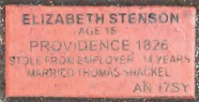
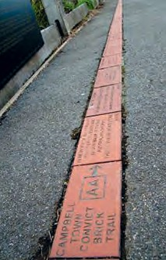
A lot of convicts
  were very dangerous people.
  came from America.
  were sent to Australia for some serious crimes.
  were nothing more than scared and hungry teenagers.
Australians used to
  be proud of their convict ancestors.
  be ashamed of their convict ancestors.
  study their country’s history carefully.
  look for relatives in America.
In the twenty-first century, Australians claim that it is due to their convict ancestors
  that they can travel to America.
  that their country is free from British rule.
  that they always have something to talk about.
  that independence and equality before law are the country’s fundamental values.
Campbell Town Trail
For some tourists who visit Tasmania, Campbell Town is just another good highway stop with delicious coffee and meals available. They visit the antique and speciality shops, admire the colonial architecture, take a couple of pictures, and drive away. After all, it’s nothing but a small town with a population of about 900 people. However, as the locals like to say: ”There is more to Campbell Town than what meets the eye,” and Australians themselves try to make time for a visit.
The thing that attracts them may seem strange for an ordinary tourist. It is called the Convict Brick Trail. The trail of bricks was created to commemorate nearly 200,000 convicts who were transported to Australia for almost 100 years from 1788 onwards.
Over 70,000 of them came to one of Australia’s
states called Tasmania. Today it is estimated that 80 % or four out of every five Tasmanians have a little convict blood in their veins. The bricks record the names, ages, crimes, sentencing dates and transport ships of many of the convicts transported to Australia.
Unit 4 Lessons 13, 14
221

Slide 23
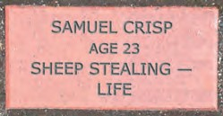
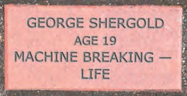
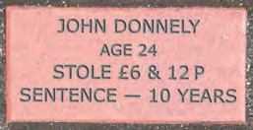
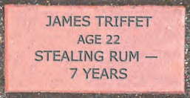
The first brick was laid by Mayor Kim Polley on August 28th 2003. It was dedicated to those who died on their way to Australia and never got to live their life in this beautiful land.
Indeed, when carefully read, the bricks of Campbell Town tell a heartbreaking story.
Walking along the trail, you will soon find out that many of the “convicts” were sent to Australia by corrupt judges for minor crimes such as stealing bread or riding off with someone’s horse based on accusations by rich aristocrats.
The youngest convict ever transported to Australia was Mary Wade who was sentenced to death for stealing another girl’s clothes. She was only 11 when her death sentence was changed to living in Australia. Not only did she survive transportation across the globe but she later gave birth to 21 children. Mary Wade is considered to be one of Australia’s founding mothers who at the time of her death had 300 descendants. One of her most famous descendants is Australian ex-prime minister Kevin Rudd!
One may think that having convicts among your ancestors should be treated as a “skeleton in the closet” and Australians used to agree. At school Australian history wasn’t even a proper subject, as students would be told their country had no history. However, this attitude started to change after World War II. A new generation of Australians regards a convict in their ancestry as enormously desirable and takes great pride in their family history. Australians now hope that when they begin searches, they will be able to find someone in their early family who has had such an interesting life that it is worth repeating to everyone prepared to listen. The Convict Brick Trail gives every Australian the chance to search for a convict ancestor amongst the thousands of bricks lining the High Street. Many surprised Australians even discover a shared heritage with Americans, as England also sent convicts to the American colonies until the Revolution. So, all in all, nowadays the most challenging question in Australian history receives a very confident answer from the people themselves. “What effect did the convicts have on the Australian national character? They made us a truly democratic nation.”
222
Unit 4 Lessons 13, 14

Slide 24


8 Определите, какие из этих утверждений соответствуют содержанию тек- ста (True), какие — не соответствуют (False) и о чем в тексте не сказано (Not Stated).
Campbell Town is situated in Tasmania.
More than 50 % of the convicts sent to Australia went to Tasmania.
The bricks make it obvious how insignificant the crimes of some convicts were.
Nowadays, in England one can be sentenced to 10 years in prison for stealing.
Australians used to keep their convict roots very quiet.
It is believed that most of the population of Tasmania have convict ancestors.
The bricks in the Convict Trail witnessed the days when the convicts came to Australia.
Kevin Rudd is mainly famous for being related to one of Australia’s founding mothers, Mary Wade.
World War II was the turning point when Australians started accepting their convict history.
Modern Australians invest all their free time in digging into their convict roots.
It is thanks to their convict background that Australian sportsmen are so hard to beat.
Письмо и Говорение
9 Обсудите эти темы и напишите план сочинения или высказывания для каждой из них.
Trying to pretend some things in history never happened, will only make them more of a problem. Comment and give examples.
Dwelling on unpleasant parts of history prevents a nation from moving on and has a negative effect on a national spirit. Comment and give examples.
Celebrating Victory Day every year is as important for our generation, as it was for the generation of our grandparents. Comment and give examples.
10 Напишите сочинение (200–250 слов) на одну из вышеуказанных тем.
11
Подготовьте высказывание на одну из вышеуказанных тем.
Unit 4 Lessons 13, 14
223

Slide 25
Наши социальные сети

