Slide 1
BOOSTING YOUNG LEARNERS SKILLS

Slide 2
Successful language learning requires…
Motivation
Confidence
Fun
Clear objectives
Right level and content
Practice
Enjoy their classes
Get positive learning
experience
Notes:
[Before showing the slide, ask the audience what they think are the important factors for successful language learning. Note that the themes on this slide are repeated throughout the presentation – shown in capitals in the notes – to demonstrate how Starters, Movers and Flyers are designed to reflect best practice.]
MOTIVATION - this is crucial to learners developing their English skills. Motivated teachers and parental involvement both also play an important role in motivating students.
CONFIDENCE – using a foreign language requires having confidence in all 4 skills (reading, writing, listening, speaking). It is particularly important for young learners that confidence is built up gradually and maintained over time.
FUN – children are more likely to stay motivated if they are enjoying themselves
CLEAR OBJECTIVES – having clear and attainable goals helps schools and teachers to structure their course, which increases learners’ motivation as they have a better understanding of how they are progressing.
RIGHT LEVEL and CONTENT – at this age, children are still developing their first language skills, they have limited world knowledge and reasoning skills. Children will perform better if the materials they use take these factors into account and are appropriate to their age and level. To be successful in learning a language, you also need to learn all the different skills and not just grammar and vocabulary, or the passive skills of reading and listening.
PRACTICE – learning any new skill requires practice and getting to a good level takes time. Starting young will help to give learners a head start on their lifelong language learning journey.

Slide 3

MOTIVATION
Intrinsic motivation
(comes within the individual,
e.g. the enjoyment of the learning
process itself/ a desire to make
themselves feel better)
Extrinsic motivation
(caused by any number of
outside factors)

Slide 4
TO HELP YOUR STUDENTS ENJOY THEIR CLASSES
Start with a smile
Don’t give homework at the end
End with something nice:
a complement (if it has been earned!) on what the students have
managed to do this lesson, or on their behavior;
congratulations on an achievement of one of the students;
singing Happy Birthday to someone with a birthday

Slide 5
CAMBRIDGE ENGLISH TEACHER COMPETITION
CAMBRIDGE ASSESSMENT ENGLISH & CAMBRIDGE UNIVERSITY PRESS
Отборочный тур: 13 сентября 2021 г. – 1 декабря 2021 г.
Финальный тур: 13-20 декабря 2021 г.
https://urok.1sept.ru/contests/cambridge-english-teacher

Slide 6
Make sure the activities involve some kind of fun challenge
The task is obviously easy, but its achievement is limited by rules:
Find out what I have in my hand, but you can only ask ‘yes/no’ questions.
Make up a sentence but it must be obviously untrue.

Slide 7
Check the activity is learning rich
Wordsearch, ‘Hangman’, ‘Word jumbles’
‘Guess what I’m miming’

Slide 8
Keep activities simple
BINGO (cards)
an alternative version of BINGO (words on the blackboard)

Slide 9
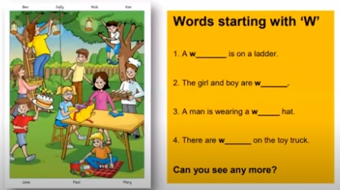
Ideas and activities to develop vocabulary

Slide 10
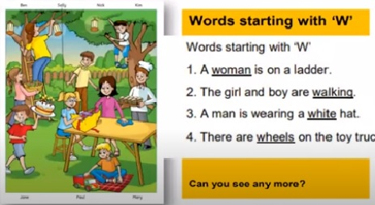

Slide 11
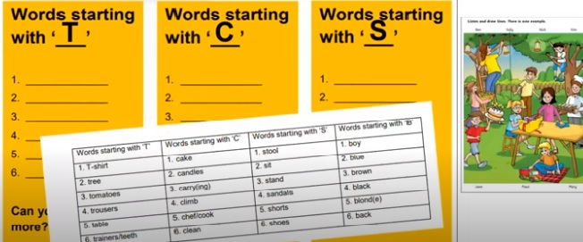

Slide 12
Activity title | Revising vocabulary (2-5 minutes, as a filler at the end of the lesson)
Skill(s) | vocabulary
Level (s) | Pre A1-A2
Aim (s) | to revise vocabulary
Materials needed | none
Preparation | none
Procedure | 1. The teacher stands at the blackboard, imitating saying the alphabet silently. 2. The student nominated by the teacher says ‘Stop!’ and the teacher announce the letter. 3. The students brainstorm the words starting with the letter. The student who says the last word is the winner and has the right to stop the teacher next time.
Variation(s)

Slide 13
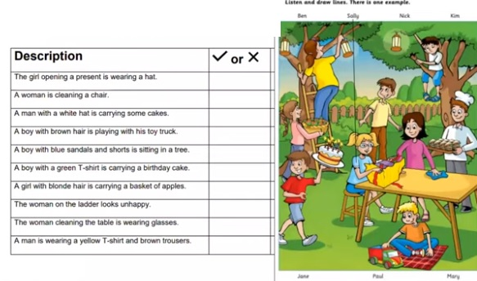
Reading

Slide 14
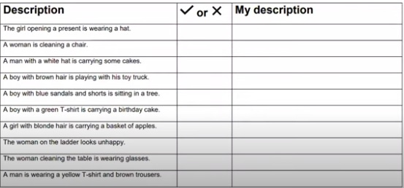

Slide 15
Activity title | Building sentences at Pre-A1 – A1 levels
Skill(s) | writing
Level (s) | Pre-A1 – A1
Aim (s) | to prepare students for writing
Materials needed | a picture, set of cards, copybooks
Preparation | Select a picture and prepare sentences about it; prepare cards with corresponding words
Procedure | Step 1. Divide students into pairs or small groups. Step 2. Give each group a set of cards containing the words that can be used to form a sentence. Step 3. Students race to put them in the right order to make the sentences and then copy the sentences onto their copybooks
Variation(s) | Instead or preparing cards with the words, these words could be cut out from different magazines, then the setting could be sending in code messages.

Slide 16
Writing from the very start
The boys and the dog are laughing.
Sam and Tom are fishing.
It’s sunny.
The dog is looking for fish in the river.

Slide 17
Activity title | Dictation with Mother-tongue accent
Skill(s) | Pronunciation, listening, writing (spelling)
Level (s) | Pre-A1 – A2+
Aim (s) | Correct mispronounced words/sounds, practice writing down.
Materials needed | notebooks
Preparation | Select a passage (2-3 sentences) from the current unit of the coursebook
Procedure | Step 1. Read the first sentence with a heavy mother-tongue accent. Step 2. Ask 2-3 individual students ‘to correct’ you and to say the same sentence with as good pronunciation as they can. After that ask the whole class say it together. Step 3. Now the students can write down the sentence.
Variation(s) | It’d be useful if you select the passage that is recorded, so that students could read their writing together with the recording.

Slide 18
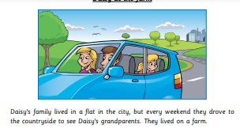
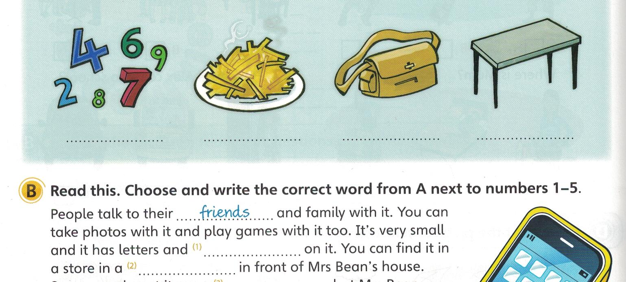
A 1 Movers. Sample test
Fun for Starters

Slide 19
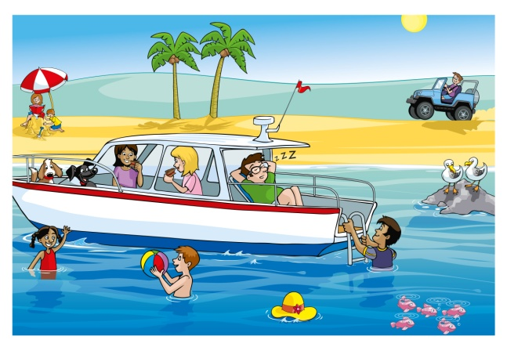
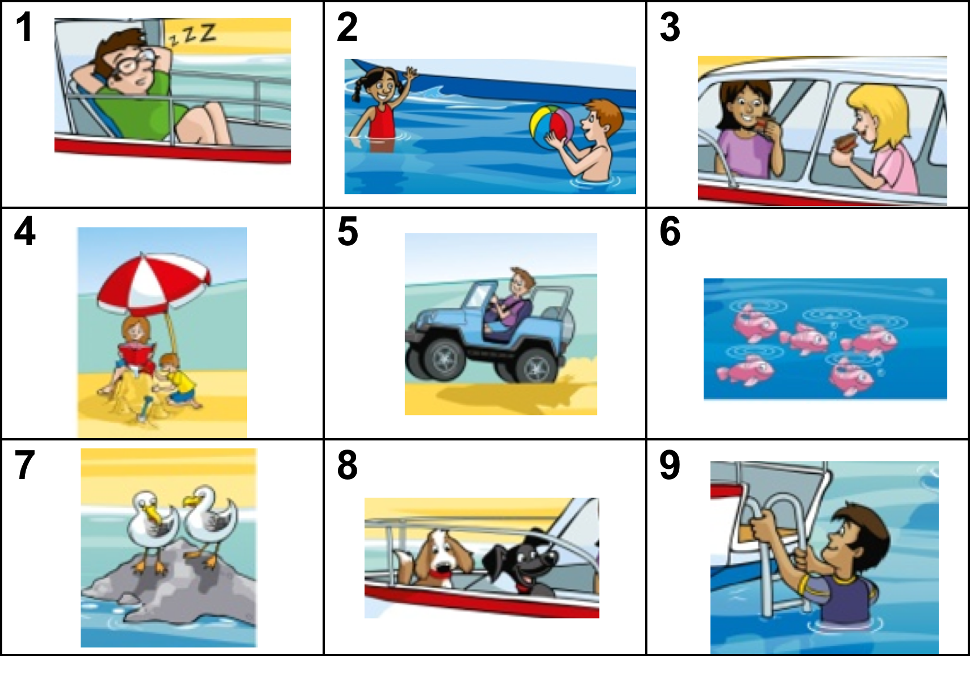
Board rush
Speaking: Noughts and Crosses

Slide 20
SOME ACTIVITIES TO RECYCLE A COURSEBOOK TASK
Ask students to close their books, and write down as much as they can remember of the exercise
the text.
Tell students to do the exercise or text again, but inserting one new word in each sentence.
Do the same, but changing one word in each sentence.

Slide 21




Slide 22
SOME FREE INTERNET RESOURCES
https://vk.com/wall-20535929_2455
https://learnenglishkids.britishcouncil.org
https://studfile.net/preview/3730738/

Slide 23

Questions ?
Notes:
Questions

Slide 24
Наши социальные сети

