Slide 1
СОВРЕМЕННЫЕ ТЕХНОЛОГИИ
ЯЗЫКОВОГО ТЕСТИРОВАНИЯ

Slide 2
TESTING
MATERIALS
PROCEDURE
ASSESSMENT

Slide 3




4 SKILLS AT DIFFERENT LEVELS

Slide 4
A2 Key for Schools
CEFR Level A2
Reading and Writing | 60 mins | Can understand short texts and messages, and write about daily life, hobbies, holidays, etc. in short, simple texts
Listening | Approx. 30 mins | Can understand simple questions and instructions
Speaking | 8-10 mins | Can make simple plans and express likes, dislikes and opinions using simple language
Total exam length | 98-100 mins
Notes:
Key for Schools has 3 papers and takes less than 2 hours in total. We saw earlier that the exams are linked to the CEFR, which describes what the learner can do at different levels. This table shows some of the things that a learner at A2 level can typically do.

Slide 5
B1 Preliminary for Schools
CEFR Level B1
Reading | 45 mins | Can understand factual texts
Writing | 45 mins | Can write about everyday subjects
Listening | Approx. 35 mins | Can understand instructions and understand main points from a talk or TV programme on familiar topics
Speaking | 10-12 mins | Can talk about reactions to films, music, etc. and give practical instructions
Total exam length | 135-137 mins
Notes:
While Reading and Writing are combined into one paper for Key for Schools, they are separated into two papers for Preliminary for Schools as the paper would be very long otherwise. In total Preliminary for Schools takes approx. 2 hours and 15 mins. The statements are some examples of what a learner can typically do at B1 level of the CEFR.

Slide 6
READING

Slide 7
What helps students to develop their reading skills
Prediction (from headings, pictures, own ideas)
Familiarisation with different types of text
Understanding of text structure
Development of different skills (skimming, scanning for specific information, reading for detail)
Vocabulary development
Working out meaning from context
Notes:
Elicit participants’ ideas about what helps students develop their reading before showing the slide. Which reading skills are tested in Key and Preliminary? (skimming, scanning, reading for detail are all tested) With vocabulary, knowing a range of synonymous or near synonymous words/phrases at the right level will help with exam reading (and listening) tasks.

Slide 8
‘Traditional approach’
Introducing new vocabulary
Reading out loud and translating the text
Answering the questions after the text/doing other comprehension activities

Slide 9



A2 Key and B1 Preliminary Reading Part 1
notices
signs
instructions
emails
messages
notes
postcards
Notes:
Students need to be familiar with a range of text types and their conventions: notices, emails, messages, signs, instructions, postcards, etc. This could be integrated with writing practice, so students write their own notices, emails, etc. after reading practice. If your school has signs or notices in English, you could use these as authentic examples or you could ask the students to create English language signs for the classroom or school. At both levels, students will need to be able to understand sentences with more than one clause, particularly at B1. Having a good range of vocabulary is also essential for good reading skills.

Slide 10
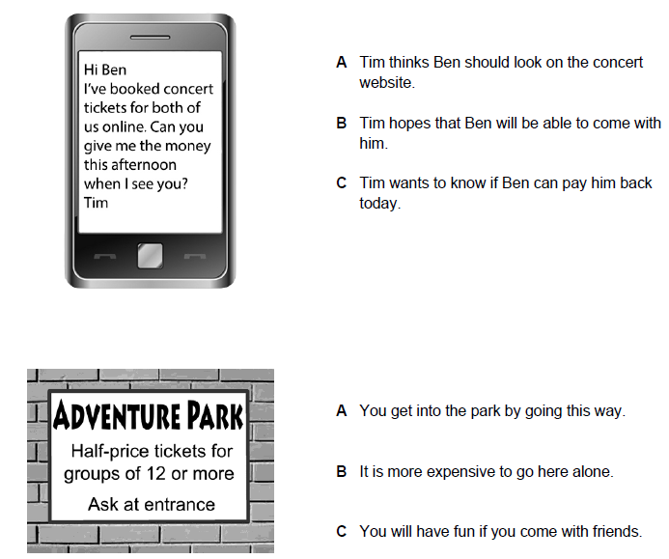
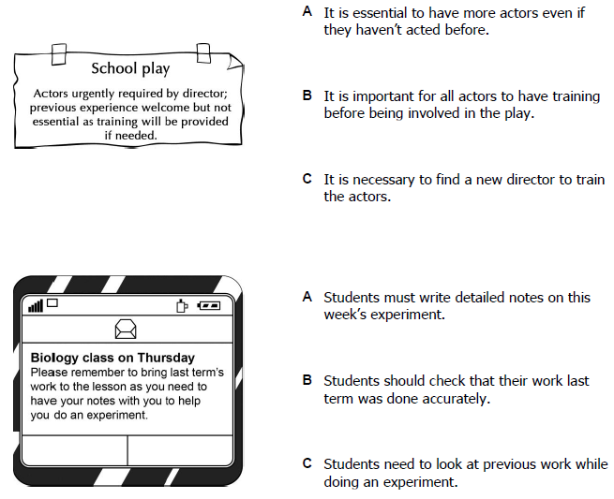
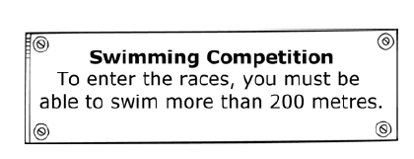
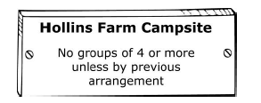
A2 Key and B1 Preliminary Reading Part 1
D
A
B
E
C
F
Notes:
The Part 1 task in A2 Key/Key for Schools Reading and Writing is in line with the B1 Preliminary/Preliminary for Schools Reading Part 1. Can you identify if these texts are from A2 Key/Key for Schools or B1 Preliminary/Preliminary for Schools? Which vocabulary or structures are more B1 than A2.
A and F are from Key and D is from Key for Schools. The level of vocabulary and structures is more basic. Notice the different topics used in the “for schools” and standard exams.
B, C and E are from Preliminary for Schools. The vocabulary is at a higher level (e.g. experiment, essential, previous arrangement, etc.). The wording of the questions also uses higher level vocabulary. Structures are also at a higher level in both the texts and the questions (e.g. passives, conditionals, multiple clauses, linking words).

Slide 11
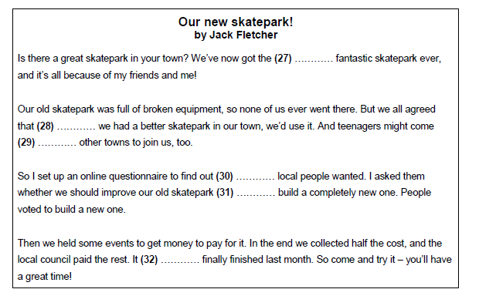
B1 Preliminary for Schools Reading
What kinds of language are tested?
superlatives
conjunctions
prepositions
relative pronouns
conjunctions
auxiliary verbs
Notes:
Paying attention to what comes before and after a gap is also useful for B1 Preliminary/Preliminary for Schools Reading Part 6, which is an open cloze – students have to decide which word to put in the gap and there are no multiple-choice options. What kind of things might be tested? For example, what word should go in gap 27? “Most” is the answer, so it is testing superlatives. What else is being tested here? Check which words go in each gap (27. most 28. if / when 29. from 30. what 31. or 32. was) and then look at what type of language is being tested in this task. Note that this task doesn’t just have a grammatical focus, it could also test a lexical element, such as phrasal verbs or fixed phrases.
The Teacher Handbook has a list of structures tested at this level.

Slide 12
Some problems learners can have with the Reading paper
Learners don’t understand what they have to do in the task.
Learners don’t read the instructions for the tasks carefully.
Learners wordspot.
Learners try to read and understand every word in the text.
Learners don’t underline key words.
Learners answers aren’t based on the text, but on their general knowledge.

Slide 13
WORD-SPOTTING
argued checked arranged contacted booked
    We made plans to go out for dinner.
    They disagreed about which film to see.
    I made sure that I had my passport with me.
    He reserved a room at the hotel in advance.
    She got in touch with the school secretary to ask for more details.
Notes:
Give participants a chance to briefly do the task – replace the underlined words in each sentence with one of the words in the box.
Before reading tasks, you can create tasks like this that anticipate words used in the reading texts. It’s useful for all reading tasks in Key and Preliminary, in particular multiple-choice texts, to help raise awareness of paraphrasing and using synonyms.

Slide 14
Ignoring words you don’t know
Procedure
1 Give learners true or false statements.
2 Give them a text with a number of words blanked out. They decide if the statements are true or false after reading the text.
3 Ask them to do the task and then discuss with their partners whether they needed the blanked out words.

Slide 15
IGNORING WORDS YOU DON’T KNOW
TRUE/FALSE
In fact, many old languages are disappearing in the UK. People on the Isle of Man spoke Manx for ….. until the last native …. died in the 20th …. . The same thing has …. to Cornish. Cant was a language spoken by …. who were bringing goods into the country …. , or travelers and criminals. It …. them to keep secrets from the …. but it too has disappeared.
People who come from the Isle of Man can speak Manx.
Cant was a special language.

Slide 16
WRITING

Slide 17

What helps students to improve their writing?
Being motivated
Analysing models of different types of text and understanding the different conventions used (e.g. article, email, story)
Building up to writing through staged tasks that provide scaffolding
Being aware of all the features that good writing involves
Thinking about the target reader
Understanding what the task requires
Notes:
Go through these points and develop and expand where necessary.

Slide 18

What helps students to improve their writing?
Planning what to write
Organising ideas
Using a range of vocabulary and grammatical structures
Using linking words (e.g. but, although, before, because, etc.)
Avoiding repetition
Checking for errors
Self-assessment and peer assessment
Feedback from teachers
Keeping a learning diary
Notes:
In this seminar, we won’t go into ‘Keeping a learning diary’ but it’s a great way of getting students to write in class and keep a record of how they’re learning and progressing.
After going through the points on the slide, ask participants ‘What helps students to write better when they do exam tasks in Key and Preliminary?’. When preparing for and doing the exams, students need to develop the same skills outlined on this slide as the exam tasks are designed to reflect the different writing skills that learners need at this level. You can use tasks from the sample papers in class to develop these skills. We will now look at some ways to develop some of these skills.
Remind participants that learning is best when it’s distributed over a long time period rather than an intensive burst of learning.

Slide 19
Motivating students before writing
Get them interested in the topic before they do a writing task
Discuss the topic
Ask and answer questions about the topic
Brainstorm ideas around the topic
Elicit relevant vocabulary
Encourage prediction
Notes:
Elicit ideas about how to motivate students before doing a writing task, then show the points on the slide.

Slide 20
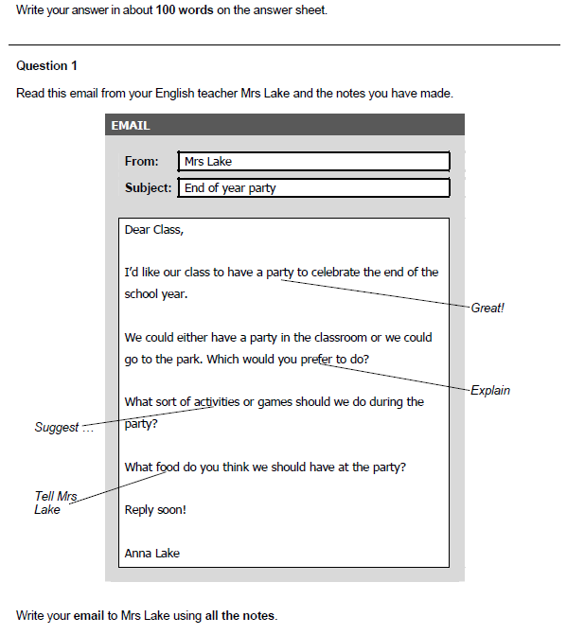
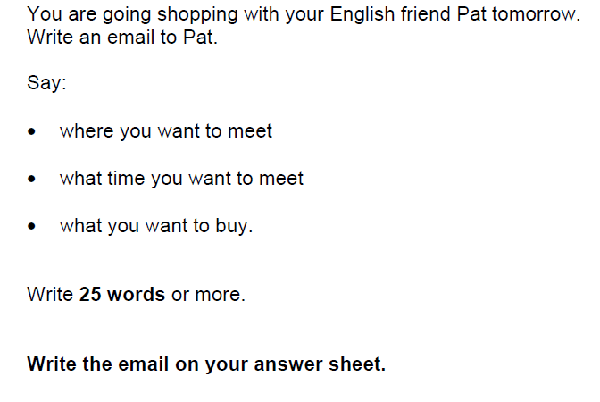
Progression
A2 Key for Schools
B1 Preliminary for Schools
Notes:
The exams are designed to help learners gradually build their skills as they progress from one level to the next. This slide shows a writing task from A2 Key for Schools and one from B1 Preliminary for Schools. In both exams, the candidates have to write an email, assessing their ability to write a communicative message. There are some similarities, for example, candidates respond to prompts given. However, in order to prepare for B1 Preliminary for Schools, candidates need to be able to write a longer text (100 words versus 25 words or more), which requires new skills such as organising ideas. The level of language required for B1 Preliminary is also higher – in this example, the candidate needs to explain and suggest.
As with other skills, the exams are designed to develop writing skills step by step. From writing at word level at Pre A1 Starters, to sentence level at A1 Movers and paragraph level at A2 Flyers/A2 Key for Schools, learners start to write more extended texts from B1 Preliminary. As learners then progress to B2 First and above, the word length increases and candidates also have to write different text types (articles, reviews, reports, etc.) and develop skills such as expressing and justifying opinions, persuading, summarising key points, etc.

Slide 21
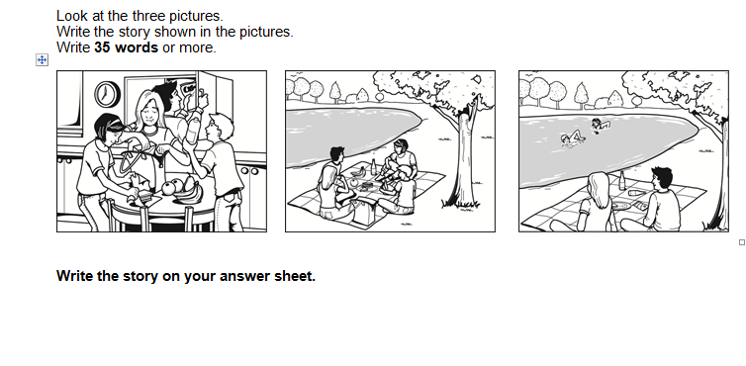
A2 KEY/ KEY FOR SCHOOLS (Story)

Slide 22
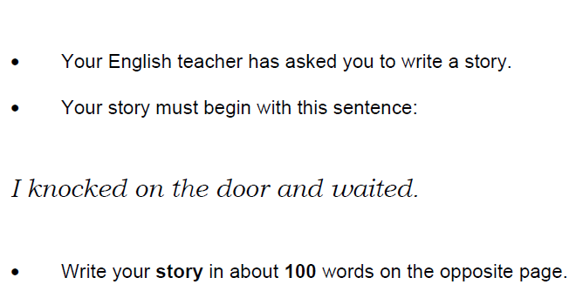
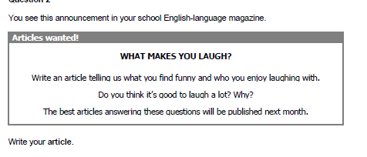
B1 Preliminary / Preliminary for Schools
ARTICLE
OR
STORY
Notes:
In Part 2, candidates now have a choice between an article (rather than a letter) or a story. An article is suitable for eliciting language functions appropriate to B1 (as defined by CEFR can-do statements) – candidates can write about feelings and opinions about a subject that’s familiar to them, so they can produce a personal, concrete response based on their own personal experiences, helping to give them confidence, or stronger candidates can write something more elaborate.

Slide 23
WRITING ASSESSMENT CRITERIA
Content
Communicative Achievement (B1- C2)
Organisation
Language
How well the candidate has fulfilled the task.
How appropriate the writing is for the task and whether the candidate has used the appropriate register.
The way the candidate puts together the piece of writing; is it logical and ordered? Are the ideas linked together well?
Focuses on vocabulary and grammar, including range and how accurate it is.

Slide 24
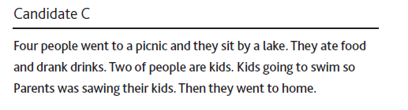
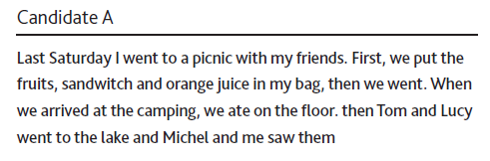
A2 KEY, STORY (Sample answers)
Content 5 Content 3
Organisation 5 Organisation 3
Language 5 Language 3

Slide 25
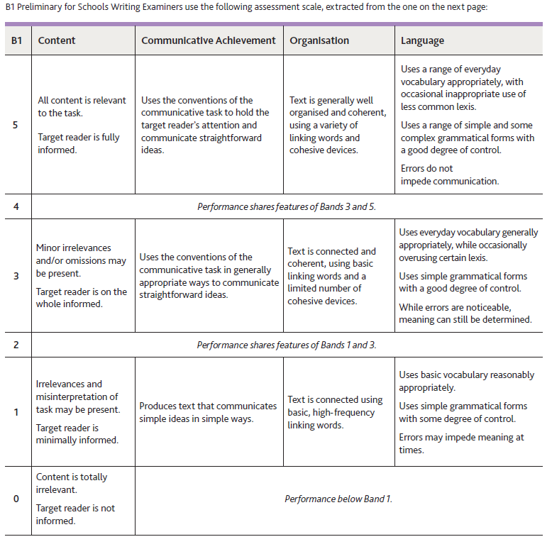
В 1

Slide 26
SELF-ASSESSMENT AND FEEDBACK

Slide 27
Write & Improve
writeandimprove.com
Notes:
Write&Improve is an online tool from Cambridge Assessment English. It evaluates a piece of writing and provides instant feedback. You need to register, but it's free. There's a video on the home page, which goes through all of the functionality, so you can see exactly how it works.

Slide 28
Notes:
Once you've registered, choose your task from those on offer. There are options for both Beginner and Intermediate. Both have suitable tasks for Key and Preliminary.

Slide 29
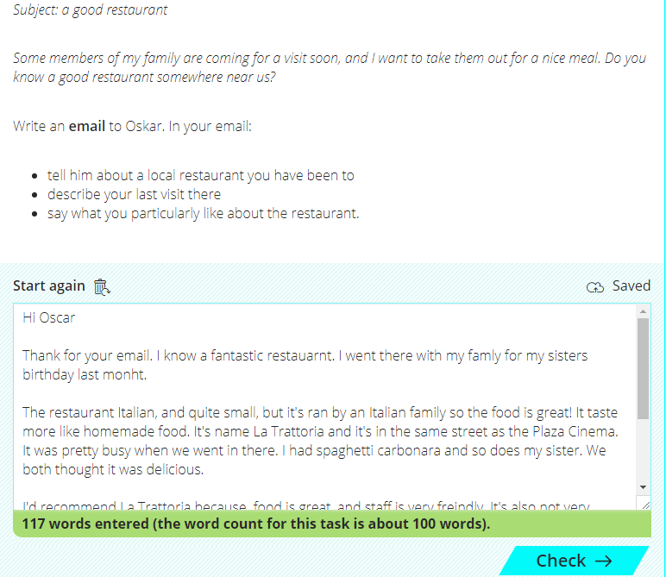
Notes:
Once you’ve chosen a task, your students write or upload their text, and submit their writing for feedback. This one is an email from a friend asking for information about a good restaurant. It is similar to the email writing tasks in both Key and Preliminary. The writer must write an email including 3 pieces of information. It tells you how many words you’ve written.

Slide 30
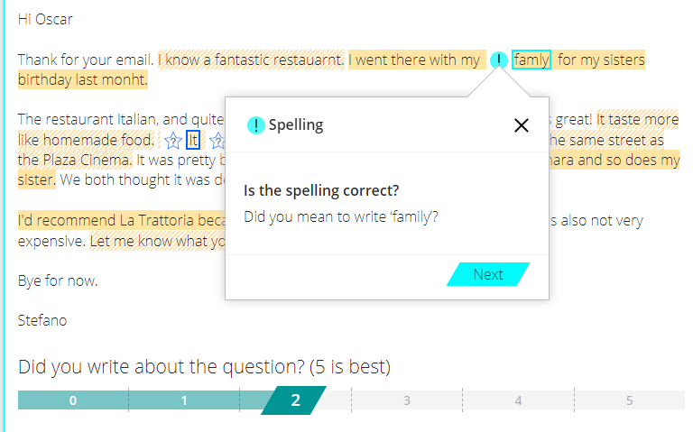
Notes:
The Write&Improve tool then gives feedback on your students’ writing. Using the suggestions from the system, students can gradually improve their writing. Here spelling is highlighted, and a suggestion given.

Slide 31
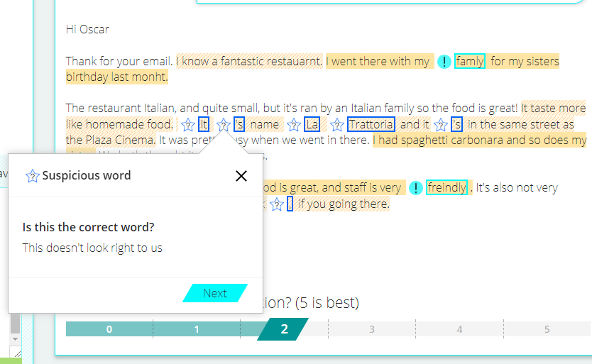
Notes:
This time it focuses on a word that looks wrong. Once a student has made some changes they can submit their writing again.
Your students can also use Microsoft Word to help identify basic spelling, punctuation and grammar errors (shown with red and blue wavy lines) and to self-correct, if they set the language to English.

Slide 32
SPEAKING

Slide 33
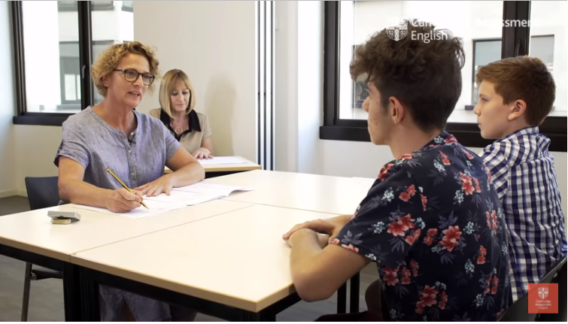
SPEAKING

Slide 34
What constitutes an A2 level speaker?
The kind of situations the speaker is in (predictable / familiar / unfamiliar / unexpected) | Very familiar or highly predictable situations
Length of utterances | Tend to be very short – words or phrases
Accuracy/range | Some control of simple grammatical forms and appropriate vocabulary
Hesitation | Frequent hesitation and pauses
Pronunciation | May at times be difficult to understand
Command of the spoken language | Basic command
Notes:
Summarise what is expected in the Speaking Test at this level. Remind participants that the test is based on a vocabulary list which can be found on cambridgeenglish.org, and a set of language specifications (including grammar, functional language and topics) which can be found in the A2 Key/A2 Key for Schools Handbook for Teachers.
(Note that this is from the Cambridge English Common Scale for Speaking)

Slide 35
A2 KEY, Test format and testing focus
Part | Test Format | Testing focus | Timing
1 | Phase 1: Conversation between interlocutor and each candidate Phase 2: Topic-based interview, where interlocutor asks five questions to each candidate across two topics | Social language, general interaction on familiar topics, e.g. daily life, interests, likes and dislikes etc. | 3-4 minutes
2 | Phase 1: Candidate discussion covering an appropriate topic, led partly by the interlocutor Phase 2: Follow-up discussion on the same topic as Phase 1, where interlocutor asks each candidate two questions. | Comparing, describing, expressing opinions and exchanging ideas | 5-6 minutes
Notes:
Give participants time to read the information on the slide. If participants are familiar with the pre-2020 exam format, ask them to think about what the revisions are and why they think these changes have been introduced. Allow 2-3 minutes for them to exchange ideas on this. Then ask them to watch the video (see next slide) and listen to the assessment specialist explaining the rationale for the changes. What reasons does she give?

Slide 36
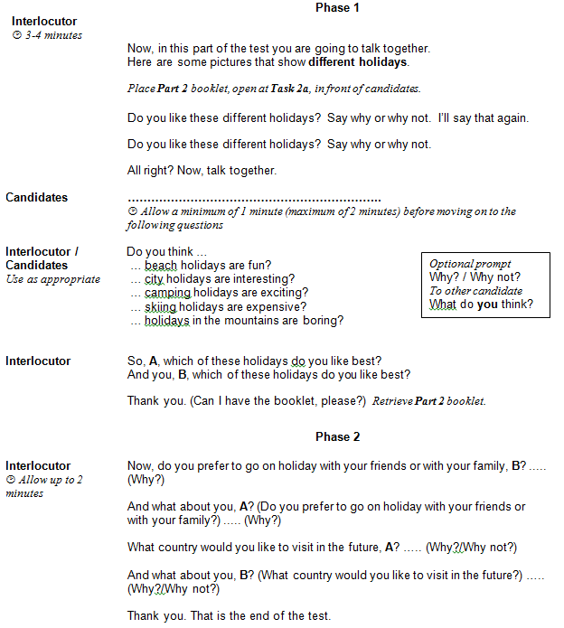
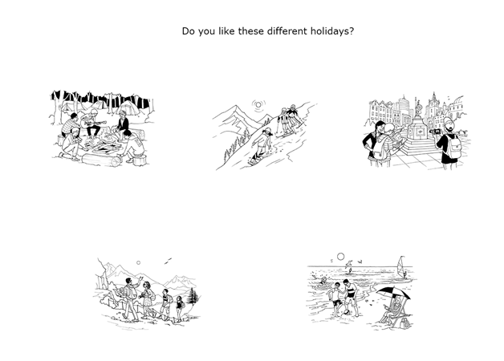
A2 KEY/KEY FOR SCHOOLS, SPEAKING PART 2
Notes:
This is the new Part 2 task, a collaborative task where the students talk together about a topic with some pictures to help them. The pictures are intended to act as prompts for candidates to express their opinions about the different activities, things or places represented. They are only expected to talk about themselves, they’re not asked to think about a situation or about the needs or opinions of someone else, as they do at Preliminary. In Phase 2, the interlocutor extends the discussion.

Slide 37
What constitutes a B1 level speaker?
The kind of situations the speaker is in (predictable / familiar / unfamiliar / unexpected) | Familiar situations
Accuracy/range | Good degree of control of simple grammatical forms, range of appropriate vocabulary
Ability to organise discourse | Some extended discourse, mostly relevant, basic cohesive devices
Hesitation | Some hesitation and pauses while searching for language to express ideas
Pronunciation | Generally intelligible, but may at times put a strain on the listener
Command of the spoken language | Limited but effective command
Notes:
Summarise what is expected in the Speaking Test at this level. Remind participants that the test is based on a vocabulary list which can be found on cambridgeenglish.org, and a set of language specifications (including grammar, functional language and topics) which can be found in the B1 Preliminary/B1 Preliminary for Schools Handbook for Teachers.
(Note that this is from the Cambridge English Common Scale for Speaking)

Slide 38
B1 PRELIMINARY, Test format and testing focus
Part | Test Format | Testing focus | Timing
1 | Conversation between interlocutor and each candidate | Social language, general interaction | 2-3 minutes
2 | Individual ‘long turn’; each candidate speaks for up to 1 minute on a photo | Describing, managing discourse, using appropriate vocabulary | 2-3 minutes
3 | Candidates talk together using a visual stimulus in a collaborative task | Making and responding to suggestions, discussing alternatives, making recommendations and negotiating agreement | 6 minutes for Parts 3 and 4 together
4 | Discussion with interlocutor and both candidates on topics related to the Part 3 task | Talking about likes/dislikes, preferences, habits, opinions and potentially agreeing/disagreeing.
Notes:
Give participants time to read the information on the slide. If participants are familiar with the pre-2020 exam format, ask them to think about what the revisions are and why they think these changes have been introduced. Allow 2-3 minutes for them to exchange ideas on this. Then ask them to watch the video (see next slide) and listen to the assessment specialist explaining the rationale for the changes. What reasons does she give?

Slide 39
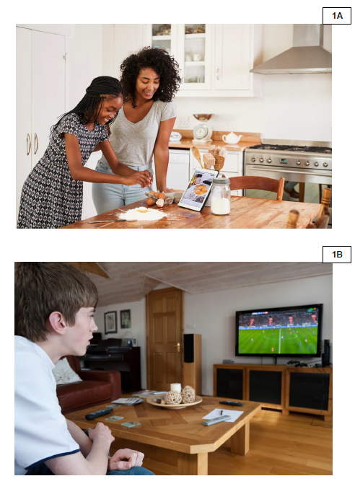
Speaking Part 2
Back-up prompts
Talk about the people/person
Talk about the place
Talk about other things in the photograph
Notes:
Part 2 of the revised test is identical to the previous Part 3, so candidates are describing a picture.
Here you can see some photos for Part 2 of Preliminary for Schools. One difference in the revised exam is that the pictures are not connected to the same topic, as this part is now stand-alone. The examiner gives the candidates the topic of their picture by saying, ‘Your picture shows…. ‘.
As you can see, the examiner also has some back-up prompts, which are the same for all pictures, to give some scaffolding to weaker candidates if they are not able to talk for a full minute about their picture.

Slide 40
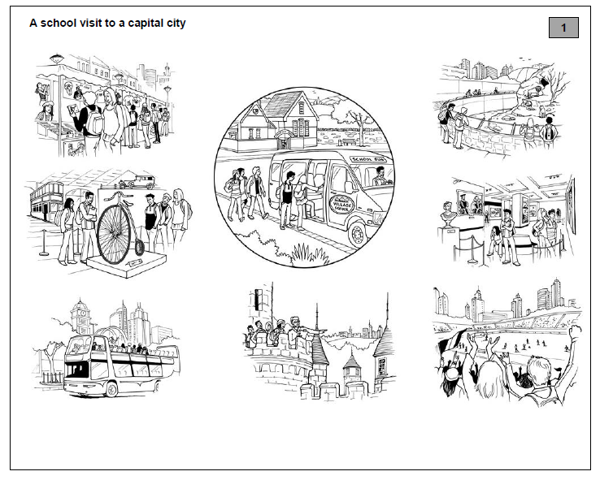
Speaking Part 3
Notes:
The Part 3 task is almost identical to the previous Part 2 task, with a graphic and situation described. As you can see, the title of the task is now printed on the candidates’ material as a reminder and so the focus of the task is more explicit. Also, the examiner doesn’t repeat the task instructions, so candidates need to listen carefully to these.

Slide 41

ASSESSING SPEAKING
Grammar and Vocabulary (control, range, appropriacy)
Pronunciation (intonation, stress, individual sounds)
Interactive Communication (initiating, responding, development)
Discourse Management (extent, relevance, coherence, cohesion)
Global achievement (overall effectiveness)
Notes:
How is Speaking assessed? We’re going to use A2 Key for Schools as the example. Do you know the criteria that examiners use to assess Speaking at A2 level?
Click to show the first three criteria, which are used at A2 level: Grammar and Vocabulary, Pronunciation and Interactive Communication. Interactive communication at this level refers to the candidate’s ability to maintain a conversation.
Click to show Discourse Management which is used at B1 level and above: this refers to assessing the student’s ability to produce extended stretches of language.
Click to show Global Achievement. There are two examiners in the room when the Speaking exam is taking place: the assessor, who is just listening, and assessing, and gives a mark for each criterion; the interlocutor, who manages the test, gives a global achievement mark.

Slide 42
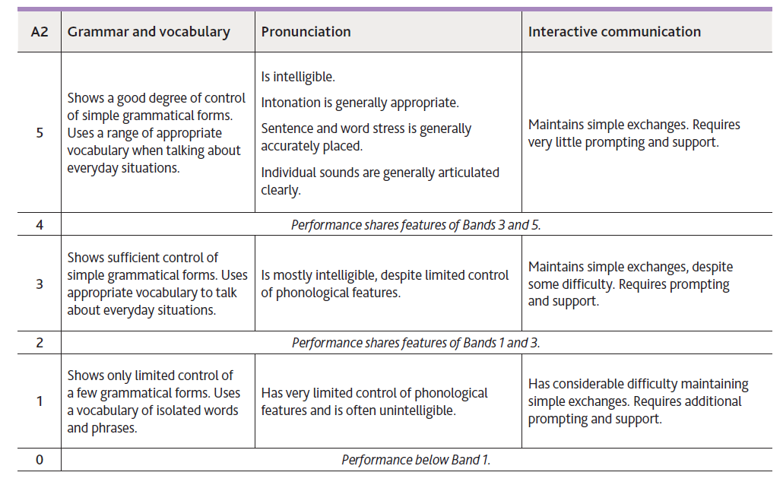
Assessing Speaking
Notes:
The Assessor uses a more detailed assessment criteria.
You can see the differences between what is expected at Band 5, Band 3 and Band 1. For example, in relation to grammar and vocabulary, a Band 5 candidate shows a good deal of control of simple grammatical forms, a Band 3 candidate shows sufficient control and Band 1 shows only limited control.
The assessor does not count errors or deduct marks for every mistake. They are focusing instead on how well the candidate communicates, so, in class, try not to worry about the mistakes your learners make, and think about whether their message is clear.

Slide 43
Assessing Speaking
BAND | A2 GLOBAL ACHIEVEMENT
5 | Handles communication in everyday situations, despite hesitation. Constructs longer utterances but is not able to use complex language except in well-rehearsed utterances.
4 | Performance shares features of Bands 3 and 5.
3 | Conveys basic meaning in very familiar everyday situations. Produces utterances which tend to be very short – words or phrases – with frequent hesitation and pauses.
2 | Performance shares features of Bands 1 and 3.
1 | Has difficulty conveying basic meaning even in very familiar everyday situations. Responses are limited to short phrases or isolated words with frequent hesitation and pauses.
0 | Performance below Band 1.
Notes:
This table shows the global achievement criterion at A2 level.
As you can see, even at Band 5, candidates are not expected to be perfect speakers of English. They are being assessed in relation to A2 level, so they are being assessed in the context of everyday situations, hesitation is expected and they are not expected to use complex language.
Notice the differences between Bands 5, 3 and 1: the types of situation, the amount of hesitation and the length of utterances vary.

Slide 44

Assessing speaking classroom activity
Speaking checklist | ☺ | ☹
Pronunciation – speaks clearly
Uses the correct words for the tasks
Uses a variety of words
Uses correct grammar for the tasks
Uses a variety of grammar
Not much hesitation/a few pauses
Notes:
The reality of your classroom may make it difficult for you to assess your students’ Speaking skills, especially if you have large classes. Let’s look at some ways you can manage this.
From A2 Key for Schools level and above, it is good to encourage your students to become more independent learners, and to develop their awareness of their language development. One activity you could try, is to show the class a Speaking test video so they are aware what the test involves. As they watch the video, ask them to consider what the candidates do well, and not so well, using a basic assessment checklist such as this.
You could show the video more than once and ask them to think about different things each time. Encourage them to think about the good things and not focus too much on mistakes.
Then divide the class into groups of four and use a sample Speaking test from the Cambridge English website. Two students in each group act as the examiners and the other two are the candidates. If possible, the student who is just listening can video or audio-record this on their mobile phone so the group can watch or listen to it again afterwards. When they have finished, each student completes an assessment checklist for each student, including one about their own performance, and then they discuss together what they did well or could improve. Then the pairs swap roles, with the examiners becoming the candidates. If the students have made recordings, you can ask them to send them to you to watch or listen to afterwards. You can then provide them with some feedback.

Slide 45
QUESTIONS?

Slide 46
Благодарим за внимание!
Наши социальные сети

