Slide 1
Steve Ligoff from INTESOLRussia
Let’s fight that tricky accent, shall we!?

Slide 2
Rule #1
Please don’t worry!
(Seriously, it’s not as bad as you think!)
https://www.keepcalmandcarryon.com/popular-keep-calm-quotes/keep-calm-and-carry-on-teaching-UbfYJjoRB/

Slide 3
Rule #2
Allow me to say this slowly: It’s not your fault.

Slide 4
Let’s do this simply, shall we?
Θ Ew! ð

Slide 5
Question time! What are your most troubling bits of accent to wiggle out from? Let’s hear your horror stories!

Slide 6
Lesson #1 (I hope you’re following along at home!)
The RRRRRRRRRolling ‘R’
(Perhaps the easiest to combat)
It comes back down to Muscle acclimatisation, let’s get there with a simple exercise.
2. Swing, Ring, Swing, Ring, Swing….RUNNING!

Slide 7
Lesson #2
That tricky, sneaky H!
Forget it’s a letter
2. How. Highly. Howls. Hear. Helps.

Slide 8
Lesson #3
The V. and the Double V!
It’s all in the teeth, Baby!
2. Very Wary, Very Wary. (Wery)

Slide 9
Let’s Practice!
Running very fast from various raptors
Harding hardly swam in the river water

Slide 10
Homework, if you’d like?
2. Whenever the weather is cold.
Whenever the weather is hot.
We'll weather the weather,
whatever the weather,
whether we like it or not.
1. Swan swam over the pond,
Swim swan swim!
Swan swam back again-
Well swum swan!

Slide 11
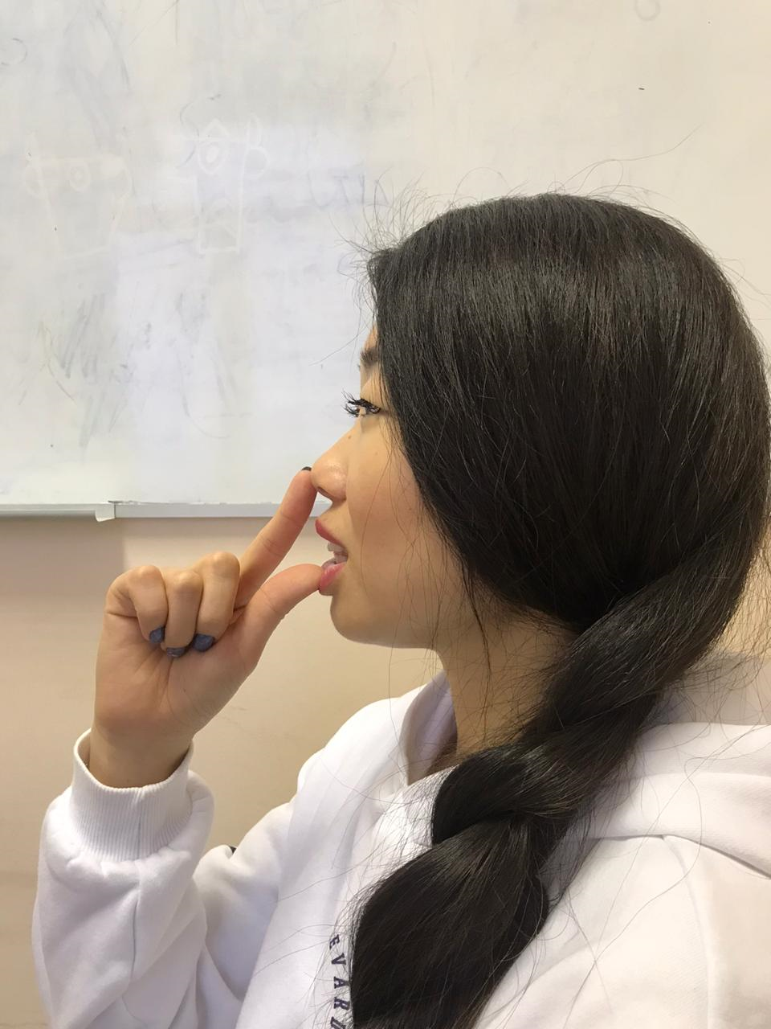
Lesson #4
Now for Hell!
The Th sounds are awful, almost as awful as thinking about how you look whilst doing this exercise!

Slide 12
Let’s practice! (With a little extra)
Cloth clothes in these thoughts with those thieves.
(EVERY NIGHT!)

Slide 13
Lesson #5
Vowel stretching!
Tighten it up! English has no letter based elasticity.
2. How many berries could a bare berry carry, if a bare berry could carry berries? Well they can not carry berries (Which could make you very wary) but a bare berry carried is more scary!

Slide 14
Lesson #6
Ingfamous ING!
No printer INK!
Reach back until you hit that fleshy protuberance! (Ew)
3. Walking while waiting and going is trapping your thinking!

Slide 15
Question time!
What are some strategies you personally found useful with accent training?
Or!
What are some English pronunciations that you don’t understand?

Slide 16
Lesson #7
It’s all in your head!
Although the thoughtь I think they thoughtь was fraughtь with this and that;
I think the thoughtь was nothing but a thoughtь that wroughtь just about naughtь.

Slide 17
Lesson #7...v2.0?
Hurts- Hurц
Thoughts- Thoughц
Tights- Tighц
Lights- Lighц
Nights- Nighц
Cheats- Cheaц

Slide 18
Lesson #8
Details Galore!
Beer Bear бир бээр
He's His
Her Hair хэр хэйр
Our Hour (Intonation) Be Neurotic!!
Wants Once уанц уонс
This These
Bad Bed бад бэд

Slide 19
Lesson #9
Rhythm!
Russian is monotone, let’s break that!
2. I went to Hunter Valley once, I really liked the cheeses there!

Slide 20
Little Lesson #10
They’re not the same, sorry
‘Interesting’ is to us what ‘Хорошо’ is to you!, try explaining yourself further instead?
‘Normal’!!!! Nothing is ‘Normal’!! Perhaps try ‘Fine’, or ‘okay’.

Slide 21
Think Simple!
Russian is a language based on concepts, whilst English is illustrative. Don’t try and apply Russian Conceptual terms to English, relax, it’s a dumber language!

Slide 22
Thank you so much for coming and I hope you’ll take something away from today!
Now let’s answer some questions!

