Slide 1
Волшебная история Британских островов. Сказочные уроки английского языка для младшей и средней школы
Марианна Юрьевна Кауфман
автор курса «Happy English. ru»
Master of Arts in Sociolinguistics University of Essex

Slide 2



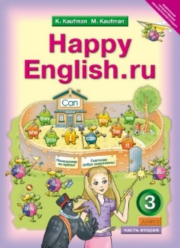
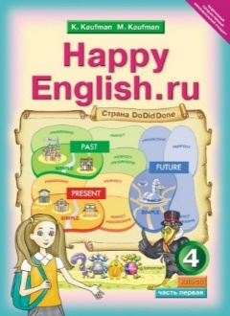
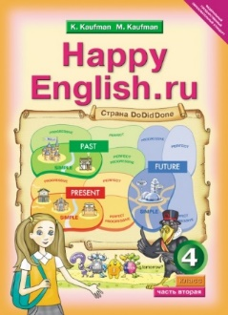

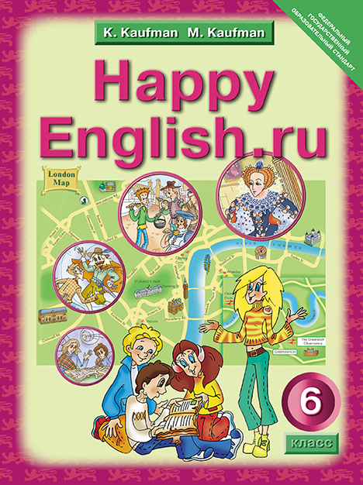
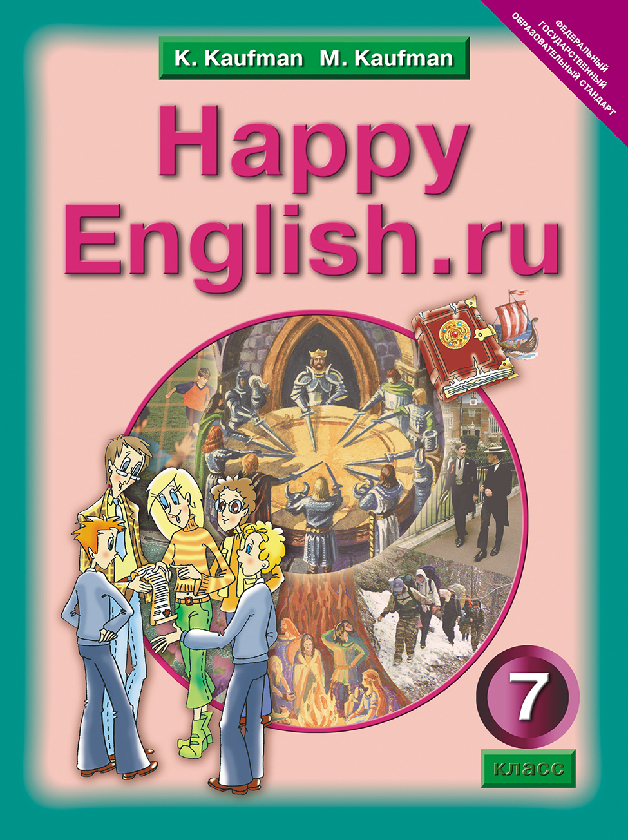
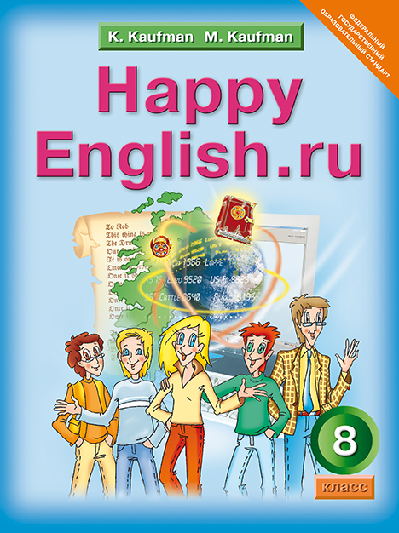
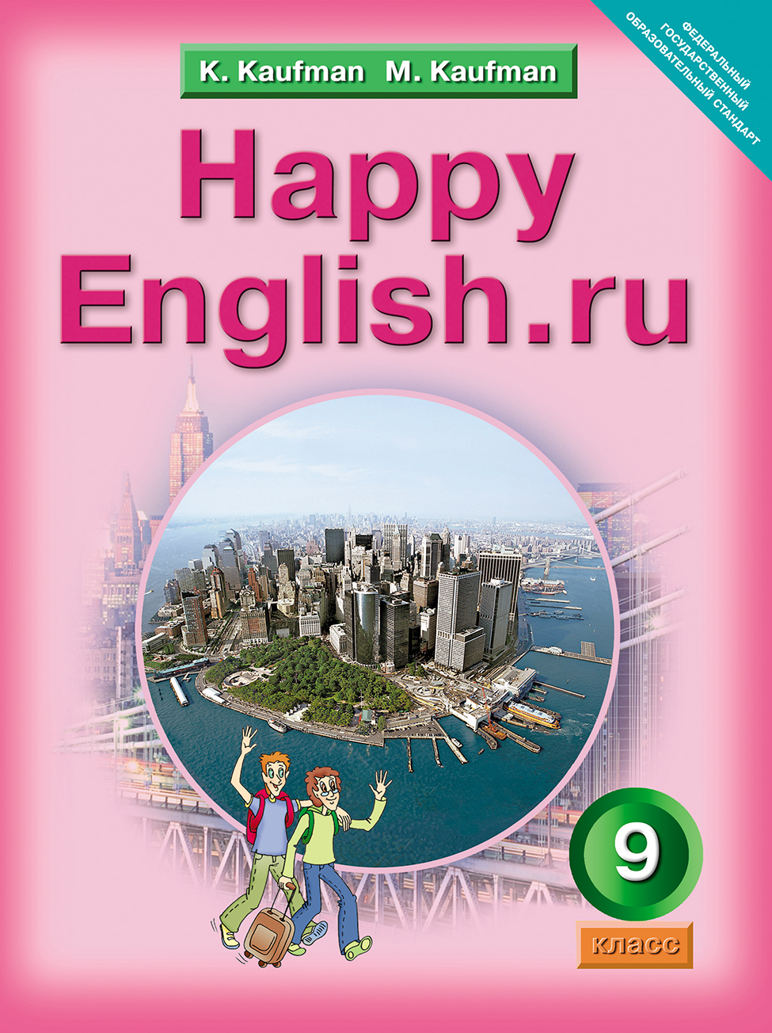
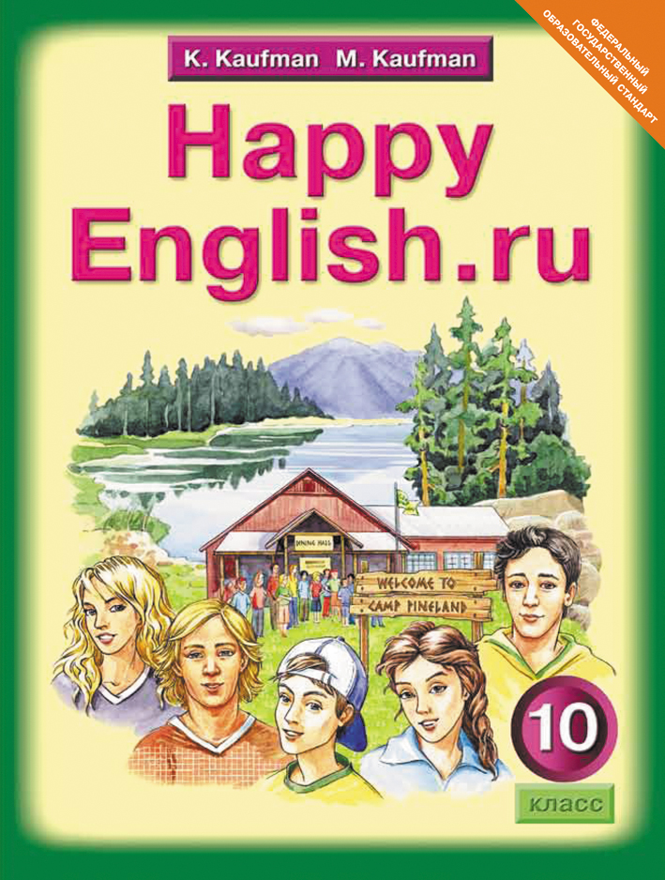

УЧЕБНИКИ

Slide 3
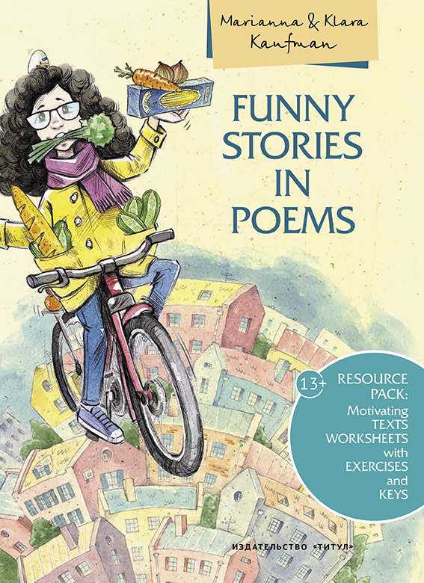

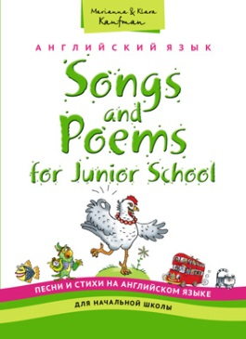


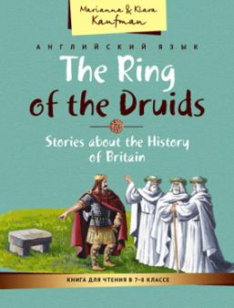
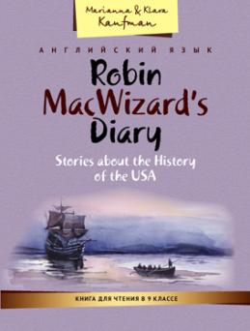
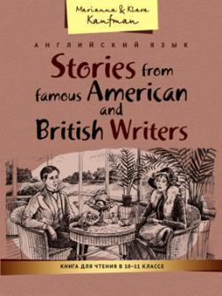
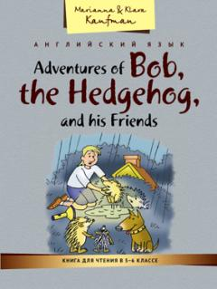
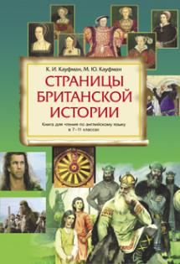


ПОСОБИЯ

Slide 4

Когнитивный треугольник
Знания
ПРЕДСТАВЛЕНИЯ
Ощущения

Slide 5
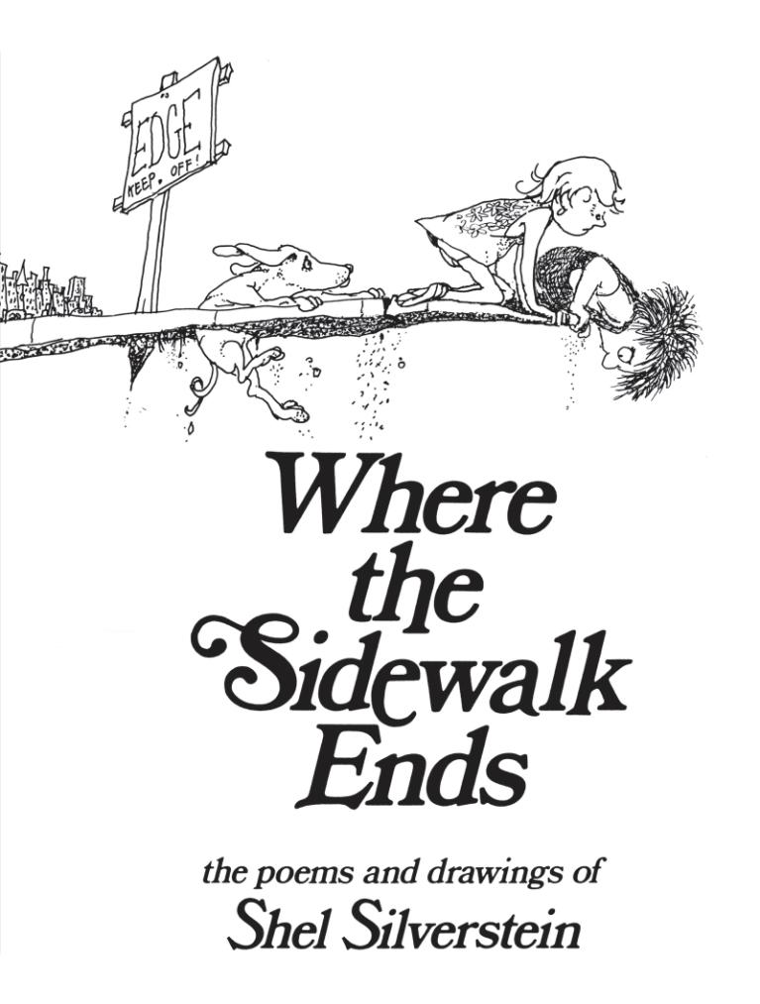

https://www.youtube.com/watch?v=G4TpdfIbSfE

Slide 6
ПРИГЛАШЕНИЕ
А если ты тоже мечтатель — входи!
Мечтатель, желатель, слегка привиратель,
Притворщик, волшебных бобов покупатель…
Поверивший в чудо, я жду тебя тут,
Где нити волшебных историй плетут.
Нас сказки и подвиги ждут впереди.
Входи!
Входи!

Slide 7
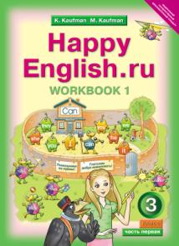
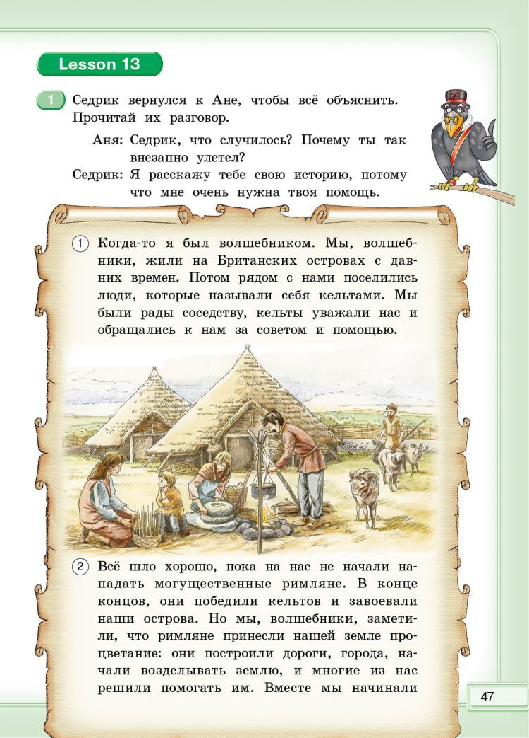
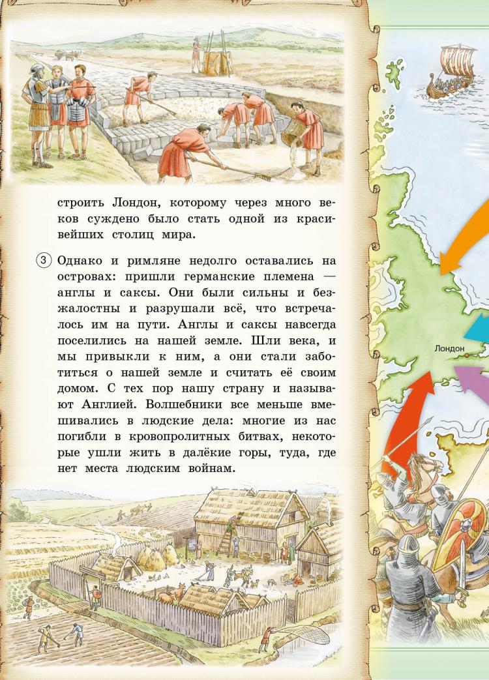
Знакомство с историей языка
3 класс 1 часть стр 47, 48, 51

Slide 8
Создание приключенческого контекста для всей учебной деятельности
3 класс 1 часть стр 47, 48, 51

Slide 9
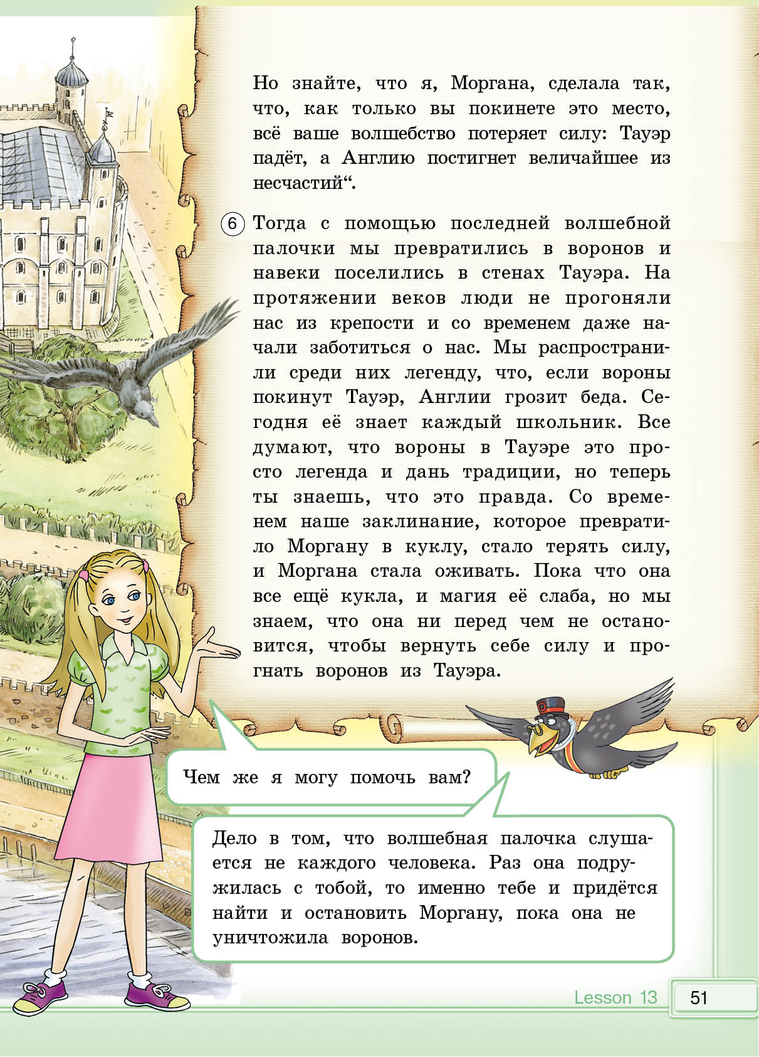

Slide 10


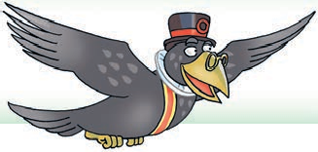












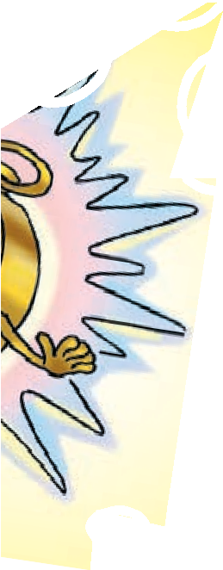





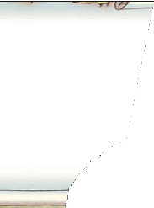
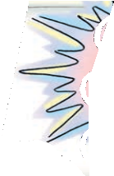


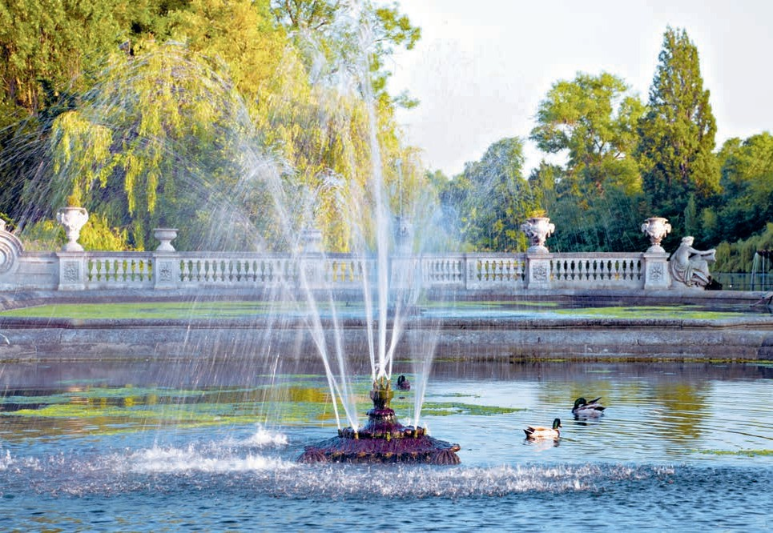
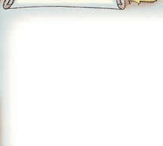



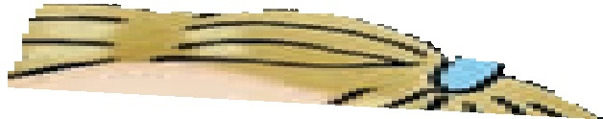

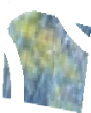


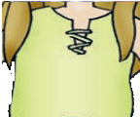
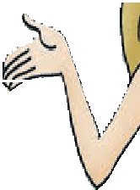


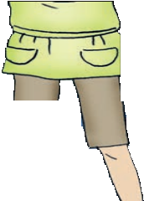
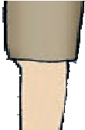


Lesson 19
Моргана продолжает оставаться неуловимой. Перед тем как прочитать новое заклинание, запомни:
Буква a перед ss, sk, st обозначает звук [¾].
Например: class, fast, mask.
Прочитай эти слова, затем послушай Седрика и повтори за ним.
past, class, grass, flask, blast, basket, cast, last, vast, pass, task, glass
Помоги Ане правильно прочитать вслух новое заклинание.
Task and flask, Glass and class. Fast and basket, Blast and ask.
Hyde Park
68

Slide 11


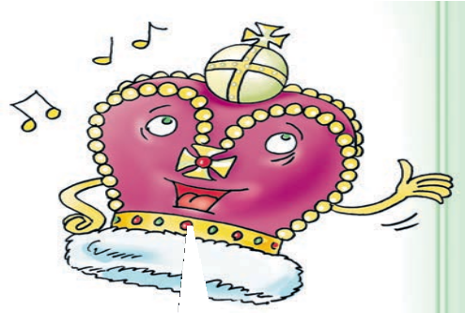
















10 Послушай песенку короны и выбери правильные ответы на вопросы.
What’s the crown’s name?
  Polly b) Molly c) Maggy
How old is the crown?
  five years old
  one hundred (сто) years old
  three hundred (триста) years old
Where is the crown from?
  London b) Russia c) Scotland
Прочитай текст песенки короны, повтори её за ней и запиши вопросы, которые она задала Ане.
11
Hello! I’m a crown, I’m clever and funny, My name is Polly.
Hello! I’m a crown,
And what’s your name, girl?
I’m three hundred years old. It is true (правда)! And how old, how old, how old are you?
Hello! I’m a crown, I’m clever and funny, London is my home. Hello! I’m a crown,
And where are you from?
I’m three hundred years old. It is true! And how old, how old, how old are you?
Пропой песенку вместе с короной.
Помоги Ане рассказать короне о себе.
14
Расскажи короне о себе. Представь короне своего друга.
Lessons 9, 10 35

Slide 12
Использование художественных текстов
Важнейшим средством приобщения учащихся к культуре страны изучаемого языка являются адаптированные тексты художественных произведений. Читая литературные тексты учащиеся становятся виртуальными, эмоциональными свидетелями и участниками происходящих событий, связанных с историей или традициями, знакомятся со специфической стороной культуры другого народа и поэтому являются наиболее значимым средством усвоения лингвострановедческой информации.
Чтение специально отобранных художественных произведений способствует более прочному усвоению культурологических сведений.

Slide 13

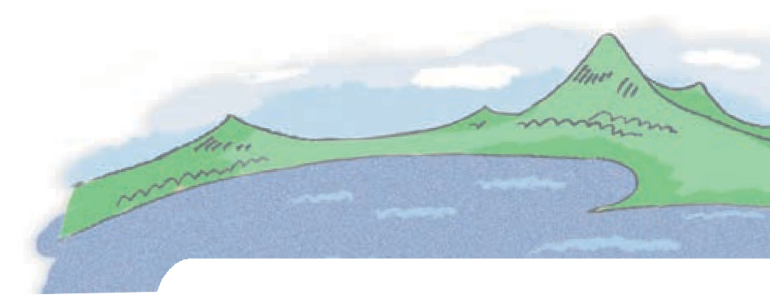
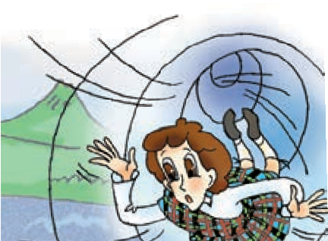






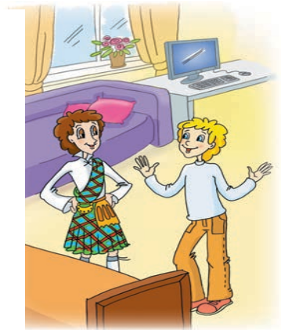

I’m a wizard
1
Listen to the words and expressions and repeat them after the speaker.
a wizard ['wizəd] — волшебник an animal ['æniml] — животное a joke [¢əυk] — шутка
an end [end] — конец
to explain [ik'splein] — объ- яснять
to believe [bi'l v] — верить quickly ['kwikli] — быстро
How many times? — Сколько раз? sense of humour [.sens əv 'hj%mə] — чувство юмора
an explanation [.eksplə'neiʃn] — объяснение
I made a mistake.— Я совершил ошибку.
somehow ['snmhaυ] — как-нибудь
2
Misha and his guest are in Misha’s room. Listen to their conversation and answer the questions.
Is Robin really Misha’s pen friend?
Can Misha call him Rob?
What can Misha’s guest do?
Read the conversation. What are the friends talking about?
Misha: So this is our room, Rob. Please come in.
Your sofa is at the window. This is my computer. We can play a game!
Robin: Rob? My name is Robin, not Rob. And what is your name?
Misha: What?! I’m Misha Inin, your pen friend, remember?
Robin: And what country are we in?
Misha: Are you OK, Robin? You’re in Russia, of course, in Obninsk.
Robin: Oh, no!
Misha: Look. Just wait for me here. I must call my parents.
Robin: No! Please don’t go away! I can explain.
Misha: OK, but you must have a really good explanation.
Robin: I must tell you a secret, Misha. My name is Robin MacWizard,
3
122 Unit 5 Lesson 1

Slide 14
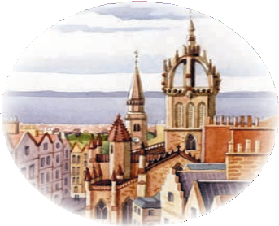


but I am not your pen friend. This is going to sound crazy (это прозвучит неправдо- подобно) but I am from the Edinburgh
of 1599 and now your real pen friend is there. I made a mistake and we must correct it quickly somehow.
Misha: Ha-ha-ha. Very funny, Rob. You’ve got a very good sense of humour.
Robin: I’m Robin! How many times must I tell you? Just listen. My family name is MacWizard: in
Scottish it means “a wizard’s son”. My father, my grandfather and my great-grandfather are all real wizards.
Misha: And what about you?
Robin: I can’t do many things. I am not very talented, but I can travel in time. I can also fly and talk to animals and trees.
Misha: Fine. But that’s the end of your stupid joke, ROBIN. If you are really a wizard, talk to my cat and tell me: What is his name? How old is he? What’s his favourite food?
Robin: OK. Give me a minute. (pause while he talks to the cat)
Robin: Well, its name is Pafnutiy. It is three years old. And his favourite food is apples. Very strange for a cat… Pafnutiy is very unhappy. It…
Misha: Oh, no… This can’t be true. I must sit down for a minute.
Are these sentences true, false or is there not enough information in the conversation?
Robin MacWizard is from Scotland.
Rob MacWizard is from London.
Misha can’t believe Robin.
Robin’s got a very good sense of humour.
Robin is from the year 1599.
Robin’s father is a wizard.
Robin’s family are good wizards.
Robin needn’t go back to his time.
Misha is very happy with his new friend.
Robin can talk to animals.
Robin can’t talk to Pafnutiy.
Answer the questions.
4
5
Where is Robin from?
What can Robin do?
Who is Robin’s father?
What must Robin do now?
What must Misha do?
Must Misha help Robin?
Who is Pafnutiy?
What’s its favourite food?
Unit 5 Lesson 1
123

Slide 15
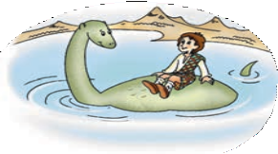


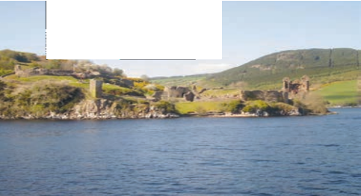
Robin: Yes, she lives in Loch Ness in Scotland. It’s not very far from my granny’s castle.
Misha: Oh, no! Is your pet a Loch Ness monster?
Robin: Nessie isn’t a monster. She likes people and she wants to have friends. When I arrive at the lake, I call her and she always comes. She plays
with me and tells me all about her life. Sometimes her life is really boring. People don’t come to the lake very often, they are afraid of her. She doesn’t want to upset people so she spends her time deep in the lake. The water is very cold there and Nessie likes the sun, but she understands… Wait a minute! How can you know about Nessie? Is she still alive in Loch Ness?
Misha: Nobody knows for sure, but people talk about a huge monster in Loch Ness.
Robin: Poor Nessie.
Misha: Nowadays she’s really popular. People from all over the world come to Loch Ness. They hope to see Nessie. There are Nessie monuments, Nessie tours, Nessie souvenirs, Nessie museums…
Robin: That’s good. So they aren’t afraid of her then?
Misha: I’m not too sure about that. I think some people just don’t believe in her. But what is she? A dinosaur?
Robin: I don’t know what a dinosaur is, Misha. But Nessie is a dragon, the last magical creature in the world. She can live only in Loch Ness. Her food is just the pure cold water of the lake.
Misha: A dragon? There are no dragons. They live in fairy tales. Robin: Your fairy tales are my reality, Misha.
Misha: Can you tell me about your world, Robin?
Robin: I want to, but I can’t do it now. Please don’t be angry with me! Misha: It’s OK. I understand. But I want to help you.
Robin: I must go to London. Can you help me do that?
FOR YOUR
Loch Ness is a large and very deep lake in Scotland. It is about 37 kilometres long and 230 metres deep. The old legend says that a Christian monk, St Columbia, saw (видел) a water dragon in Loch Ness 1400 years ago. Then in 1933, Kenneth Wilson, a doctor from London, took a picture of a huge animal in the lake. People remembered the old legend and a hunt for Nessie began. (Тогда люди вспомнили старую легенду, и охота за Несси началась.)
Unit 5 Lessons 4, 5 131
INFORMATION

Slide 16



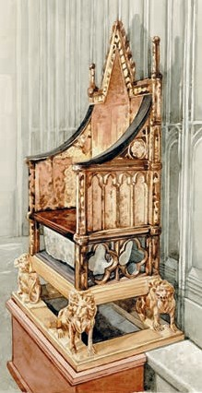
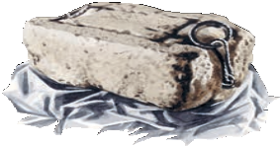








7 Read the end of the conversation and check your ideas.
Misha: Nowadays we associate England with Queen Elizabeth II, Big Ben, double-decker buses, tea, football…
Robin: And what do you associate Scotland with?
Misha: Tartans, kilts, bagpipes, lochs, Nessie, Edinburgh Castle… Robin: Oh, really? And what about the Stone of Destiny? Do you know
about it?
Misha: The Stone of Destiny? What is it?
Robin: Well, I think it’s time to tell you my story. But we must start from the beginning.
Misha: OK. But can we start now? I don’t want to wait. Robin: We can talk tomorrow, Misha. It’s a long story.
FOR YOUR
The Stone of Destiny — Камень судьбы. По преданию Камень судьбы был при- везен из Святой земли более четырех
INFORMATION
тысяч лет тому назад. На протяжении веков все шотландские короли короновались на Камне судьбы. Более семисот лет назад, в XIII веке, английский король Эдуард I похитил этот священ- ный камень у шотландцев, надеясь, что без него они не смогут больше короновать своих правите- лей и воинственная Шотландия, наконец, утратит независимость. Камень был привезен в Лондон в Вестминстерское аббатство и помещен под коро- левский трон.
С тех пор все короли Англии короновались на этом Камне. Однако Эдуард ошибся: похищение Камня только подогрело ненависть шотландцев к завоевателям, война между ними продолжалась еще много лет, и шотландцы не раз предпринимали попытки вернуть похищенную реликвию.
Ask Miss Reading
8
Буква u перед буквосочетаниями ll, sh может читаться как [υ]: bush [bυʃ], pull [pυl].
Unit 6 Lesson 6
171

Slide 17



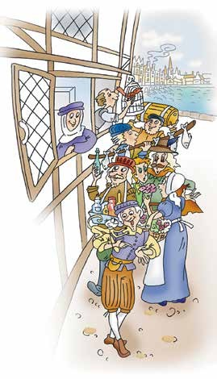


What did the stars say?
1 Listen to the words and expressions and repeat them after the speaker.
a plate — тарелка
a spoon — ложка
to smile — улыбаться
a market [mkt] — рынок
a feast [fst] — пир
glass — стекло
How much do you know about life
in 1599? Try to answer the questions.
  Were there any castles?
  Was there a queen or a king?
  Were there beds in the houses?
  Was there any furniture in the houses?
  Were there toilets in the houses?
  Did people have oranges?
  Did people have sugar?
  Did people have plates?
  Did people have spoons?
  Did people eat with their hands?
  Did people use any medicine?
Listen to the third part of the story and check your answers.
a sheep — овца
a countess [kaυnts] — графиня
furniture [f:ntʃə] — мебель
a manner — манера
to recognise [rekəgnaz] — узнавать
4 Read the story and answer the questions.
What did the London of the past look like?
Was countess Bagshow Phillip’s relative?
Why did the countess take Rob to her house?
Did Rob like countess Bagshow’s house?
What did the countess give Rob before dinner?
What was the food at the feast like?
What were people’s manners like?
What happened at night?
Did Rob help countess Bagshow?
Unit 11 Lesson 5 217

Slide 18
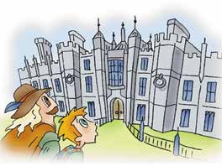
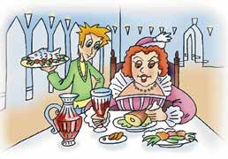
Rob’s story
PART III
In London
London was a big surprise. It was small, and I didn’t recognise any of the streets. They weren’t the same as the streets of the London of my time. We went through the market. I liked it. They had everything: medicine, roses, fish, meat, oranges. There were people with sheep and pigs. I also saw a lot of beggars.
Phillip lived with his aunt, countess Bagshow. We went to her house and Phillip introduced me. “This boy can cure any disease,” he said. The countess was very happy, and I became her servant. I liked the house.
The furniture was comfortable, and I could sleep in a bed. The windows had glass in them. When I saw a toilet inside the house, I was very happy. There were no beds or toilets in Edinburgh.
That evening there was a feast in the castle. The countess gave me a spoon and said, “You must come with your own spoon when somebody invites you to dinner.”
The people in the castle wore beautiful, expensive clothes, but the smell there was bad. I thought all the people needed a bath. But there was no bathroom and no toilet in the castle!
At the feast I had to stand behind the countess’s chair and serve her. All
the plates and cups were made of silver*, and the food looked tasty. But I didn’t like people’s manners. They ate with their hands and threw bones on the floor**. Their hands were dirty and their teeth were black, because they ate a lot of sugar. The Queen didn’t smile, because her teeth were black too.
* сделаны из серебра
** бросали кости на пол
218 Unit 11 Lesson 5

Slide 19

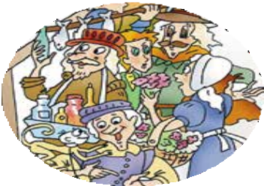
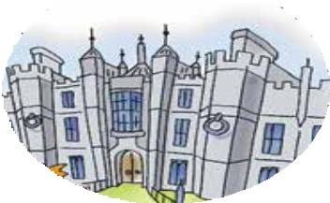
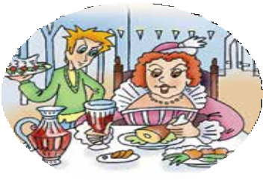
At night the countess didn’t feel well. She had a stomachache and I had to help her. But I made a big mistake. I said, “I am not surprised. You ate five chickens and two cakes at the feast. And you didn’t wash your hands!”
The countess was very angry and told me to leave her house. My friend Phillip felt sorry for me, but what could he do?
I needed money, so I went to the market and started my own business.
I predicted the future and gave people aspirin. Finally, the Queen invited me to her castle and I told her about the future of England. You know the end of the story. Now I am in the Tower, and everything is ready for my execution.
go | went
can | could
see | saw
come | came
become | became
have | had
feel | felt
give | gave
wear | wore
think | thought
make | made
eat | ate
throw | threw
give | gave
5 Put the verbs in brackets in the Past Simple and complete the sentences. Where did these events take place?
countess Bagshow’s house
1
2
market
People (wear) beautiful clothes.
Rob (have to) serve the countess.
Rob (see) a lot of beggars.
People (can) buy everything there.
Rob (like) the furniture.
The countess (give) Rob a spoon.
The food (look) great.
The countess (tell) Rob to leave.
The Queen (not smile) because her teeth (be) black.
3
feast in the castle
Unit 11 Lesson 5
219

Slide 20
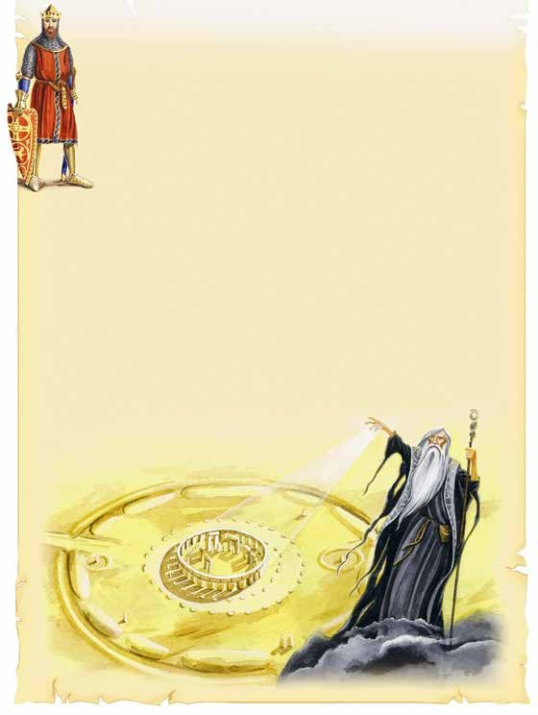
build | built
bring | brought
put | put
Druids worshipped the sun here. But there’s a beautiful legend about this place. Let me tell you. In the fifth century there was a magic place in England called Camelot.
The kings of Camelot were kind and strong.
Their best friend was Merlin who was a great wizard.
It all happened after a big war. A lot of soldiers died for their country and the king.
The king’s brother Ambrosius wanted to build a monument to his soldiers. “This monument must stand forever,” he said to Merlin.
“Send for the Giants’ Ring, which is in Ireland. In that place, there’s a circle of stones. No man from our time could build it. The stones are huge and nobody on earth is strong enough to move them. The giants brought them to Ireland from Africa. They used the stones to cure diseases. You must take the stones from Ireland and put them in the same position on Salisbury Plain. Then, they will stand forever.”
Ambrosius and his soldiers went to Ireland and found the huge stone ring, but they couldn’t move it. Finally, Merlin used his magic and brought the stones to this place. The legend also says Merlin’s grave is under these stones.
Rosy: That’s a very beautiful legend, Robin, but I don’t believe it. The name of this place is Stonehenge. It is older than the
pyramids in Egypt. My brother Mark will tell you all about it.
224 Unit 12 Lesson 1

Slide 21

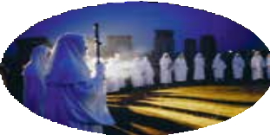
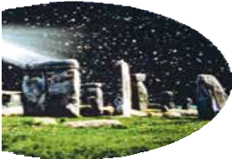


A Ballad of Stonehenge
Three thousand years before Christ was a child, England was beautiful, young and wild.
There were people, forests and rivers there, And the magic stones hung in the air.
The people who brought them were strong and brave, And under these stones they found their graves.
Where did they come from? Where did they go? Who were those people? We’ll never know.
Was it a temple? An ancient god’s house? Was it a compass for friends from the stars? They built it five thousand years ago,
But why did they do it? We’ll never know.
Now those days are gone and the people are gone, But the midsummer sunrise still shines on the stone. And the midwinter sunset still comes with the rain, And Stonehenge greets them on Salisbury Plain.
Match the statements about Stonehenge (Homework Ex. B) with the lines of the ballad.
Model: There are ancient graves around Stonehenge.— “And under these stones they found their graves.”
There are many theories about Stonehenge and nobody knows which theory is correct. What do you think? How could the builders use Stonehenge?
Model: I think Merlin could use Stonehenge as a monument to soldiers.
Merlin
Druids
ordinary people
aliens
a temple of ancient gods
a monument to soldiers
a compass which helped them find the planet again
a calendar
5
In groups. Discuss the results and report to your classmates. Which theory about Stonehenge do you believe? Use the following words and expressions: I guess, I think, perhaps, maybe.
Use the following ideas for explanations.
…because Stonehenge is so old.
…because we have no information about life at that time.
…because the stones are very big and nobody could move them.
Unit 12 Lesson 2 227

Slide 22


Slide 23




Slide 24
Детективное расследование
The Star of Africa
Hitler’s toilet
William the Conqueror
Armed forces record of at least 22 years
One wedding present given to two women

Slide 25



The tower of London tour
https://www.youtube.com/watch?v=lCp908S9z28
https://www.youtube.com/watch?v=sqtwLgkLo5E

Slide 26
Наши социальные сети

