Slide 1
Инновационные электронные ресурсы для подготовки к устной части
ОГЭ и ЕГЭ по английскому языку:
из опыта работы.
Хитрова И.В.
Умерова М.В.

Slide 2
Вы используете электронные образовательные ресурсы на занятиях? Какие?
В чем преимущества и недостатки этих ресурсов?

Slide 3
Преимущества электронных обр. ресурсов
Интерактивность обучения
Визуализация учебной информации
Возможность моделирования
Автоматизация процессов

Slide 4

Недостатки электронных обр. ресурсов

Slide 5
ИННОВАЦИИ
дистанционное обучение (охват регионов)
использование новых
Информационных технологий
Использование Интернет – ресурсов
https://exam-simulator.ru/

Slide 6
Формы работы
Отработка произношения
Обучение диалогической и монологической речи
Изучение лексики
Отработка грамматических явлений

Slide 7


Пособия для подготовки к ОГЭ и ЕГЭ

Slide 8
Vocabulary Exercises
1.Match the words from the first column with their definitions.
Make up a story using all the words from the first column.
2. Read the text and fill in the gaps with an appropriate form of the words from the list.
3. Study the words below to complete the columns with the words to describe …
(e.g. travelling by air, by land or by water).
4. Match the English words with their Russian equivalents.
5. Sort out the words into topic groups.
6. Brainstorm activity:
complete the table with the words
related to … (e.g. holiday, summer activities, leisure)

Slide 9
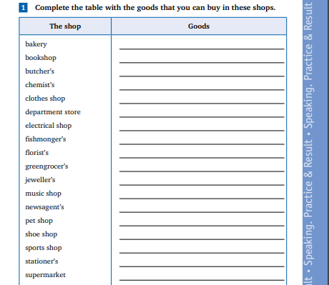

Slide 10
Match the types of houses with their definitions.
1) terraced house | a) a large building that is divided into apartments
2) cottage | b) a house that is joined to the houses on either side of it by shared walls
3) block of flats | c) a very tall modern building, usually in a city
4) skyscraper | d) a house that usually has only one storey (= level)
5) bungalow | e) a small house, usually in the countryside

Slide 11
Interview your friend. Find out his attitude to healthy eating using the following:
to cut down on fatty food/caffeine/ sugar,
to get into habit of,
to eat healthily/sensibly,
to keep to a balanced diet,
to contain too much sugar,
to eat junk/ fast food,
to have regular meals,
to eat in/out,
to benefit from homemade food,
to cook healthy food.

Slide 12
DOER | PLACE OF WORK | ACTIVITY
builder
 | lecture hall
 |  | cooking meals
hairdresser
 |  | fixing pipes

Slide 13
Describe a holiday celebration that you remember.
You should say
- what holiday you were celebrating
- what special activities are connected with the holiday
- who you celebrated it with
- what made the celebration special
- why you enjoyed the occasion.

Slide 14
Choose the inventions you need every day and say what you use them for.
⮚ camcorder
⮚ digital camera
⮚ dishwasher
⮚ MP3 player
⮚ washing machine
⮚ microwave oven
⮚ cooker
⮚ mobile phone
⮚ remote control
⮚ vacuum cleaner
⮚ TV set
⮚ electronic book

Slide 15

Make up a short story using all the word combinations given below.
• (to) share smb’s good times
• (to) support each other through the bad
• (a) particular feature
• (to) be wedded together by
• (to) provide a sense of stability
• (to) retain
• (to) overcome difficulties

Slide 16
Sort out the phrases that can be said by a customer and by a shop
assistant. Act out a dialogue “In a shop” using the following phrases.
Can I help you?
Could I try it (them) on?
I’d prefer…
Can I pay by credit card?
How does it fit?
Could you help me? I’m looking for...
How would you like to pay?
Do you have this in … (medium / large / small /
extra large / XL / blue / black / other colours)?
Are you looking for anything in particular?
We don’t have any of these left in stock.

Slide 17
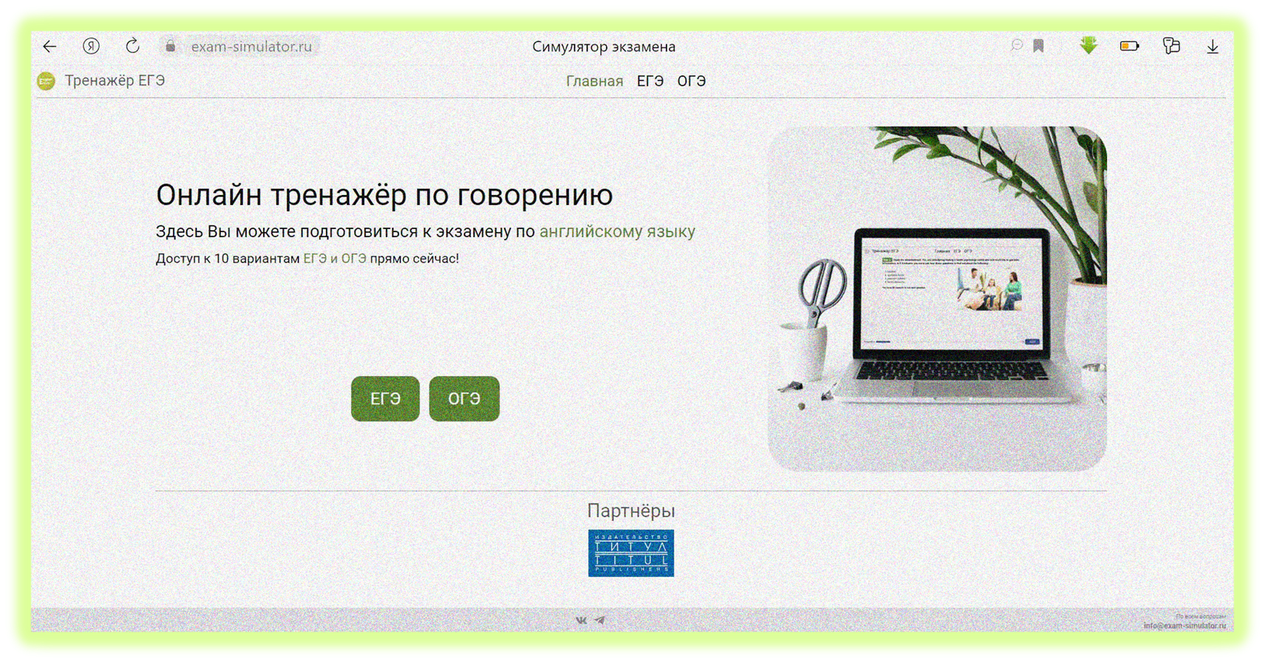
exam-simulator.ru

Slide 18

Разработан для:
учащихся старших классов школ, гимназий, лицеев;
выпускников прошлых лет;
преподавателей английского языка;
всех, кто готовит и готовится к ОГЭ и ЕГЭ по английскому языку
Включает в себя:
интерактивную подготовку к устной части ОГЭ и ЕГЭ по английскому языку;
учет времени на подготовку к ответу и сам ответ во время экзамена;
сохранение аудиозаписи ответа;
возможность оценивания аудиозаписи ответа по критериям, разработанным ФИПИ

Slide 19
https://exam-simulator.ru/
Делает процесс подготовки к экзамену более эффективным
Повышает интерес к занятиям
Способствует достижению наивысшего возможного результата
Предполагает не только совместную работу с преподавателем, но и самостоятельную работу
Записывает ответ

Slide 20
Речевые стратегии для интервью
Задание 3 ЕГЭ
Honestly, I like DOING (Ving) … because…
I think the greatest merit \ plus of … is that … + CLAUSE
Meanwhile, the main demerit \ minus of … is … + NOUN
In my childhood I used to + INF …
When I was a child I DID (Past Simple) …
As for me, I HAVE NEVER BEEN \ PARTICIPATED in … (Present Perfect)
I am convinced it is NECESSARY \ IMPORTANT \ USEFUL to + INF …

Slide 21
Сложная ситуация: не понял вопрос
Задание 3 ЕГЭ
Важно не растеряться, не молчать.
Можно выдержать паузу (40 сек - это много), подумать
Постараться угадать по контексту значение незнакомого слова (языковая догадка)
Отвечать наиболее общими словами, используя речевые обороты:
It seems reasonable \ useful to …
Obviously \ Evidently …
This idea looks \ doesn’t look like ….

Slide 22
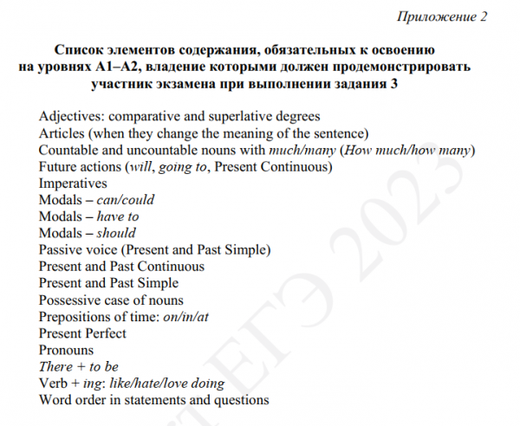
Методические материалы для председателей и членов предметных комиссий субъектов Российской Федерации по проверке выполнения заданий с развёрнутым ответом экзаменационных работ ЕГЭ 2022 года (стр 103)
Авторы-составители:
М.В. Вербицкая, К.С. Махмурян
https://doc.fipi.ru › angliyskiy_uch_mr_ege_2022

Slide 23
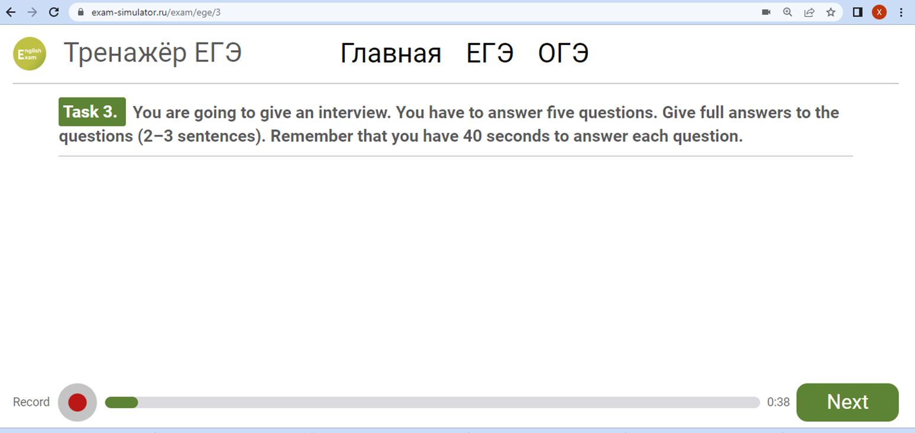
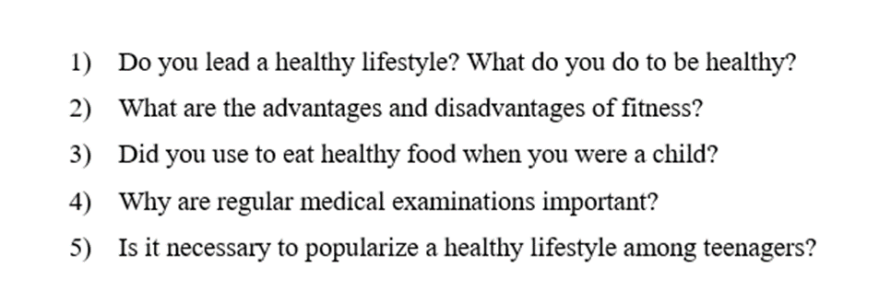
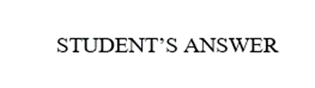


Slide 24
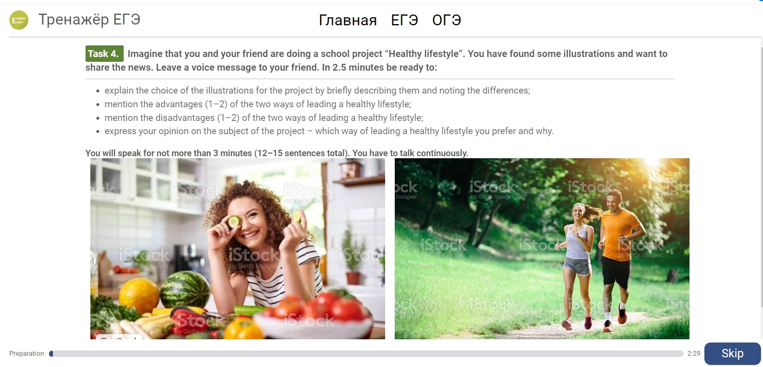
Задание 4

Slide 25
Речевые стратегии для устного сообщения
Задание 4 ЕГЭ
Вводная фраза (с обращением к другу):
1) Hi, Vasya! I’ve found two photos for our project ___TITLE OF THE PROJECT___ and I’d like to tell you about them.
2) Hello, Olga, I‘d like to discuss with you the choice of the photos for our project _____.
3) Hi, Misha/ Masha, I’ve found two photos for our project ___TITLE OF THE PROJECT___ and I’d like to give you a few details about them.

Slide 26
Речевые стратегии для устного сообщения
Задание 4 ЕГЭ
Short description (for each photo)
The first photo shows... (who, what is doing, where)
There is / are ... in the second photo

Slide 27
Речевые стратегии для устного сообщения
Задание 4 ЕГЭ
Why do the photos illustrate the project ?
In my opinion, these photos perfectly illustrate our project because…
I consider these two pictures perfect for our project because ...
I’m sure these photos illustrate our project perfectly because...
Well, I think these shots suit our project perfectly because...

Slide 28
Речевые стратегии для устного сообщения
Задание 4 ЕГЭ
.Differences b/n the photos related to the topic of the project
It’s good/ great/ excellent that these photos/ shots are different because they prove / show/ demonstrate that …
In fact, these photos are quite different. There is/ are ... in the first picture ... , while/whereas there is/ are ...in the second picture ...
Another difference is that …
Actually, it is great that these shots are different because they show/ will help us prove that

Slide 29
Речевые стратегии для устного сообщения
Задание 4 ЕГЭ
ADVANTAGES OF BOTH TYPES / WAYS OF …
Evidently, both types / ways / methods of………… have their benefits.
I think the pluses of the two types of ……. are quite obvious.
Obviously, both types / ways / methods of………… have their merits.
One of the main advantages /benefits /strong points of ... is that ...
The greatest positive effect / aspect of ... is that ...
Another good thing / benefit / great thing about ... is that ..

Slide 30
Речевые стратегии для устного сообщения
Задание 4 ЕГЭ
yDDIDISADVANTAGES OF BOTH TYPES / WAYS OF …
Evidently, both types / ways / methods of … have their drawbacks.
I think that the minuses of two types of … are quite obvious.
Obviously, both types / ways / methods of… have their flaws.
A key disadvantage of ... is that ...
A really negative effect of / bad thing about ... is that ...
One of the main disadvantages /drawbacks/bad points of ... is that …

Slide 31
Речевые стратегии для устного сообщения
Задание 4 ЕГЭ
e
EXPRESS YOUR OPINION ON THE SUBJECT OF THE PROJECT
As for me, I wouldn't like to…(live without gadgets) because ..
In my opinion, ...
In conclusion, I would like to say that ...
NB!!! Следите за грамматическими формами глаголов в задании

Slide 32
Речевые стратегии для устного сообщения
Задание 4 ЕГЭ
Завершающая фраза
That’s all for now, Misha. I’ll be waiting for your opinion about the photos.
That’s all I wanted to discuss with you, Vasya. Call me back or send a message. Bye!

Slide 33
Hi Victor. Do you remember we are doing a project devoted to family holidays? I have found two photos for it and I would like to discuss them with you.
To my mind, these photos perfectly suit our project as they demonstrate different ways of spending time outdoors with the family. In the first picture there is a family camping in the forest. They are sitting by the fire and are having a snack. The second picture shows a family having a picnic on a beach. They are sitting at the very edge of the sea enjoying the seascape.
I suppose that each type of family holidays presented in the photos has its own merits and drawbacks. As for the positive sides, one of the advantages of going camping is that it is cheap and unusual The advantage of spending time on a beach is that you can enjoy sunbathing and swimming in the sea. You can also go surfing or diving.
As for the negative sides, one of the disadvantages of spending a family holiday in the forest is that it is difficult for people to spend their time without modern conveniences. Spending time in the forest can be stressful for the people who are not used to it. The disadvantage of having a rest at the seaside is its cost. Such holidays can be very expensive.
Personally, I would prefer to sunbathe at the sea instead of going camping during family holidays because it’s more comfortable and relaxing to me.
That’s what I wanted to discuss with you. Do you think we can use these photos in our project? I will be looking forward to your answer.
Sample answer

Slide 34
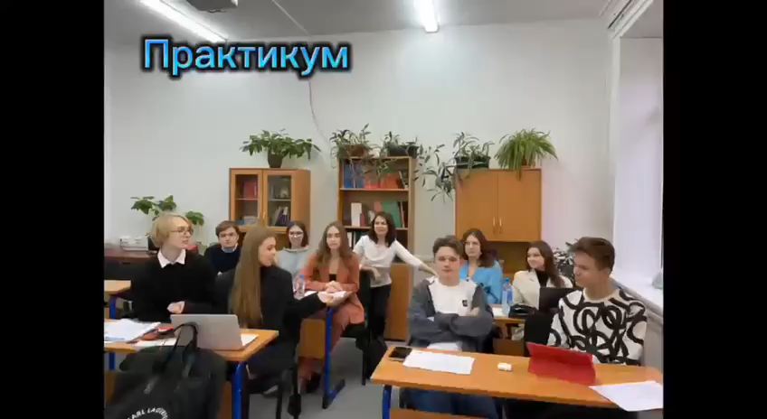

Slide 35
Наши Контакты
Хитрова Ирина Викторовна khitrova@inbox.ru
Зверева Наталья Сергеевна bagirova914@gmail.com
Умерова Мария Викторовна umerova@inbox.ru

Slide 36



Slide 37

Наши социальные сети

