Slide 1
Новый учебный год. Как начать и организовать обучение английскому языку во 2, 5,10 классах.
Марианна Юрьевна Кауфман автор курса «Happy English. ru» Master of Arts in Sociolinguistics University of Essex

Slide 2












Учебные ПОСОБИЯ

Slide 3













УЧЕБНИКИ

Slide 4
10 Класс - Основные задачи
Ликвидация пробелов, образовавшихся в предыдущие
годы.
2. Всеобъемлющее повторение.
3. Создание мотивации для дальнейшего изучения языка, обеспечение «языковой среды», формирование зоны ближайшего развития.
4. Подготовка к экзаменам.

Slide 10


Lessons 1, 2, 3
Meet the main characters of the book
Make questions for these answers.
  Marina’s height is 163 cm.
  His dream is to see the world.
  Yes, the sisters have a lot in common.
  My friend’s weight now is 54 kg.
  No, his father is a staff member in our local newspaper.
  Yes, they arrive in London on Friday.
  Mary is saving up money to buy Christmas presents.
  She has to improve her English this year.
Fill in the gaps with the necessary prepositions and translate the sentences into Russian.
  I like it when people are responsible their actions.
  They waited their counsellor for 3 hours but nobody turned .
  When she arrived airport, she found out that she had left her passport at home.
  Call me if you need to find more information.
  I remember my feelings when I first arrived London.
  Why are you so rebellious? Why do you need to get involved bad companies?
  If the bus turns on time, we won’t miss our train.
4
Unit 1 Lessons 1, 2, 3

Slide 11
8. The sisters have a lot in common. Both of them are always responsible their actions, they always turn on time.
Put the verbs in brackets in the correct form.
  I (pack) my suitcase now.
  Who normally (pack) your father’s suitcase?
  As a rule I (not save up) money.
  What you (save up) this money for?
  I (meet) my friend tonight.
  We never (meet) on Sundays.
  At the moment they (look) for their counsellors.
  When Lisa (lose) a toy, she never (look) for it.
  What you (do) ? — I (wait) for the next stopover.
  Normally if Emily is lost, she never (cry) , but (wait) for her mum.
Say the opposite. Use the verbs in the Present Simple Tense.
Model: I read books very often, but my friend (seldom)...
I read books very often, but my friend seldom reads them.
I always go to bed early, but my sister (never)…
I usually spend the summer in the village, but my friend (seldom)…
I often visit my granny, but my aunt (rarely)…
My parents always watch television on Sundays, and they (rarely go to the cinema)…
He often has tea with us, but he (to help us, never)…
Mr Brown works in his office on weekdays, but he (never work on Sundays)…
5
Make questions for these answers.
1. Yes, he likes to take pictures of his friends.
2. Pete never shares his thoughts with anybody.
3. Jane always helps her sister do her homework in English, because she knows English well.
Unit 1 Lessons 1, 2, 3 5

Slide 12
4. Thank you. She’s better now.
5. He always turns up when we need him.
6. She is a counsellor. She works with children.
Спросите друга:
  что он обычно делает летом.
  хочет ли он поехать в международный летний лагерь в этом году.
  в какую страну он хочет поехать.
  что он хочет посмотреть в этой стране.
  хороший ли он пловец.
  играет ли он на гитаре.
  кто его любимый писатель.
Complete the sentences. Use the words in brackets.
  What time your plane (land)? —
  My brother (work) in another town and (not live) at home. —
  Where you (come) from? —
  What time Steve (get) home after work? —
  He usually (stay) at the Hilton when he (be) in London. —
  How many languages you (speak)? —
  How often she (go) to the theatre? —
8 Choose the correct form of the verb.
The teacher is angry. His pupils to him. (don’t listen / are not listening)
He to talk to James now. (is not wanting / does not want)
I often try to read the newspapers in English, but I very much. (am not understanding / don’t understand)
Unit 1 Lessons 1, 2, 3
6

Slide 13
“Don’t shout,” she said, “I you.” (hear / am hearing)
anything? (Do you see / Are you seeing)
He anything at the moment. (isn’t remembering / doesn’t remember)
I he Helen. (think / am thinking, isn’t loving / doesn’t love)
My daughter in a restaurant for the summer, but she
it very much. (works / is working, doesn’t like / isn’t liking)
Put the verbs in brackets in the correct form.
  My wife normally at home, but she this month in Nottingham. She in a summer school there. (work, spend, teach)
  A: Look, it again.
B: Yes, it most days at this time of year. (rain, rain)
  Good night, I to bed. I always to bed early during the week. (go, go)
  A: Where are the children?
B: They in the garden. They home from school at about four and usually straight out to play with their friends. (play, get, go)
  We usually the news on TV at seven o’clock, but tonight we that new soap opera. (watch, watch)
Translate into English.
  Вожатые в лагере ответственны за всех детей.
  Я уверена, что узнаю этого человека, когда приду на место встречи.
  Мне очень нравится в лагере, но я часто скучаю по дому.
  Я сейчас коплю деньги на подарок своему другу.
  Он постоянно делает ошибку в этом слове.
  Она выходит замуж весной.
  Снег тает при 0 ºС.
  Когда он приезжает в наш город, мы иногда приглашаем его на обед.
Unit 1 Lessons 1, 2, 3 7

Slide 14

2 класс – ключ к успеху.

Slide 15
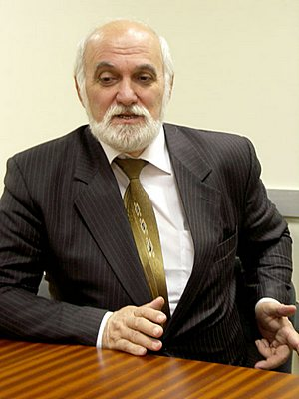
ПРОФЕССОР
МУХАМЕД КАБАРДОВ
ДОКТОР ПСИХОЛОГИЧЕСКИХ НАУК,
Федеральное государственное бюджетное научное учреждение «Психологический институт Российской академии образования», зав. лабораторией дифференциальной психологии и психофизиологии.
«Не все дети способны успешно заниматься
в условиях непроизвольного запоминания»

Slide 16
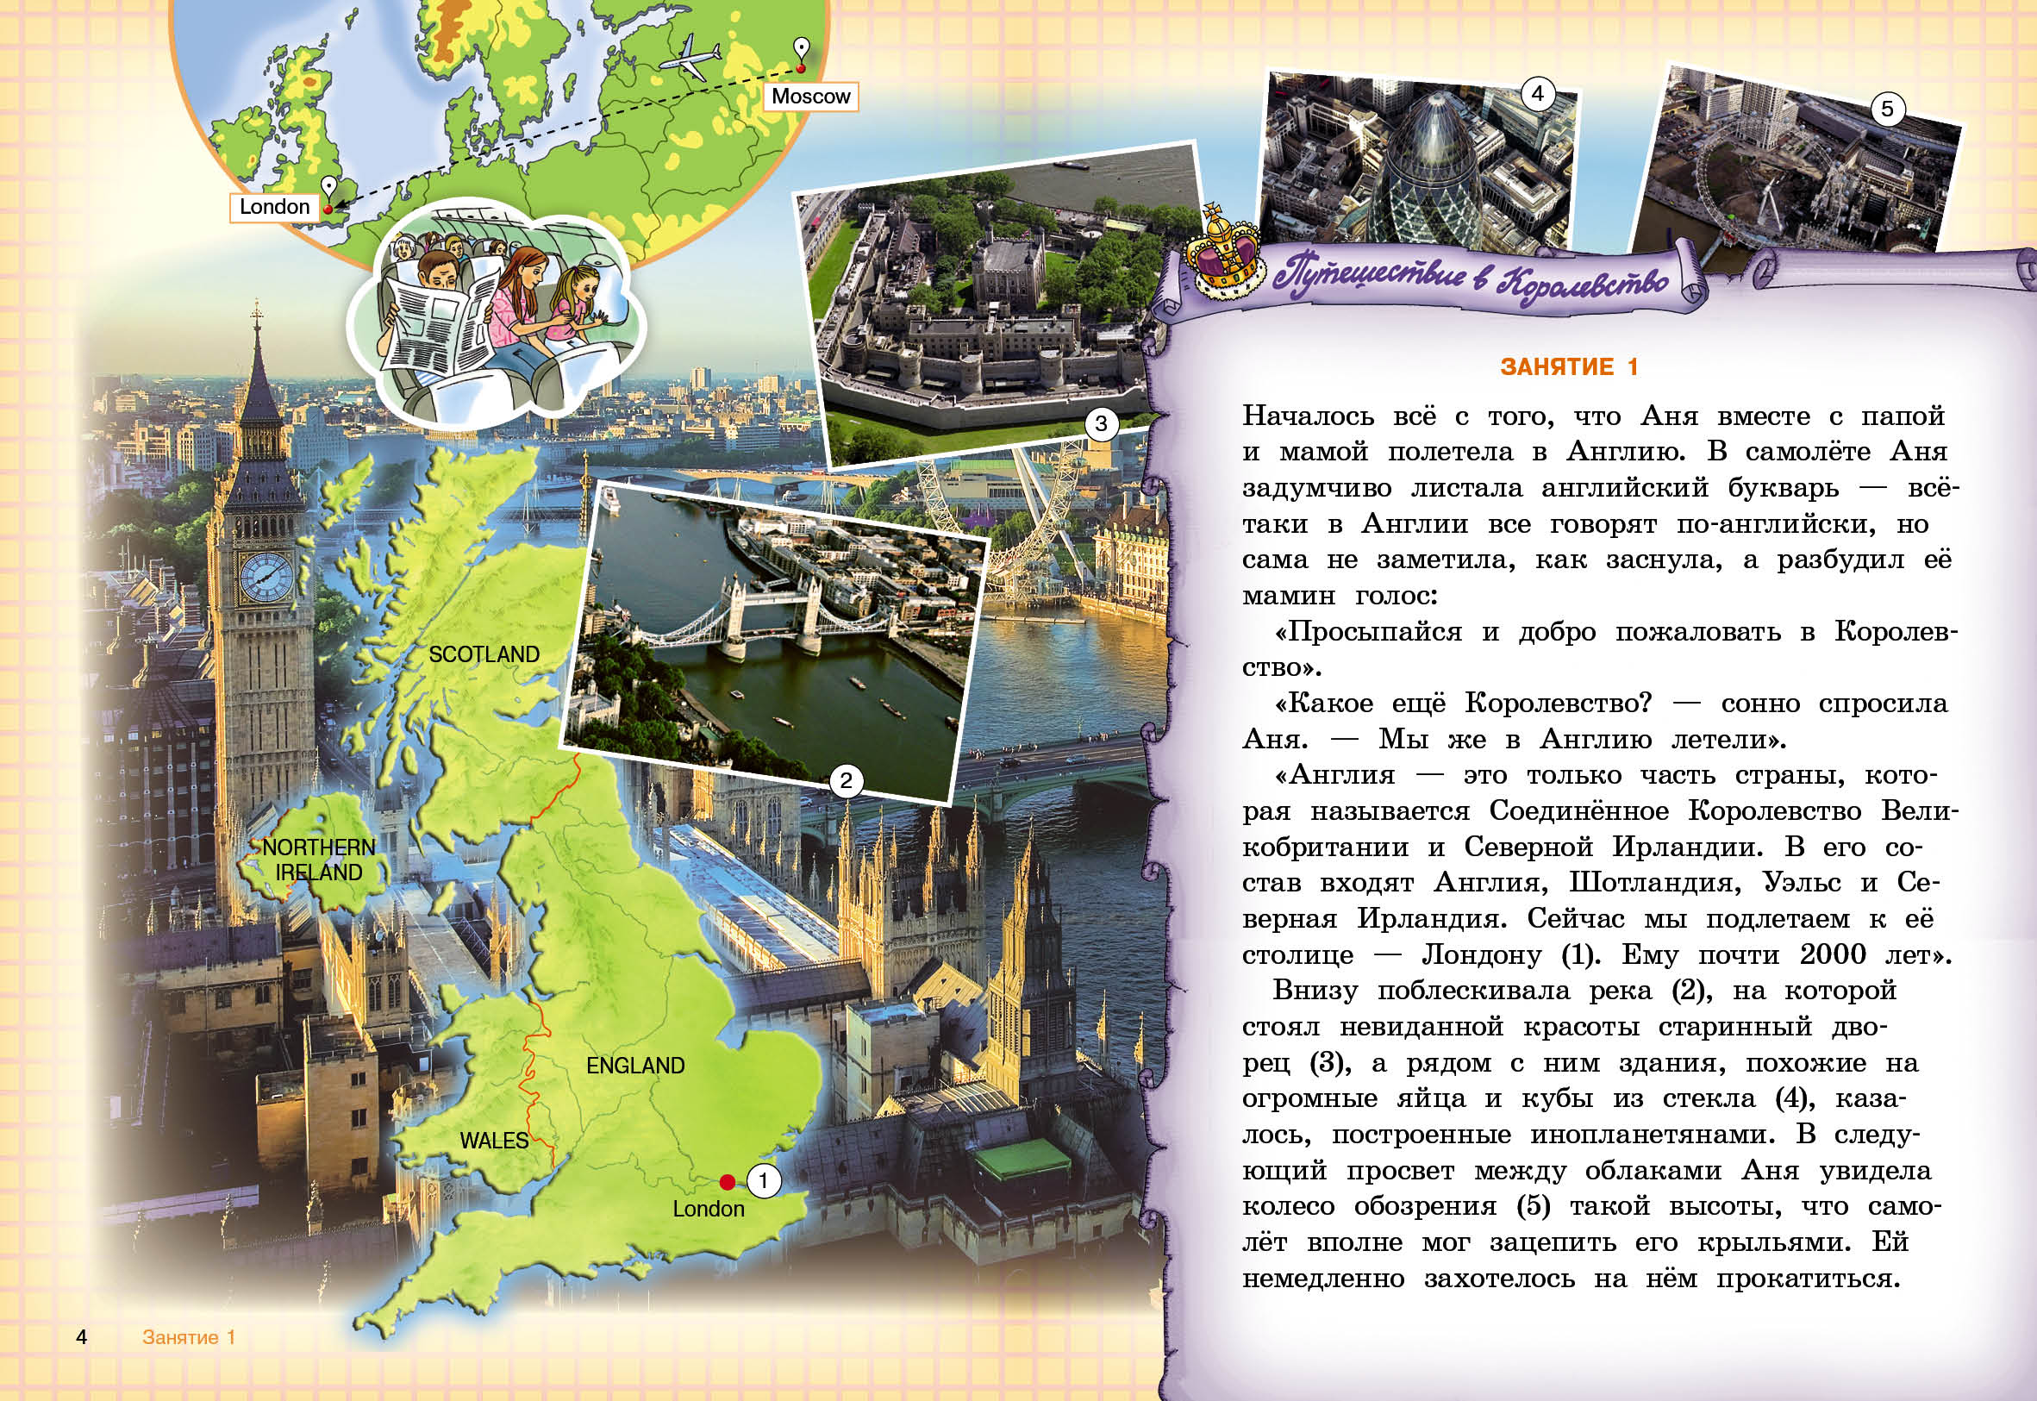



Slide 17
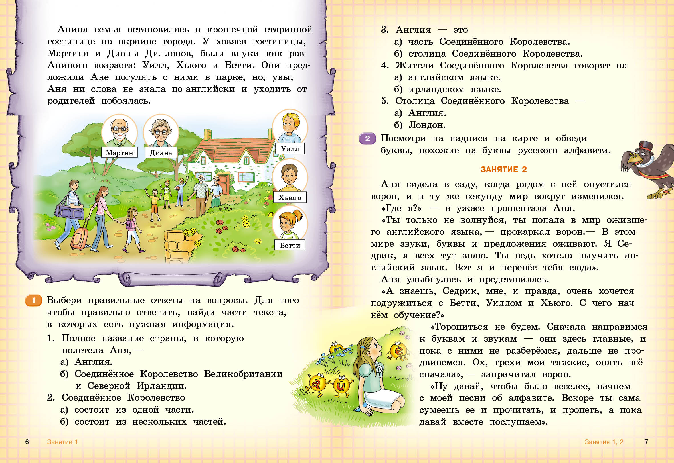



Slide 18
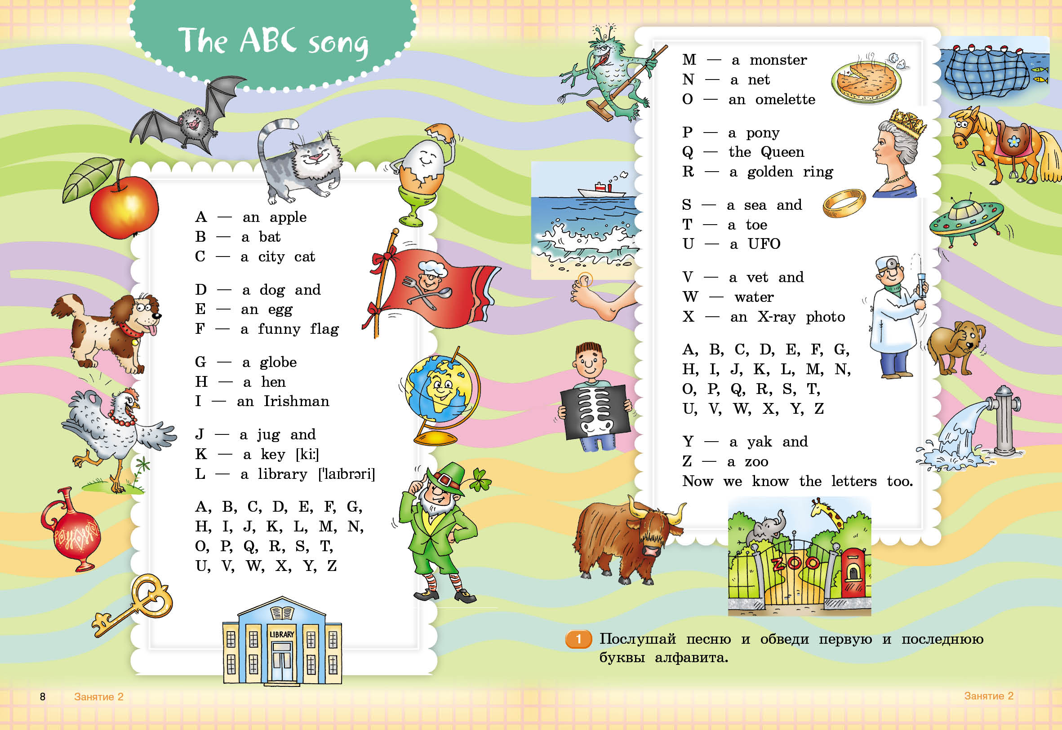
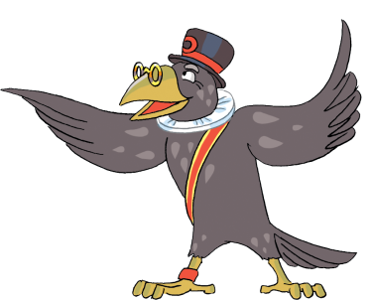
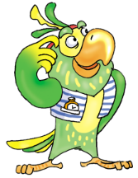
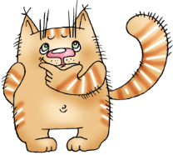

Slide 19
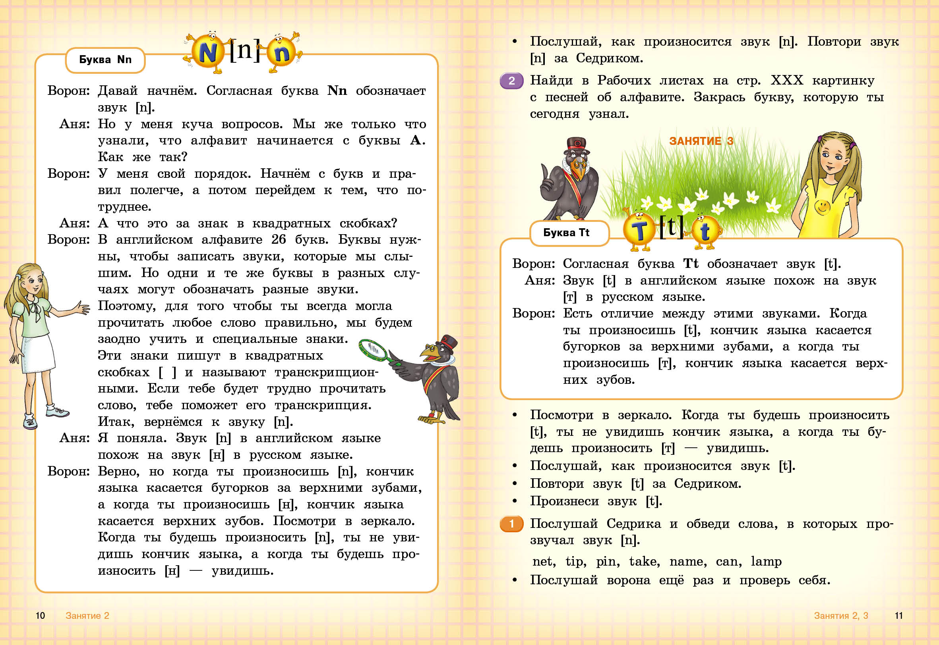


Slide 20
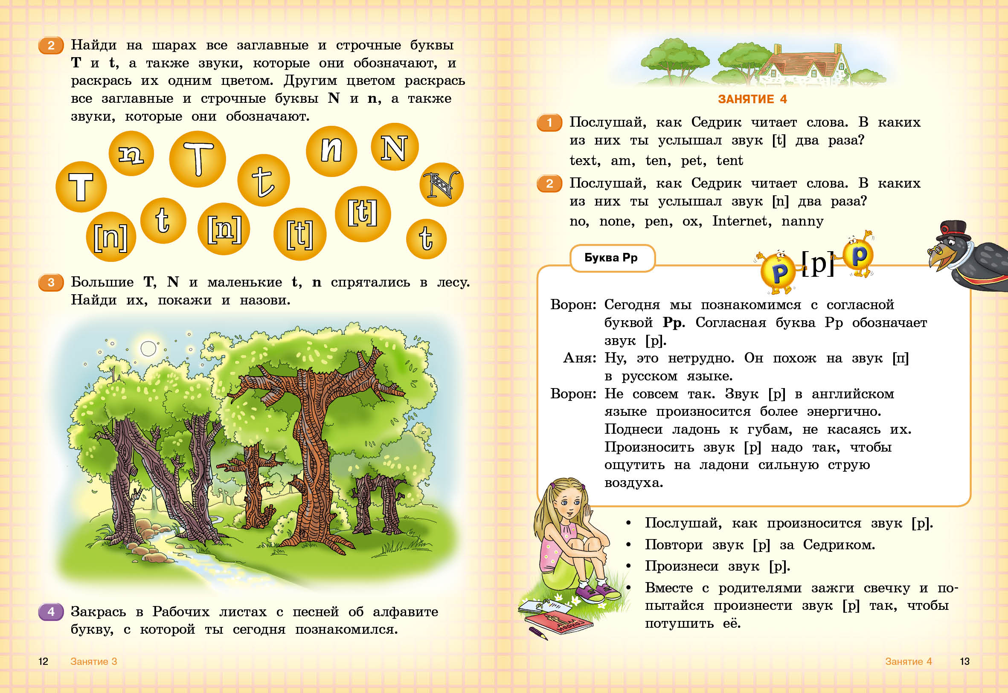


Slide 21
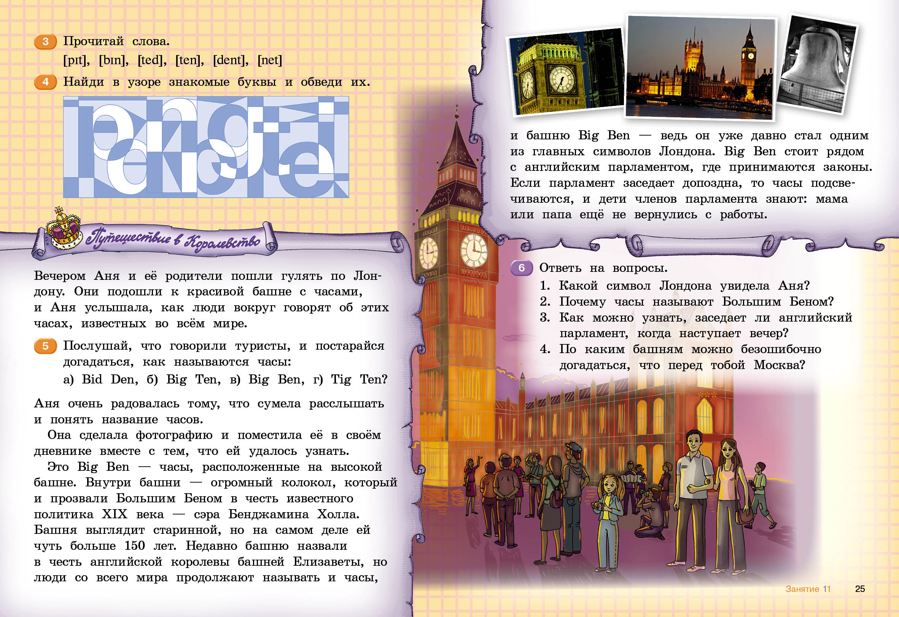


Slide 22
5 класс – возможность наверстать упущенное

Slide 23
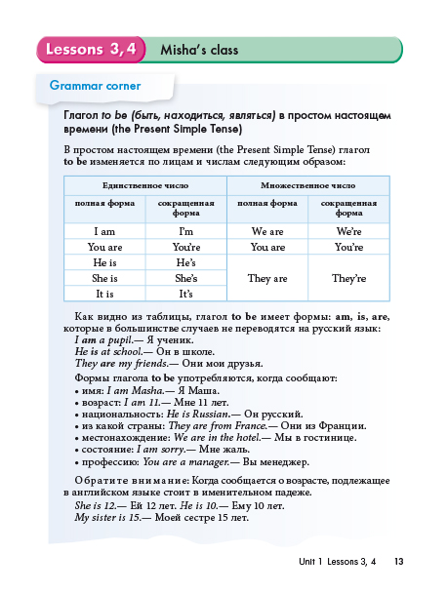
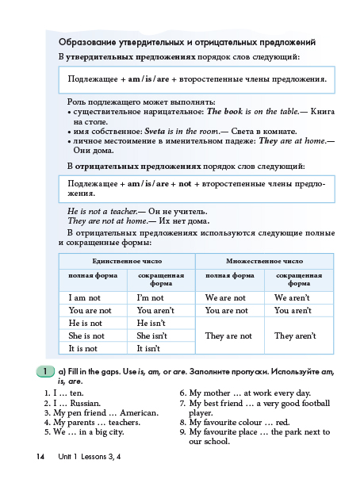


Slide 24
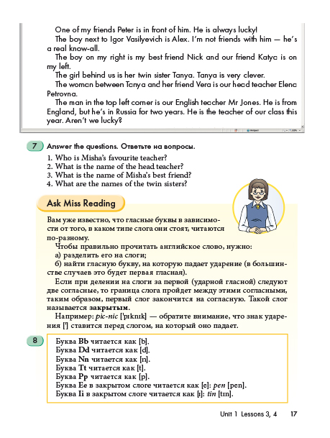
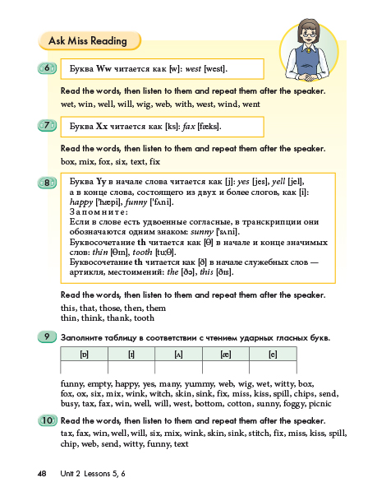

Slide 25
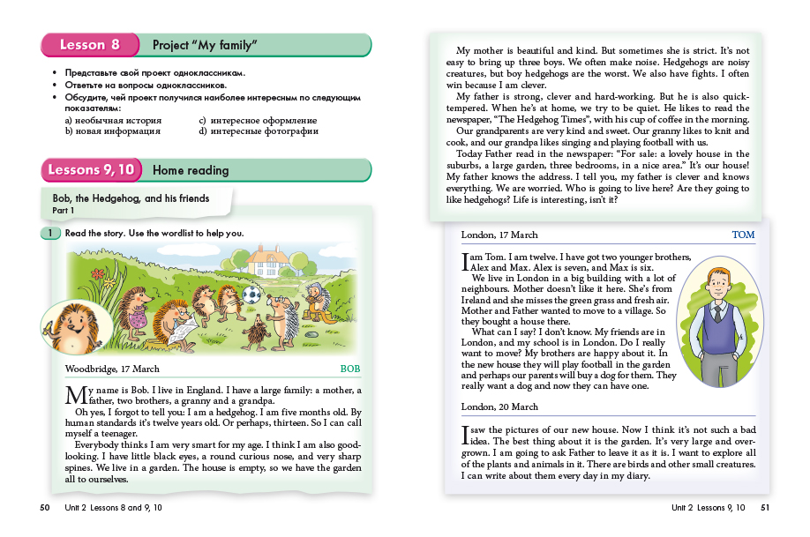


Slide 26

New material

Slide 27
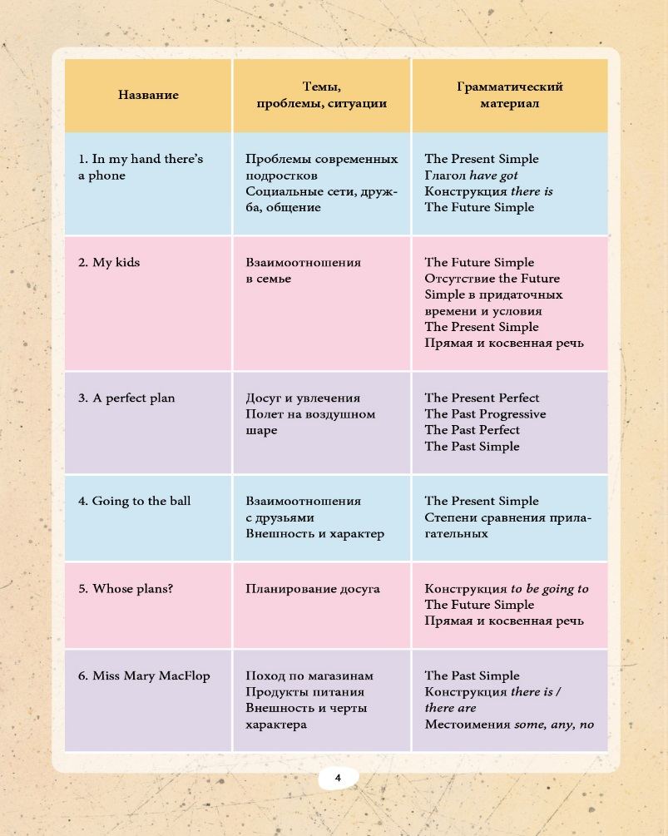
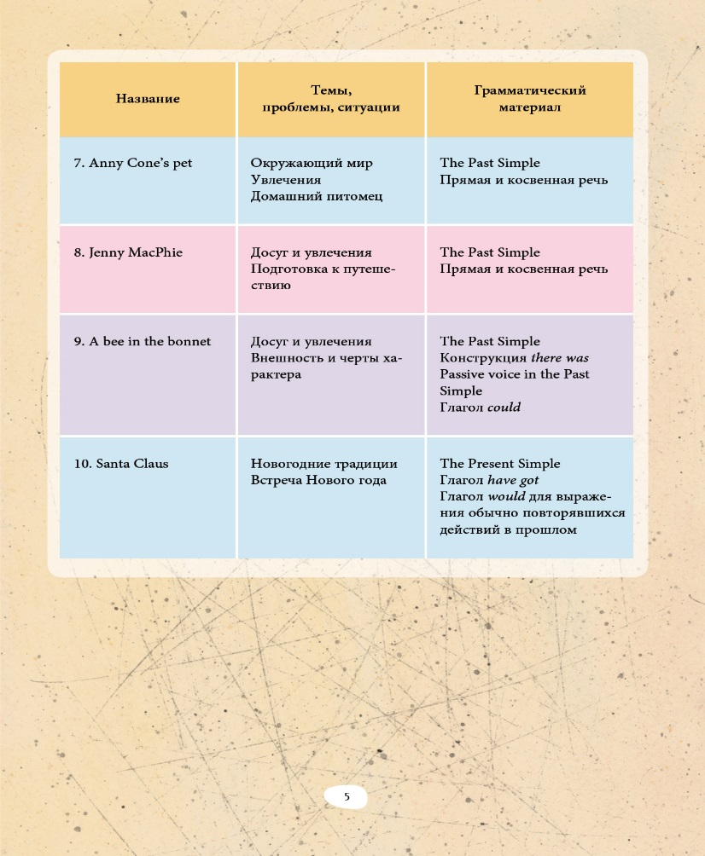

Slide 28
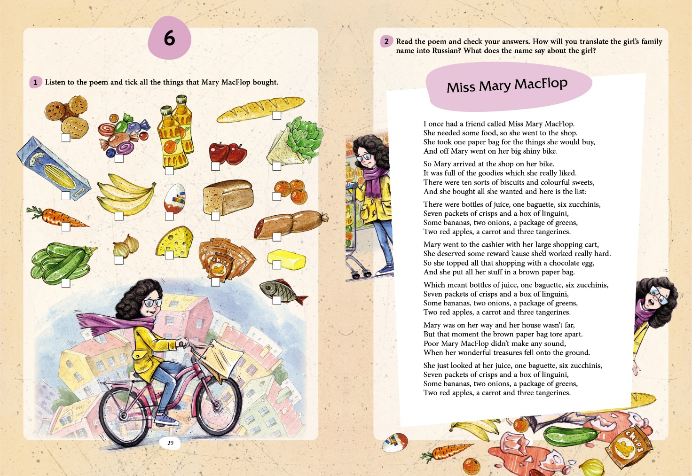

Slide 29
Наши социальные сети

