Slide 1
Стили и жанры текстов в обучении английскому языку в школе: от сказок до грамматических чантов
Марианна Юрьевна Кауфман

Slide 2




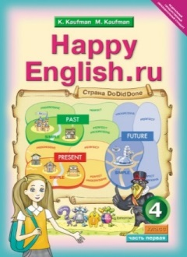
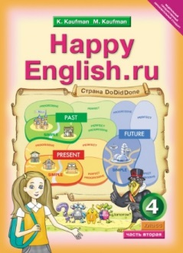







УЧЕБНИКИ

Slide 3





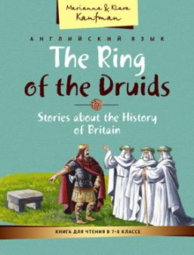
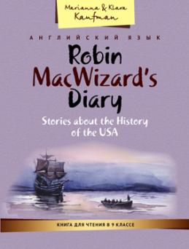
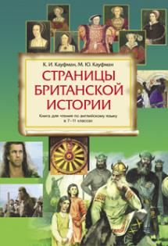




Учебные пособия

Slide 4

Новые издания

Slide 5
Функции текста
1. Текст как языковой объект
Иллюстрация грамматических явлений, демонстрация лексики
2. Текст как средство передачи информации
Факты, идеи, культурологические сведения
3. Текст как стимул для продуктивной деятельности
Основа для говорения, письма, дискуссий

Slide 6
Критерии отбора текстов
Жанр - соответствие возрасту и интересам учащихся
Объем - посильность для данного уровня
Связность - логичность и структурированность
Языковая насыщенность - баланс знакомого и нового
Методический потенциал - возможности для разных видов работы
Мотивационная ценность - способность заинтересовать

Slide 7
Рифмовки и чанты для начинающих
Ритм и рифма облегчают запоминание
Работает слуховая и моторная память. Ритм + движение + хоровое проговаривание = прочное запоминание форм (If I find out…, I will phone…).
Повторяемость структур создает автоматизм
Автоматизация. Чаще всего именно такие тексты «выстреливают» в речи в нужный момент, потому что хранятся целыми кусками.
Грамматика воспринимается как «игра», а не как правило. Это резко снижает сопротивление к отработке структур.
- Физическая активность усиливает запоминание
Групповое исполнение снижает тревожность. Музыкальность повышает мотивацию

Slide 8


Сборники учебных песен для начальной и основной школы

Slide 9
Сборники учебных песен для начальной и основной школы
2 сборника включают 57 песен и стихотворений.
Учебные песни и стихи органично сочетают учебный и развлекательный характер деятельности.
Учебные песни и стихи предлагаются не изолированно, а сопровождаются серией упражнений, что позволяет использовать сборники как на уроке, так и во внеурочной деятельности.
Учебные песни и стихи сопровождаются аудиозаписями и караоке версиями, которые можно скачать бесплатно с помощью QR кода.
В каждом сборнике приводится таблица с указанием названия песни, темы, лексического и грамматического наполнения, социокультурной информации

Slide 10
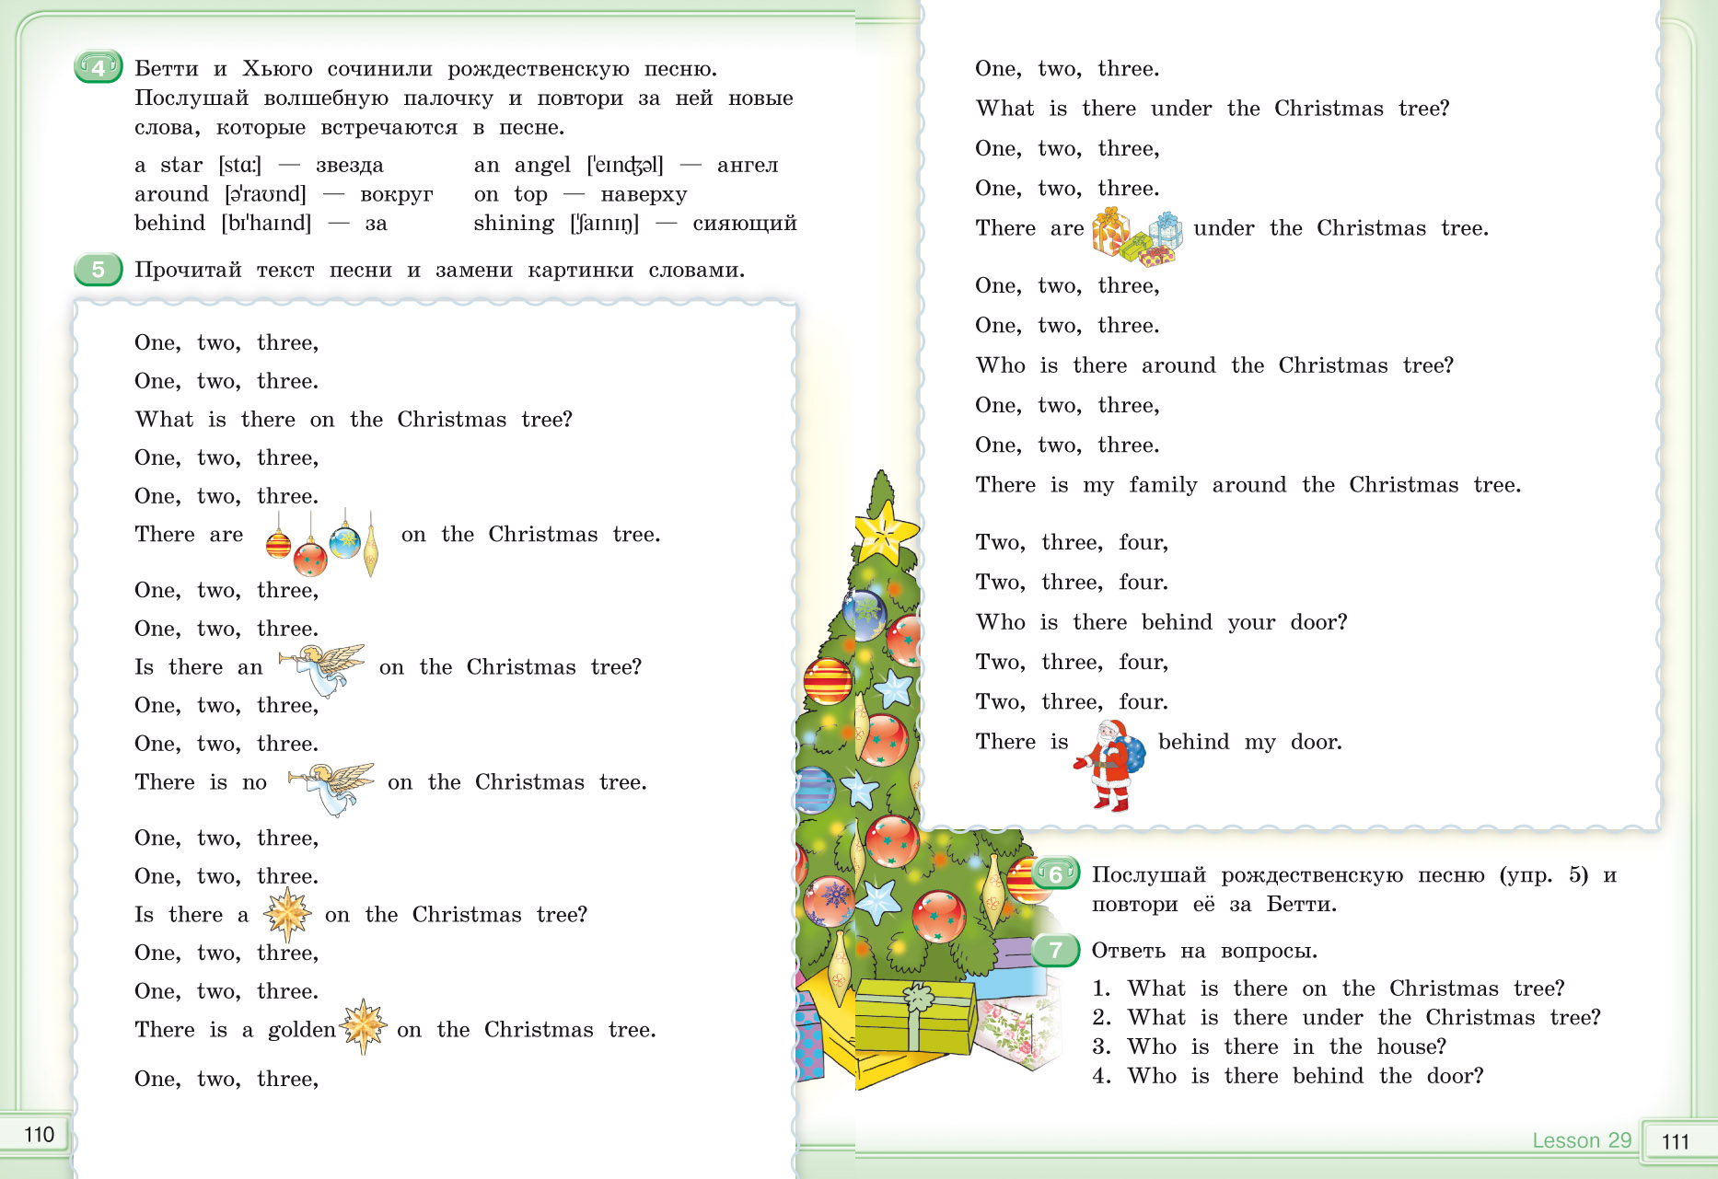


Slide 12


Slide 13
Фабульные тексты (истории, сказки, комиксы)
Эмоциональное вовлечение. Сюжет, герои, интрига сразу включают эмоции, поэтому дети легче «входят» в текст и хотят дочитать.
Снижение тревожности. История воспринимается как «интересное», а не «задание», поэтому снижается страх перед английским.
Лучшее запоминание лексики. Повторяющиеся слова и конструкции в разных эпизодах истории запоминаются почти незаметно.

Slide 14
Сторителлинг
Качественный сторителлинг в учебнике — это не просто «интересная история», а тщательно выстроенный инструмент, который одновременно обучает, мотивирует и развивает языковую личность ученика. Понятный и увлекательный сюжет — история должна «цеплять» с первых строк, иметь завязку, развитие, кульминацию и развязку, чтобы удерживать внимание учеников до конца.
• Повторяемость ключевых структур — целевая грамматика и лексика должны встречаться в тексте естественно и многократно (не менее 5–7 раз), чтобы обеспечить запоминание через контекст.
• Соответствие возрасту и интересам — темы, герои и ситуации должны быть близки ученикам: для младших — животные, волшебство, приключения; для подростков — дружба, конфликты, самоопределение.
• Культурная и языковая аутентичность — тексты должны отражать реалии англоязычного мира (имена, праздники, традиции), но при этом быть адаптированы по уровню сложности.
• Методический потенциал — история должна легко «разбираться» на задания: предсказание сюжета, работа с персонажами, драматизация, пересказ, творческое продолжение.
• Эмоциональная окраска — текст должен вызывать эмоции (радость, удивление, сопереживание), чтобы активировать эмоциональную память и повысить мотивацию к чтению.

Slide 15

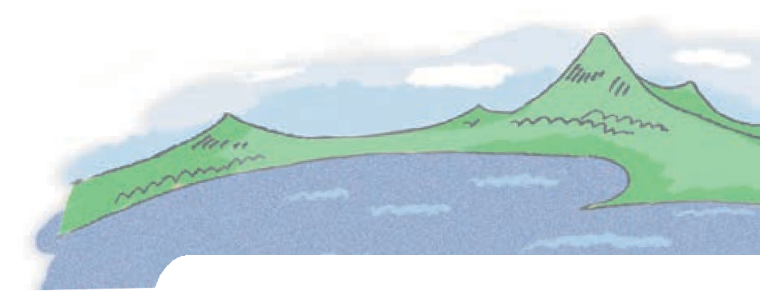
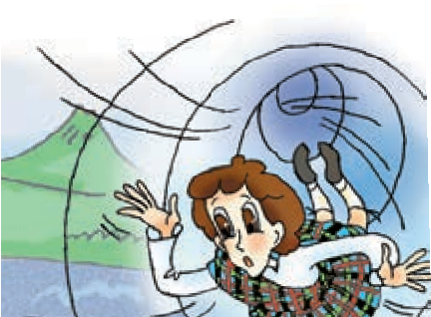






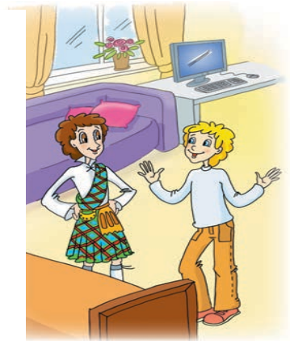

I’m a wizard
1
Listen to the words and expressions and repeat them after the speaker.
a wizard ['wizəd] — волшебник an animal ['æniml] — животное a joke [¢əυk] — шутка
an end [end] — конец
to explain [ik'splein] — объ- яснять
to believe [bi'l v] — верить quickly ['kwikli] — быстро
How many times? — Сколько раз? sense of humour [.sens əv 'hj%mə] — чувство юмора
an explanation [.eksplə'neiʃn] — объяснение
I made a mistake.— Я совершил ошибку.
somehow ['snmhaυ] — как-нибудь
2
Misha and his guest are in Misha’s room. Listen to their conversation and answer the questions.
Is Robin really Misha’s pen friend?
Can Misha call him Rob?
What can Misha’s guest do?
Read the conversation. What are the friends talking about?
Misha: So this is our room, Rob. Please come in.
Your sofa is at the window. This is my computer. We can play a game!
Robin: Rob? My name is Robin, not Rob. And what is your name?
Misha: What?! I’m Misha Inin, your pen friend, remember?
Robin: And what country are we in?
Misha: Are you OK, Robin? You’re in Russia, of course, in Obninsk.
Robin: Oh, no!
Misha: Look. Just wait for me here. I must call my parents.
Robin: No! Please don’t go away! I can explain.
Misha: OK, but you must have a really good explanation.
Robin: I must tell you a secret, Misha. My name is Robin MacWizard,
3
122 Unit 5 Lesson 1

Slide 16
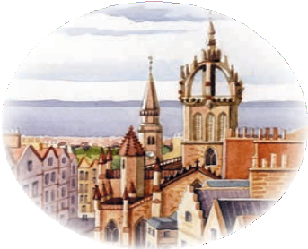


but I am not your pen friend. This is going to sound crazy (это прозвучит неправдо- подобно) but I am from the Edinburgh
of 1599 and now your real pen friend is there. I made a mistake and we must correct it quickly somehow.
Misha: Ha-ha-ha. Very funny, Rob. You’ve got a very good sense of humour.
Robin: I’m Robin! How many times must I tell you? Just listen. My family name is MacWizard: in
Scottish it means “a wizard’s son”. My father, my grandfather and my great-grandfather are all real wizards.
Misha: And what about you?
Robin: I can’t do many things. I am not very talented, but I can travel in time. I can also fly and talk to animals and trees.
Misha: Fine. But that’s the end of your stupid joke, ROBIN. If you are really a wizard, talk to my cat and tell me: What is his name? How old is he? What’s his favourite food?
Robin: OK. Give me a minute. (pause while he talks to the cat)
Robin: Well, its name is Pafnutiy. It is three years old. And his favourite food is apples. Very strange for a cat… Pafnutiy is very unhappy. It…
Misha: Oh, no… This can’t be true. I must sit down for a minute.
Are these sentences true, false or is there not enough information in the conversation?
Robin MacWizard is from Scotland.
Rob MacWizard is from London.
Misha can’t believe Robin.
Robin’s got a very good sense of humour.
Robin is from the year 1599.
Robin’s father is a wizard.
Robin’s family are good wizards.
Robin needn’t go back to his time.
Misha is very happy with his new friend.
Robin can talk to animals.
Robin can’t talk to Pafnutiy.
Answer the questions.
4
5
Where is Robin from?
What can Robin do?
Who is Robin’s father?
What must Robin do now?
What must Misha do?
Must Misha help Robin?
Who is Pafnutiy?
What’s its favourite food?
Unit 5 Lesson 1
123

Slide 17
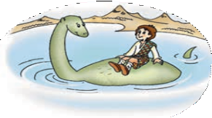


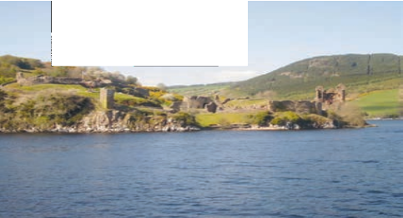
Robin: Yes, she lives in Loch Ness in Scotland. It’s not very far from my granny’s castle.
Misha: Oh, no! Is your pet a Loch Ness monster?
Robin: Nessie isn’t a monster. She likes people and she wants to have friends. When I arrive at the lake, I call her and she always comes. She plays
with me and tells me all about her life. Sometimes her life is really boring. People don’t come to the lake very often, they are afraid of her. She doesn’t want to upset people so she spends her time deep in the lake. The water is very cold there and Nessie likes the sun, but she understands… Wait a minute! How can you know about Nessie? Is she still alive in Loch Ness?
Misha: Nobody knows for sure, but people talk about a huge monster in Loch Ness.
Robin: Poor Nessie.
Misha: Nowadays she’s really popular. People from all over the world come to Loch Ness. They hope to see Nessie. There are Nessie monuments, Nessie tours, Nessie souvenirs, Nessie museums…
Robin: That’s good. So they aren’t afraid of her then?
Misha: I’m not too sure about that. I think some people just don’t believe in her. But what is she? A dinosaur?
Robin: I don’t know what a dinosaur is, Misha. But Nessie is a dragon, the last magical creature in the world. She can live only in Loch Ness. Her food is just the pure cold water of the lake.
Misha: A dragon? There are no dragons. They live in fairy tales. Robin: Your fairy tales are my reality, Misha.
Misha: Can you tell me about your world, Robin?
Robin: I want to, but I can’t do it now. Please don’t be angry with me! Misha: It’s OK. I understand. But I want to help you.
Robin: I must go to London. Can you help me do that?
FOR YOUR
Loch Ness is a large and very deep lake in Scotland. It is about 37 kilometres long and 230 metres deep. The old legend says that a Christian monk, St Columbia, saw (видел) a water dragon in Loch Ness 1400 years ago. Then in 1933, Kenneth Wilson, a doctor from London, took a picture of a huge animal in the lake. People remembered the old legend and a hunt for Nessie began. (Тогда люди вспомнили старую легенду, и охота за Несси началась.)
Unit 5 Lessons 4, 5 131
INFORMATION

Slide 18



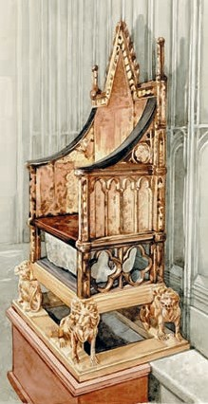
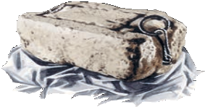








7 Read the end of the conversation and check your ideas.
Misha: Nowadays we associate England with Queen Elizabeth II, Big Ben, double-decker buses, tea, football…
Robin: And what do you associate Scotland with?
Misha: Tartans, kilts, bagpipes, lochs, Nessie, Edinburgh Castle… Robin: Oh, really? And what about the Stone of Destiny? Do you know
about it?
Misha: The Stone of Destiny? What is it?
Robin: Well, I think it’s time to tell you my story. But we must start from the beginning.
Misha: OK. But can we start now? I don’t want to wait. Robin: We can talk tomorrow, Misha. It’s a long story.
FOR YOUR
The Stone of Destiny — Камень судьбы. По преданию Камень судьбы был при- везен из Святой земли более четырех
INFORMATION
тысяч лет тому назад. На протяжении веков все шотландские короли короновались на Камне судьбы. Более семисот лет назад, в XIII веке, английский король Эдуард I похитил этот священ- ный камень у шотландцев, надеясь, что без него они не смогут больше короновать своих правите- лей и воинственная Шотландия, наконец, утратит независимость. Камень был привезен в Лондон в Вестминстерское аббатство и помещен под коро- левский трон.
С тех пор все короли Англии короновались на этом Камне. Однако Эдуард ошибся: похищение Камня только подогрело ненависть шотландцев к завоевателям, война между ними продолжалась еще много лет, и шотландцы не раз предпринимали попытки вернуть похищенную реликвию.
Ask Miss Reading
8
Буква u перед буквосочетаниями ll, sh может читаться как [υ]: bush [bυʃ], pull [pυl].
Unit 6 Lesson 6
171

Slide 19




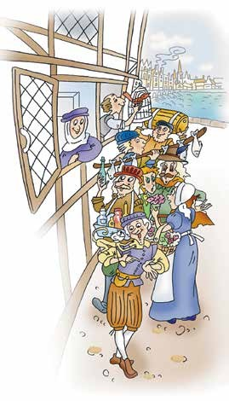


What did the stars say?
1 Listen to the words and expressions and repeat them after the speaker.
a plate — тарелка
a spoon — ложка
to smile — улыбаться
a market [mkt] — рынок
a feast [fst] — пир
glass — стекло
How much do you know about life
in 1599? Try to answer the questions.
Were there any castles?
Was there a queen or a king?
Were there beds in the houses?
Was there any furniture in the houses?
Were there toilets in the houses?
Did people have oranges?
Did people have sugar?
Did people have plates?
Did people have spoons?
Did people eat with their hands?
Did people use any medicine?
Listen to the third part of the story and check your answers.
a sheep — овца
a countess [kaυnts] — графиня
furniture [f:ntʃə] — мебель
a manner — манера
to recognise [rekəgnaz] — узнавать
4 Read the story and answer the questions.
What did the London of the past look like?
Was countess Bagshow Phillip’s relative?
Why did the countess take Rob to her house?
Did Rob like countess Bagshow’s house?
What did the countess give Rob before dinner?
What was the food at the feast like?
What were people’s manners like?
What happened at night?
Did Rob help countess Bagshow?
Unit 11 Lesson 5 217

Slide 20
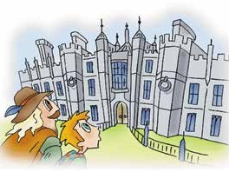
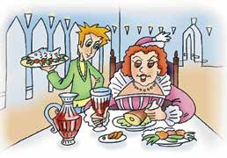
Rob’s story
PART III
In London
London was a big surprise. It was small, and I didn’t recognise any of the streets. They weren’t the same as the streets of the London of my time. We went through the market. I liked it. They had everything: medicine, roses, fish, meat, oranges. There were people with sheep and pigs. I also saw a lot of beggars.
Phillip lived with his aunt, countess Bagshow. We went to her house and Phillip introduced me. “This boy can cure any disease,” he said. The countess was very happy, and I became her servant. I liked the house.
The furniture was comfortable, and I could sleep in a bed. The windows had glass in them. When I saw a toilet inside the house, I was very happy. There were no beds or toilets in Edinburgh.
That evening there was a feast in the castle. The countess gave me a spoon and said, “You must come with your own spoon when somebody invites you to dinner.”
The people in the castle wore beautiful, expensive clothes, but the smell there was bad. I thought all the people needed a bath. But there was no bathroom and no toilet in the castle!
At the feast I had to stand behind the countess’s chair and serve her. All
the plates and cups were made of silver*, and the food looked tasty. But I didn’t like people’s manners. They ate with their hands and threw bones on the floor**. Their hands were dirty and their teeth were black, because they ate a lot of sugar. The Queen didn’t smile, because her teeth were black too.
* сделаны из серебра
** бросали кости на пол
218 Unit 11 Lesson 5

Slide 21

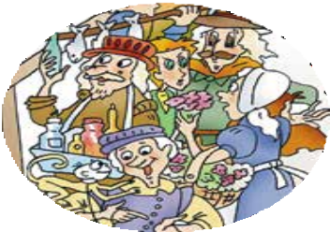

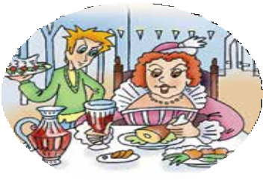
At night the countess didn’t feel well. She had a stomachache and I had to help her. But I made a big mistake. I said, “I am not surprised. You ate five chickens and two cakes at the feast. And you didn’t wash your hands!”
The countess was very angry and told me to leave her house. My friend Phillip felt sorry for me, but what could he do?
I needed money, so I went to the market and started my own business.
I predicted the future and gave people aspirin. Finally, the Queen invited me to her castle and I told her about the future of England. You know the end of the story. Now I am in the Tower, and everything is ready for my execution.
go | went
can | could
see | saw
come | came
become | became
have | had
feel | felt
give | gave
wear | wore
think | thought
make | made
eat | ate
throw | threw
give | gave
5 Put the verbs in brackets in the Past Simple and complete the sentences. Where did these events take place?
countess Bagshow’s house
1
2
market
People (wear) beautiful clothes.
Rob (have to) serve the countess.
Rob (see) a lot of beggars.
People (can) buy everything there.
Rob (like) the furniture.
The countess (give) Rob a spoon.
The food (look) great.
The countess (tell) Rob to leave.
The Queen (not smile) because her teeth (be) black.
3
feast in the castle
Unit 11 Lesson 5
219

Slide 22
Диалоги
Имитируют реальное общение. Ученики видят, «как это звучит в жизни», а не в упражнении.
Снимают страх говорить. Модели реплик дают готовые фразы, которые легко повторить и разыграть.
Развивают прагматическую компетенцию. Учат не только словам, но и вежливости, интонации, реакции собеседника.

Slide 24
Информативные и научно-популярные тексты
Когнитивное напряжение. Они требуют больше концентрации, так как содержат факты, термины, причинно‑следственные связи.
Специфическая лексика
Интеграция с другими предметами
Мотивация «через смысл». Интересные факты повышают познавательную мотивацию: «Хочу понять, потому что интересно».
Развитие учебных стратегий. Ученики учатся вычленять главное, работать с заголовками, подзаголовками, ключевыми словами, учатся трансформации.

Slide 25

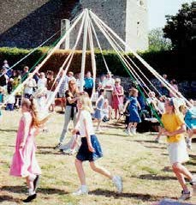
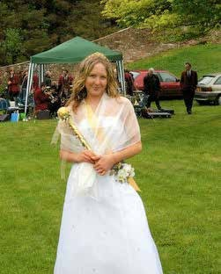
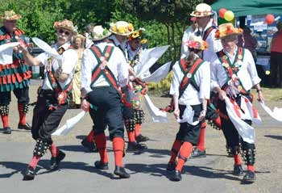





Kim: That’s a pity! Сostumes are fun! I’m going to be a May Queen. I’ve got a dress, but I haven’t got nice shoes.
Lora: Buy a pair of shoes and wear them after the party too.
Kim: That’s a good idea! I’ll wear them for my birthday.
Dennis: I’m going to be a Morris dancer! I have a hat, but I need a white shirt and a pair of trousers. I’m going to wear them in summer.
Ann: I’ll be a Morris dancer too. I need some paint for my face.
Mike: You’ll buy it. Let’s go shopping!
Выпиши из текста предложения и заполни таблицу в рабочей тетради. В каких случаях употребляется Future Simple, а в каких — to be going to?
go to their country homes (called dachas), work in the garden, have picnics or barbecues.
The first day of May in England is called May Day. The weather gets warm after a long winter and flowers and trees start to blossom. So on May Day people celebrate the coming of summer.
Traditional English May Day celebrations are very old.
They are: Morris dancing, choosing a May Queen and dancing around a maypole.
5
Планы на будущее | Решения, принятые в момент речи
7 Как отмечают Первое мая в твоей семье? Скажи 4–5 предложений.
6 Прочитай, как отмечают Первое мая в России и в Ве- ликобритании. Распредели эти традиции между двумя странами.
Homework
•Выполни в рабочей тетради упр. 1–3.
Choosing May Queen, dancing around a maypole, working in the garden, having picnics, going
to dachas, spending time with family and friends, Morris dancing
Lessons 6, 7
1 a) Аня и её друзья пошли в магазин за покупками. Их сопровождает Седрик. Послушай новые выражения и повтори их за вороном.
a shop assistant — продавец
How can I help you? — Чем я могу вам помочь? What size are you? — Какой у вас размер?
A lot of countries celebrate May 1. In Russia it’s a Spring and Labour Day. It is also a public holiday. People don’t go to work. Banks and offices are closed.
The Russians relax and celebrate on this day. They spend time with their family and friends. Some people
76 Unit 4 Lesson 5
Unit 4 Lessons 5 and 6, 7 77
HEru4SB2_2019.indb 76-77
06.02.2020 12:43:35

Slide 26


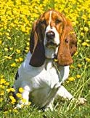
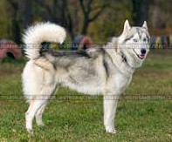
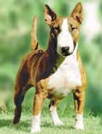
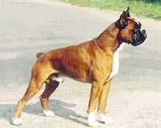
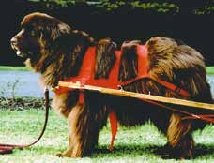
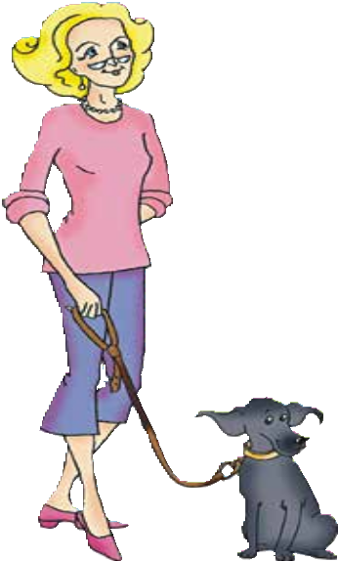
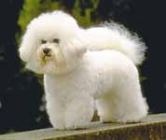
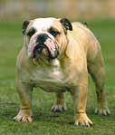
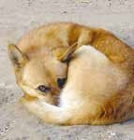
Types of dogs
Work in a group. Think how you can help rescue homes for animals and write a list of activities.
Read the information about rescue homes and check your ideas. Which group got more points?
K
ids and their families can help rescue homes. It can be a perfect hobby
and a chance to spend some free time together.
There are a lot of things they can do. Parents and kids can walk dogs, give
out food and treats, and play with animals. Older kids may be able to help
1
2
3
with bathing the dogs too. Together, it will be a fun family pastime.
Dogs in rescue homes spend many hours of the day in cages if volunteers don’t come and help. Kids can volunteer to walk and play with dogs and give them some time outside. The animals will be happier and healthier. It’s also good for kids. With dogs they can play and get physical activity.
Playing with puppies is, of course, the most wonderful thing for kids. Puppies must be with people. It teaches them to be good and safe family dogs. They also have a lot of energy and need a lot of physical activity. Playing with puppies teaches kids a lot of important things too. They learn to train pets, responsible and patient.
Kids can also help clean at rescue homes. Kids usually enjoy cleaning and doing chores for animals, even if they don’t like doing it at home.
Some rescue homes have a fantastic volunteer program: kids read to the dogs. The kids practice their reading, and the dogs get love and attention. These programs have been really successful for kids and dogs, so check it with your local rescue organisation. If they don’t have it, you can help them start it. Families and their kids often help the dogs they love find great homes. Kids will not see their favourite dog at a rescue home every day because it will get a new home, but they will learn a very important lesson. It makes you happy
if you can help someone you love.
Answer the questions.
Why is helping rescue homes a good hobby for the whole family?
What can puppies teach kids?
What can older kids do?
Why is playing with dog a part of a healthy lifestyle?
Is there a rescue home in your city / town/ village?
Would you like to work there?
What would you like to do?
4
4
5
6
7
8
basset [bst]
Siberian husky [sabriən hski]
bullterrier [bυlteriə]
boxer [bɒksə]
Newfoundland [njfaυndlənd]
poodle [pdl]
bulldog [bυldɒg]
mongrel [mŋgrəl] — дворняжка
168 Unit 7 Lessons 1, 2
Unit 7 Lessons 1, 2 169

Slide 27
Виды деятельности с информативными текстами
Предсказать содержание по заголовку
Найти факты, которые удивили или были новыми
Ответить на вопросы для проверки понимания
Суммировать основные идеи текста
Провести исследование и сделать презентацию
Сравнить с информацией из других источников

Slide 28
Легенды и сказки
Жанр, объединяющий фабульное и информативное
Позволяют работать с аутентичными текстами
Методический потенциал:
Культурологический компонент, богатый язык описаний
Элементы волшебства привлекают внимание, жают возможность орагизации проетной деятельноси: отдели реальные события от вымысла.

Slide 29
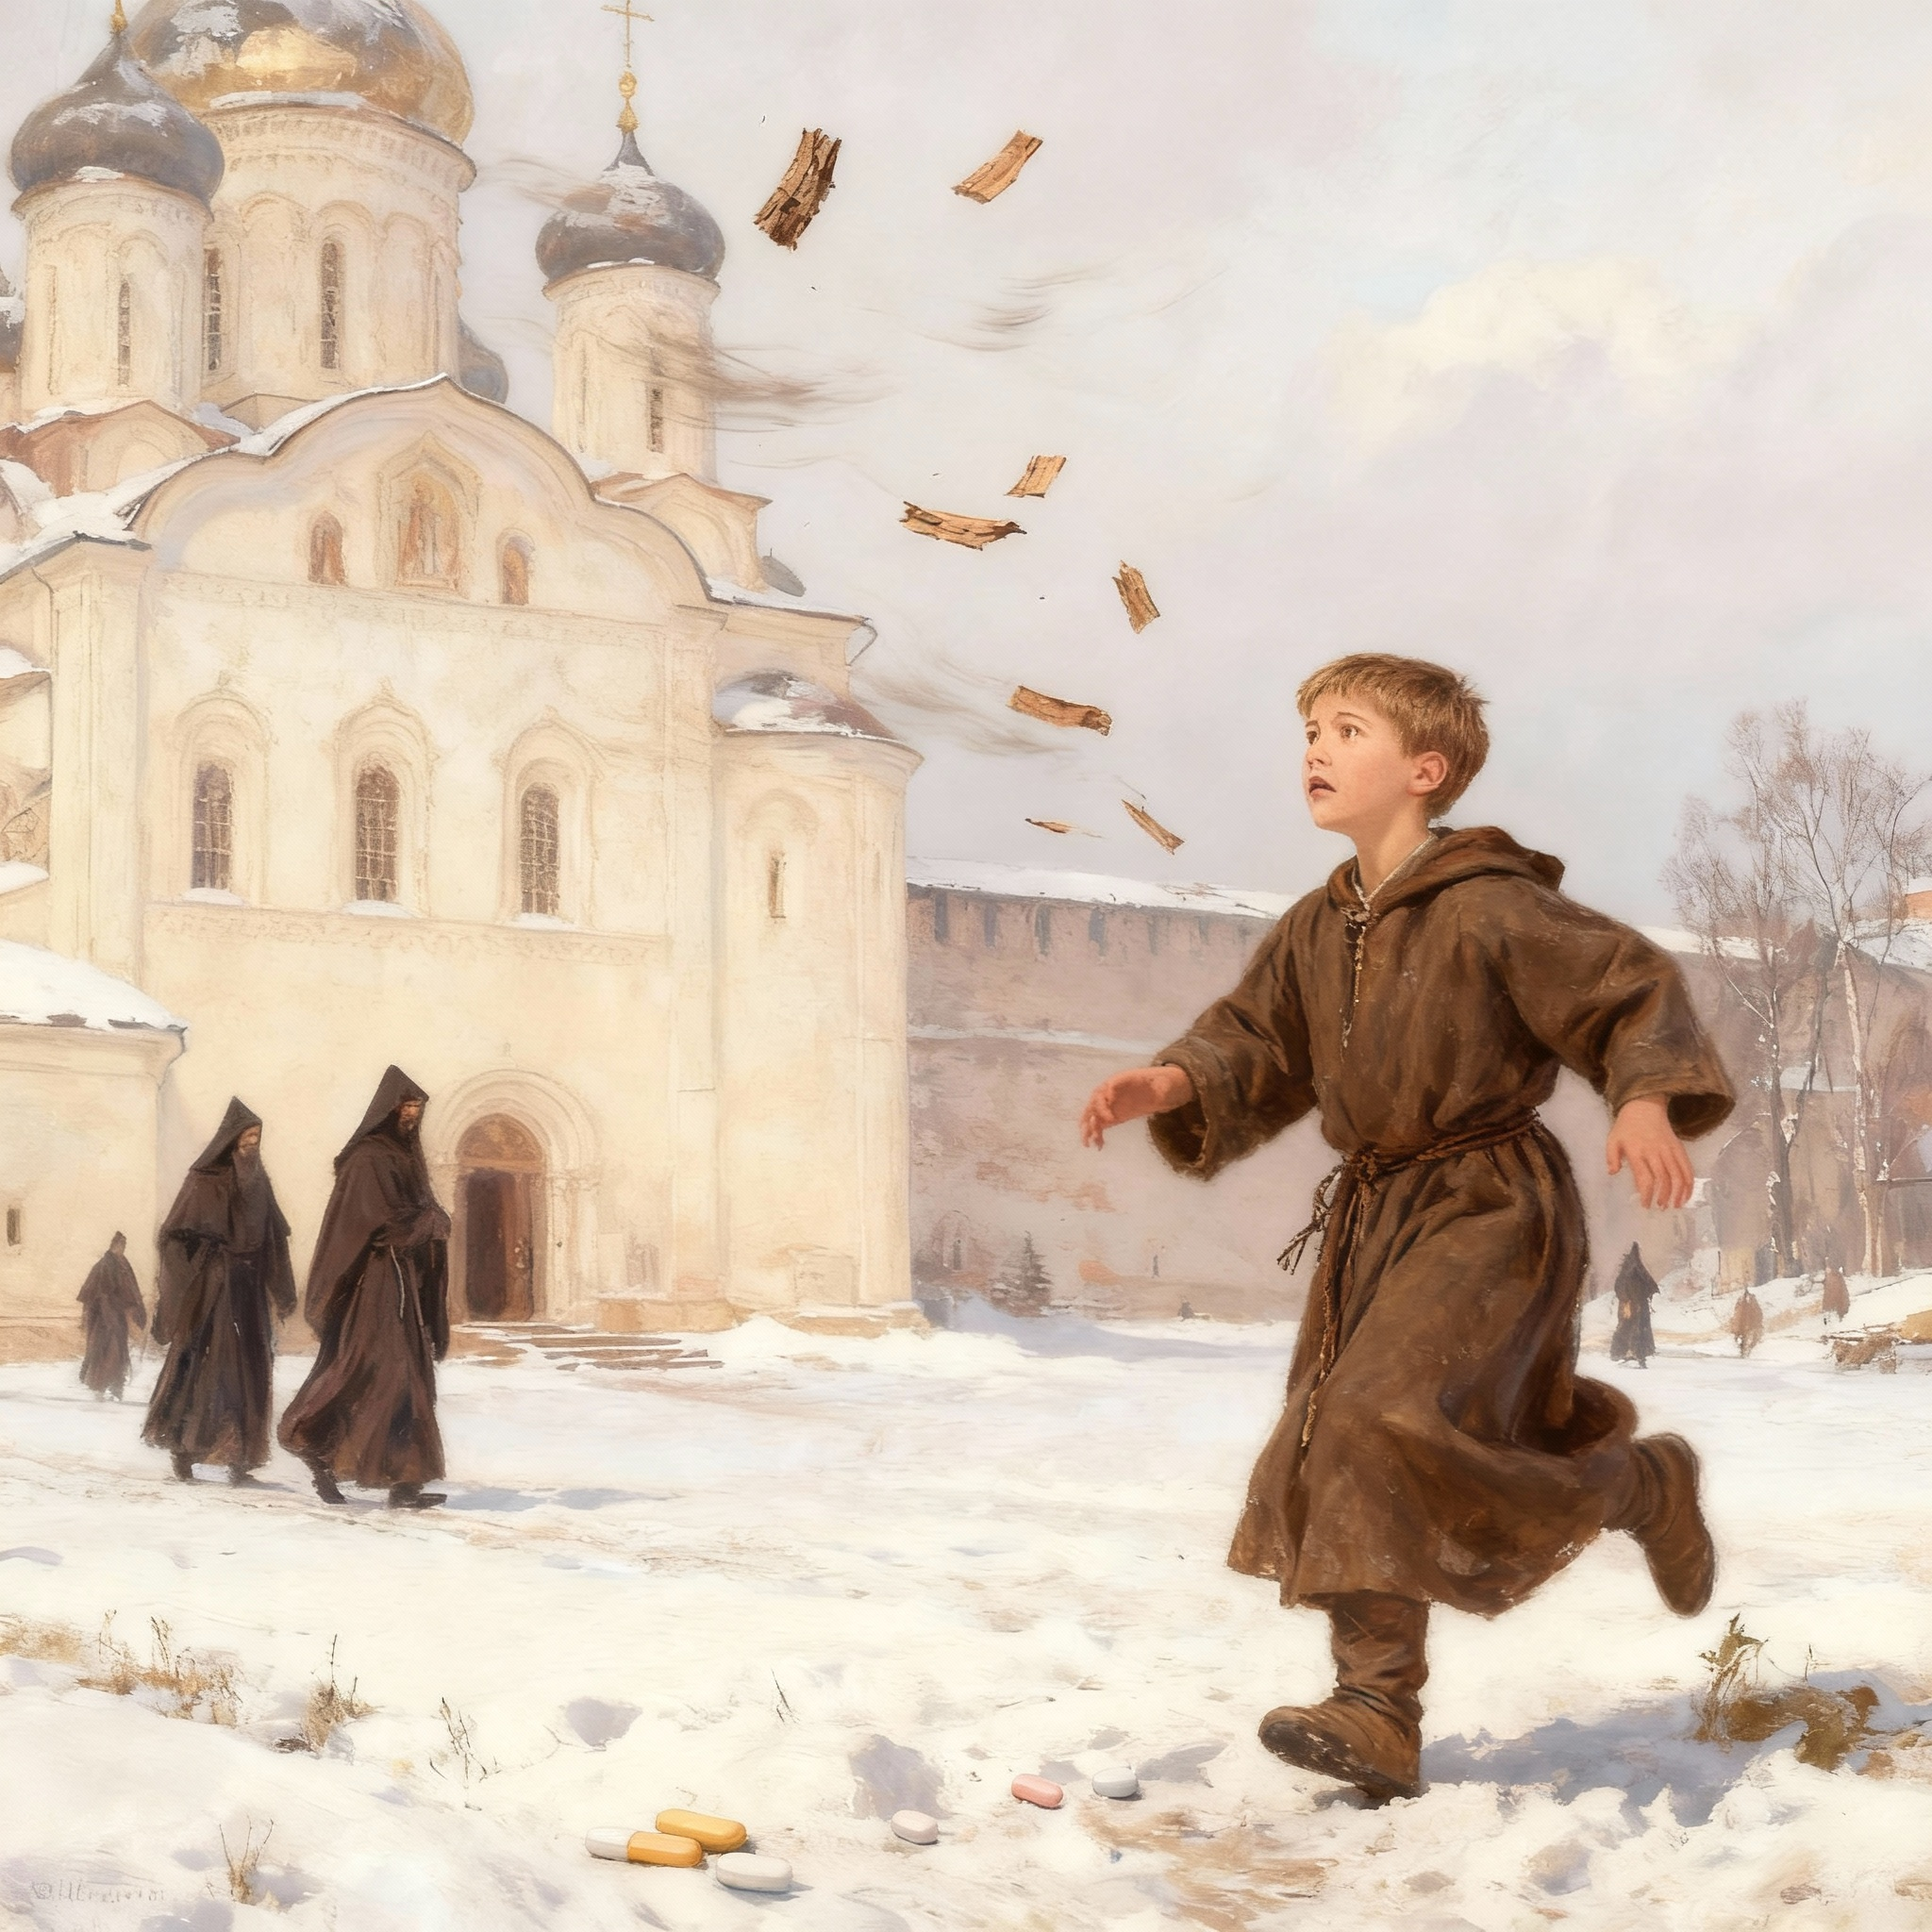

Slide 30
Read these historical facts.
Novgorod was a great trading city in medieval Russia.
Merchants sold furs and honey in Novgorod's markets.
Builders made most houses from wood.
Saint Sophia Cathedral stands in Novgorod with shining silver domes.
Few children went to school; rich families paid monks to teach boys.
Students learned to read and write by copying short prayers.
People wrote and drew on birch bark sheets.
Archaeologists found a real boy's notes and drawings; his name was Onfim.
Icon painters mixed pigments and painted holy images on wooden panels.
Artists often showed Saint George fighting a dragon in Russian art.
2. Try to answer the questions.
1. Where will this story take place?
2. Who will be the main character of this story?
3. Wil this be a real person or an imaginary character?
4. What will the main character do?
5. Will the main character be from a rich or a pooor family?
3. Listen to the story and check your ideas.
4. Read the story after the speaker.

Slide 31
Onfim's Dream of Saint Sophia
In the great trading city of Novgorod, wooden houses stood along muddy streets. Merchants sold furs and honey from distant lands. Church bells rang from tall towers, but none was more beautiful than Saint Sophia Cathedral with its silver domes reaching toward heaven.
Most children in Novgorod worked. Boys learned trades. Girls helped at home. But Onfim was lucky. His father was a wealthy fur trader. He paid a learned monk to teach his son reading and writing. Very few boys in all of Novgorod went to school and Onfim was one of them.
At school, Onfim practiced his letters. "Lord, help your servant Onfim." He wrote this prayer over and over. Onfim loved school.
But he loved something else even more. Every day after lessons, he ran to Saint Sophia Cathedral. He stared at the painted walls. Angels with golden wings. Saints with kind faces. Jesus with his mother Mary. The faces looked so real in the candlelight.
After that Onfim went home and drew pictures.
One day he drew Saint George fighting dragons on his birch bark. Another day there were angels with shining wings. Sometimes he just drew people he knew and his father always nodded and smiled.
One winter morning, Onfim walked to school. He carried his birch bark drawings. The wind was strong. Snow swirled everywhere. Suddenly, the wind tore the drawings from his hands. They flew across the white streets like brown leaves.
"No!" Onfim cried. He chased after them. But the wind was too strong. His drawings disappeared into snowdrifts, under carts, and between houses.
At school, Onfim sat quietly with empty hands. His friend Pavel noticed his sadness.
"Where are your drawings today?"
"The wind took them," Onfim whispered.

Slide 32
Find proof for each historical fact
Instructions: Read each historical fact below. Then find the sentence or sentences in the story that prove this fact is true. Write down what you found or underline it in the text.
Historical Fact 1: Novgorod was a rich trading city. Proof from the story:
Historical Fact 2: Merchants sold furs and honey. Proof from the story:
Historical Fact 3: Houses were made of wood. Proof from the story:
Historical Fact 4: Saint Sophia Cathedral has silver domes. Proof from the story:
Historical Fact 5: Only rich families could pay for their children to go to school. Proof from the story:
Historical Fact 6: Students learned by copying prayers. Proof from the story:
Historical Fact 7: People wrote and drew on birch bark. Proof from the story:
Historical Fact 8: A real boy named Onfim made drawings that archaeologists found. Proof from the story:
Historical Fact 9: Icon painters mixed pigments and painted on wooden panels. Proof from the story:
Historical Fact 10: Artists often showed Saint George fighting a dragon. Proof from the story:

Slide 33
Circle the correct word.
Onfim lived in (Novgorod / Moscow / Kiev).
His father sold (bread / furs / fish).
Onfim learned to write from a (painter / monk / merchant).
Onfim drew on (paper / wood / birch bark).
The cathedral had (gold / silver / bronze) domes.
Onfim's friend was named (Ivan / Pavel / George).
The (rain / snow / wind) took Onfim's drawings.
Master Ivan was a (merchant / monk / painter).

Slide 34
Novgorod was a great __________ city where merchants sold furs and honey.
Saint Sophia __________ had beautiful silver domes.
Onfim's father was __________, so he could pay for his son's education.
A learned __________ taught Onfim reading and writing.
Onfim practiced his letters by copying ______ many times.
The cathedral walls were painted with___________.
People in Novgorod wrote and drew on __________ .
The winter wind was so strong it blew Onfim's_______ away.
The boys __________ for the lost drawings in the snow.
Icon __________ mixed pigments and painted on wooden panels.
8. Answer the Questions. Write complete answers.
Why could Onfim go to school when most children could not?
Where did Onfim go after school every day?
Why do you think Onfim loved the cathedral paintings?
What happened to Onfim's drawings in the snow?
How did Pavel help Onfim when he was sad?
Why did the monk say Onfim needed "something stronger" than birch bark?
What do you think Onfim will learn from Master Ivan?
9.Match the words and their meanings.
trading
merchant
monk
cathedral
birch bark
prayers
icon
pigments
medieval
panel
a. a large, important church b. words people say to talk to God c. a person who buys and sells goods d. buying and selling goods e. a religious man who lives simply and teaches f. the thin covering of a birch tree used for writing g. a flat piece of wood used for painting h. a religious painting of a holy person i. colored powders usedto make paint j. from the Middle Ages (a time period 500-1500 years ago)

Slide 35
10. Number these events from 1 to 10.
___ Onfim and Pavel searched for the drawings in the snow. ___ The wind took Onfim's drawings. ___ Onfim drew Saint George fighting dragons. ___ Master Ivan invited Onfim to learn painting. ___ Onfim walked to school on a winter morning. ___ The monk took Onfim to meet the painters. ___ Onfim's father paid a monk to teach his son. ___ Pavel noticed Onfim's sadness at school. ___ Onfim visited Saint Sophia Cathedral after school every day. ___ The monk said Onfim needed something stronger than birch bark.
11. Retell the story.
Use these prompts to help you:
Who was Onfim and why was he lucky?
What did Onfim learn at school?
What did Onfim love even more than school?
What did Onfim draw at home?
What happened one winter morning?
How did Pavel help?
What did the monk tell Onfim?
Where did the monk take the boys?
What did Master Ivan offer?
12 . Find out and make a mini-presentation on one or more questions.
Where is Novgorod and why was it an important trading city?
What is Saint Sophia Cathedral and does it still exist today?
What is birch bark and why did people use it for writing?
Who was the real Onfim and what did archaeologists find?
What are icon paintings and how were they made?
Who was Saint George and why is he often shown fighting a dragon?
What did medieval Russian schools teach?

Slide 36


Slide 37
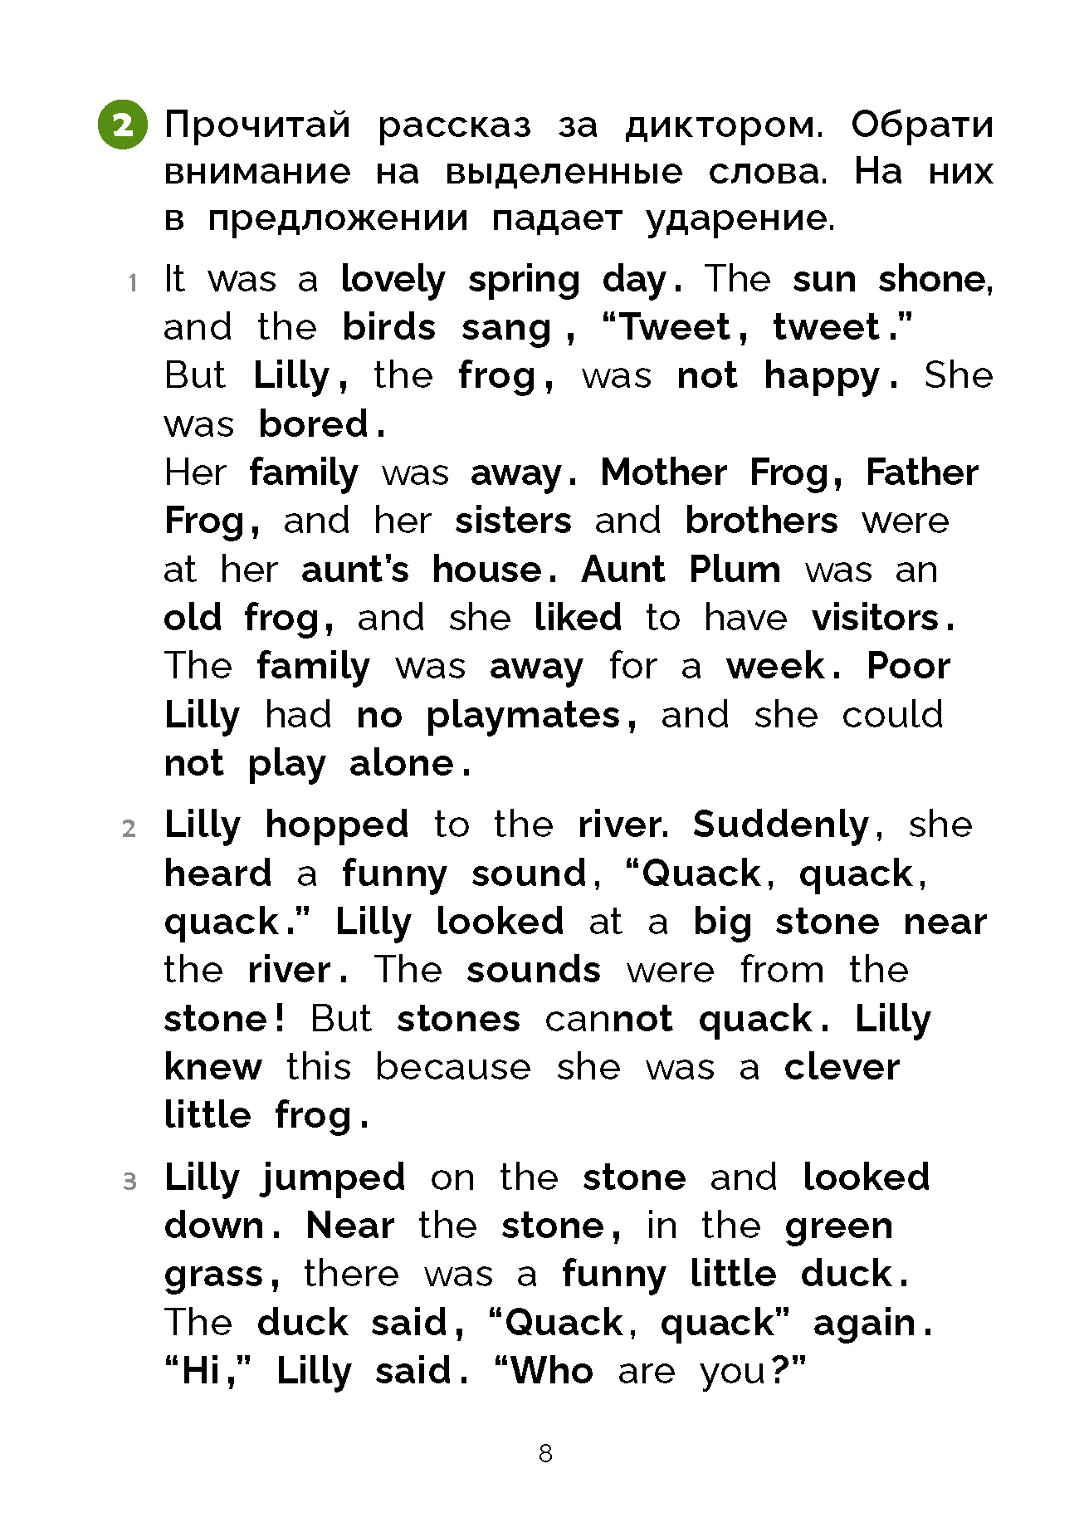

Slide 38
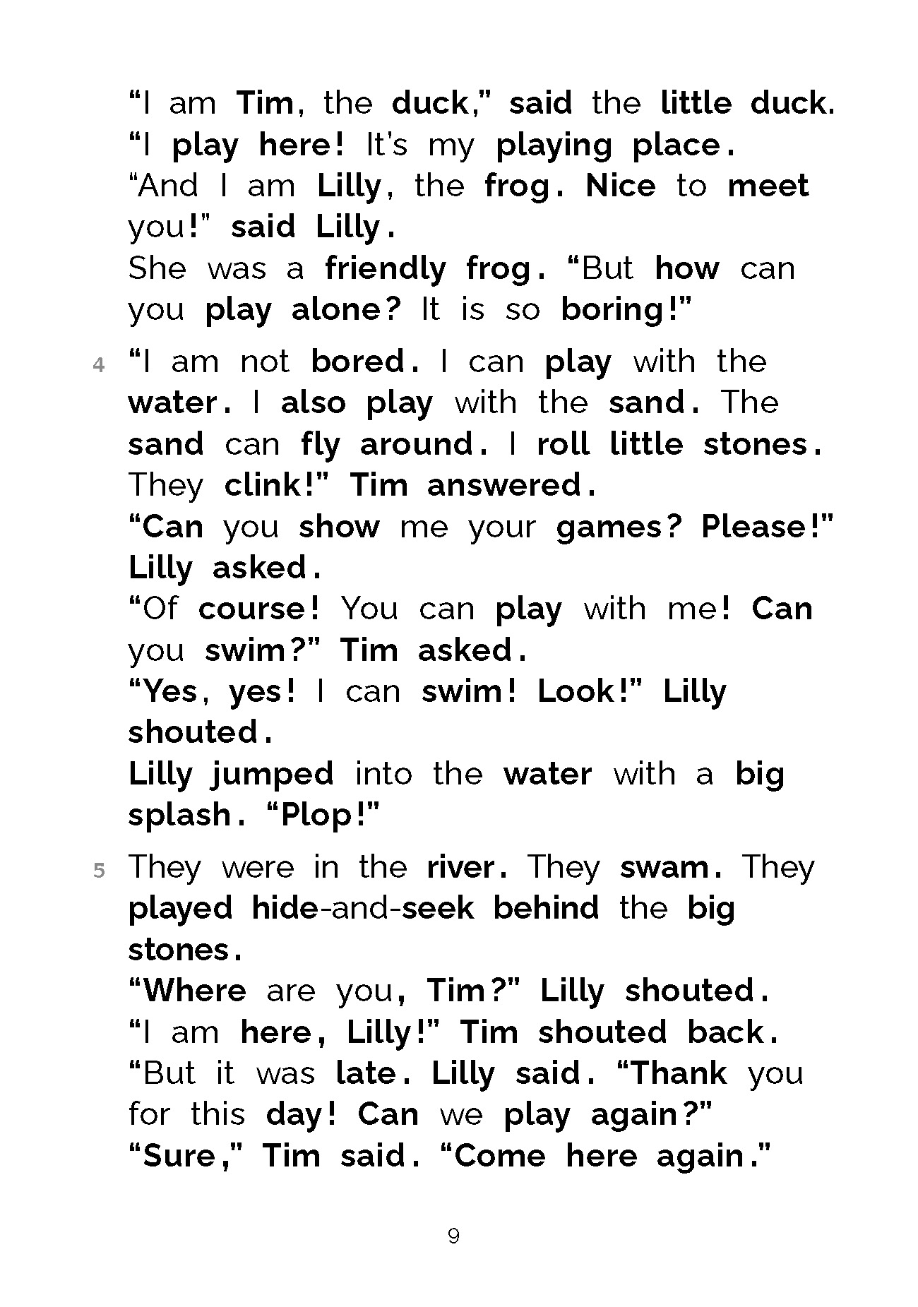

Slide 39
Заключение
Разнообразие жанров обогащает языковой опыт
Фабульные тексты создают эмоциональную вовлеченность
Информативные тексты развивают когнитивные навыки
Рифмовки и чанты эффективны для запоминания
Анализ методической полезности - ключ к выбору

