Slide 1

Страноведение России как компонент обучения
Кауфман Марианна Юрьевна

Slide 2













УЧЕБНИКИ

Slide 3





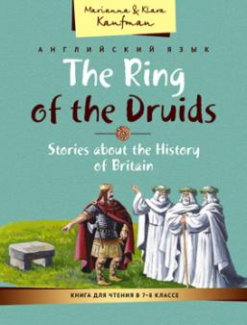
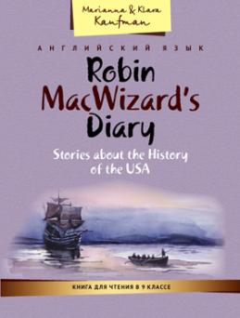





Учебные пособия

Slide 4

Новые издания

Slide 12



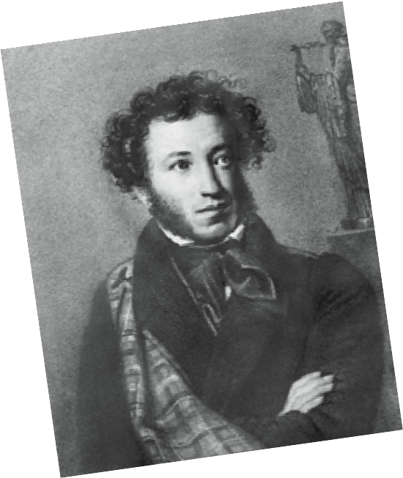
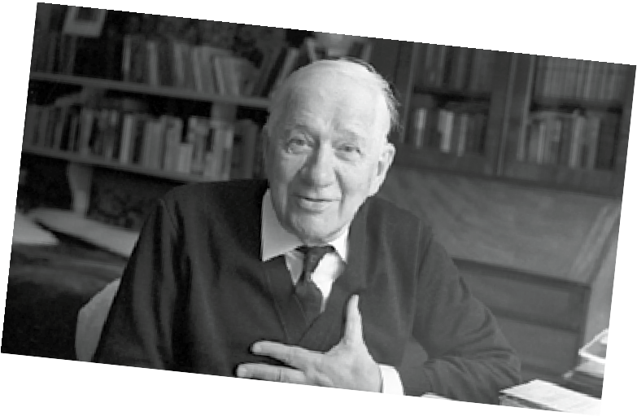
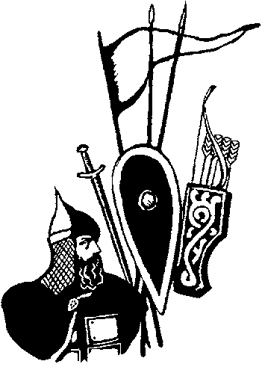


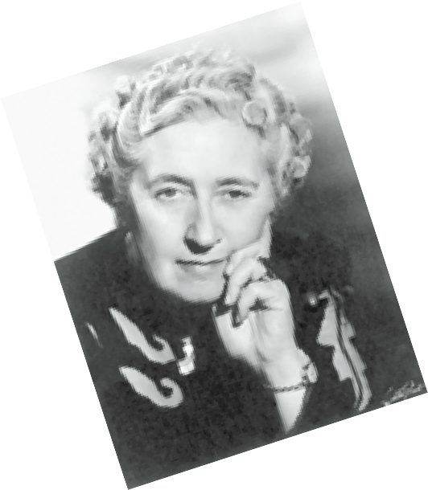
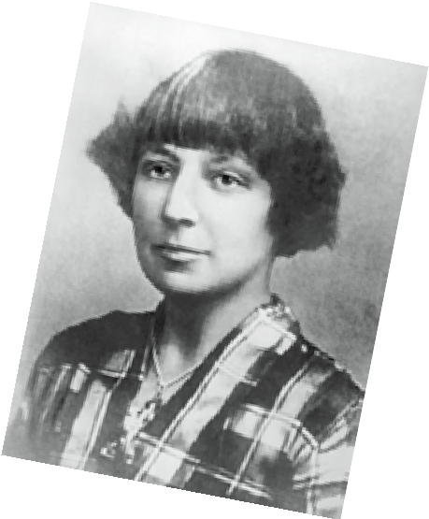
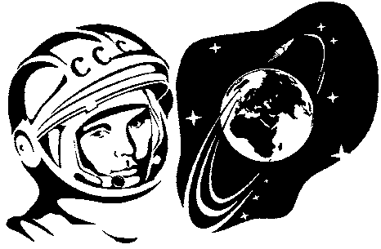
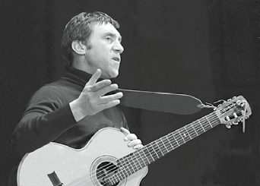
4
Solve the riddle and find the birthdays of these famous people. Разгадайте загадку и найдите даты рождения этих известных людей.
6 Look at the pictures of important dates. Listen to the speaker and answer the questions.
When do people celebrate these dates?
When was this event (событие)?
Are these dates important for Russian history?
Are these dates important for the whole world?
Korney Chukovskiy
Aleksandr Pushkin
Victory Day
rist^{i}
31 March
The Battle of Kulikovo
Moscow Fire 1812
Agatha Ch
e
8 October
Marina Tsvetaeva
6 June
25 January
The first man in space
7 Misha and Robin want to tell each other about the greatest writers of their countires. Read the information about Pushkin with a dictionary. Find the English equivalents for these Russian words in the text.
поэт писатель лицей знать знатный сказка
15 September
Vladimir Visotskiy
Aleksandr Pushkin is the most famous Russian writer and poet.
He was born on May 26, 1799. His father Sergey came from a noble
The birthday of one of the poets is on the eighth.
The singer’s birthday is in January.
The birthday of one of the women is in September.
Pupils must know Pushkin’s birthday.
The birthday of the author of wonderful poems for children is in spring.
5 Listen to the speaker and check your answers.
Russian family. His mother Nadezhda Hannibal was a granddaughter of an African lord.
Pushkin’s teachers were French and the poet could speak the language very well. Pushkin also had a Russian nanny Arina Rodionovna. This old
woman sang him Russian folk songs and told him Russian fairy tales.
Later Pushkin remembered these fairy tales and wrote his famous poem Ruslan and Lyudmila and wonderful fairy tales: The Golden Cockerel, Tale of Tsar Saltan and many others.
150
Unit 6 Lessons 10, 11
Unit 6 Lessons 10, 11 151
HEru5(4)SB2019.indb 150-151

Slide 13
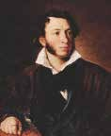



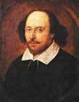
In 1811 Pushkin went to a special school for children of the nobility, the Imperial Lyceum. He was not a very good student and had bad marks in most subjects, but he was brilliant at French and Russian literature. Pushkin published his first poem when he was 15. At the Lyceum Pushkin met his best friends Ivan Pushchin and Anton Delvig. They were friends for life.
Pushkin’s most famous works are: The Captain’s Daughter
and The Belkin Tales.
Pushkin died when he was only 37 in 1837 after his duel with a French aristocrat D’Anthès.
10
Fill in the table about Pushkin. Get some information from the Internet.
Name
Time of birth
Place of birth
Family | mother:
 | father:
 | wife:
Job
Best friends
Most famous plays
Number of plays and poems
Interesting facts
Answer the questions.
  When was Pushkin born?
  What was the name of the poet’s father?
  What was his mother’s family name? What's special about her family?
  What foreign language did Pushkin know very well?
  Where did Pushkin study?
  Who told Pushkin Russian fairy tales? Was it useful for his poetry?
  What are the names Pushkin’s best friends? Where did he meet them?
  What are Pushkin’s most famous works?
Read the facts about Shakespeare with a dictionary. Write 5 questions to this text and let your friends answer them using the table.
Суффикс -ful
Для образования существительных может использоваться суффикс -ful,
обозначающий присутствие определенного качества: beauty (красота) — beatiful (красивый, полный красоты), wonder (чудо) — wonderful (чудесный).
1
Заполните таблицу прилагательными с суффиксом -ful.
Переведите глаголы в таблице на русский язык.
Каким способом образованы эти глаголы? Приведите еще несколько примеров такого словообразования в английском языке.
Name | William Shakespeare
Time of birth | April 1564
Place of birth | Stratford-upon-Avon
Family | children: Susanna, Hamnet and Judith wife: Anne Hathaway
Job | poet, playwright and actor
First play | Henry V
Most famous plays | Romeo and Juliet, Othello and Macbeth
Number of plays and sonnets | 154 sonnets and around 40 plays
Существительное | Глагол | Прилагательное
help (помощь) | to help (помогать) | helpful (готовый помочь, помогающий)
hope (надежда) | to hope
colour (цвет) | to colour
care (забота) | to care
harm (вред) | to harm
stress (стресс) | to stress
use (польза) | to use
152
Unit 6 Lessons 10, 11
Unit 6 Lessons 10, 11 153
HEru5(4)SB2019.indb 152-153

Slide 14
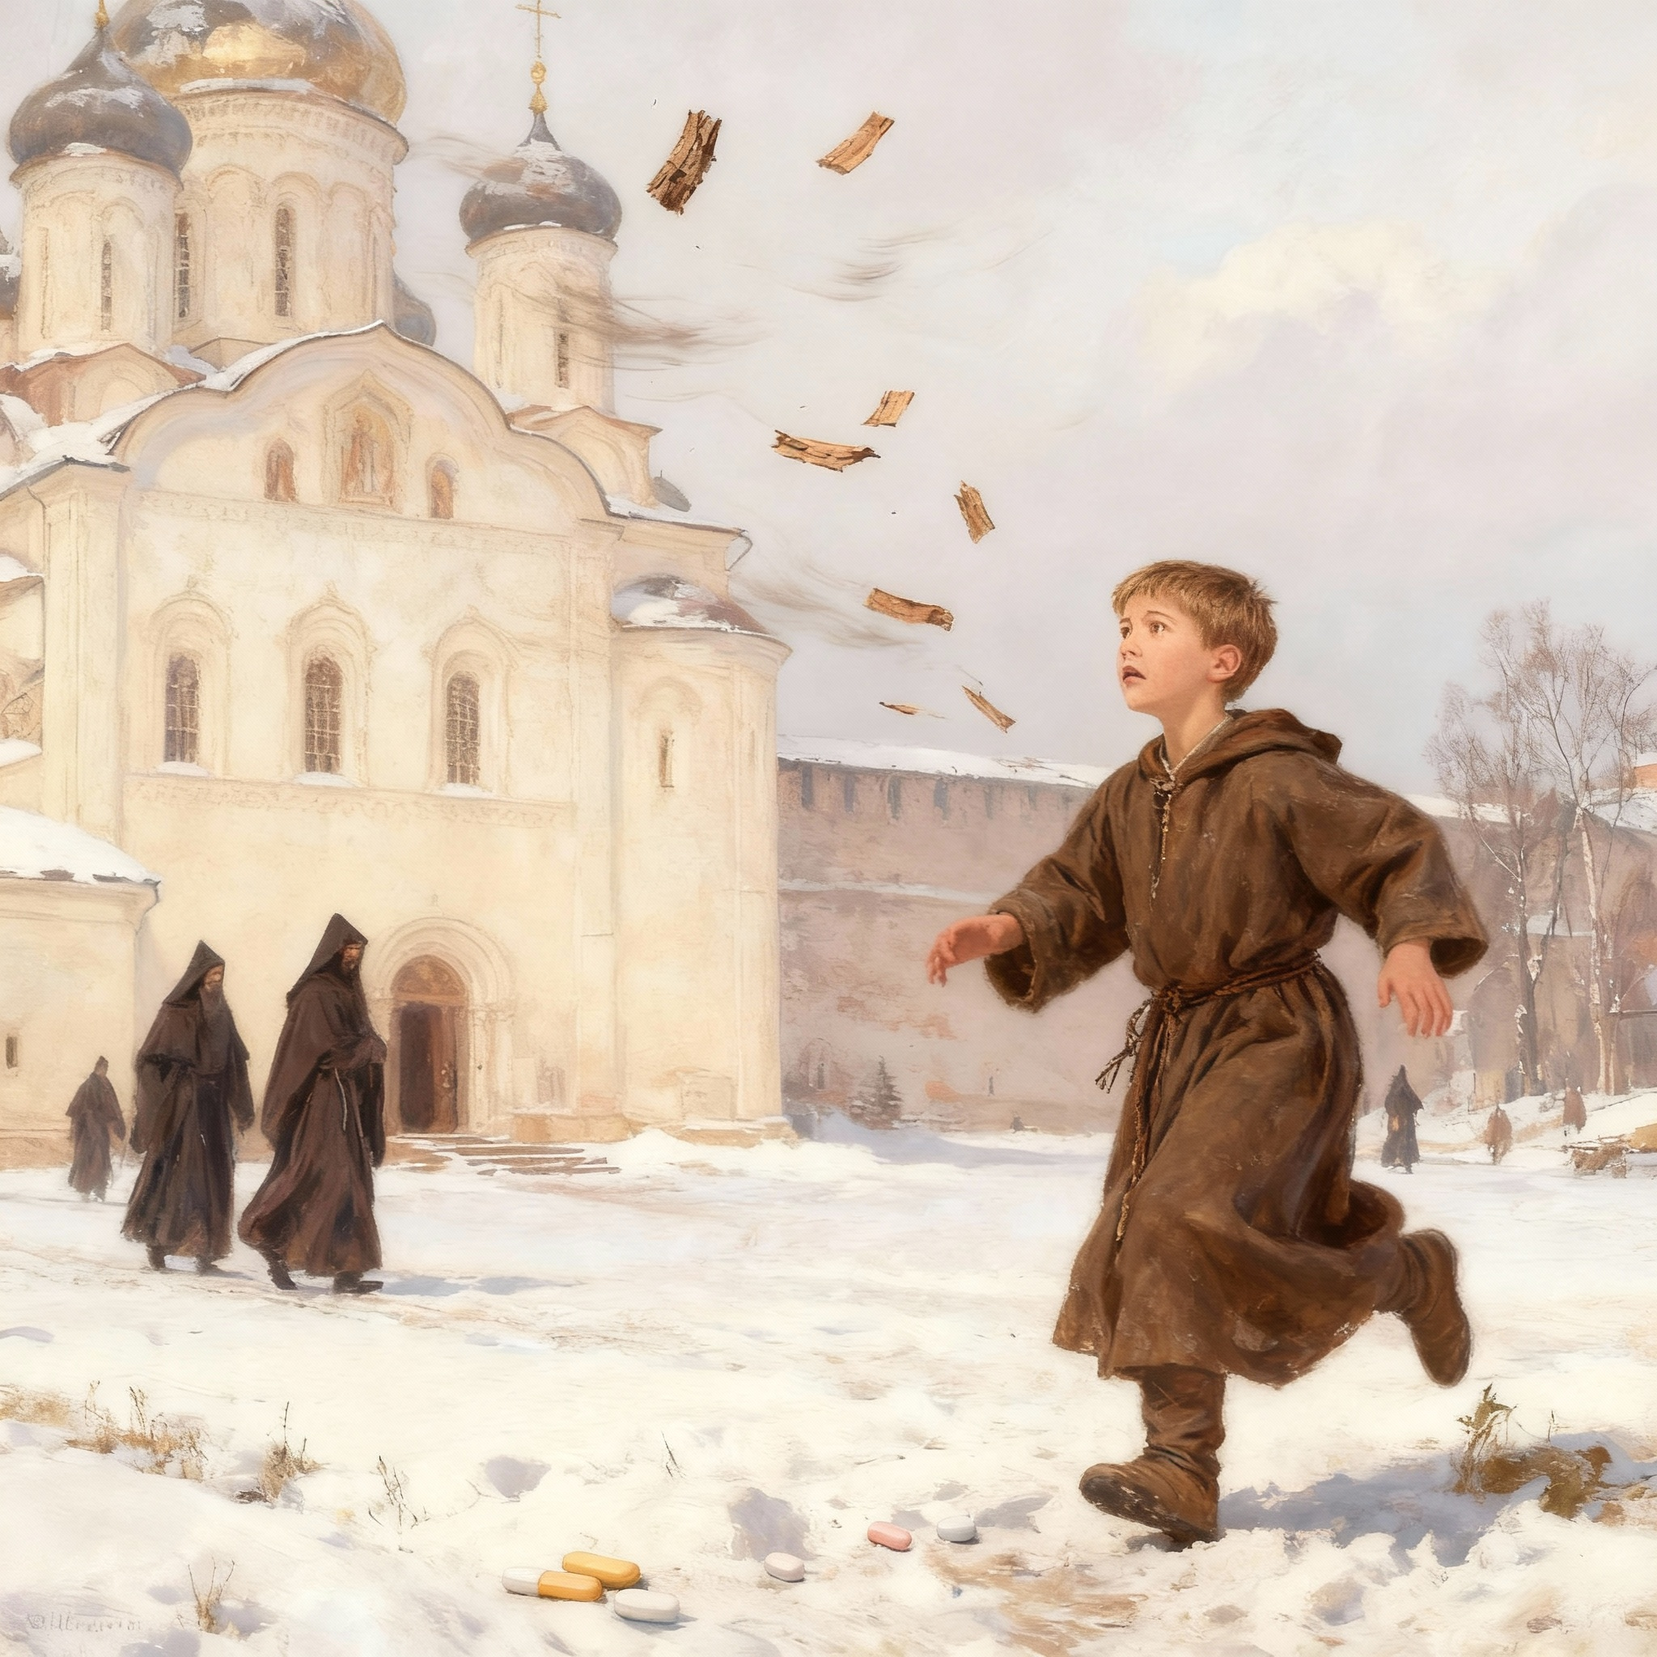

Slide 15
Onfim's Dream of Saint Sophia
In the great trading city of Novgorod, wooden houses stood along muddy streets. Merchants sold furs and honey from distant lands. Church bells rang from tall towers, but none was more beautiful than Saint Sophia Cathedral with its silver domes reaching toward heaven.
Most children in Novgorod worked. Boys learned trades. Girls helped at home. But Onfim was lucky. His father was a wealthy fur trader. He paid a learned monk to teach his son reading and writing. Very few boys in all of Novgorod went to school and Onfim was one of them.
At school, Onfim practiced his letters. "Lord, help your servant Onfim." He wrote this prayer over and over. Onfim loved school.
But he loved something else even more. Every day after lessons, he ran to Saint Sophia Cathedral. He stared at the painted walls. Angels with golden wings. Saints with kind faces. Jesus with his mother Mary. The faces looked so real in the candlelight.
After that Onfim went home and drew pictures.
One day he drew Saint George fighting dragons on his birch bark. Another day there were angels with shining wings. Sometimes he just drew people he knew and his father always nodded and smiled.
One winter morning, Onfim walked to school. He carried his birch bark drawings. The wind was strong. Snow swirled everywhere. Suddenly, the wind tore the drawings from his hands. They flew across the white streets like brown leaves.
"No!" Onfim cried. He chased after them. But the wind was too strong. His drawings disappeared into snowdrifts, under carts, and between houses.
At school, Onfim sat quietly with empty hands. His friend Pavel noticed his sadness.
"Where are your drawings today?"
"The wind took them," Onfim whispered.

Slide 16
Find proof for each historical fact
Instructions: Read each historical fact below. Then find the sentence or sentences in the story that prove this fact is true. Write down what you found or underline it in the text.
Historical Fact 1: Novgorod was a rich trading city.
Proof from the story:
Historical Fact 2: Merchants sold furs and honey.
Proof from the story:
Historical Fact 3: Houses were made of wood.
Proof from the story:
Historical Fact 4: Saint Sophia Cathedral has silver domes.
Proof from the story:
Historical Fact 5: Only rich families could pay for their children to go to school.
Proof from the story:
Historical Fact 6: Students learned by copying prayers.
Proof from the story:
Historical Fact 7: People wrote and drew on birch bark.
Proof from the story:
Historical Fact 8: A real boy named Onfim made drawings that archaeologists found.
Proof from the story:
Historical Fact 9: Icon painters mixed pigments and painted on wooden panels.
Proof from the story:
Historical Fact 10: Artists often showed Saint George fighting a dragon.
Proof from the story:

Slide 17


Slide 18


Slide 19


Slide 21



Новые издания

Slide 22


